Slide 1
Fullstack Web Application Development
Raghu Prasad K S
www.kaushalya.tech
9845547471

Slide 2
Introduction
Raghu Prasad – BE, MS
Total of 24 years of experience
7 years as a lecturer in Engineering College
17 Years into IT
Worked with companies like CISCO,CSC,ICICI,First Apex – NTT Data
Started Kaushalya Technologies an EduTechnology company in 2017
Currently into Corporate training,consultancy and application development
Worked with corporates and public sector
Technologies – Java,Python,Data Sciences,Web technologies,Java Script technologies (MEAN stack),IOT,Test Automation – Selenium,JMeter

Slide 3
Course Outline
Introduction to Fullstack Web Application Develoment
Technologies related to Fullstack web application
Web application architecture
Software Development Life cycle – Agile methodology and Model

Slide 4
Course Objective
Learn and explore Fullstack application development using Java and Angular
Learn by coding
Develop end to end module of a full web application development
Develop web application using agile process

Slide 5
Fullstack Web Application Development
Full stack developer Simile
Defining, describing, and drawing you a picture…
I’m going to use the most popular example to define a full-stack developer. If there’s one person who wore many hats in his lifetime, it’s Leonardo Da Vinci. He was a painter, scientist, mathematician, cartographer, geologist, astronomer, historian, musician, and sculptor. People believe that diverse experiences fed into his creative genius, making him a nonpareil innovator.
If this extraordinary Renaissance man was a programmer today, he would be what we call a “full-stack” developer. Murky picture becoming a little clearer, I hope.

Slide 6
Fullstack Web Application Development
Full stack development: It refers to the development of both front end(client side) and back end(server side) portions of web application.
Full stack web Developers: Full stack web developers have the ability to design complete web application and websites. They work on the frontend, backend, database and debugging of web application or websites.

Slide 7
Technologies related to fullstack development
Front end: It is the visible part of website or web application which is responsible for user experience. The user directly interacts with the front end portion of the web application or website.
Languages – HTML/CSS/Java Script/AJAX
Frameworks and Libraries – Angular,React,Bootstrap,Jquery,SAAS
Back end: It refers to the server-side development of web application or website with a primary focus on how the website works. It is responsible for managing the database through queries and APIs by client-side commands
Languages – PHP/C++/Java/Python/JavaScript-Node.js
Frameworks and Libraries – Express,Django,Rails,Laravel,Spring
Database – Oracle,MySQL,MongoDB,MSSQL,PostgreSQL

Slide 8
Technologies related to fullstack development
Popular Stacks
MEAN (Mongo,Express,Angular,Node)
MERN (Mongo,Express,React,Node)
Django (Django,Python,MySQL)
Rails or Ruby on Rails (Ruby,PHP,MySQL)
LAMP (Linux,Apache,MySQL,PHP)
Hybrid Stacks
Angular,Java,Spring
React,Java,Spring
Angular,Python,Django

Slide 9
Tips to choose web tech stack
Define project requirement – both functional and non functional requirement
Non functional
Scalability
Availability
Security
Maintainability
Development time
Development cost

Slide 10

Fullstack Developer

Slide 11
Key skills of a full stack developer
Understand customer need and develop a use case
Convert use case into wire frame and user interface
Understand and implement responsive webdesign
Develop front end code
Understand project architecture and implement relevant design pattern.
Develop web services for backend integration
Understand the mechanism of interfacing with third party softwares
Such as ERP,payment gateway,etc
Develop backend code and interface with database (RDBMS,NoSQL,ORM)
Unit and integration testing

Slide 12
Web Application Architecture
The web application architecture describes the interactions between applications, databases, and middleware systems on the web. It ensures that multiple applications work simultaneously.
Service Oriented Architecture (SOA)
Model View Controller (MVC)
Single Page Applications (SPA)
Microservices
Serverless Architecture

Slide 13
Web Application Architecture – SOA
Service-Oriented Architecture (SOA) is a style of software design where services are provided to the other components by application components, through a communication protocol over a network. Its principles are independent of vendors and other technologies. In service oriented architecture, a number of services communicate with each other, in one of two ways: through passing data or through two or more services coordinating an activity. This is just one definition of Service-Oriented Architecture.

Slide 14
Web Application Architecture – SOA
Service-Oriented Architecture (SOA) is a style of software design where services are provided to the other components by application components, through a communication protocol over a network. Its principles are independent of vendors and other technologies. In service oriented architecture, a number of services communicate with each other, in one of two ways: through passing data or through two or more services coordinating an activity. This is just one definition of Service-Oriented Architecture.

Slide 15
Web Application Architecture – SOA
Service-Oriented Architecture (SOA) is a style of software design where services are provided to the other components by application components, through a communication protocol over a network. Its principles are independent of vendors and other technologies. In service oriented architecture, a number of services communicate with each other, in one of two ways: through passing data or through two or more services coordinating an activity. This is just one definition of Service-Oriented Architecture.

Slide 16
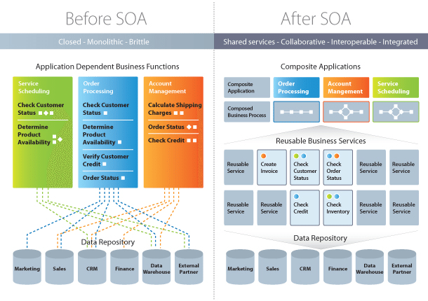
Web Application Architecture – SOA

Slide 17
Web Application Architecture – SOA
Characteristics of SOA
Business value
Strategic goals
Intrinsic inter-operability
Shared services
Flexibility
Evolutionary refinement

Slide 18
Web Application Architecture – SOA
Implementing SOA
Simple Object Accessing Protocol (SOAP)
In a nutshell, SOAP “is a messaging protocol specification for exchanging structured information in the implementation of web services in computer networks.
REpresentational State Transfer (REST)
It means when a RESTful API is called, the server will transfer to the client a representation of the state of the requested resource.

Slide 19
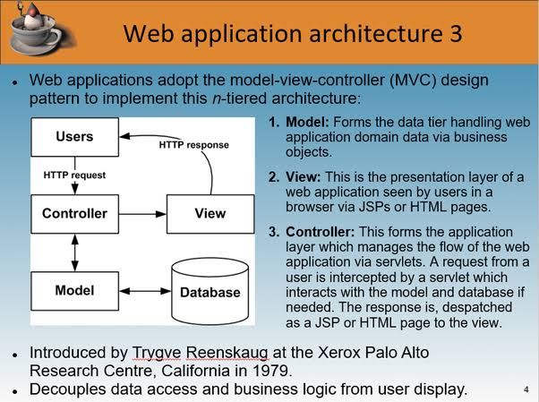
Web Application Architecture - MVC

Slide 20
Web Application Architecture - MVC
MVC – Advantages
Multiple developers can work with the three layers (Model, View, and Controller) simultaneously
Offers improved scalability, that supplements the ability of the application to grow
As components have a low dependency on each other, they are easy to maintain
A model can be reused by multiple views which provides reusability of code
Adoption of MVC makes an application more expressive and easy to understand
Extending and testing of the application becomes easy

Slide 21
Web Application Architecture – SPA’s
Single-Page Applications (SPAs) – Instead of loading completely new pages from the server each time for a user action, single page web applications allows for a dynamic interaction by means of providing updated content to the current page.
AJAX, a concise form of Asynchronous JavaScript and XML, is the foundation for enabling page communications and hence, making SPAs a reality. Because single-page applications prevent interruptions in user experience, they, in a way, resemble traditional desktop applications.
SPAs are designed in a way so that they request for most necessary content and information elements. This leads to the procurement of an intuitive as well as interactive user experience.

Slide 22
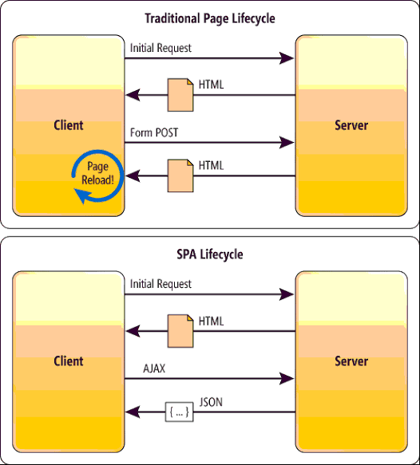
Web Application Architecture – SPA’s

Slide 23
Web Application Architecture – Microservices
Microservices – These are small and lightweight services that execute a single functionality. The Microservices Architecture framework has a number of advantages that allows developers to not only enhance productivity but also speed up the entire deployment process. The components making up an application build using the Microservices Architecture aren’t directly dependent on each other. As such, they don’t necessitate to be built using the same programming language. Hence, developers working with the Microservices Architecture are free to pick up a technology stack of choice. It makes developing the application simpler and quicker.

Slide 24
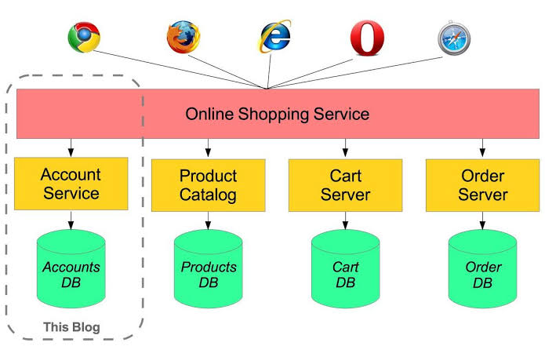
Web Application Architecture – Microservices

Slide 25
Web Application Architecture – Serverless
Serverless Architectures – In this type of web application architecture, an application developer consults a third-party cloud infrastructure services provider for outsourcing server as well as infrastructure management. The benefit of this approach is that it allows applications to execute the code logic without bothering with the infrastructure-related tasks. The Serverless Architecture is best when the development company doesn’t want to manage or support the servers as well as the hardware they have developed the web application for.

Slide 26
Software development life cycle (SDLC)
AGILE methodology is a practice that promotes continuous iteration of development and testing throughout the software development lifecycle of the project. Both development and testing activities are concurrent unlike the Waterfall model
The agile software development emphasizes on four core values.
Individual and team interactions over processes and tools
Working software over comprehensive documentation
Customer collaboration over contract negotiation
Responding to change over following a plan

Slide 27
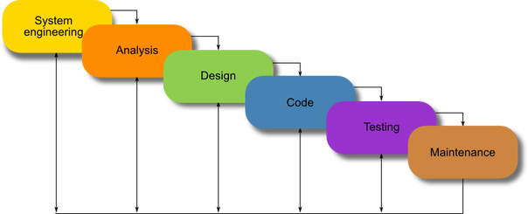
SDLC - Waterfall
Waterfall model

Slide 28
SDLC-Scrum
SCRUM is an agile development method which concentrates specifically on how to manage tasks within a team-based development environment. Basically, Scrum is derived from activity that occurs during a rugby match. Scrum believes in empowering the development team and advocates working in small teams (say- 7 to 9 members). It consists of three roles, and their responsibilities are explained as follows:

Slide 29
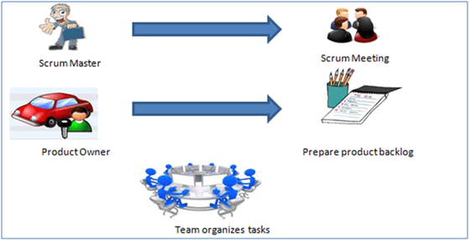
SDLC-Scrum

Slide 30
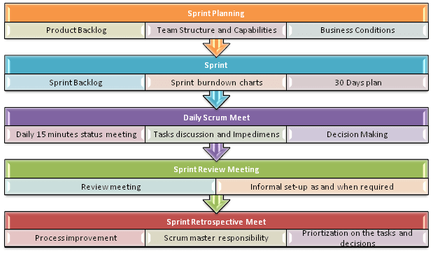
SDLC-Scrum

Slide 31
Thanks
Visit – www.kaushalya.tech
9845547471

