Slide 1
Java Recap
Raghu Prasad
9845547471

Slide 2
Introduction
Raghu Prasad – BE, MS
Total of 29 years of experience
7 years as a lecturer in Engineering College
22 Years into IT
Worked with companies like CISCO, CSC, ICICI, First Apex – NTT Data
Currently into Corporate training, consultancy and application development
Worked with corporates and public sector
Technologies – Java, SQL,Python, C#,.Net Framework,AI/ML, Data Sciences, Web Technologies, Java Script technologies (MEAN/MERN stack), IOT, Test Automation – Selenium, Jmeter,Block Chain,Cloud Computing,DevOps

Slide 3
Topics
Introduction to Java
Installation of JDK and Eclipse
Getting started with java
Sample programs
JDK vs JVM vs JRE
Data types
Operators
Arrays
Loops, Conditional-Statements, Switch
Static – Variables, Blocks, methods, class
Garbage collection
OOPS
Collection Framework
Hands-on and Assignment

Slide 4
Introduction to Java
What ?
An Object Oriented Programming language.
Developed by Patrick Naughton and James Gosling
Developed at Sun Microsystems in 1995 and later Sun Microsystem was acquired by Oracle in 2010
Current latest version of Java SE - 17

Slide 5
Introduction to Java
Why ?
Simple
Object Oriented
Distributed
Multithreaded
Dynamic
Architecture neutral
Portable (write once and run any where)
High performance
Robust
Secure

Slide 6
Introduction to Java
Facts
97% of Enterprise Desktops Run Java
89% of Desktops (or Computers) in the U.S. Run Java
9 Million Java Developers Worldwide
#1 Choice for Developers
#1 Development Platform
3 Billion Mobile Phones Run Java
100% of Blu-ray Disc Players Ship with Java
5 Billion Java Cards in Use
125 million TV devices run Java
5 of the Top 5 Original Equipment Manufacturers Ship Java ME

Slide 7
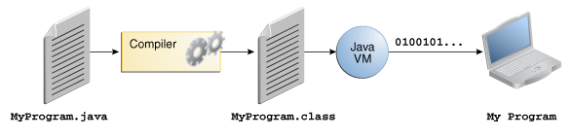
Introduction to Java
How ?

Slide 8
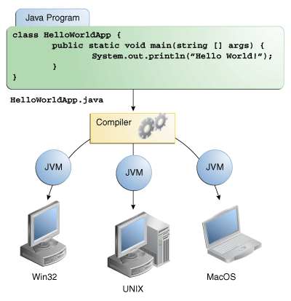
Introduction to Java

Slide 9
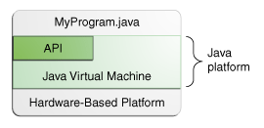
Introduction to Java
The Java Platform
A platform is the hardware or software environment in which a program runs. The Java platform has two components:
The Java Virtual Machine
The Java Application Programming Interface (API)

Slide 10
Introduction to Java
What can java technology do?
Development tools
Application Programming Interface (API)
Deployment technologies
User Interface Tool Kits
Integration libraries

Slide 11
Introduction to Java
How will Java technology change my life?
Get started quickly
Write less code
Write better code
Develop programs more quickly
Avoid platform dependencies

Slide 12
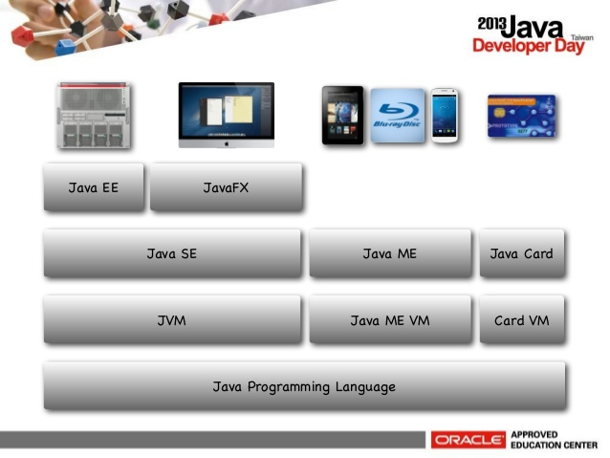
Java Platform
Java Platform Standard Edition (Java SE)
Java Platform Enterprise Edition (Java EE)
Java Platform Micro Edition (Java ME)
Java FX

Slide 13
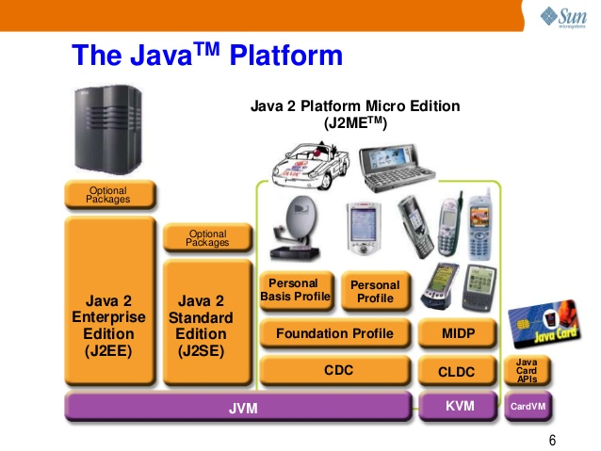
Java Platform

Slide 14
Java Platform
All Java platforms consist of a Java Virtual Machine (VM) and an application programming interface (API).
The Java Virtual Machine is a program, for a particular hardware and software platform, that runs Java technology applications.
An API is a collection of software components that you can use to create other software components or applications.
Each Java platform provides a virtual machine and an API, and this allows applications written for that platform to run on any compatible system with all the advantages of the Java programming language: platform-independence, power, stability, ease-of-development, and security.
Java SE
When most people think of the Java programming language, they think of the Java SE API. Java SE's API provides the core functionality of the Java programming language. It defines everything from the basic types and objects of the Java programming language to high-level classes that are used for networking, security, database access, graphical user interface (GUI) development, and XML parsing.

Slide 15
Java Platform
In addition to the core API, the Java SE platform consists of a virtual machine, development tools, deployment technologies, and other class libraries and toolkits commonly used in Java technology applications.
Java EE
The Java EE platform is built on top of the Java SE platform. The Java EE platform provides an API and runtime environment for developing and running large-scale, multi-tiered, scalable, reliable, and secure network applications.
Java ME
The Java ME platform provides an API and a small-footprint virtual machine for running Java programming language applications on small devices, like mobile phones. The API is a subset of the Java SE API, along with special class libraries useful for small device application development. Java ME applications are often clients of Java EE platform services.
JavaFX
JavaFX is a platform for creating rich internet applications using a lightweight user-interface API. JavaFX applications use hardware-accelerated graphics and media engines to take advantage of higher-performance clients and a modern look-and-feel as well as high-level APIs for connecting to networked data sources. JavaFX applications may be clients of Java EE platform services.

Slide 16
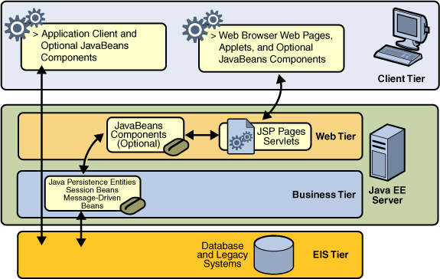
Enterprise application

Slide 17
JDK Installation
Hands-on - Getting Started
Download JDK (Java Standard Edition (Java SE) from http://www.oracle.com/technetwork/java/javase/downloads/index.html
Install JDK
Set Path using environment variable (i,e path should be set up to bin folder of JDK)

Slide 18
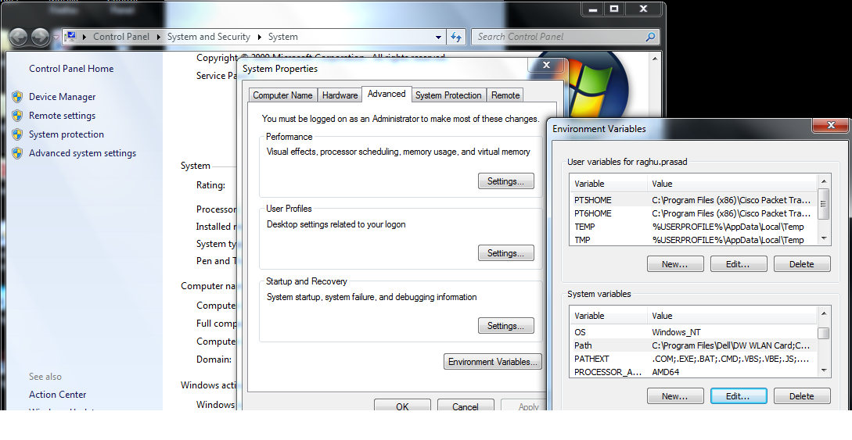
Language Fundamentals
Setting path to <jdkhome>/bin

Slide 19
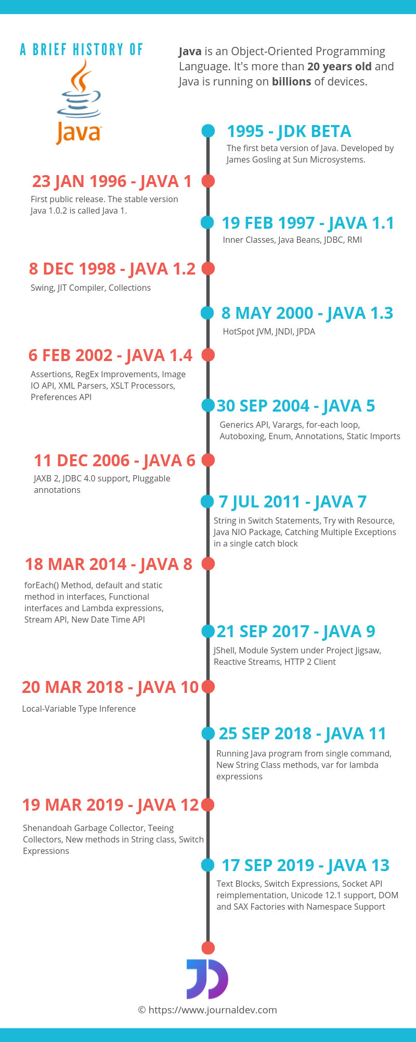
Java SE versions history

Slide 20
Eclipse Installation
Download eclipse from
http://www.eclipse.org/downloads/
Latest eclipse - Get Eclipse PHOTON
Configure eclipse for Java EE Developers

Slide 21
Language Fundamentals
First Program
public class HelloWorld
{
public static void main(String args[])
{
System.out.println("Hello World");
}
}
javac HelloWorld.java
java HelloWorld

Slide 22
Language Fundamentals
HelloWorld with arguments
public class HelloWorldArgs
{
public static void main(String args[])
{
System.out.println("You have entered " +args.length + " words");
for (int i=0;i<args.length;i++)
{
System.out.println ("The words you have entered are " +args[i]);
}}}

Slide 23
Language Fundamentals
Simple maths
public class Maths
{
public int firstnumber;
public int secondnumber;
public int result;
public static void main(String args[])
{
Maths mat = new Maths (args[0],args[1]);
mat.add();
mat.subtract();
mat.multipy();
mat.division(); }

Slide 24
Language Fundamentals
public Maths (String firstnum,String secondnum)
{
firstnumber = new Integer(firstnum).intValue();
secondnumber = new Integer(secondnum).intValue();
}
public int add ()
{
result = firstnumber + secondnumber;
System.out.println("The Sum is " +result);
return result;
}
public int subtract ()
{
result = firstnumber - secondnumber;
System.out.println("The diference is " +result);
return result;
}

Slide 25
Language Fundamentals
public int multipy ()
{
result = firstnumber*secondnumber;
System.out.println("The multiplication is " +result);
return result;
}
public int division ()
{
result = firstnumber/secondnumber;
System.out.println("The division is " +result);
return result;
}
}

Slide 26
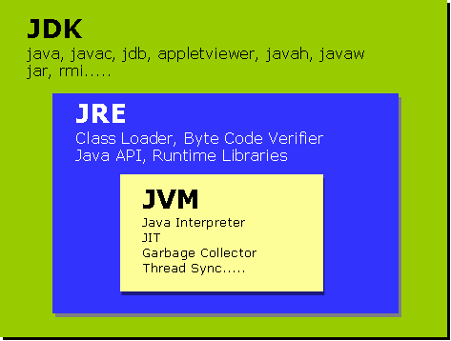
JDK vs JRE vs JVM

Slide 27
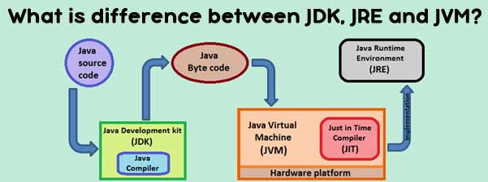
JDK vs JRE vs JVM

Slide 28
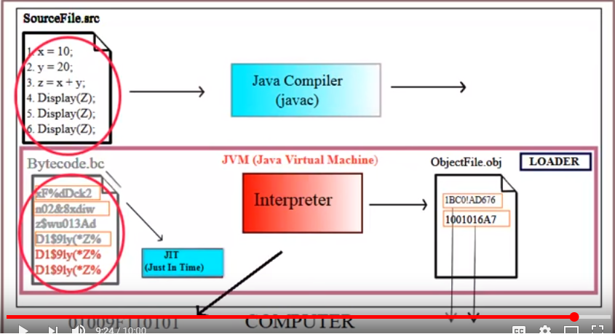
JIT (Just In Time) Compiler

Slide 29
JDK
JDK is an acronym for Java Development Kit. It physically exists. It contains JRE + development tools.

Slide 30
JVM
JVM (Java Virtual Machine) is an abstract machine. It is a specification that provides runtime environment in which java bytecode can be executed. JVMs are available for many hardware and software platforms. JVM, JRE and JDK are platform dependent because configuration of each OS differs. But, Java is platform independent. The JVM performs following main tasks: Loads code Verifies code Executes code Provides runtime environment

Slide 31
JRE
JRE is an acronym for Java Runtime Environment.It is used to provide runtime environment.It is the implementation of JVM.It physically exists.It contains set of libraries + other files that JVM uses at runtime. Implementation of JVMs are also actively released by other companies besides Sun Micro Systems.

Slide 32
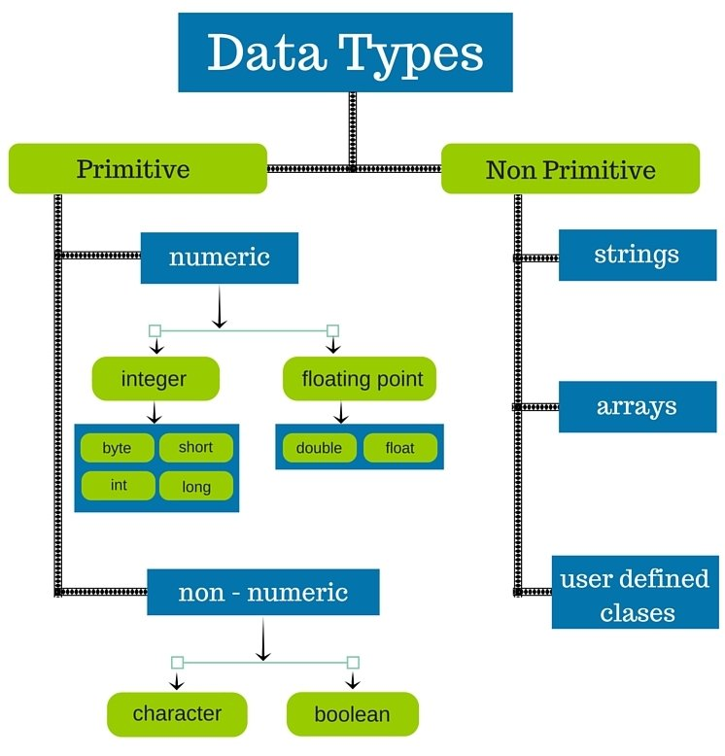
Data types

Slide 33
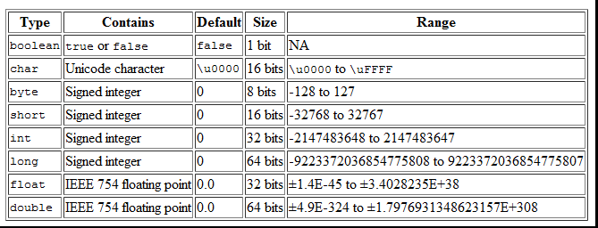
Data types

Slide 34
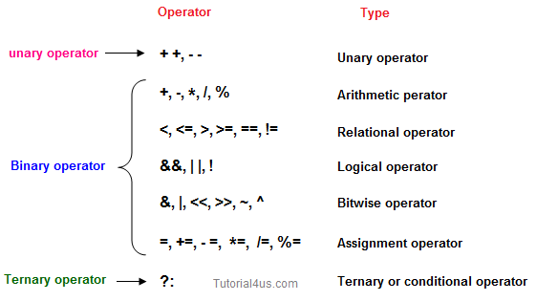
Operators

Slide 35
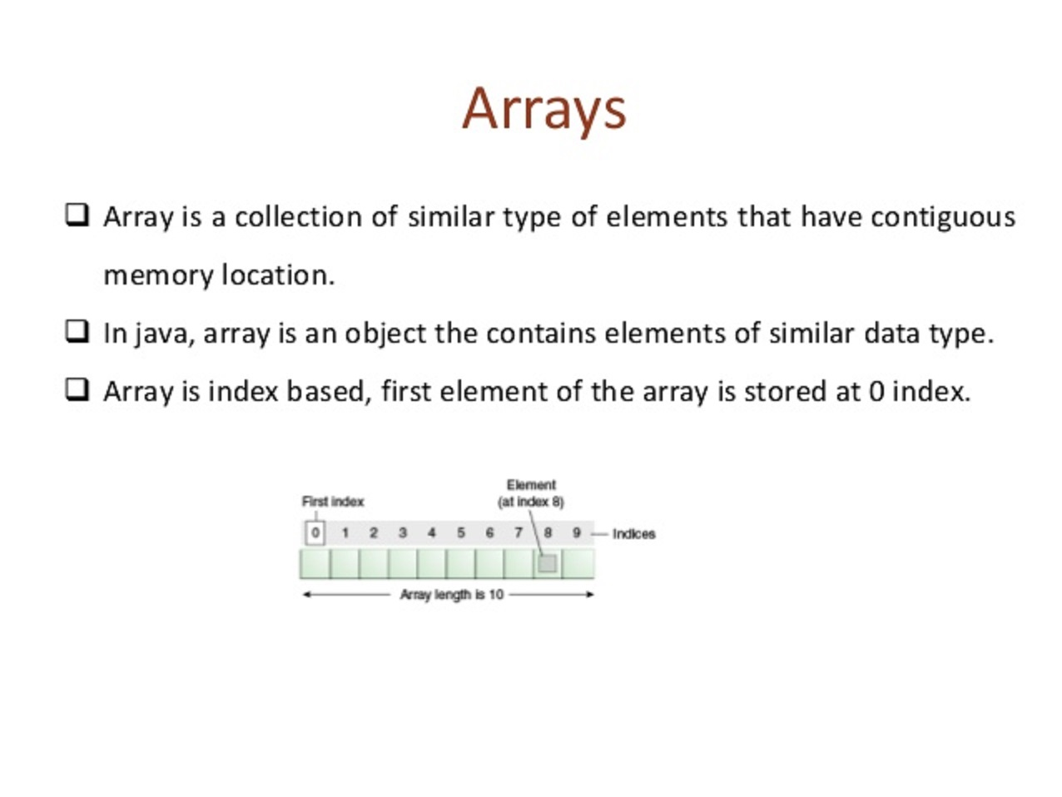
Arrays

Slide 36
Arrays
Advantage of Java Array
Code Optimization: It makes the code optimized, we can retrieve or sort the data easily.
Random access: We can get any data located at any index position.
Disadvantage of Java Array
Size Limit: We can store only fixed size of elements in the array. It doesn't grow its size at runtime. To solve this problem, collection framework is used in java.
Syntax to Declare an Array in java
dataType[] arr; (or)
dataType []arr; (or)
dataType arr[];
Instantiation
arr = new datatype(Size)
int a[]=new int[5];//declaration and instantiation

Slide 37
Arrays
Multidimensional array in java
Syntax to Declare Multidimensional Array in java
dataType[][] arrayRefVar; (or)
dataType [][]arrayRefVar; (or)
dataType arrayRefVar[][]; (or)
dataType []arrayRefVar[];
int[][] arr=new int[3][3];//3 row and 3 column
//declaring and initializing 2D array
int arr[][]={{1,2,3},{2,4,5},{4,4,5}};

Slide 38
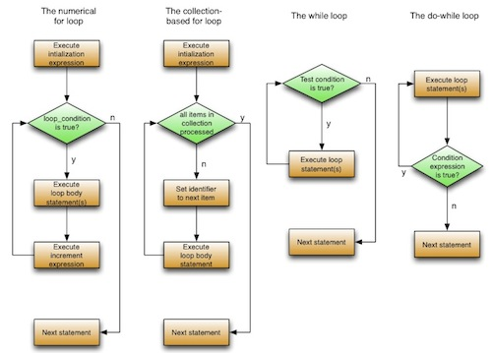
Loops

Slide 39
Loops
for-each : Enhanced for loop
for(Type var:array){
//code to be executed
}
Labeled For Loop
labelname:
for(initialization;condition;incr/decr){
//code to be executed
}

Slide 40
Break and Continue
The Java break is used to break loop or switch statement. It breaks the current flow of the program at specified condition. In case of inner loop, it breaks only inner loop.
Syntax:
jump-statement;
break;
Java Continue Statement
The Java continue statement is used to continue loop. It continues the current flow of the program and skips the remaining code at specified condition. In case of inner loop, it continues only inner loop.
Syntax:
jump-statement;
continue;

Slide 41
Conditional Statements
Java If-else Statement
The Java if statement is used to test the condition. It checks boolean condition: true or false. There are various types of if statement in java.
if statement
if-else statement
if-else-if ladder
nested if statement
Java if Statement
The Java if statement tests the condition. It executes the if block if condition is true.
Syntax:
if(condition){
//code to be executed
}

Slide 42
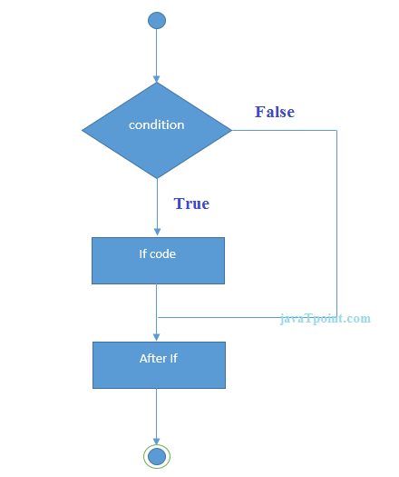
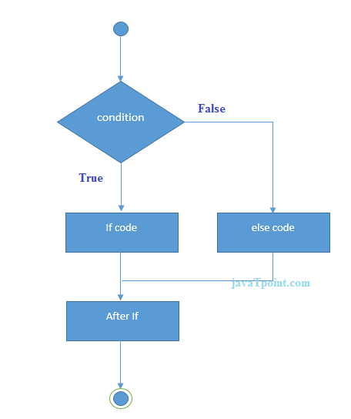
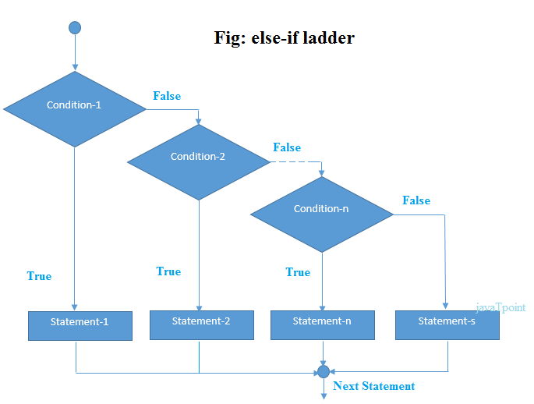
Conditional Statements

Slide 43
Switch Statements
The Java switch statement executes one statement from multiple conditions. It is like if-else-if ladder statement.
Syntax:
switch(expression){
case value1:
//code to be executed;
break; //optional
case value2:
//code to be executed;
break; //optional
......
default:
code to be executed if all cases are not matched;
}

Slide 44
Static keyword
The static keyword in java is used for memory management mainly. We can apply java static keyword with variables, methods, blocks and nested class. The static keyword belongs to the class than instance of the class.
The static can be:
variable (also known as class variable)
method (also known as class method)
block
nested class
1) Java static variable
If you declare any variable as static, it is known static variable.
The static variable can be used to refer the common property of all objects (that is not unique for each object) e.g. company name of employee,,college name of students etc.
The static variable gets memory only once in class area at the time of class loading.
Advantage of static variable
It makes your program memory efficient (i.e it saves memory).
Java static property is shared to all objects.

Slide 45
Examples of static variable
//Program of static variable
class Student8{
int rollno;
String name;
static String college ="ITS";
Student8(int r,String n){
rollno = r;
name = n;
}
void display (){System.out.println(rollno+" "+name+" "+college);}
public static void main(String args[]){
Student8 s1 = new Student8(111,"Karan");
Student8 s2 = new Student8(222,"Aryan");
s1.display();
s2.display();
}
}

Slide 46
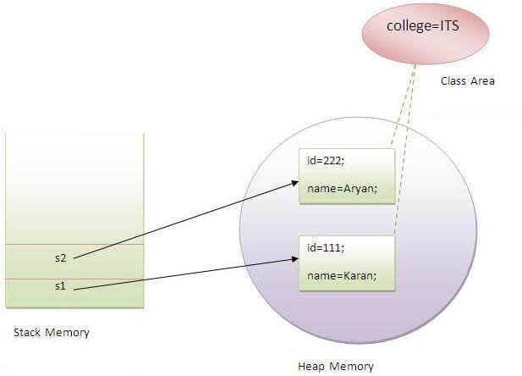
Examples of static variable

Slide 47
Examples of static methods
If you apply static keyword with any method, it is known as static method.
A static method belongs to the class rather than object of a class.
A static method can be invoked without the need for creating an instance of a class.
A static method can access static data member and can change the value of it.
The static method can not use non static data member or call non-static method directly.
this and super cannot be used in static context.
Restrictions for static method
There are two main restrictions for the static method. They are:

Slide 48
Examples of static block
Is used to initialize the static data member.
It is executed before main method at the time of class loading.

Slide 49
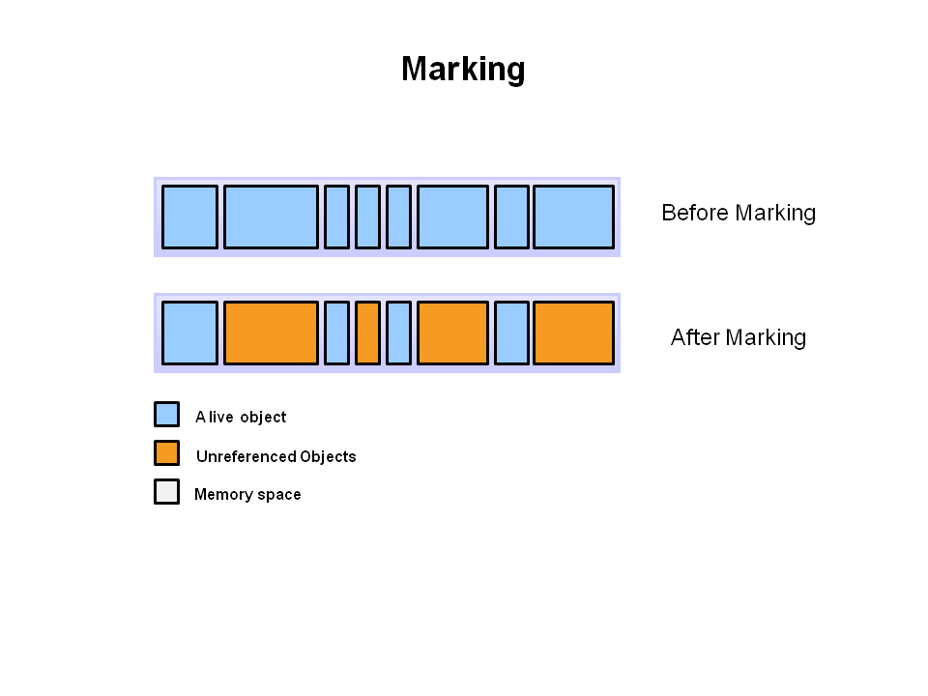
Garbage Collection
Automatic garbage collection is the process of looking at heap memory, identifying which objects are in use and which are not, and deleting the unused objects. An in use object, or a referenced object, means that some part of your program still maintains a pointer to that object. An unused object, or unreferenced object, is no longer referenced by any part of your program. So the memory used by an unreferenced object can be reclaimed.
In a programming language like C, allocating and deallocating memory is a manual process. In Java, process of deallocating memory is handled automatically by the garbage collector. The basic process can be described as follows.
Step 1: Marking
The first step in the process is called marking. This is where the garbage collector identifies which pieces of memory are in use and which are not.

Slide 50
Garbage Collection
Automatic garbage collection is the process of looking at heap memory, identifying which objects are in use and which are not, and deleting the unused objects. An in use object, or a referenced object, means that some part of your program still maintains a pointer to that object. An unused object, or unreferenced object, is no longer referenced by any part of your program. So the memory used by an unreferenced object can be reclaimed.
In a programming language like C, allocating and deallocating memory is a manual process. In Java, process of deallocating memory is handled automatically by the garbage collector. The basic process can be described as follows.
Step 1: Marking
The first step in the process is called marking. This is where the garbage collector identifies which pieces of memory are in use and which are not.

Slide 51
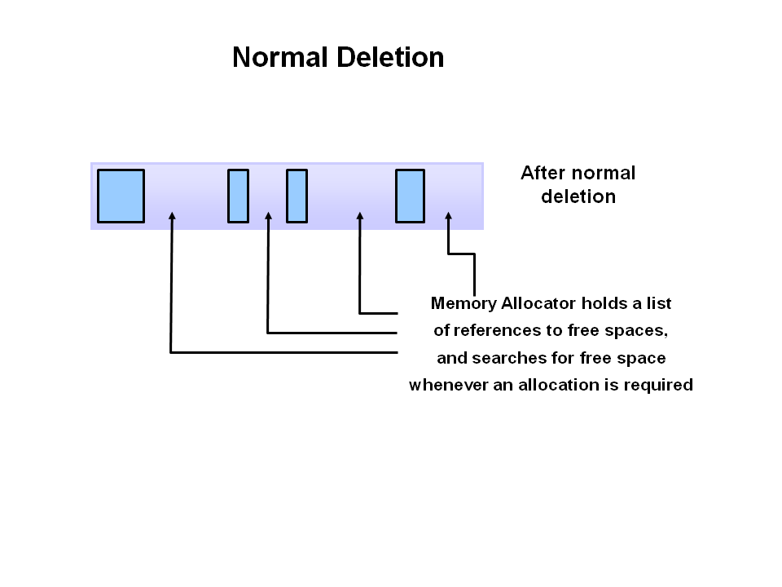
Garbage Collection
Step 2: Normal Deletion
Normal deletion removes unreferenced objects leaving referenced objects and pointers to free space.
(Ref :http://www.oracle.com/webfolder/technetwork/tutorials/obe/java/gc01/index.html)

Slide 52
String
Generally, string is a sequence of characters. But in java, string is an object that represents a sequence of characters. The java.lang.String class is used to create string object.
How to create String object?
There are two ways to create String object:
By string literal
By new keyword
String s1="Welcome"; String s2="Welcome";//will not create new instance
Each time you create a string literal, the JVM checks the string constant pool first. If the string already exists in the pool, a reference to the pooled instance is returned. If string doesn't exist in the pool, a new string instance is created and placed in the pool.String objects are stored in a special memory area known as string constant pool. To make Java more memory efficient Strings are immutable. The java String is immutable i.e. it cannot be changed. Whenever we change any string, a new instance is created. For mutable string, you can use StringBuffer and
StringBuilder classes.

Slide 53
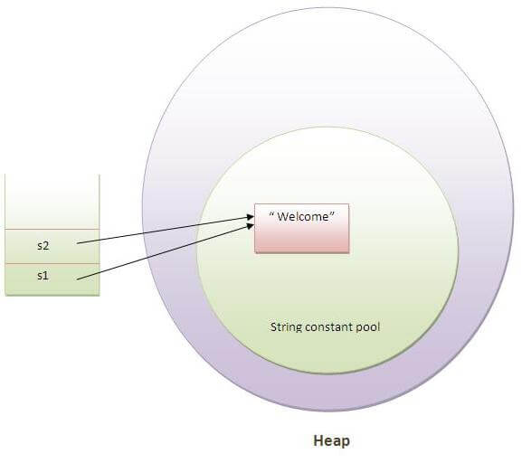
String
Java String class provides a lot of methods to perform operations on string such as compare(), concat(), equals(), split(), length(), replace(), compareTo(), intern(), substring() etc
The java.lang.String class implements Serializable, Comparable and CharSequence interfaces.
char[] ch={'j','a','v','a'}; String s=new String(ch); String s=“java”
String s=new String("Welcome");//creates two objects and one reference variable
In such case, JVM will create a new string object in normal(non pool) heap memory and the literal "Welcome" will be placed in the string constant pool. The variable s will refer to the object in heap(non pool).

Slide 54
OOPS in java
Abstraction
Encapsulation
Polymorphism
Inheritance
Association
Aggregation
Composition

Slide 55
OOPS in java
Abstraction
Abstraction is the concept of hiding the internal details and describing things in simple terms. For example, a method that adds two integers. The internal processing of the method is hidden from the outer world. There are many ways to achieve abstraction in object-oriented programmings, such as encapsulation and inheritance.
Encapsulation
Encapsulation is the technique used to implement abstraction in object-oriented programming. Encapsulation is used for access restriction to class members and methods.
Access modifier keywords are used for encapsulation in object oriented programming. For example, encapsulation in java is achieved using private, protected and public keywords.

Slide 56
OOPS in java
Polymorphism
Polymorphism is the concept where an object behaves differently in different situations. There are two types of polymorphism – compile time polymorphism and runtime polymorphism.
Compile-time polymorphism is achieved by method overloading.
Here we have multiple draw methods but they have different behavior. This is a case of method overloading because all the methods name is same and arguments are different. Here compiler will be able to identify the method to invoke at compile-time, hence it’s called compile-time polymorphism.
Runtime polymorphism is implemented when we have “IS-A” relationship between objects. This is also called a method overriding because subclass has to override the superclass method for runtime polymorphism.

Slide 57
OOPS in java
Polymorphism
If we are working in terms of the superclass, the actual implementation class is decided at runtime. The compiler is not able to decide which class method will be invoked. This decision is done at runtime, hence the name as runtime polymorphism or dynamic method dispatch.
Inheritance
Inheritance is the object-oriented programming concept where an object is based on another object. Inheritance is the mechanism of code reuse. The object that is getting inherited is called superclass and the object that inherits the superclass is called subclass.

Slide 58
OOPS in java
Association
Association is the OOPS concept to define the relationship between objects. The association defines the multiplicity between objects. For example Teacher and Student objects. There is a one-to-many relationship between a teacher and students. Similarly, a student can have a one-to-many relationship with teacher objects. However, both student and teacher objects are independent of each other.
Aggregation
Aggregation is a special type of association. In aggregation, objects have their own life cycle but there is ownership. Whenever we have “HAS-A” relationship between objects and ownership then it’s a case of aggregation.

Slide 59
OOPS in java
Composition
Association is the OOPS concept to define the relationship between objects. The association defines the multiplicity between objects. For example Teacher and Student objects. There is a one-to-many relationship between a teacher and students. Similarly, a student can have a one-to-many relationship with teacher objects. However, both student and teacher objects are independent of each other.

Slide 60
Collection framework
A Collection is a group of individual objects represented as a single unit. Java provides Collection Framework which defines several classes and interfaces to represent a group of objects as a single unit.
A Collection is a group of individual objects represented as a single unit. Java provides Collection Framework which defines several classes and interfaces to represent a group of objects as a single unit.

Slide 61
Collection framework
A Collection is a group of individual objects represented as a single unit. Java provides Collection Framework which defines several classes and interfaces to represent a group of objects as a single unit.
Need for collection framework
Before Collection Framework (or before JDK 1.2) was introduced, the standard methods for grouping Java objects (or collections) were Arrays or Vectors or Hashtables. All of these collections had no common interface.
Accessing elements of these Data Structures was a hassle as each had a different method (and syntax) for accessing its members:

Slide 62
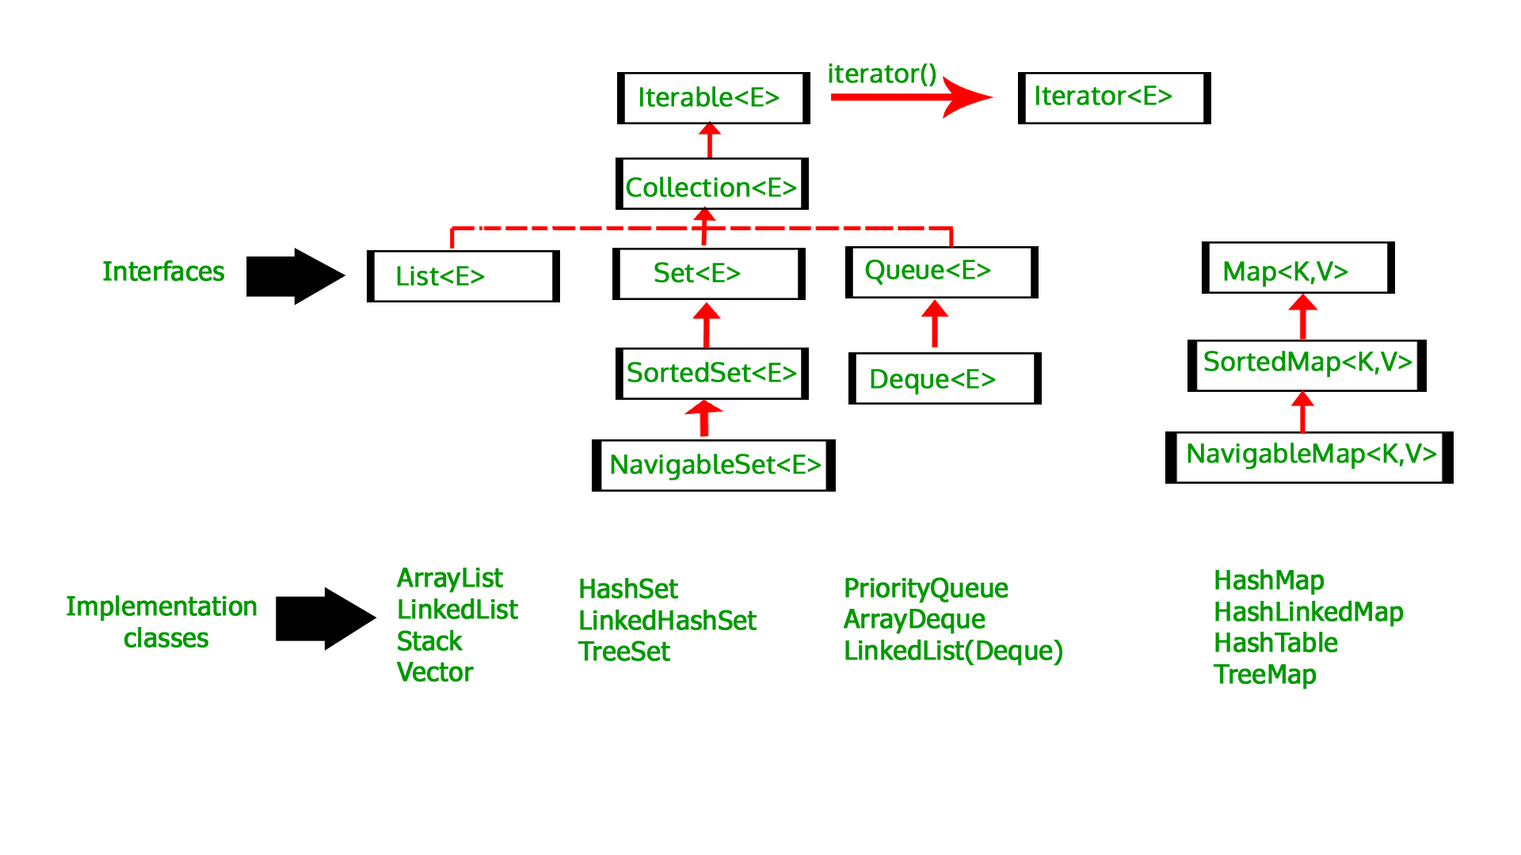
Collection framework

Slide 63
Collection framework
Advantages of Collection Framework:
Consistent API : The API has a basic set of interfaces like Collection, Set, List, or Map. All classes (ArrayList, LinkedList, Vector, etc) that implement these interfaces have some common set of methods.
Reduces programming effort: A programmer doesn’t have to worry about the design of Collection, and he can focus on its best use in his program.
Increases program speed and quality: Increases performance by providing high-performance implementations of useful data structures and algorithms.

Slide 64
Collection framework
Collection : Root interface with basic methods like add(), remove(),
contains(), isEmpty(), addAll(), ... etc.
Set : Doesn't allow duplicates. Example implementations of Set
interface are HashSet (Hashing based) and TreeSet (balanced
BST based). Note that TreeSet implements SortedSet.
List : Can contain duplicates and elements are ordered. Example
implementations are LinkedList (linked list based) and
ArrayList (dynamic array based)
Queue : Typically order elements in FIFO order except exceptions
like PriorityQueue.

Slide 65
Collection framework
Deque : Elements can be inserted and removed at both ends. Allows both LIFO and FIFO.
Map : Contains Key value pairs. Doesn't allow duplicates. Example
implementation are HashMap and TreeMap. TreeMap implements SortedMap.
The difference between Set and Map interface is that in Set we
have only keys, whereas in Map, we have key, value pairs.

Slide 66
Thank You

