Slide 1
Android Mobile Application Development using Java
Raghu Prasad K S – BE,MS
Subject Matter Expert

Slide 2
Introduction
Raghu Prasad – BE, MS
Total of 28 years of experience
7 years as a lecturer in Engineering College
21 Years into IT
Worked with companies like CISCO, CSC, ICICI, First Apex – NTT Data
Currently into Corporate training, consultancy and application development
Worked with corporates and public sector
Technologies – Java,Android,Python, C#,.Net Framework, DataSciences, Web Technologies, Java Script technologies (MEAN/MERN stack), IOT, Test Automation – Selenium, Jmeter,Block Chain

Slide 3
Course Objectives
The objective of this program is to introduce complete process of android app development using Android Studio and programming language, on board sensors, communication modules and media elements.

Slide 4
Course Outcomes
Clear understanding about need of java programming in mobile app development.
Get knowledge about Android Java Programming.
Methodologies for Android App Development.
Android Studio implementation for mobile app development.
Exposure to XML GUI Elements.
Android Layout, Drawable, Assets Usage.
Media elements, communication modules integration for advance app development.
Event Listeners, Intent Actions. Android File and Folder System.
Exposure to methodology of innovative project development.

Slide 5
Introduction to mobile application development
Mobile application development is the process of creating software applications that run on a mobile device, and a typical mobile application utilizes a network connection to work with remote computing resources.
Hence, the mobile development process involves creating installable software bundles (code, binaries, assets, etc.) , implementing backend services such as data access with an API, and testing the application on target devices.

Slide 6
Mobile Applications and Device Platforms
There are two dominant platforms in the modern smartphone market.
One is the iOS platform from Apple Inc. The iOS platform is the operating system that powers Apple's popular line of iPhone smartphones.
The second is Android from Google. The Android operating system is used not only by Google devices but also by many other OEMs to built their own smartphones and other smart devices.

Slide 7
Alternatives for Building Mobile Apps
There are four major development approaches when building mobile applications
Native Mobile Applications
Cross-Platform Native Mobile Applications
Hybrid Mobile Applications
Progressive Web Applications
Each of these approaches for developing mobile applications has its own set of advantages and disadvantages. When choosing the right development approach for their projects, developers consider the desired user experience, the computing resources and native features required by the app, the development budget, time targets, and resources available to maintain the app.

Slide 8
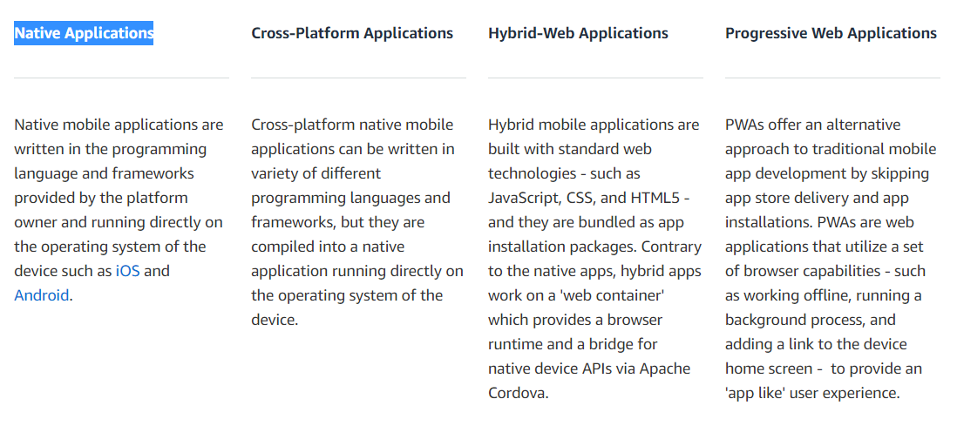
Alternatives for Building Mobile Apps

Slide 9
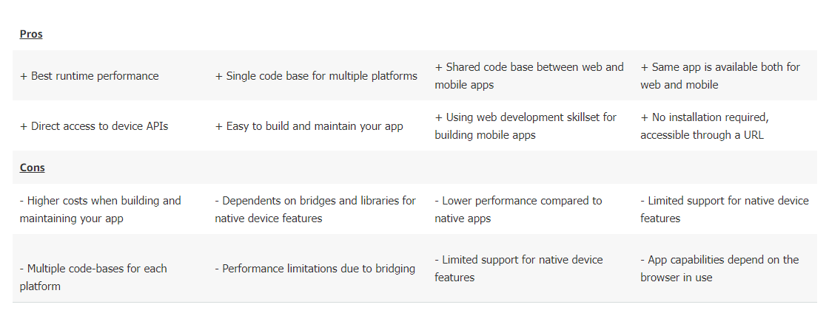
Alternatives for Building Mobile Apps

Slide 10
Demand for native app developers
One problem with native mobile application development is that it requires a highly specialized skill set.
Although there are large and vibrant developer communities for C and Java -- the language families that are mostly used for native development --, there are fewer developers who are knowledgeable in platform-specific versions of those languages and their respective IDEs.
In fact, skilled native app developers are in such demand, that many companies are hard-pressed to hire and retain them on staff, and instead they frequently have to resort to outside 3rd party design and development houses to build their apps for them.

Slide 11
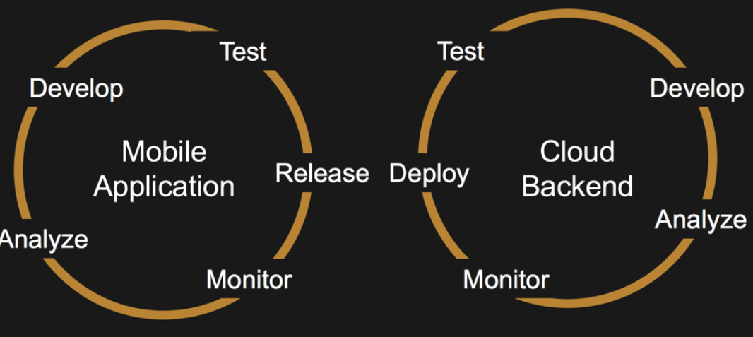
The Mobile Application Development Lifecycle
There are two interlinked core components of a mobile application:
1) the mobile application “Front-End” that resides on the mobile device, and
2) the services “Back-End” that supports the mobile front-end.

Slide 12
Q&A Session
Thanks

