Slide 1
Android Mobile Application Development
Raghu Prasad K S – BE,MS
Subject Matter Expert

Slide 2
Introduction
Raghu Prasad – BE, MS
Total of 28 years of experience
7 years as a lecturer in Engineering College
21 Years into IT
Worked with companies like CISCO, CSC, ICICI, First Apex – NTT Data
Currently into Corporate training, consultancy and application development
Worked with corporates and public sector
Technologies – Java,Android,Python, C#,.Net Framework, DataSciences, Web Technologies, Java Script technologies (MEAN/MERN stack), IOT, Test Automation – Selenium, Jmeter,Block Chain

Slide 3
Introduction to Android
Android is the best-selling Operating System among various mobile platforms across the globe.
Hundreds of millions of mobile devices are powered by Android in more than 190 countries of the world.
It conquered around 75% of the global market share by the end of 2020, and this trend is growing bigger every other day.
Pre-requisites
XML
Java
Database
https://www.geeksforgeeks.org/introduction-to-android-development/
Prerequisites: Basics o

Slide 4
XML
Extensible Markup Language (XML) is a markup language that defines a set of rules for encoding documents in a format that is both human-readable and machine-readable.
The design goals of XML focus on simplicity, generality, and usability across the Internet.
It is a textual data format with strong support via Unicode for different human languages.
Although the design of XML focuses on documents, the language is widely used for the representation of arbitrary data structures such as those used in web services.

Slide 5
Sample XML
XML stands for extensible Markup Language
XML is a markup language like HTML
XML is designed to store and transport data
XML is designed to be self-descriptive
<?xml version="1.0" encoding="UTF-8"?>
<employee>
<code>1</code>
<name>Ravi</name>
<department>IT</department>
<text category = “message”>Hi</text>
</employee>

Slide 6
Sample XML with attribute
<?xml version = “1.0”?>
<contactinfo>
<address category = “college”>
<name>G4G</name>
<College>Geeksforgeeks</College>
<mobile>2345456767</mobile>
</address>
</contactinfo>

Slide 7
Sample XML
XML stands for extensible Markup Language
XML is a markup language like HTML
XML is designed to store and transport data
XML is designed to be self-descriptive
<?xml version="1.0" encoding="UTF-8"?>
<employee>
<code>1</code>
<name>Ravi</name>
<department>IT</department>
<text category = “message”>Hi</text>
</employee>

Slide 8
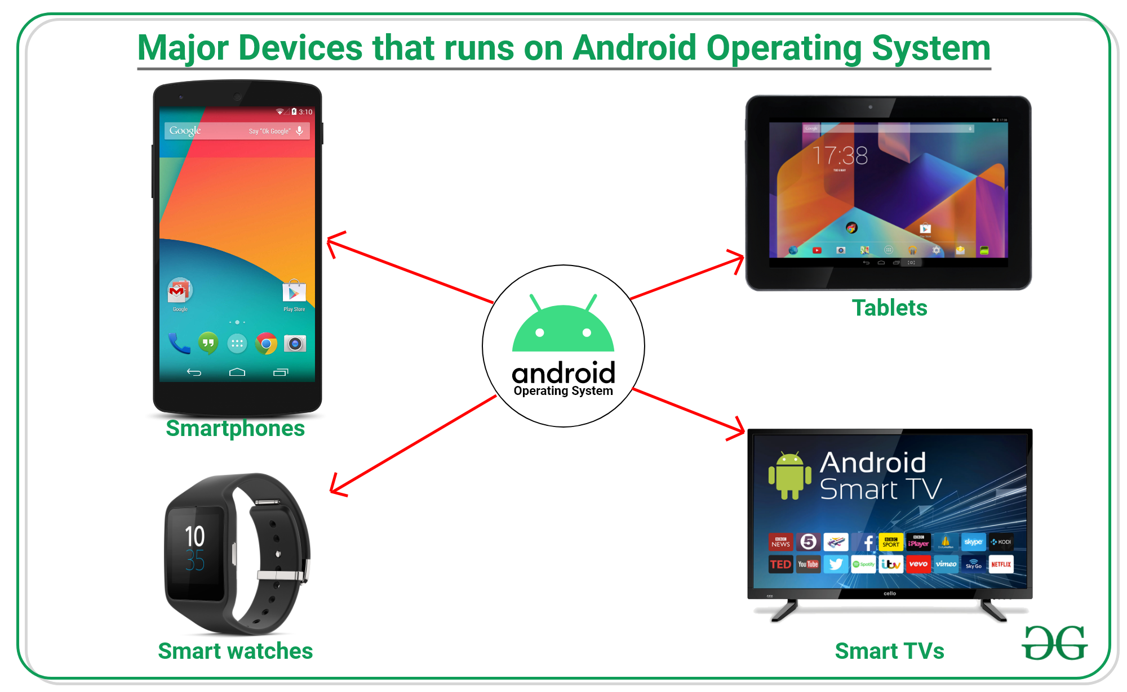
Introduction to Android
https://www.geeksforgeeks.org/introduction-to-android-development/

Slide 9
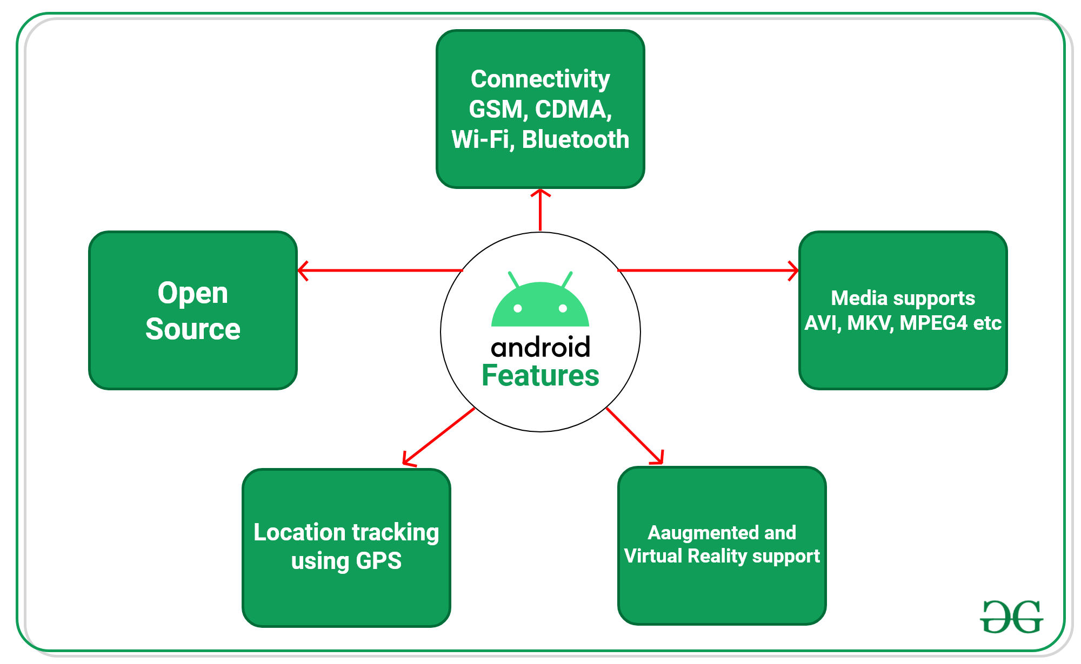
Features
https://www.geeksforgeeks.org/introduction-to-android-development/

Slide 10
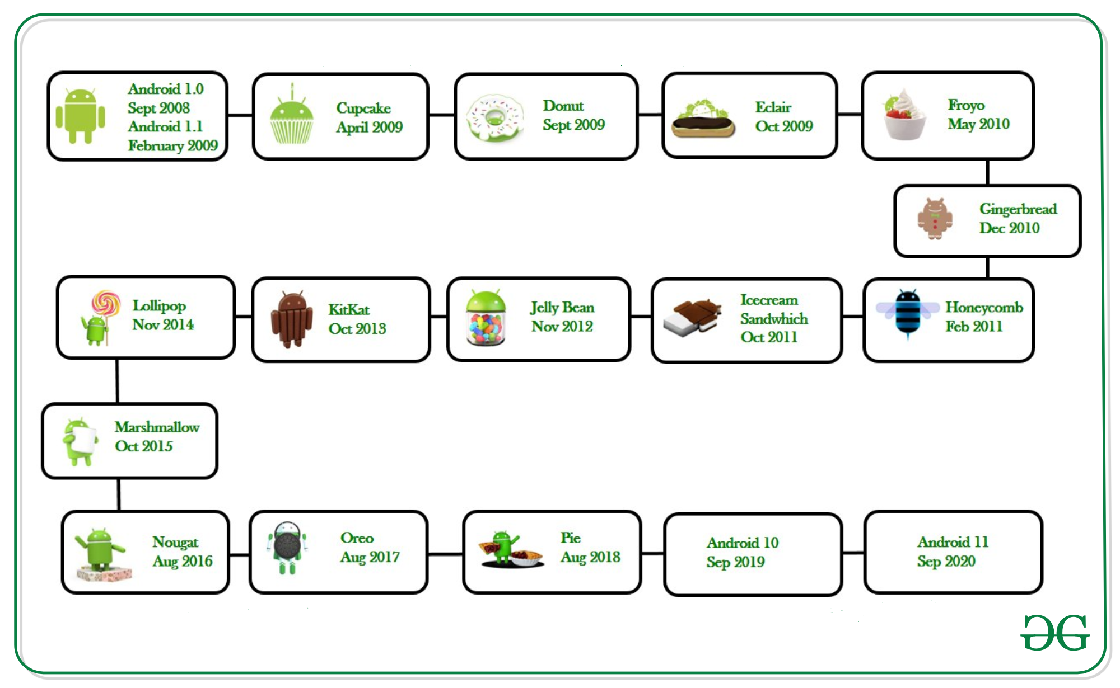
Android Versions

Slide 11
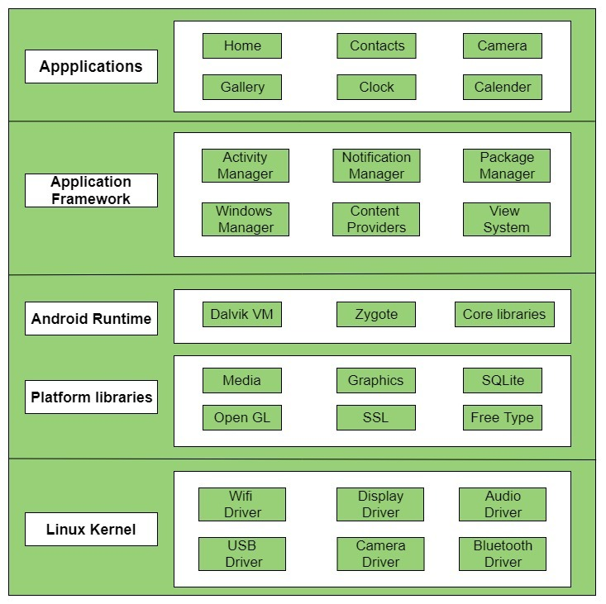
Android Architecture

Slide 12
Q&A Session
Thanks

