Slide 1
FULLSTACK Web Application Development using MEAN Stack
Raghu Prasad K S
CEO
www.kaushalya.tech
9845547471

Slide 2
Introduction
Raghu Prasad – BE, MS
Total of 28 years of experience
7 years as a lecturer in Engineering College
21 Years into IT
Worked with companies like CISCO, CSC, ICICI, First Apex – NTT Data
Currently into Corporate training, consultancy and application development
Worked with corporates and public sector
Technologies – Java, Python, C#,.Net Framework DataSciences, Web Technologies, Java Script technologies (MEAN/MERN stack), IOT, Test Automation – Selenium, Jmeter,Block Chain

Slide 3
Course Outline
Introduction to FULLSTACK Web Application Development
Technologies related to FULLSTACK web application
MEAN
Software Development Life Cycle (SDLC)
Types of Web application architecture

Slide 4
Course Objectives
Learn and explore FULLSTACK application development using MEAN
Learn by coding
Develop end to end module of a full Web Application Development
Develop web application using agile process

Slide 5
FULLSTACK Web Application Development
Full stack developer Simile
Defining, describing, and drawing you a picture…
I’m going to use the most popular example to define a full-stack developer. If there’s one person who wore many hats in his lifetime, it’s Leonardo Da Vinci. He was a painter, scientist, mathematician, cartographer, geologist, astronomer, historian, musician, and sculptor. People believe that diverse experiences fed into his creative genius, making him a nonpareil innovator.
If this extraordinary Renaissance man was a programmer today, he would be what we call a “full-stack” developer. Murky picture becoming a little clearer, I hope.

Slide 6
FULLSTACK Web Application Development
Full stack development: It refers to the development of both front end(client side) and back end(server side) portions of web application.
Full stack web Developers: Full stack web developers have the ability to design complete web application and websites. They work on the frontend, backend, database and debugging of web application or websites.

Slide 7
Web Application Architecture
Web application architecture is a blueprint of simultaneous interactions between components, databases, middleware systems, user interfaces, and servers in an application. It can also be described as the layout that logically defines the connection between the server and client-side for a better web experience.
All applications are made up of two primary components:
Client-side, popularly called: the frontend, where the code is written in HTML, CSS, JavaScript and stored within the browser. It’s where user interaction takes place.
Server-side, also known as the backend, controls the business logic and responds to HTTP requests. The server-side code is written in Java, PHP, Ruby, Python, Node.js, C# etc.

Slide 8
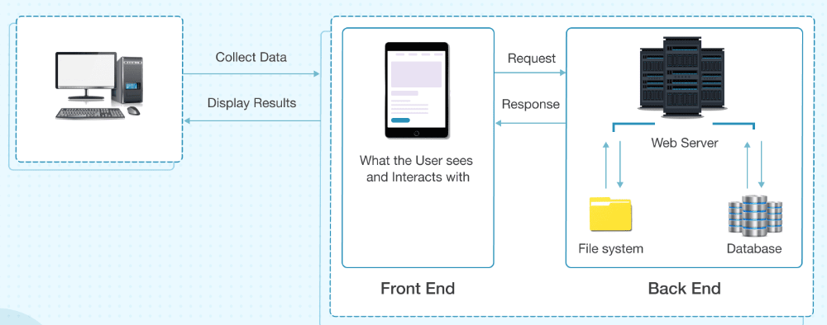
Web Application Architecture

Slide 9
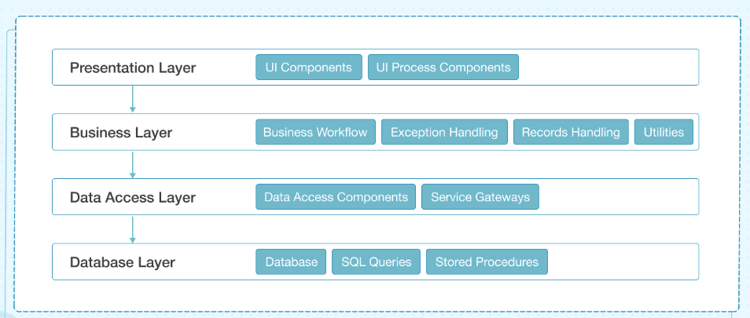
Layers of Web Application

Slide 10
Technologies related to FULLSTACK development
Front end: It is the visible part of website or web application which is responsible for user experience. The user directly interacts with the front end portion of the web application or website.
Languages – HTML/CSS/Java Script/AJAX
Frameworks and Libraries – Angular, React, Bootstrap, Jquery, SAAS
Back end: It refers to the server-side development of web application or website with a primary focus on how the website works. It is responsible for managing the database through queries and APIs by client-side commands
Languages – PHP/C++/Java/Python/JavaScript-Node.js/C#
Frameworks and Libraries – Express, Django, Rails, Laravel, Spring,.Net
Database – Oracle, MySQL, MongoDB, MSSQL, PostgreSQL,MS-SQL

Slide 11
Technologies related to FULLSTACK development
Popular Stacks
MEAN (Mongo, Express, Angular, Node)
MERN (Mongo, Express, React, Node)
Django (Django, Python,MySQL)
Rails or Ruby on Rails (Ruby, PHP,MySQL)
LAMP (Linux, Apache, MySQL, PHP)
.Net (C#,MS-SQL)
Hybrid Stacks
Angular, Java,Spring
React, Java,Spring
Angular, Python,Django

Slide 12
Tips to choose Web Tech Stack
Define project requirement – both functional and non functional requirement
Non functional
Scalability
Availability
Security
Maintainability
Development time
Development cost

Slide 13

FullStack Developer

Slide 14
Key skills of a FullStack Developer
Understand customer need and develop a use case
Convert use case into wire frame and user interface
Understand and implement responsive webdesign
Develop front end code
Understand project architecture and implement relevant design pattern.
Develop web services for backend integration
Understand the mechanism of interfacing with third party softwares
Such as ERP,payment gateway,etc
Develop backend code and interface with database (RDBMS,NoSQL,ORM)
Unit and integration testing

Slide 15
MEAN Stack
The MEAN stack is JavaScript-based framework for developing web applications. MEAN is named after MongoDB, Express, Angular, and Node, the four key technologies that make up the layers of the stack.
MongoDB - document database
Express(.js) - Node.js web framework
Angular(.js) - a client-side JavaScript framework
Node(.js) - the premier JavaScript web server
There are variations to the MEAN stack such as MERN (replacing Angular.js with React.js) and MEVN (using Vue.js). The MEAN stack is one of the most popular technology concepts for building web applications.

Slide 16
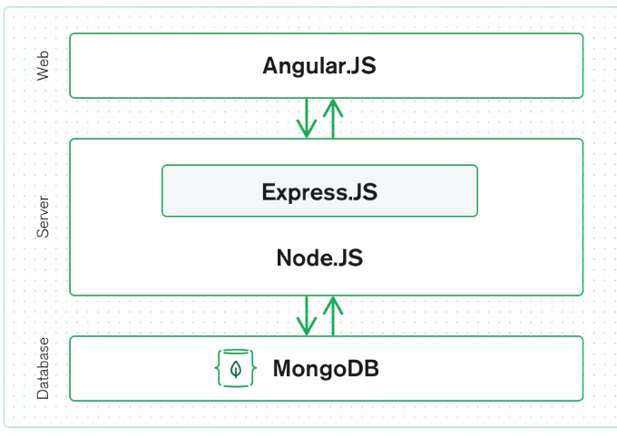
How does MEAN Stack Work
The MEAN architecture is designed to make building web applications in JavaScript and handling JSON incredibly easy.

Slide 17
Software development life cycle (SDLC)
AGILE methodology is a practice that promotes continuous iteration of development and testing throughout the software development lifecycle of the project. Both development and testing activities are concurrent unlike the Waterfall model
The agile software development emphasizes on four core values.
Individual and team interactions over processes and tools
Working software over comprehensive documentation
Customer collaboration over contract negotiation
Responding to change over following a plan

Slide 18
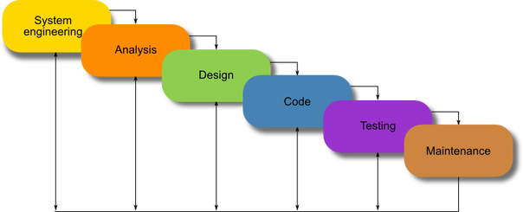
SDLC - Waterfall
Waterfall model

Slide 19
SDLC-Scrum
SCRUM is an agile development method which concentrates specifically on how to manage tasks within a team-based development environment. Basically, Scrum is derived from activity that occurs during a rugby match. Scrum believes in empowering the development team and advocates working in small teams (say- 7 to 9 members). It consists of three roles, and their responsibilities are explained as follows:

Slide 20
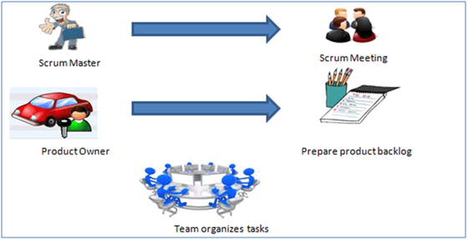
SDLC-Scrum

Slide 21
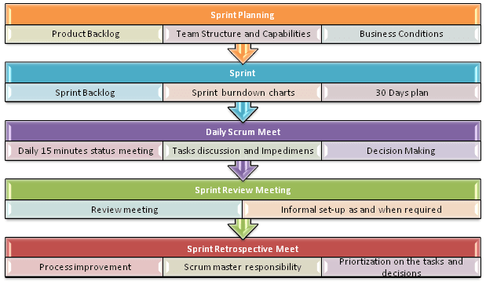
SDLC-Scrum

Slide 22
Types of Web Application Architecture
1. Model View Controller(MVC)
2. Single Page Application (SPA)
3. Service Oriented Architecture (SOA)
4. Microservices

Slide 23
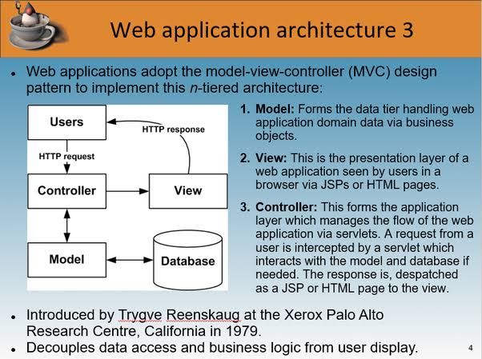
Web Application Architecture - MVC

Slide 24
Web Application Architecture - MVC
MVC – Advantages
Multiple developers can work with the three layers (Model, View, and Controller) simultaneously
Offers improved scalability, that supplements the ability of the application to grow
As components have a low dependency on each other, they are easy to maintain
A model can be reused by multiple views which provides reusability of code
Adoption of MVC makes an application more expressive and easy to understand
Extending and testing of the application becomes easy

Slide 25
SPA
SPA (Single Page Applications) has been introduced to overcome the traditional limitations to achieve smooth app performance, intuitive, and interactive user experience.
Instead of loading a new page, SPAs load a single web page and reload the requested data on the same page with dynamically updated content. The rest of the web page remains untouched. They are developed on the client-side using JavaScript frameworks as the entire logic is always shifted to the frontend.

Slide 26
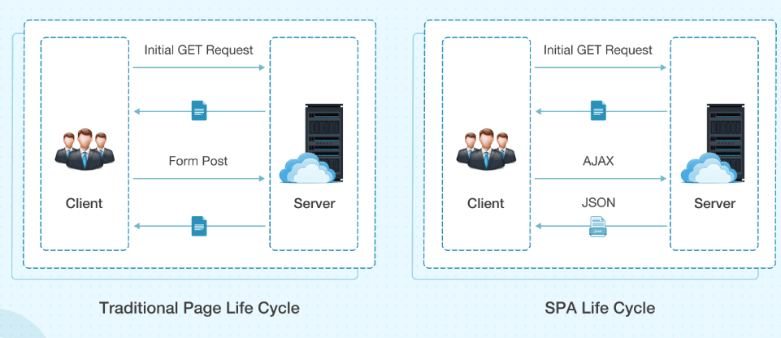
SPA

Slide 27
SPA
Single-Page Applications (SPAs) – Instead of loading completely new pages from the server each time for a user action, single page web applications allows for a dynamic interaction by means of providing updated content to the current page.
AJAX, a concise form of Asynchronous JavaScript and XML, is the foundation for enabling page communications and hence, making SPAs a reality. Because single-page applications prevent interruptions in user experience, they, in a way, resemble traditional desktop applications.
SPAs are designed in a way so that they request for most necessary content and information elements. This leads to the procurement of an intuitive as well as interactive user experience.

Slide 28
Web Application Architecture – SOA
Service-Oriented Architecture (SOA) is a style of software design where services are provided to the other components by application components, through a communication protocol over a network. Its principles are independent of vendors and other technologies. In service oriented architecture, a number of services communicate with each other, in one of two ways: through passing data or through two or more services coordinating an activity. This is just one definition of Service-Oriented Architecture.

Slide 29
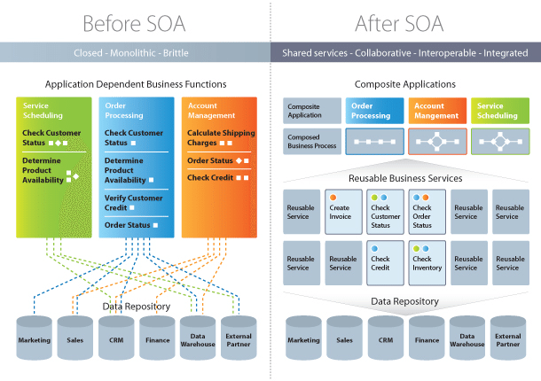
Web Application Architecture – SOA

Slide 30
Web Application Architecture – SOA
Characteristics of SOA
Business value
Strategic goals
Intrinsic inter-operability
Shared services
Flexibility
Evolutionary refinement

Slide 31
Web Application Architecture – SOA
Implementing SOA
Simple Object Accessing Protocol (SOAP)
In a nutshell, SOAP “is a messaging protocol specification for exchanging structured information in the implementation of web services in computer networks.
Representational State Transfer (REST)
It means when a RESTful API is called, the server will transfer to the client a representation of the state of the requested resource.

Slide 32
Web Application Architecture – Microservices
Microservices – These are small and lightweight services that execute a single functionality. The Microservices Architecture framework has a number of advantages that allows developers to not only enhance productivity but also speed up the entire deployment process. The components making up an application build using the Microservices Architecture aren’t directly dependent on each other. As such, they don’t necessitate to be built using the same programming language. Hence, developers working with the Microservices Architecture are free to pick up a technology stack of choice. It makes developing the application simpler and quicker.

Slide 33
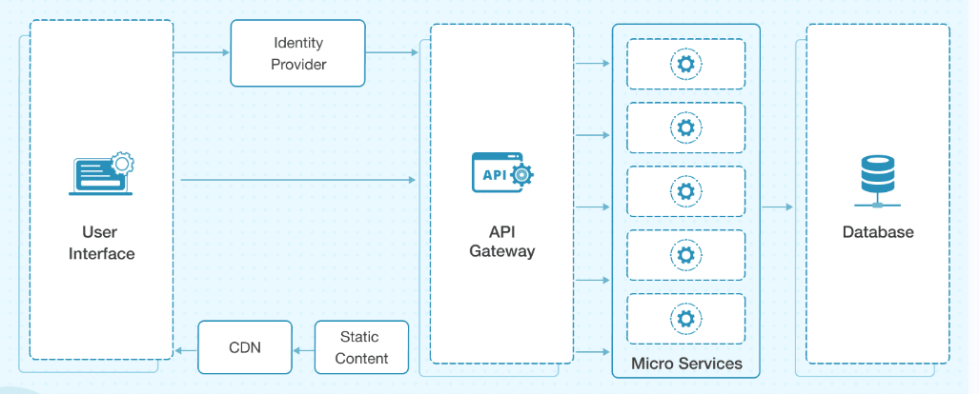
Microservices

Slide 34
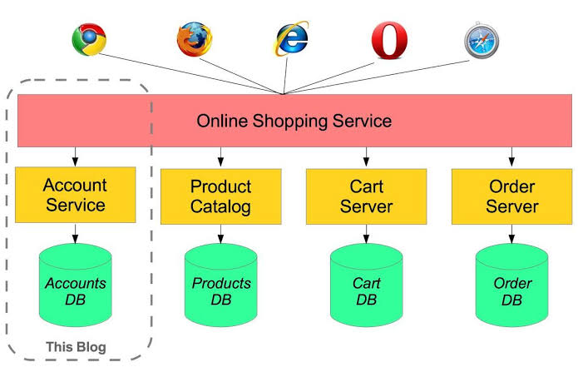
Web Application Architecture – Microservices

Slide 35
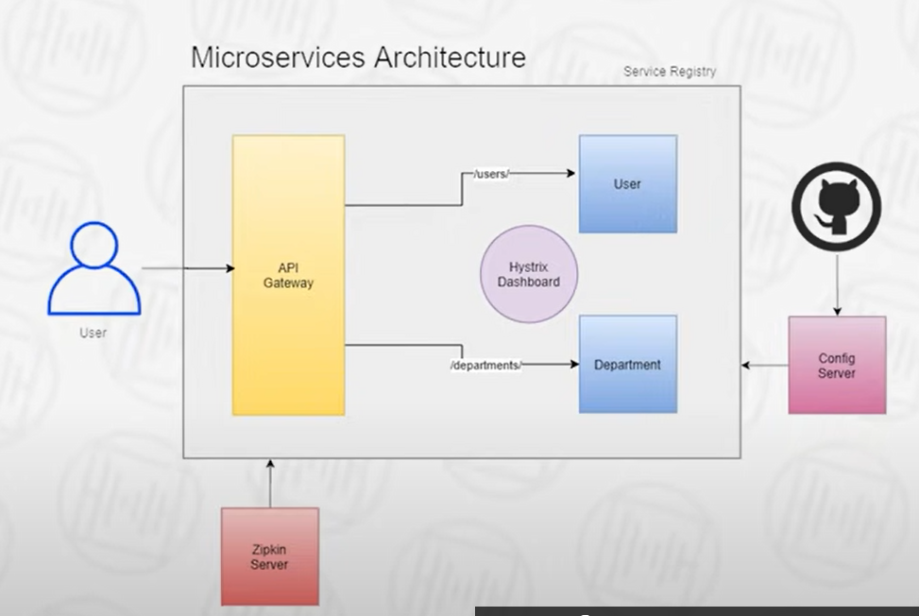
Web Application Architecture – Microservices

Slide 36
Q&A Session
Thanks

