Slide 1
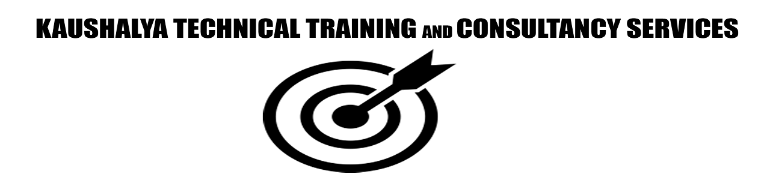
Angular
Raghu Prasad
9845547471
www.kaushalya.tech
FB : https://www.facebook.com/raghuprasadkonandur/
Skill Up-Skill Re-Skill
Excellence in action

Slide 2
Introduction
Raghu Prasad – BE, MS
Total of 23 years of experience
7 years as a lecturer in an Engineering College
16 Years into IT
Worked with companies like CISCO,CSC,ICICI,First Apex – NTT Data
Currently into Corporate training and consultancy
Worked with corporates and public sector
Service Offerings – In person/On-line/Corporate/Academic Institutes
Technologies – Java,Python,Web technologies,Java Script technologies (MEAN stack),IOT,Test Automation,Machine Learning,Artificial Intelligence,ERP
Customers – L & T,NextGen,Incarnus,BGS-IT,Sindhi College

Slide 3
Topics
Router

Slide 4
What does the Router Do ?
Handles navigation from one component to another
Mimics loading separate pages via browser
Includes back button functionality
Most Angular apps are SPA

Slide 5
Basic Steps To Take
Create app-routing module
Import RouterModule
Create routes
Router outlet
Add Links

Slide 6
<base href>
Root url goes here
<!doctype html>
<html lang=“en”>
<head>
<meta charset=“utf-8”>
<title>Angularapp</title>
<base href=“/”>

Slide 7
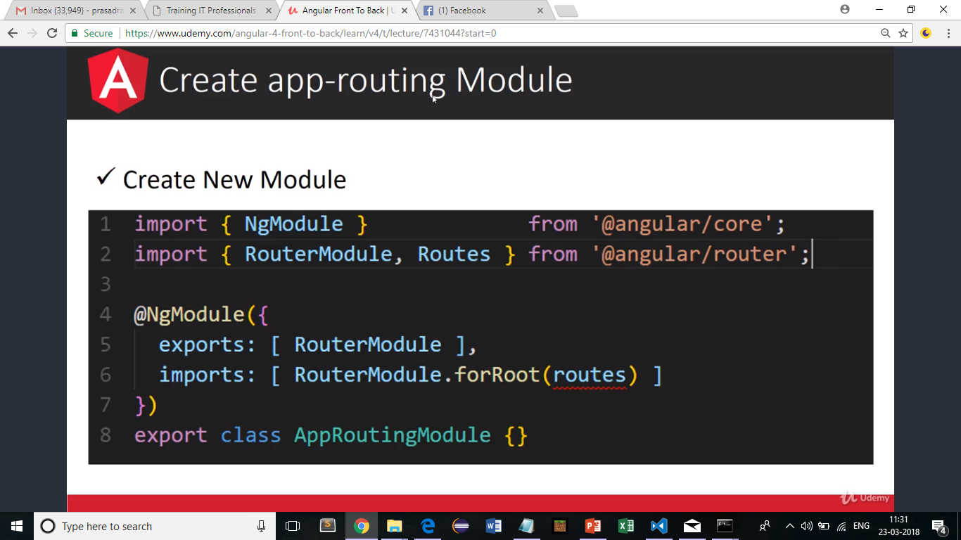
Create app-routing Module

Slide 8
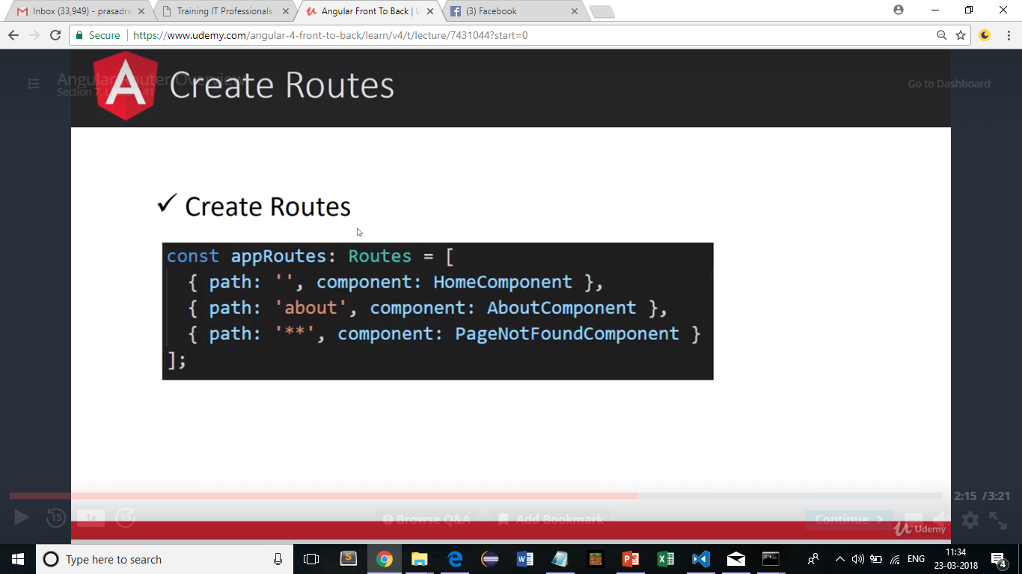
Create Routes

Slide 9
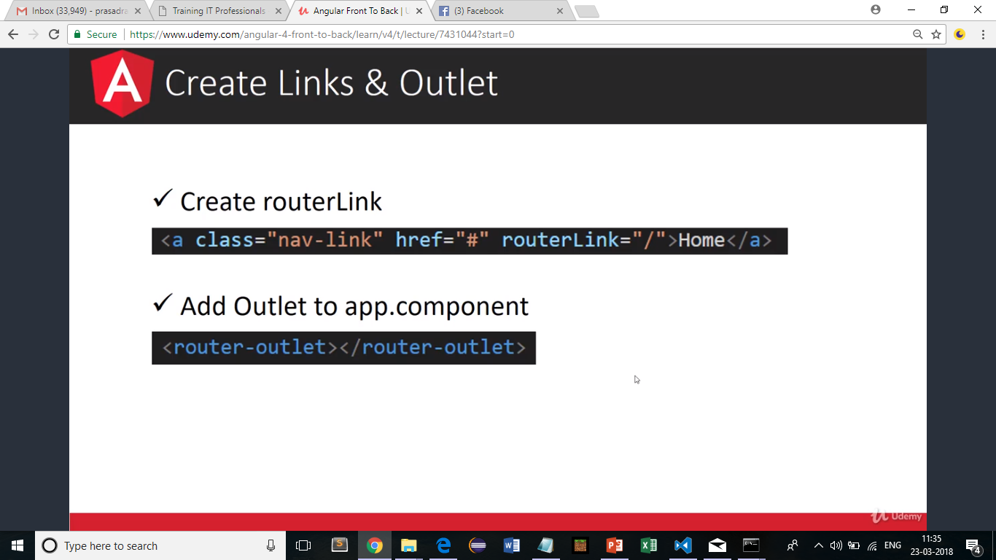
Create Link and Outlet

Slide 10
Thank You
Raghu Prasad
9845547471
www.kaushalya.tech
FB : https://www.facebook.com/raghuprasadkonandur/
Skill Up-Skill Re-Skill
Excellence in action

