Slide 1

Angular Unit Testing
Raghu Prasad
9845547471
www.kaushalya.tech
FB : https://www.facebook.com/raghuprasadkonandur/
Skill Up-Skill Re-Skill
Excellence in action

Slide 2

Introduction
Raghu Prasad – BE, MS
Total of 23 years of experience
7 years as a lecturer in an Engineering College
16 Years into IT
Worked with companies like CISCO,CSC,ICICI,First Apex – NTT Data
Currently into Corporate training and consultancy
Worked with corporates and public sector
Service Offerings – In person/On-line/Corporate/Academic Institutes
Technologies – Java,Python,Web technologies,Java Script technologies (MEAN stack),IOT,Test Automation,Machine Learning,Artificial Intelligence,ERP
Customers – L & T,NextGen,Incarnus,BGS-IT,Sindhi College

Slide 3
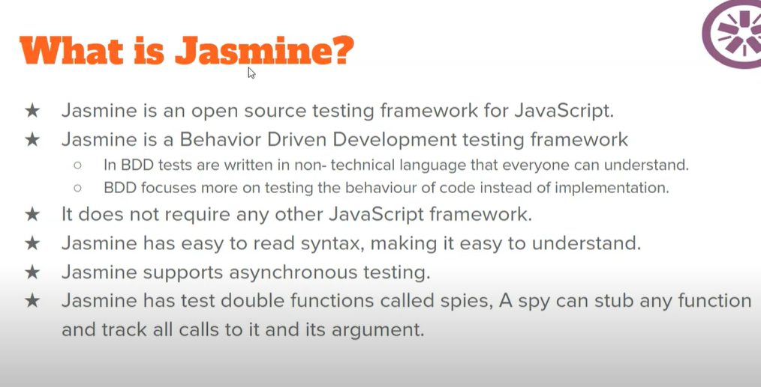
Jasmine

Slide 4
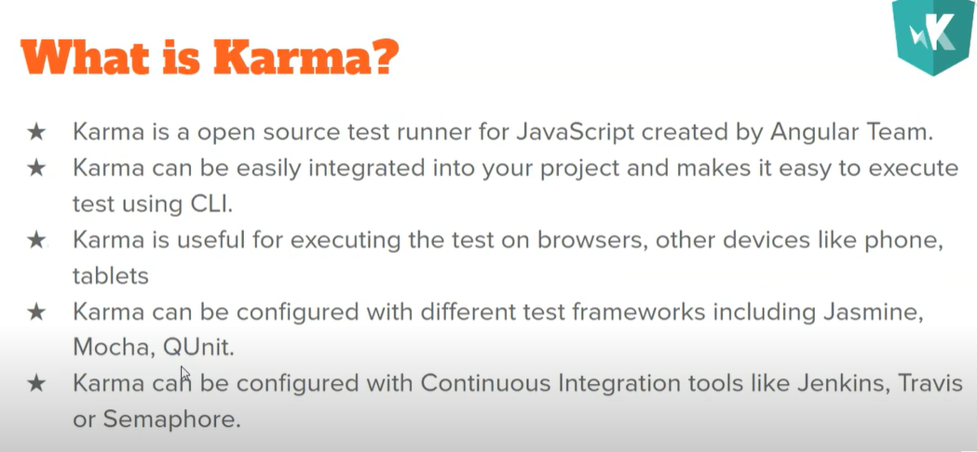
Karma

Slide 5
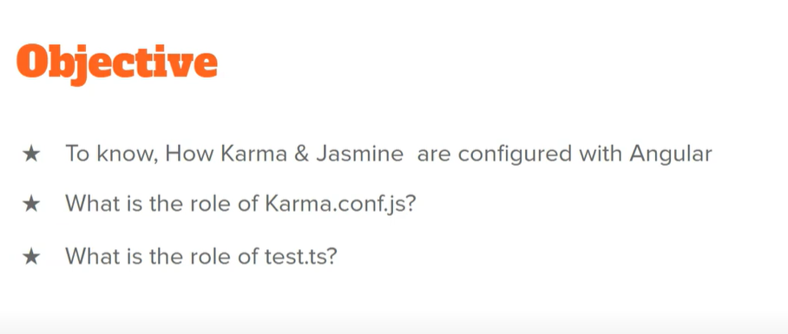
Jasmine and Karma Configuration

Slide 6
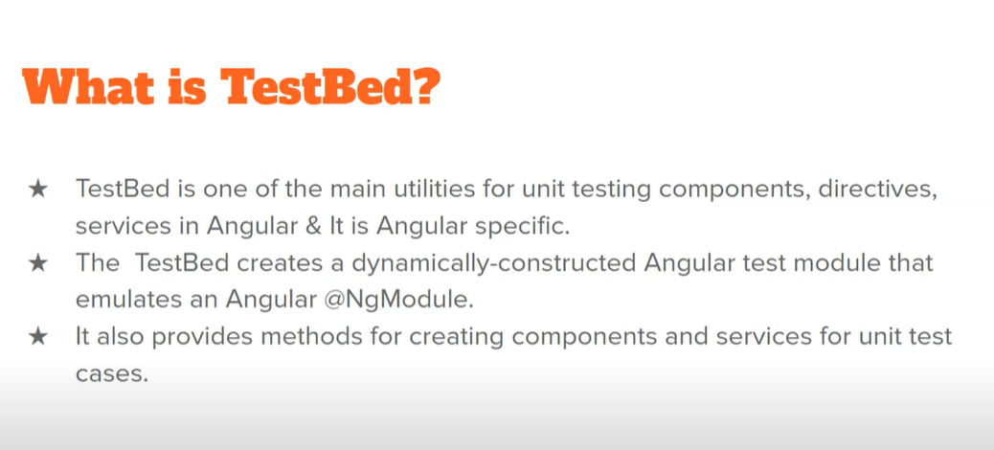
Test Bed

Slide 7
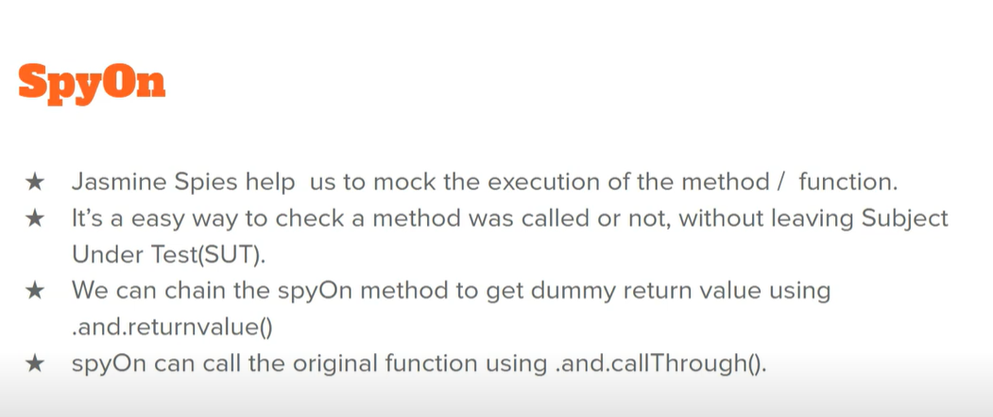
SpyOn

Slide 8
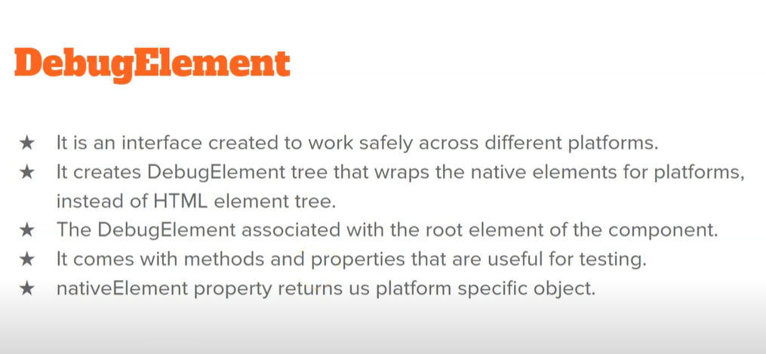
Debug Element

Slide 9
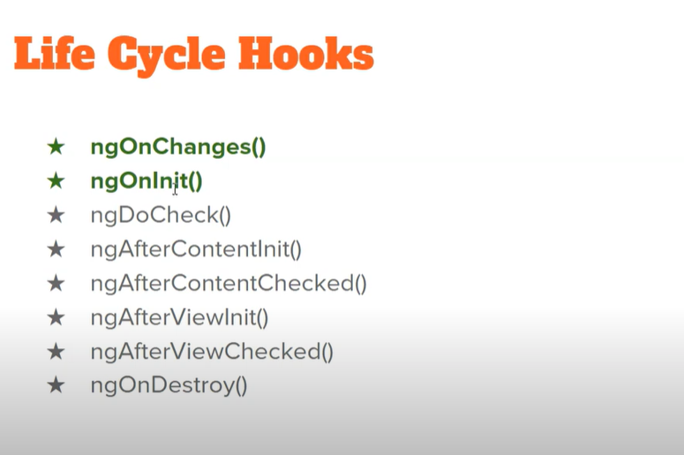
Life Cycle Hooks

Slide 10
Thank You
Raghu Prasad
9845547471
www.kaushalya.tech
FB : https://www.facebook.com/raghuprasadkonandur/
Skill Up-Skill Re-Skill
Excellence in action

