Slide 1
Spring Framework
Raghu Prasad Konandur

Slide 2
Agenda
Introduction to Spring Framework
Features of Spring Framework
History of Spring Framework
Inversion of Control (IoC)
Dependency Injection (DI)
Architecture of Spring Framework
Spring WebAPI Framework

Slide 3
Introduction to Spring Framework
Spring Framework is an open-source framework for building web applications with Java as a programming language. It is powerful and lightweight yet easy to use, and it provides support for developing Java applications easily.
Spring is a lightweight framework which can be thought of as a framework of frameworks because it also offers support for various frameworks such as hibernate, struts, tapestry, and JSF.

Slide 4
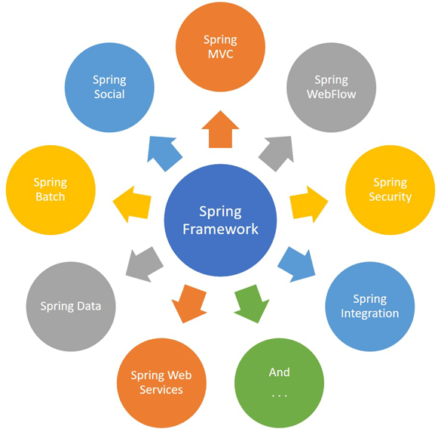
Introduction to Spring Framework

Slide 5
Features of Spring Framework
Predefined templates
Easy to test
Loose coupling
Lightweight
Fast development
Powerful abstraction
Offers an array of resources
Declarative support
Offers comprehensive tools

Slide 6
History of Spring Framework
Spring framework was written by Rod Johnson and was first released in June 2002.
Spring la^{s}t version release in March 2004
Spring 1.2.6 version release in 2006
Spring 2.0 version release in Oct 2006
Spring 2.5 version release in Nov 2007
Spring 3 version release in Dec 2009
Spring 3.1 version release in Dec 2011
Spring framework 4 version release in Dec 2013 with Java 8 support
Spring framework 4.2.0 version released on July 2015
Spring framework 4.2.1 version released in Sept 2015
Spring Framework 4.3 version released on 10 June 2016
Spring framework 5.0 version released on June 2017

Slide 7
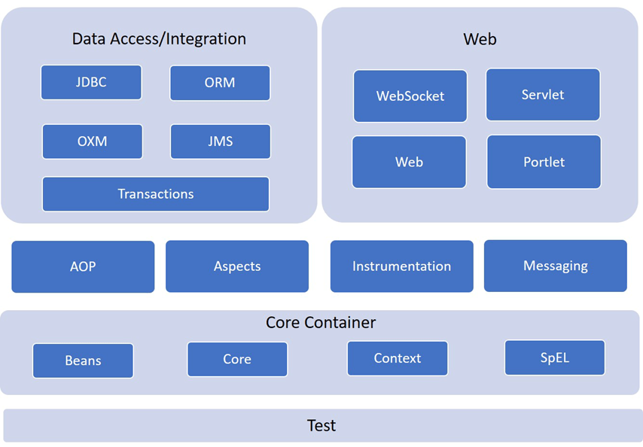
Spring Framework Architecture

Slide 8
Spring Framework Architecture
The Core and Bean provide the fundamental part of the framework, including IoC and DI.
Core Container
The Core Container is further divided by subcomponents like Core, Beans, Context, and Expression Language modules.

Slide 9
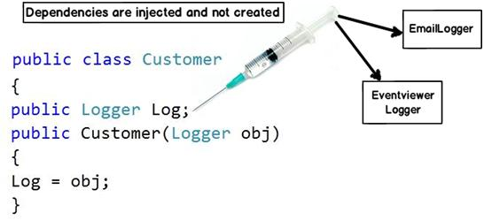
Dependency Injection
.

Slide 10
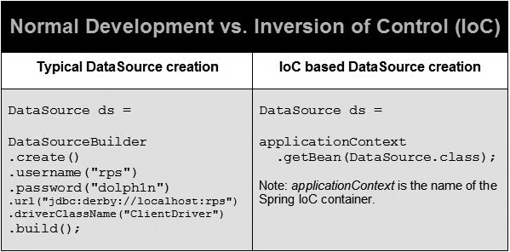
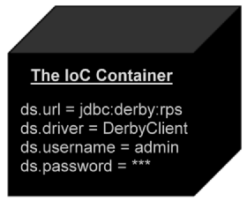
Inversion Of Control
.

Slide 11
Spring Framework Architecture
Spring Core:
The Core module provides all the primary component of the spring framework. It includes IoC (Inversion of Control) and Dependency Injection features.
Spring Bean:
This module offers BeanFactory, which is a sophisticated implementation of the factory pattern.
Spring Context:
The Context module builds on the solid base provided by the Core and Beans modules, and it is a medium which helps you to access any objects defined and configured.
Spring Expression Languages (SpEL):
This module offers expression language for modifying and querying object graph during the runtime.

Slide 12
Spring Framework Architecture
Data Access/Integration:
The Data Access and Integration layer consist of the JDBC, ORM, JDBC, OXM, JMS, and Transaction modules.
ORM: ORM module offers consistency/ portability to code irrespective of data access technologies. It will be based on object-oriented mapping concept.
The JDBC module consists of a JDBC-abstraction layer. It helps you elements the need to perform JDBC related coding.
OXM: Object XML Mappers (OCM) helps you to convert the objects into XML format and vice versa.
The Java Messaging Service module offers features like producing and consuming messages.
Transaction: This module offers declarative and programmatic management method for implementing unique interfaces and for all types of POJOs (Plain Old Java Object)

Slide 13
Spring Framework Architecture
Spring Web:
Web: This module uses servlet listeners and a web-oriented application context. It also offers a feature of web-oriented integration and functionality for multi-part file upload.
Web-servlet: This module stores MVC based implementation for web applications.
Web-Socket: Module offers WebSocket based and two-way communication between the client and the server in web apps.
Web-Portlet: This module is also called Spring-MVC-Portlet module. It offers for Spring-based Portlets and copies all the functionality of a Web-Servlet module.
AOP: AOP language is a useful tool which allows developers to add enterprise functionality to the application.
Instrumentation: This module offers class instrumentation and loader implementations. It is used for specific application servers.
Test: This module provides support for testing of Spring components with TestNG or JUnit tools. It offers consistent loading of Spring ApplicationContexts and caching of those contexts.

Slide 14
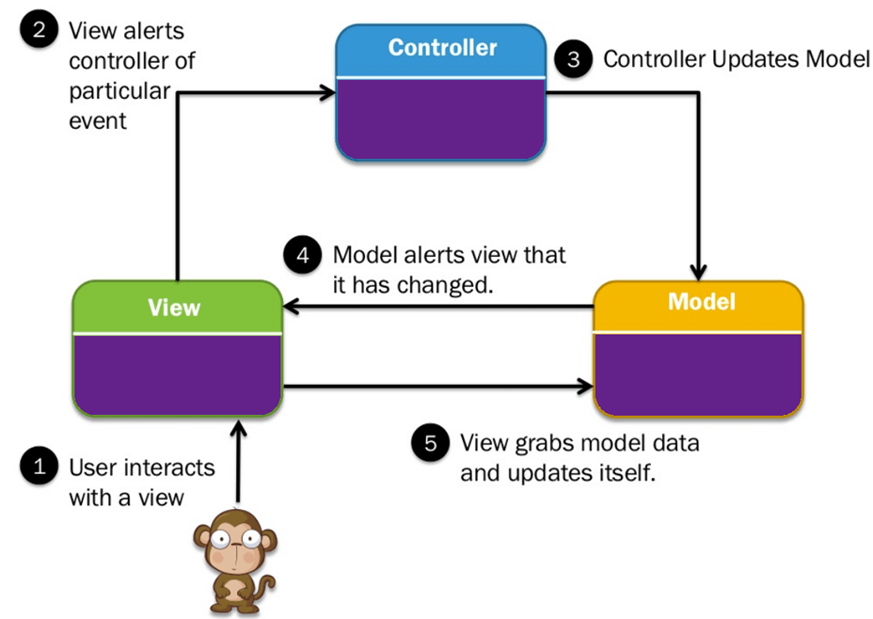
Spring - MVC Framework

Slide 15
Spring - MVC Framework
The Spring web MVC framework offers model-view-controller architecture offers components which helps you to be flexible and loosely coupled web applications.
The MVC pattern allows you to separate different aspects of the application while offering loose coupling between these elements. Spring MVC also helps you to build flexible and loosely coupled web applications.
The MVC design also allows you to separate business logic, presentation logic, and navigation logic. It also offers an elegant solution to use MVC in Spring Framework with the help of DispatcherServlet.

Slide 16
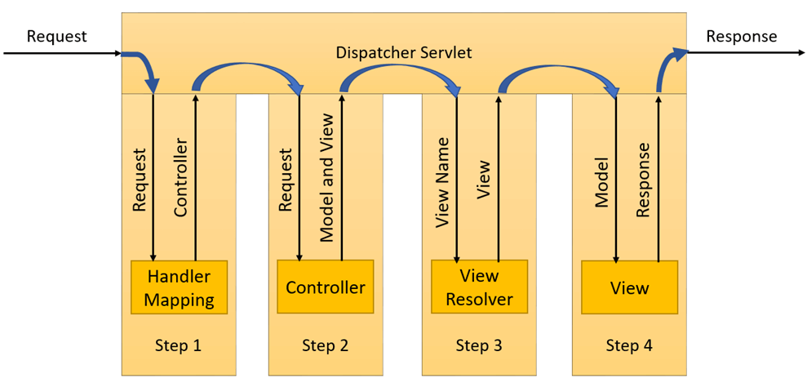
How MVC works in Spring?

Slide 17
How MVC works in Spring?
DispatcherServlet receives a request.
After that, the DispatcherServlet communicates with HandlerMapping. It also revokes controller associated with that specific request.
The Controller processes this request by calling the service methods, and a ModelAndView object returned by the DispatcherServlet.
The view name is sent to a ViewResolver to search the actual View to invoke.
After that, DispatcherServlet is passed to View to render the result.
By using the model data, the View renders and send back result back to the user.

