Slide 1
MongoDB
Raghu Prasad Konandur
9845547471
www.kaushalya.tech

Slide 2
Agenda
Introduction to NoSQL Database
Introduction to MongoDB
Schema Design
MongoDB Commands

Slide 3
Introduction to NoSQL database
NoSQL originally referring to non SQL or non relational is a database that provides a mechanism for storage and retrieval of data.
NoSQL databases are used in real-time web applications and big data and their use are increasing over time.
The data structures used by NoSQL databases are different from those used by default in relational databases which makes some operations faster in NoSQL
The suitability of a given NoSQL database depends on the problem it should solve. Data structures used by NoSQL databases are sometimes also viewed as more flexible than relational database tables.

Slide 4
Introduction to NoSQL database
When should NoSQL be used:
When a huge amount of data needs to be stored and retrieved.
The relationship between the data you store is not that important
The data changes over time and is not structured.
Support of Constraints and Joins is not required at the database level
The data is growing continuously and you need to scale the database regularly to handle the data.

Slide 5
Introduction to NoSQL database
Types of NoSQL database: Types of NoSQL databases and the name of the databases system that falls in that category are:
Graph Databases: Amazon Neptune, Neo4j
Key value store: Memcached, Redis, Coherence
Tabular: Hbase, Big Table, Accumulo
Document-based: MongoDB, CouchDB, Cloudant

Slide 6
Introduction to MongoDB
MongoDB is a source-available cross-platform document-oriented database program. Classified as a NoSQL database program, MongoDB uses JSON-like documents with optional schemas. MongoDB is developed by MongoDB Inc. and licensed under the Server Side Public License (SSPL) which is deemed non-free by several distributions.

Slide 7
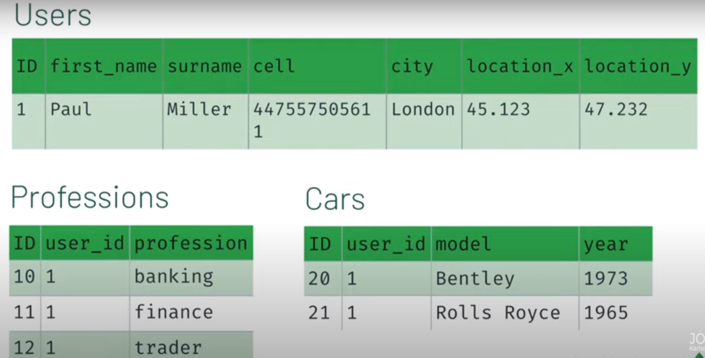
Schema Design – SQL Vs Document Database

Slide 8
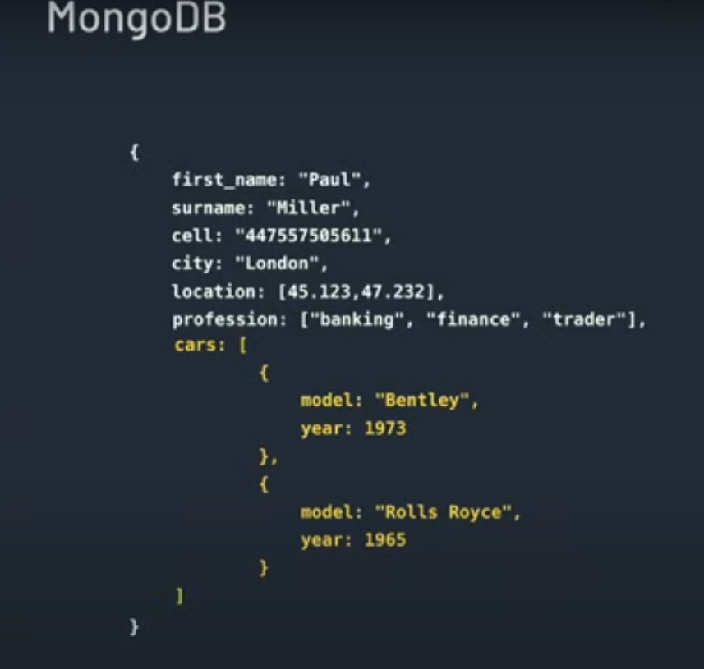
Schema Design – SQL Vs Document Database

Slide 9
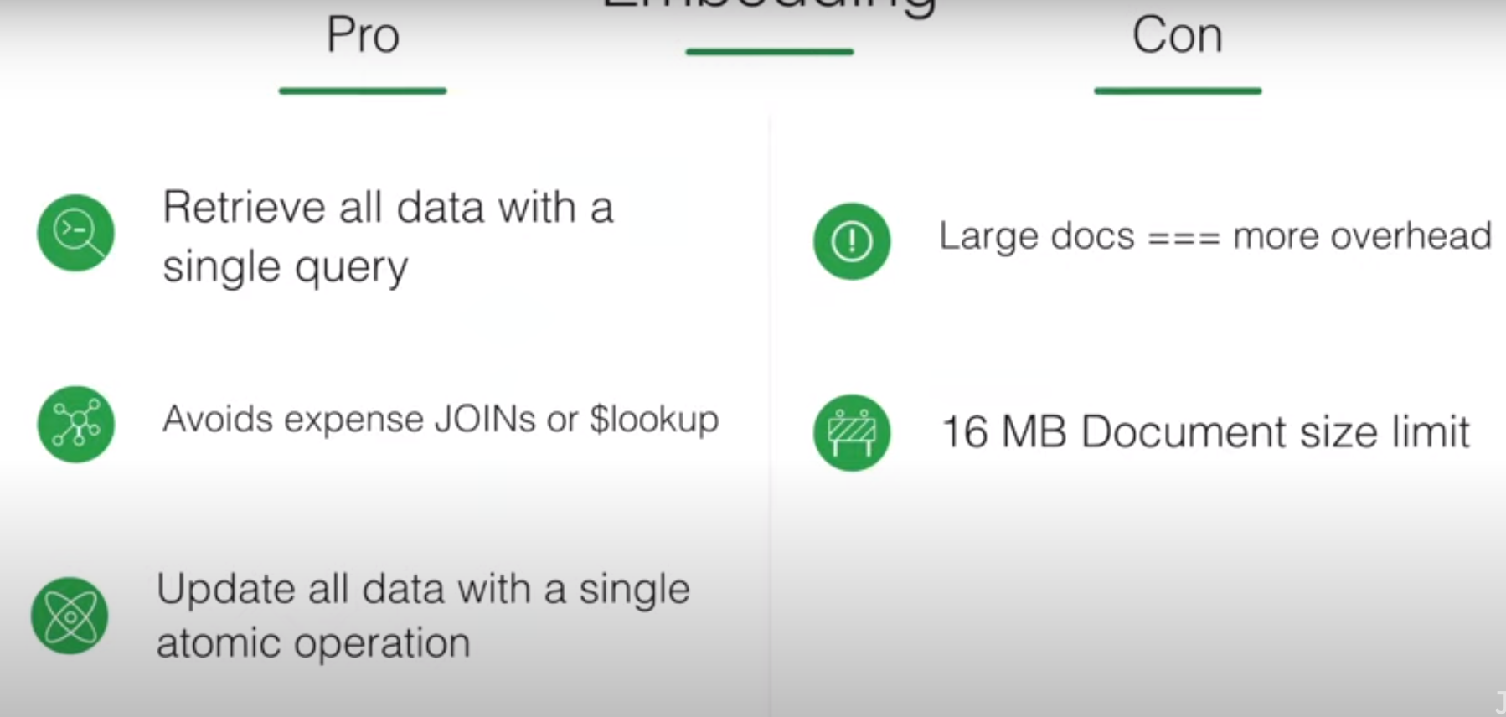
Schema Design – Embedding

Slide 10
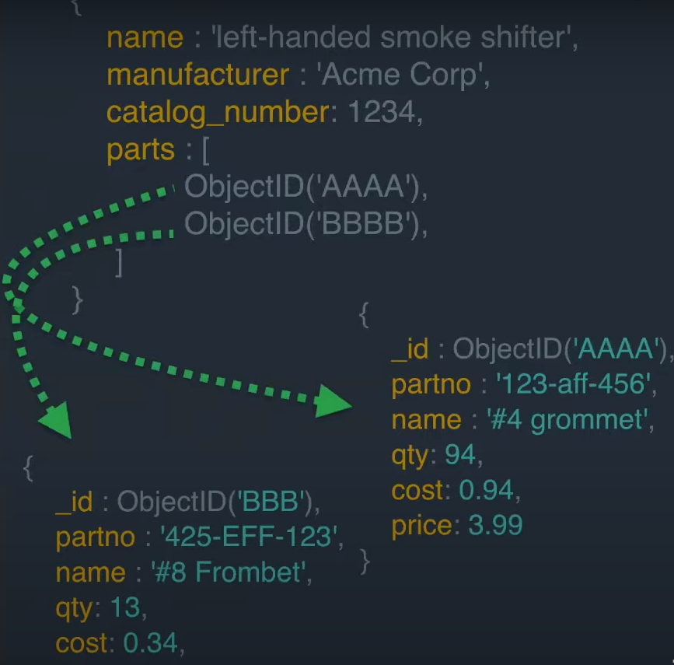
Schema Design – Referencing

Slide 11
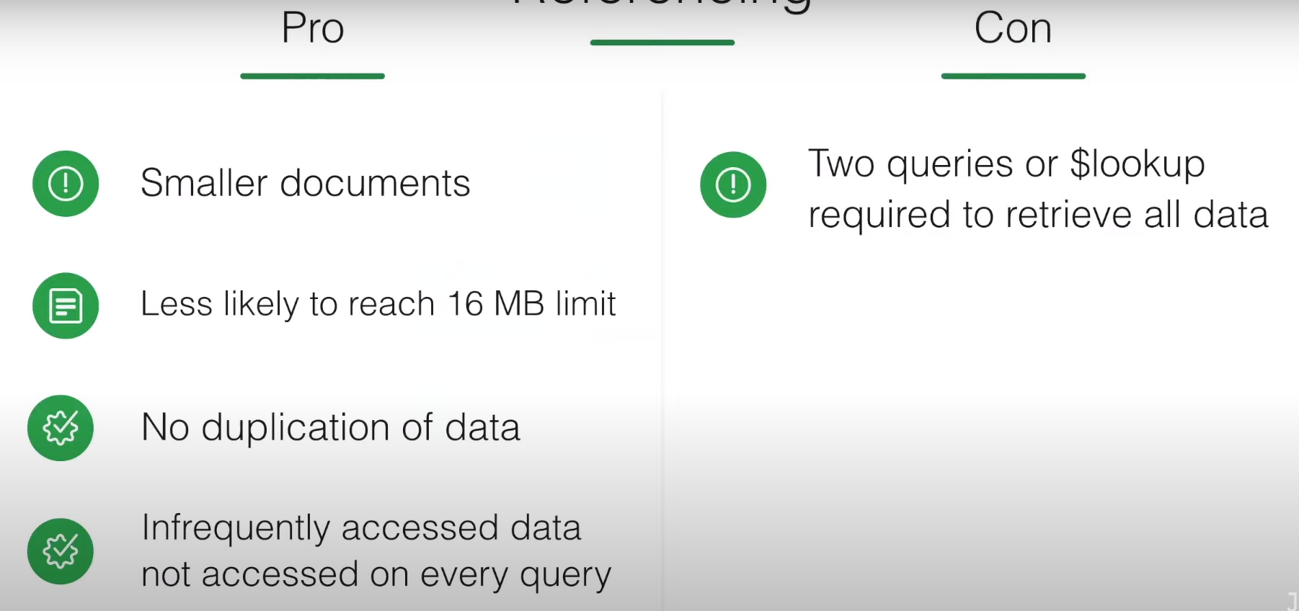
Schema Design – Referencing

Slide 12
Schema Design – Sample Schema
Mongo DB Commands

