Slide 1
SOLIDITY

Slide 2
What is Solidity?
Ethereum Solidity is a contract-oriented, high-level language with syntax like that of JavaScript.
A solidity is a tool used to generate a machine-level code to execute on EVM.
The solidity compiler takes the high-level code and breaks it down into simpler instructions.

Slide 3

Contracts in Ethereum Solidity
A contract is the fundamental building block of Ethereum’s decentralized Applications. All variables and functions are part of a contract and this is the starting point of all the projects.
An empty contract named MyFirst would look like this:
1 2 3 | version pragma ^0.4.19; contract MyFirst{ }

Slide 4
Layout of Solidity File
Source files can contain an arbitrary number of contract definitions, include directives and pragma directives.
Version Pragma
Version Pragma is the declaration of the version of the Solidity compiler that the particular code should use.
1. version pragma ^0.4.00;
Note: The source file shown above will not compile with a compiler earlier than version 0.4.0 and it will also not work on a compiler starting from version 0.5.0.

Slide 5
Importing other Source Files
Ethereum Solidity supports import statements that are very similar to those available in JavaScript, although Solidity does not know the concept of a “default export”.
At a global level you can use import statements of the following form:
1 | import "filename";
The above statement imports all global symbols from “filename” into the current global scope.
1 | import * as symbolName from "filename";
…creates a new global symbol symbolName whose members are all the global symbols from “filename”

Slide 6
Comments
Just like any other language, single line and multi-line comments are possible in Solidity.
1 2 3 4 5 | // This is a single-line comment. /* This is a multi-line comment */
Now, before we move further in our Solidity tutorial, you should know that Ethereum has three areas where it can store items.
Storage: where all the contract state variables reside. Every contract has its own storage and it is persistent between function calls
Memory: hold temporary values and gets erased between (external) function calls and is cheaper to use
Stack: hold small local variables and is almost free to use, but can only hold a limited amount of values
For almost all the types, you cannot specify where they should be stored, because they are copied
every time they are used.
Alright, now that you are aware of the storage locations in Ethereum Solidity, let me tell you about the
general value types.

Slide 7
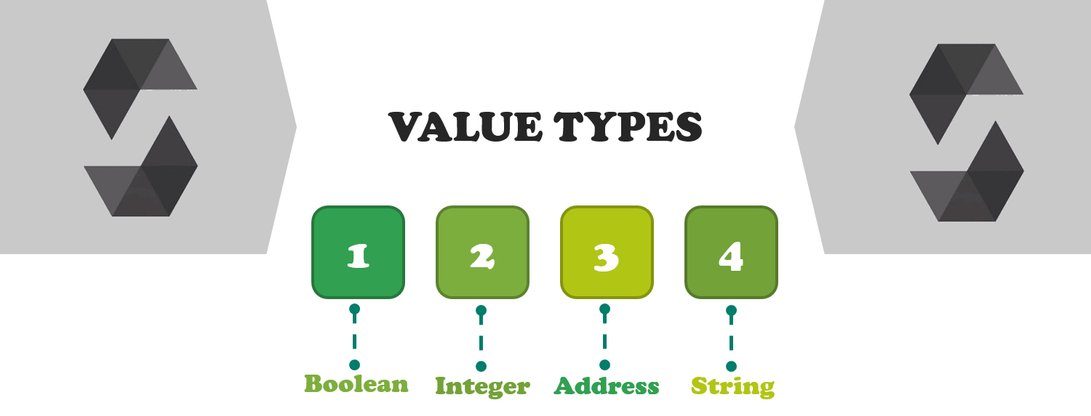
Value Types in Solidity
The following types are also called value types because variables of these types will always be passed by value.
Boolean
Keyword: Bool
The possible values are constants i.e., true or false

Slide 8
Integers
Keyword: int/uint (uint8 to uint256 in steps of 8 (unsigned of 8 up to 256 bits) and int8 to int256)
Signed and unsigned integers of various sizes.
Example:
1 2 3 | contract MySample{ uint UnsignedInt =50; }
In the above statement, we have created a uint called InsignedInt & set it to 50.
uint is a keyword that is used to declare a variable which can store an integral type of value (unsigned integer) from the range of 0 to 4,294,967,295. It keyword is an alias of System. ... uint keyword occupies 4 bytes (32 bits) space in the memory.

Slide 9
Address:
Keyword: address
Holds a 20-byte value (size of an Ethereum address). Address types also have members and serve as a base for all contracts.
Members of Addresses: Balance & Transfer
It is possible to query the balance of an address using the property balance and to send Ether to an address using the transfer function.
1 2 3 4 | address x = 0x123; address myAddress = this; if (x.balance < 10 && myAddress.balance > = 10) x.transfer(10);
Strings:
Keyword: String literals are written with either double or single-quotes “foo” or ‘bar’. Used for arbitrary-length UTF-data.
1 | string language = "Solidity";
These value types can interact with each other in expressions containing operators. Next, in our Solidity tutorial, let me tell you about the various operators.

Slide 10
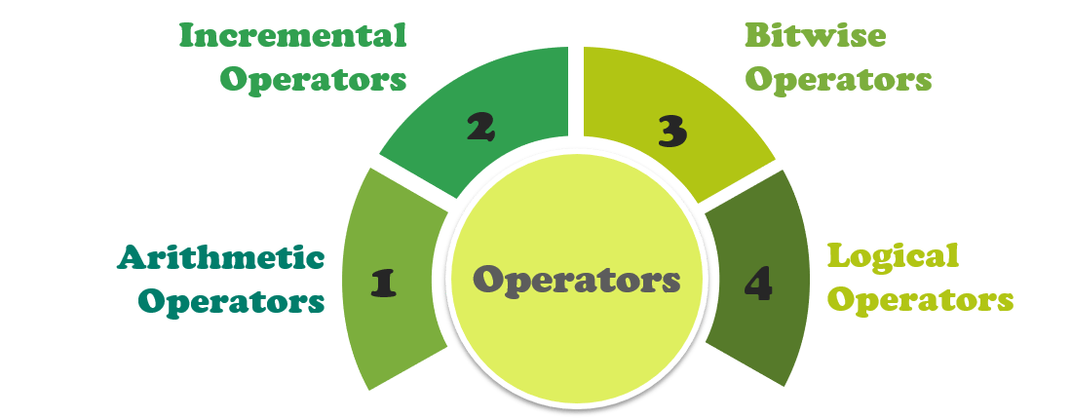
Operators
Operators in solidity are same as in JavaScript. Solidity has four types of operators:

Slide 11
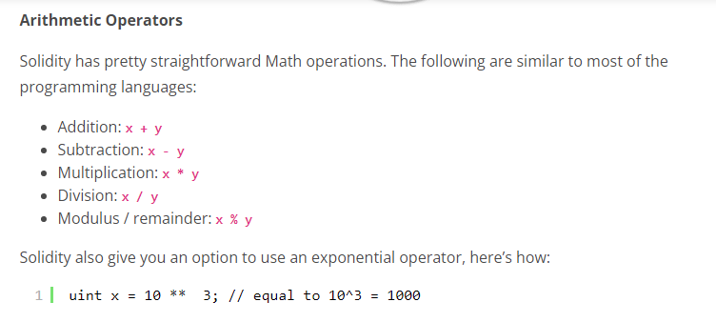

Slide 12
Incremental Operators
Incremental operators in solidity: a++, a–, ++a, –a, a+=1, a=a+1
Rules applicable to other programming languages are similar in solidity also.
Bitwise Operators:
Following are the operators: (Bitwise OR) ‘|’, (Bitwise XOR), (Bitwise negation) ‘~’ , (Bitwise right shift) ‘>>’, (Bitwise left shift) ‘<<‘
Logical Operators:
Logical operators in Solidity: ! (logical negation), && (logical and), || (logical or), ==(equality), != (not equal)
1 2 3 4 5 6 7 8 9 10 11 12 13 14 15 | contract operators { // Arithmetic Operators // +,-,*,/, %, ** // Incremental Operators // a++, a--, a+=1, a=a+1,++a,--a; a=10; a= a++; //here, output will be 10, because the value is first returned and then then increment is done a=++a; //Logical Operators !, &&, ||, ==, != isOwner = true && false; var orValue= 0x02 | 0x01; // output would be 0x03 //Bitwise Operators~,>>, <<; function Operators() { // Initialize state variables here}}

Slide 13
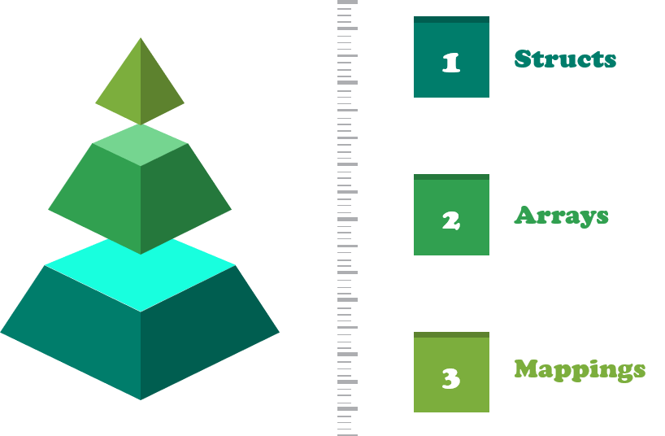
Now Sometimes there is a need for a more complex data type. For this Solidity provides structs.
Data Structures in Solidity
Solidity provides three types of data structures:

Slide 14

Structs
Solidity provides a way to define new types in the form of structs. Structs are custom defined types that can group several variables.
1 2 3 4 5 6 7 8 9 | pragma solidity ^0.4.0; contract Ballot { struct Voter { // Struct uint weight1, weight2, weight3; bool voted; address delegate1, delegate2, delegate3, delegate4; string name; uint vote1, vote2, vote3, vote4, vote5; uint height1, height2, height3 } }
Note: Structs can only have 16 members, exceeding which the following error might occur: Stack too Deep.
Structs allow you to create more complicated data types that have multiple properties.
Now, what if you need a collection of something, say addresses. Well, just like most of the languages, Solidity also has Arrays.

Slide 15
Arrays
Arrays in Solidity can have a compile-time fixed size or they can be dynamic.
1 | uint[3] fixed; //array of fixed length 3
1 | uint[] dynamic; //a dynamic array has no fixed size, it can keep growing
You can also create an array of structs. Using the previously created Voter struct:
1 | Voter[] voting;
Note: declaring an array as public will automatically create a better method for it
1 | Voter[] public voting;

Slide 16
Mappings
Mappings can be seen as hash tables which are virtually initialized such that every possible key exists and is mapped to a value whose byte-representation is all zeros: a type’s default value.
Mappings are declared as:
1 | Mapping(_Keytype => _ValueType )
Note: _Keytype can be almost any type except for a dynamically sized array, a contract, an enum and a struct.
Example:
1 2 3 4 5 6 7 8 9 10 | contract MappingExample { mapping(address => uint) public balances; function update(uint newBalance) { balances[msg.sender] = newBalance; }} contract MappingUser { function f() returns (uint) { MappingExample m = new MappingExample(); m.update(100); return m.balances(this); }}

Slide 17
Control Structures
Most of the control structures in JavaScript are available in Solidity except for switch and goto.
So there is: if, else, while, do, for, break, continue, return, ? :, with the usual semantics known from C or JavaScript.
Note: There is no type conversion from non-boolean to boolean types as there is in C and JavaScript.
Now let’s see how these Control structures are used in Solidity.
1 2 3 4 5 6 7 8 9 10 11 12 13 14 15 16 17 18 19 20 21 22 23 24 | contract ControlStructure { address public a; function ControlStructure>){ // if-else can be used like this if(input1==2) a=1; else a=0; // while can be used like this while(input1>=0){ if(input1==5) continue; input1=input1-1; a++;} // for loop can be used like this for(uint i=0;i<=50;i++) { a++; if(a==4) break; } //do while can be used like this do { a--; } (while a>0); // Conditional Operator can be used like this bool IsTrue = (a == 1)?true: false; /*will show an error because there is no type conversion from non-boolean to boolean */ if(1) { }

Slide 18
Moving on with our Solidity tutorial blog, let’s talk about the executable units of code within a Contract. These are called functions.
Functions
Here is how a function is declared in Solidity.
1 2 | function sampleFunc(string name, uint amount) { }
The above-declared is an empty body function which takes two parameters: a string and a uint.
You would call this function like:
1 | sampleFunc("Shashank", 10000);
Talking about functions, Solidity also provides function modifiers.
Function Modifiers
It is used to easily change the behavior of the functions. These conditions can be checked before even making the function calls because they have been declared in the function definitions in the smart contracts.

Slide 19
Example: If you want to call a kill contract function through only the owner or creator of the function.
1 2 3 4 5 6 7 8 9 10 11 | contract FunctionModifiers{ address public creator; function FunctionModifiers() { creator = msg.sender;} Modifier onlyCreator() { if(msg.sender!=creator){ throw; } _; //resumes the function wherever the access modifier is used } function killContract() onlyCreator{ //function will not execute if an exception occurs self-destruct(creator); }}

Slide 20
Inheritance
Solidity supports multiple Inheritance by copying code including polymorphism.
1 2 3 4 5 6 7 8 9 10 11 12 13 14 | contract Owned { address Owner ; function owned() { owner = msg.sender; }} contract Mortal is Owned { // 'is' keyword is used for inheritance function kill(){ self-destruct(owner); }} contract User is Owned, Mortal //Multiple inheritance { string public UserName; function User(string _name){ UserName = _name; }}
Alright, I feel the above-discussed concepts are sufficient enough for you to kick-start with Solidity programming.

Slide 21
Scope of local variables is limited to function in which they are defined but State variables can have three types of scopes.
Public − Public state variables can be accessed internally as well as via messages. For a public state variable, an automatic getter function is generated.
Internal − Internal state variables can be accessed only internally from the current contract or contract deriving from it without using this.
Private − Private state variables can be accessed only internally from the current contract they are defined not in the derived contract from it.

Slide 22
pragma solidity ^0.5.0;
contract C {
uint public data = 30;
uint internal iData= 10;
uint storedData;
function x() public returns (uint) {
data = 3; // internal access
return data;
}
}
contract Caller {
C c = new C();
function f() public view returns (uint) {
return c.data(); //external access
}
}
contract D is C {
function y() public returns (uint) {
iData = 3; // internal access
return iData;
}
function getResult() public view returns(uint){
uint a = 1; // local variable
uint b = 2;
uint result = a + b;
return storedData; //access the state variable
}
}

Slide 23
Operators
What is an Operator?
Let us take a simple expression 4 + 5 is equal to 9. Here 4 and 5 are called operands and '+' is called the operator. Solidity supports the following types of operators.
Arithmetic Operators
Comparison Operators
Logical (or Relational) Operators
Assignment Operators
Conditional (or ternary) Operators

Slide 24
Arithmetic Operators
Solidity supports the following arithmetic operators −
Assume variable A holds 10 and variable B holds 20, then −
1
+ (Addition)
Adds two operands
Ex: A + B will give 30
2
- (Subtraction)
Subtracts the second operand from the first
Ex: A - B will give -10
3
* (Multiplication)
Multiply both operands
Ex: A * B will give 200

Slide 25
4
/ (Division)
Divide the numerator by the denominator
Ex: B / A will give 2
5
% (Modulus)
Outputs the remainder of an integer division
Ex: B % A will give 0
6
++ (Increment)
Increases an integer value by one
Ex: A++ will give 11
7
-- (Decrement)
Decreases an integer value by one
Ex: A-- will give 9

Slide 26
pragma solidity ^0.5.0;
contract SolidityTest {
constructor() public{
}
function getResult() public view returns(uint){
uint a = 1;
uint b = 2;
uint result = a + b; //arithmetic operation
return result;
}
}

Slide 27
Comparison Operators
Solidity supports the following comparison operators −
Assume variable A holds 10 and variable B holds 20, then −
1
= = (Equal)
Checks if the value of two operands are equal or not, if yes, then the condition becomes true.
Ex: (A == B) is not true.
2
!= (Not Equal)
Checks if the value of two operands are equal or not, if the values are not equal, then the condition becomes true.
Ex: (A != B) is true.

Slide 28
3
> (Greater than)
Checks if the value of the left operand is greater than the value of the right operand, if yes, then the condition becomes true.
Ex: (A > B) is not true.
4
< (Less than)
Checks if the value of the left operand is less than the value of the right operand, if yes, then the condition becomes true.
Ex: (A < B) is true.
6
<= (Less than or Equal to)
Checks if the value of the left operand is less than or equal to the value of the right operand, if yes, then the condition becomes true.
Ex: (A <= B) is true
5
>= (Greater than or Equal to)
Checks if the value of the left operand is greater than or equal to the value of the right operand, if yes, then the condition becomes true.
Ex: (A >= B) is not true

Slide 29
pragma solidity ^0.5.0;
contract SolidityTest {
uint storedData;
constructor() public{
storedData = 10;
}
function getResult() public view returns(string memory){
uint a = 1; // local variable
uint b = 2;
uint result = a + b;
return integerToString(result);
}
function integerToString(uint _i) internal pure
returns (string memory _uintAsString) {

Slide 30
if (_i == 0) { //comparison operator
return "0";
}
uint j = _i;
uint len;
while (j != 0) { //comparison operator
len++;
j /= 10;
}
bytes memory bstr = new bytes(len);
uint k = len - 1;
while (_i != 0) {
bstr[k--] = byte(uint8(48 + _i % 10));
_i /= 10;
}
return string(bstr);//access local variable
}
}

Slide 31
Loops
While writing a contract, you may encounter a situation where you need to perform an action over and over again.
In such situations, you would need to write loop statements to reduce the number of lines.
Solidity supports all the necessary loops to ease down the pressure of programming.

Slide 32
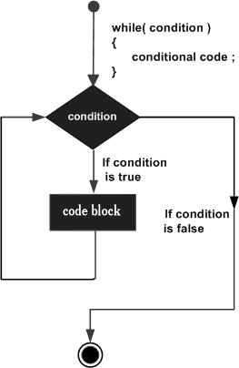
1
While Loop
The most basic loop in Solidity is the while loop which would be discussed in this chapter.
Flow Chart:
The flow chart of while loop looks as follows

Slide 33
Syntax
The syntax of while loop in Solidity is as follows −
while (expression) {
Statement(s) to be executed if expression is true
}
pragma solidity =0.5.0 <= 0.9.0;
contract array
{
uint[3] public arr;
uint public count;
function loop() public{
while(count<arr.length)
{
arr[count] = count;
count++;
}
}
}

Slide 35
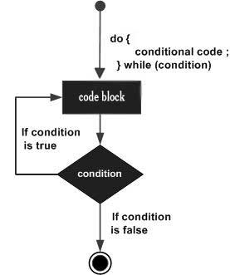
2
do...while Loop
The do...while loop is similar to the while loop except that the condition check happens at the end of the loop.
Syntax
The syntax for do-while loop in Solidity is as follows −
do {
Statement(s) to be executed;
} while (expression);

Slide 36
// Solidity program to
// demonstrate the use of
// 'Do-While loop'
pragma solidity ^0.5.0;
// Creating a contract
contract Types {
// Declaring a dynamic array
uint[] data;
// Declaring state variable
uint8 j = 0;
// Defining function to demonstrate
// 'Do-While loop'
function loop(
) public returns(uint[] memory){
do{
j++;
data.push(j);
}while(j < 5) ;
return data;
}
}

Slide 37
For Loop
The for loop is the most compact form of looping. It includes the following three important parts.
The loop initialization where we initialize our counter to a starting value. The initialization statement is executed before the loop begins.
The test statement which will test if a given condition is true or not. If the condition is true, then the code given inside the loop will be executed, otherwise the control will come out of the loop.
The iteration statement where you can increase or decrease your counter.

Slide 38
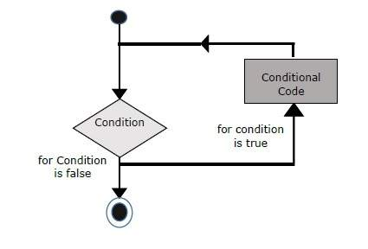
Syntax
The syntax of for loop is Solidity is as follows −
for (initialization; test condition; iteration statement) {
Statement(s) to be executed if test condition is true
}

Slide 39
// Solidity program to
// demonstrate the use
// of 'For loop'
pragma solidity ^0.5.0;
// Creating a contract
contract Types {
// Declaring a dynamic array
uint[] data;
// Defining a function
// to demonstrate 'For loop'
function loop(
) public returns(uint[] memory){
for(uint i=0; i<5; i++){
data.push(i);
}
return data;
}
}

Slide 40
1 if statement
The if statement is the fundamental control statement that allows Solidity to make decisions and execute statements conditionally.
// Solidity program to
// demonstrate the
// use of 'if statement'
pragma solidity ^0.5.0;
// Creating a contract
contract Types {
// Declaring state variable
uint i = 10;
// Defining function to
// demonstrate use of
// 'if statement'
function decision_making(
) public returns(bool){
if(i<10){
return true;
}
}
}

Slide 41
2 if...else statement
The 'if...else' statement is the next form of control statement that allows Solidity to execute statements in a more controlled way.
Defining function to
// demonstrate the use of
// 'if...else statement'
function decision_making(
) public payable returns(bool){
if(i%2 == 0){
even = true;
}
else{
even = false;
}
return even;
}
}
// Solidity program to
// demonstrate the use of
// 'if...else' statement
pragma solidity ^0.5.0;
// Creating a contract
contract Types {
// Declaring state variables
uint i = 10;
bool even;
//

Slide 42
if...else if... statement.
The if...else if... statement is an advanced form of if...else that allows Solidity to make a correct decision out of several conditions.
pragma solidity ^0.5.0;
// Creating a contract
contract Types {
// Declaring state variables
uint i = 10;
string result;
// Defining function to
// demonstrate the use
// of 'if...else if...else
// statement'
function decision_making(
) public returns(string memory){
if(i<10){
result = "less than 10";
}
else if(i == 10){
result = "equal to 10";
}
else{
result = "greater than 10";
}
return result;
}
}

Slide 43
Structs
Solidity enables users to create their own type in the form of Structure. The structure is the group of different types although it is not possible to contain a member of its own type. Structure is a reference type variable and can contain both - value types and reference types.
Declaration
struct <name of structure> {
<type> variable1;
<type> variable2;

Slide 44
pragma solidity ^0.5.0;
contract Types {
struct User {
string name;
uint age;
bool isValid;
}
User _user = User("John", 40, true);
function getUserInfo()
public view
returns (string memory, uint,bool) {
return(_user.name, _user.age, _user.isValid);
}
}

Slide 45
Mapping Types
Mapping types are the most used reference type; they are used to store data in a key-value pair; where the key can be any built-in value types or byte and string. You can think of it as a hash table or dictionary as in any other language, in which a user can store data in a key-value format and data can be retrieved by key.
mapping(_KeyType => _ValueType) <access specifier> <name>;
Example
mapping (address => uint) account;
pragma solidity ^0.5.0;
contract MappingExample {
mapping(address => uint) account;
function updateBalance(uint newBalance) public {
account[msg.sender] = newBalance;
}
function getBalance(address _address)
public view returns (uint) {
return account[_address];
}
}

Slide 46
A function is a group of reusable code which can be called anywhere in your program.
This eliminates the need of writing the same code again and again. It helps programmers in writing modular codes.
Functions allow a programmer to divide a big program into a number of small and manageable functions.
Like any other advanced programming language, Solidity also supports all the features necessary to write modular code using functions.
This section explains how to write your own functions in Solidity.

Slide 47
Function Definition
Before we use a function, we need to define it.
The most common way to define a function in Solidity is by using the function keyword, followed by a unique function name, a list of parameters (that might be empty), and a statement block surrounded by curly braces.

Slide 48
Syntax
The basic syntax is shown here.
function function-name(parameter-list) scope returns() {
//statements
}

Slide 49
Introduction
A programming language has an important aspect of taking decisions in code.
Solidity delivers the if…else and switches statements to execute different instructions based on circumstances.
This is too significant to loop through multiple items.
Solidity provides different constructs such as for loops and while statements.

Slide 50
Solidity expressions
A statement, comprising multiple operands and optionally zero or more operators is referred to as an expression.
That gives results in a single value, object, or function.
The operand may be a variable, literal, function invocation, or another expression itself.

