Slide 1

Python Blockchain
Raghu Prasad Konandur
CEO
www.kaushalya.tech
9845547471
raghuprasadkonandur@kaushalya.tech

Slide 2
Topics
Introduction to Ethereum
DAPPS
Smart Contract
Solidity

Slide 3
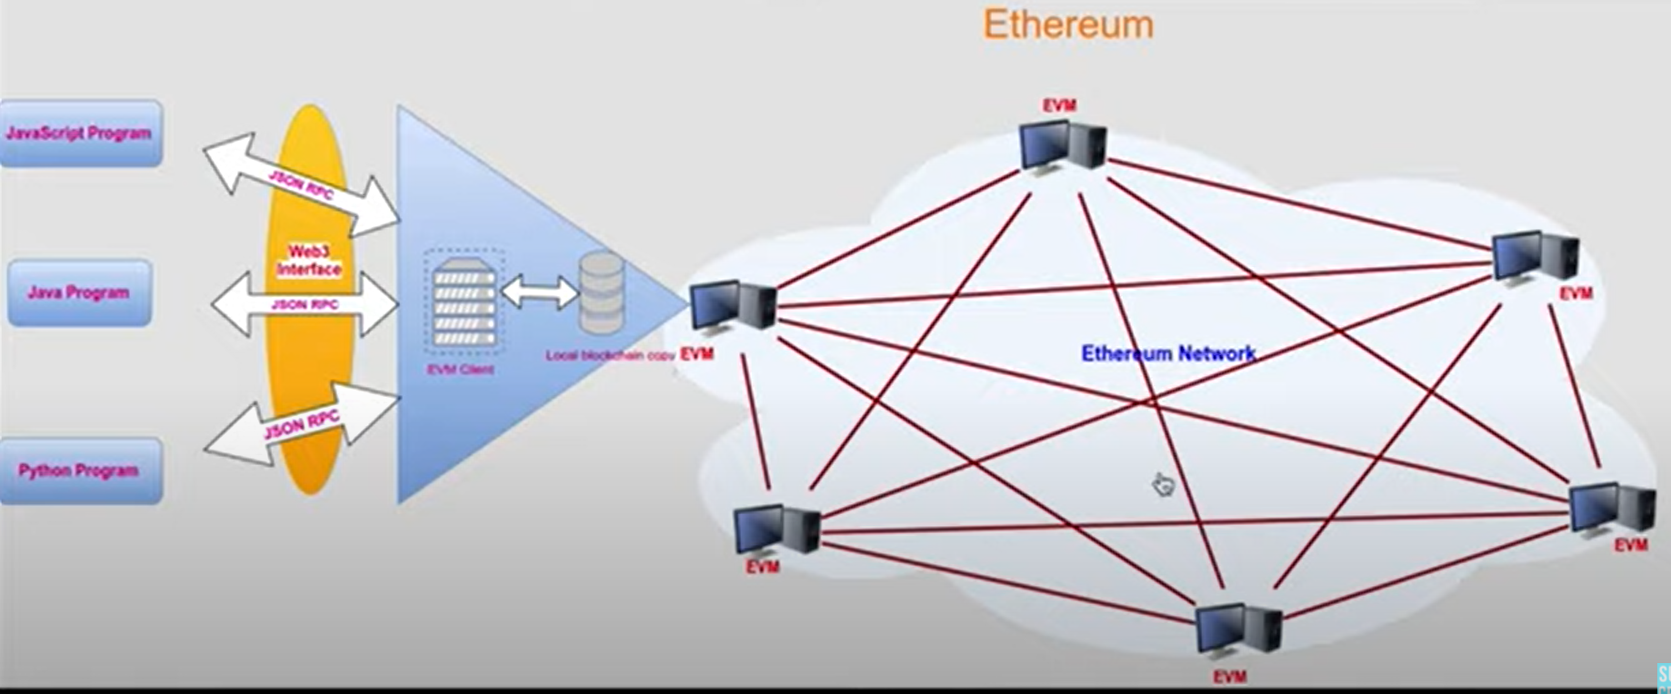
Architecture

Slide 4
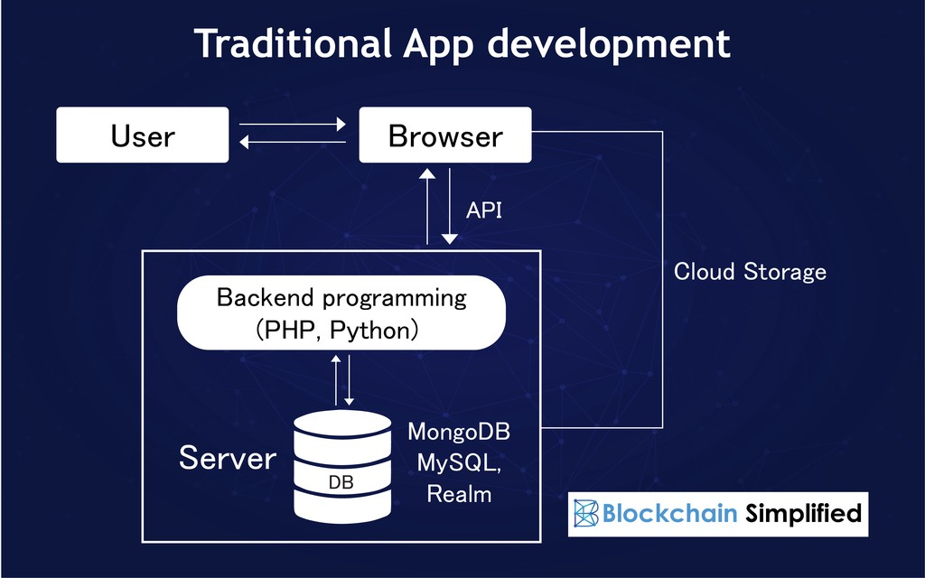
Traditional App Development

Slide 5
Decentralized Applications (DAPPS)
A decentralized application (dapp) is an application built on a decentralized network that combines a smart contract and a frontend user interface.
On Ethereum, smart contracts are accessible and transparent – like open APIs – so your dapp can even include a smart contract that someone else has written.
A dapp has its backend code running on a decentralized peer-to-peer network. Contrast this with an app where the backend code is running on centralized servers.

Slide 6
Decentralized Applications (DAPPS)
A dapp can have frontend code and user interfaces written in any language (just like an app) to make calls to its backend. Furthermore, its frontend can get hosted on decentralized storage such as IPFS.
Decentralized - dapps operate on Ethereum, an open public decentralized platform where no one person or group has control
Deterministic - dapps perform the same function irrespective of the environment in which they get executed
Turing complete - dapps can perform any action given the required resources
Isolated - dapps are executed in a virtual environment known as Ethereum Virtual Machine so that if the smart contract has a bug, it won’t hamper the normal functioning of the blockchain network

Slide 7
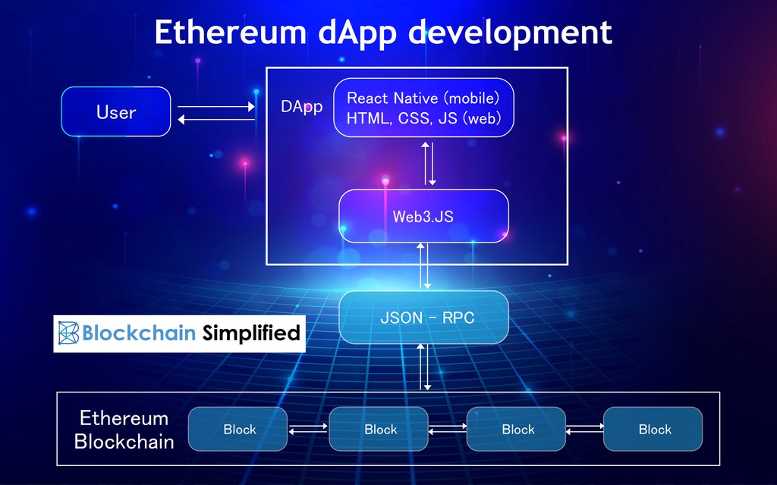
Decentralized Applications (DAPPS)

Slide 8
Decentralized Applications (DAPPS)
BENEFITS OF DAPP DEVELOPMENT
Zero downtime – Once the smart contract is deployed and on the blockchain, the network as a whole will always be able to serve clients looking to interact with the contract. Malicious actors, therefore, cannot launch denial-of-service attacks targeted towards individual dapps.
Privacy – You don’t need to provide real-world identity to deploy or interact with a dapp.
Resistance to censorship – No single entity on the network can block users from submitting transactions, deploying dapps, or reading data from the blockchain.
Complete data integrity – Data stored on the blockchain is immutable and indisputable, thanks to cryptographic primitives. Malicious actors cannot forge transactions or other data that has already been made public.
Trustless computation/verifiable behavior – smart contracts can be analyzed and are guaranteed to execute in predictable ways, without the need to trust a central authority. This is not true in traditional models; for example, when we use online banking systems, we must trust that financial institutions will not misuse our financial data, tamper with records, or get hacked.

Slide 9
Decentralized Applications (DAPPS)
DRAWBACKS OF DAPP DEVELOPMENT
Maintenance – Dapps can be harder to maintain because the code and data published to the blockchain are harder to modify. It’s hard for developers to make updates to their dapps (or the underlying data stored by a dapp) once they are deployed - even if bugs or security risks are identified in an old version.
Performance overhead – There is a huge performance overhead, and scaling is really hard. To achieve the level of security, integrity, transparency, and reliability that Ethereum aspires to, every node runs and stores every transaction. On top of this, proof-of-work takes time as well. A back-of-the-envelope calculation puts the overhead at something like 1,000,000x that of standard computation currently.
Network congestion – When one dapp uses too many computational resources, the entire network gets backed up. Currently, the network can only process about 10-15 transactions per second; if transactions are being sent in faster than this, the pool of unconfirmed transactions can quickly balloon.
User experience – It may be harder to engineer user-friendly experiences because the average end-user might find it too difficult to set up a tool stack necessary to interact with the blockchain in a truly secure fashion.
Centralization – User-friendly and developer-friendly solutions built on top of the base layer of Ethereum might end up looking like centralized services anyways. For example, such services may store keys or other sensitive information server-side, serve a frontend using a centralized server, or run important business logic on a centralized server before writing to the blockchain. Centralization eliminates many (if not all) of the advantages of blockchain over the traditional model.

Slide 10
Smart Contract
A "smart contract" is simply a program that runs on the Ethereum blockchain. It's a collection of code (its functions) and data (its state) that resides at a specific address on the Ethereum blockchain.
Smart contracts are a type of Ethereum account. This means they have a balance and they can send transactions over the network. However they're not controlled by a user, instead they are deployed to the network and run as programmed. User accounts can then interact with a smart contract by submitting transactions that execute a function defined on the smart contract. Smart contracts can define rules, like a regular contract, and automatically enforce them via the code. Smart contracts cannot be deleted by default, and interactions with them are irreversible.

Slide 11
Solidity
Object-oriented, high-level language for implementing smart contracts.
Curly-bracket language that has been most profoundly influenced by C++.
Statically typed (the type of a variable is known at compile time).
Supports:
Inheritance (you can extend other contracts).
Libraries (you can create reusable code that you can call from different contracts – like static functions in a static class in other object oriented programming languages).
Complex user-defined types.
Practical's
Sample programs
https://remix.ethereum.org/
https://www.tutorialspoint.com/solidity/solidity_quick_guide.htm

Slide 12
Thank You
Raghu Prasad Konandur
9845547471
www.kaushalya.tech
raghuprasadkonandur@kaushalya.tech

