Slide 1
Business Analytics With Python
Raghu Prasad Konandur
CEO
www.Kaushalya.tech
9845547471

Slide 2
Introduction
Raghu Prasad – BE, MS
Total of 29 years of experience
7 years as a lecturer in an Engineering College
22 Years into IT
Worked with companies like CISCO,CSC,ICICI,First Apex – NTT Data
Currently into Corporate training and consultancy
Worked with corporates and public sector
Service Offerings – In person/On-line/Corporate/Academic Institutes
Consultancy – Consultant to vendor of Atal Tinkering Lab/ECIL-ECIT, Incarnus – Healthcare Service Provider
Technologies – Java,Python,Web technologies,Java Script technologies (MEAN stack),IOT,Test Automation,Machine Learning,Artificial Intelligence,ERP,.NET
Customers – Philips,L & T,NextGen,Incarnus,Aspire system,BGS-IT,Sindhi College,Malnad Enginering College,S B College of Management, REVA University,Nagarjuna Engineering College,Dayanand Sagar University,Acharya Institute of Technology,NIE Mysore,NIT-Imphal,etc

Slide 3
Topics
Introduction to Data science
Python for Data Sciences and project lifecycle
Exploratory Data Analytics
Numpy
Pandas
Matlablib

Slide 4
Data Science
Data science is a multi-disciplinary field that uses scientific methods, processes, algorithms and systems to extract knowledge and insights from structured and unstructured data.^{[1][2]} Data science is the same concept as data mining and big data: "use the most powerful hardware, the most powerful programming systems, and the most efficient algorithms to solve problems"

Slide 5
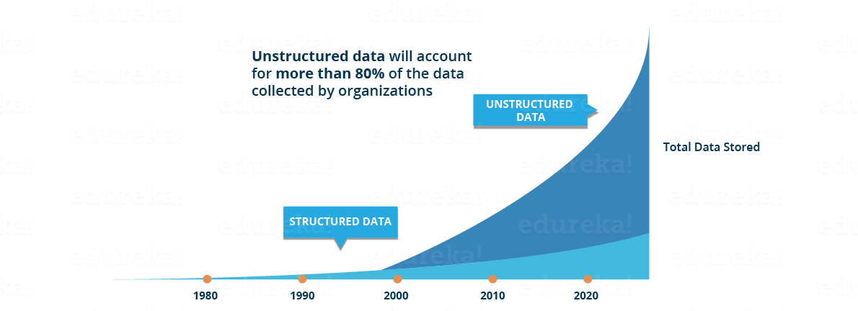
Data Science
Need for data science
https://jeremyronk.wordpress.com/2014/09/01/structured-semi-structured-and-unstructured-data/

Slide 6
Data Science
Need for data science
This data is generated from different sources like financial logs, text files, multimedia forms, sensors, and instruments.
Source - https://www.edureka.co/blog/what-is-data-science/
Simple BI tools are not capable of processing this huge volume and variety of data.
This is why we need more complex and advanced analytical tools and algorithms for processing, analyzing and drawing meaningful insights out of it.
https://www.geeksforgeeks.org/difference-between-structured-semi-structured-and-unstructured-data/
https://www.w3trainingschool.com/structured-semi-structured-unstructured-data

Slide 7
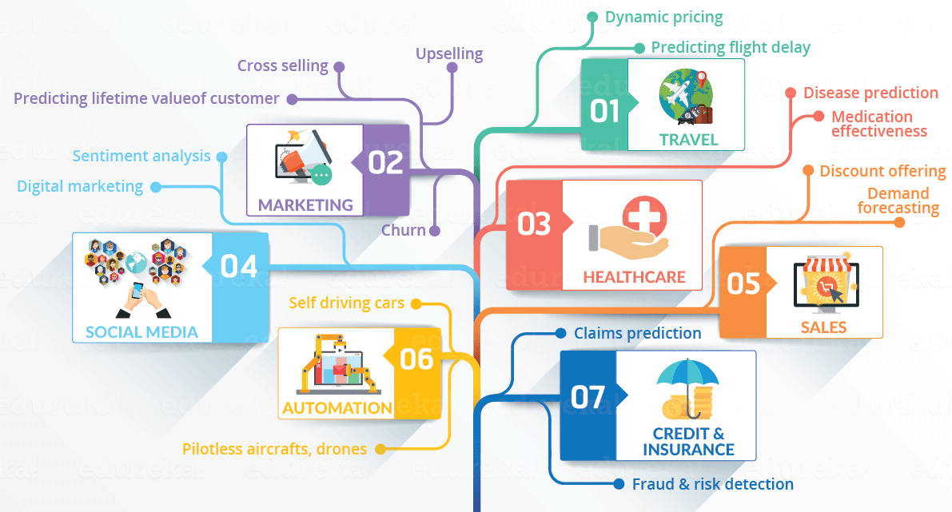
Data Science
Domains currently using data science

Slide 8
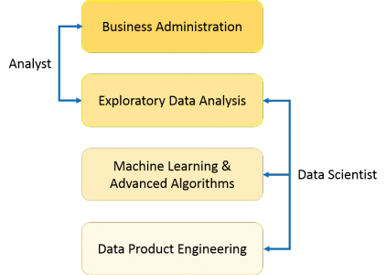
Data Science
What is data science
Data Science is a blend of various tools, algorithms, and machine learning principles with the goal to discover hidden patterns from the raw data, make sense of the data, predicting the future and take business decisions.

Slide 9
Data Science
Predictive causal analytics – If you want a model which can predict the possibilities of a particular event in the future, you need to apply predictive causal analytics.
Example: If you are providing money on credit, then the probability of customers making future credit payments on time is a matter of concern for you. Here, you can build a model which can perform predictive analytics on the payment history of the customer to predict if the future payments will be on time or not.
Prescriptive analytics: If you want a model which has the intelligence of taking its own decisions and the ability to modify it with dynamic parameters, you certainly need prescriptive analytics for it. This relatively new field is all about providing advice. In other terms, it not only predicts but suggests a range of prescribed actions and associated outcomes.
Example for this is Google’s self-driving car which I had discussed earlier too. The data gathered by vehicles can be used to train self-driving cars. You can run algorithms on this data to bring intelligence to it. This will enable your car to take decisions like when to turn, which path to take, when to slow down or speed up.

Slide 10
Exploratory Data Analysis
Exploratory Data Analysis (EDA) refers to the method of studying and exploring record sets to apprehend their predominant traits, discover patterns, locate outliers and identify relationships between variables.
EDA is normally carried out as a preliminary step before undertaking extra formal statistical analyses or modeling.

Slide 11
Data Analytics
As a term, data analytics predominantly refers to an assortment of applications, from basic business intelligence (BI), reporting and online analytical processing (OLAP) to various forms of advanced analytics.
In that sense, it's similar in nature to business analytics, another umbrella term for approaches to analyzing data. The difference is that the latter is oriented to business uses, while data analytics has a broader focus. The expansive view of the term isn't universal, though: In some cases, people use data analytics specifically to mean advanced analytics, treating BI as a separate category.

Slide 12
Data Analytics
Data analytics initiatives can help businesses increase revenue, improve operational efficiency, optimize marketing campaigns and bolster customer service efforts.
Analytics also enable organizations to respond quickly to emerging market trends and gain a competitive edge over business rivals.
The ultimate goal of data analytics, however, is boosting business performance. Depending on the particular application, the data that's analyzed can consist of either historical records or new information that has been processed for real-time analytics. In addition, it can come from a mix of internal systems and external data sources.

Slide 13
Types of Data Analytics applications
At a high level, data analytics methodologies include exploratory data analysis (EDA) and confirmatory data analysis (CDA)
EDA aims to find patterns and relationships in data, while CDA applies statistical techniques to determine whether hypotheses about a data set are true or false.
EDA is often compared to detective work, while CDA is akin to the work of a judge or jury during a court trial -- a distinction first drawn by statistician John W. Tukey in his 1977 book Exploratory Data Analysis.

Slide 14
Types of Data Analytics applications
Data analytics can also be separated into quantitative data analysis and qualitative data analysis.
The former involves the analysis of numerical data with quantifiable variables. These variables can be compared or measured statistically.
The qualitative approach is more interpretive -- it focuses on understanding the content of non-numerical data like text, images, audio and video, as well as common phrases, themes and points of view.

Slide 15
Types of Data Analytics applications
At the application level, BI and reporting provide business executives and corporate workers with actionable information about key performance indicators, business operations, customers and more.
In the past, data queries and reports typically were created for end users by BI developers who worked in IT
Now, more organizations use self-service BI tools that let executives, business analysts and operational workers run their own ad hoc queries and build reports themselves.

Slide 16
Types of Data Analytics applications
Advanced types of data analytics include data mining, which involves sorting through large data sets to identify trends, patterns and relationships
Another is predictive analytics, which seeks to predict customer behavior, equipment failures and other future business scenarios and events.
Machine learning can also be used for data analytics, by running automated algorithms to churn through data sets more quickly than data scientists can do via conventional analytical modeling.

Slide 17
Types of Data Analytics applications
Big data analytics applies data mining, predictive analytics and machine learning tools to data sets that can include a mix of structured, unstructured and semistructured data.
Text mining provides a means of analyzing documents, emails and other text-based content.

Slide 18
Data at rest vs Data in motion
Gaining insights from big data is no small task. Having the right technology in place to collect, manage and analyze data for predictive purposes or real-time insight is critical. Different types of data may require different computing platforms to provide meaningful insights. Understanding the difference between data in motion vs. data at rest can help determine the type of technology and processing capabilities required to glean insights from the data.
Data at rest This refers to data that has been collected from various sources and is then analyzed after the event occurs. The point where the data is analyzed and the point where action is taken on it occur at two separate times. For example, a retailer analyzes a previous month’s sales data and uses it to make strategic decisions about the present month’s business activities. The action takes place after the data-creating event has occurred. This data is meaningful to the retailer, and allows them to create marketing campaigns and send customized coupons based on customer purchasing behavior and other variables. While the data provides value, the business impact is dependent on the customer coming back in the store to take advantage of the offers.

Slide 19
Data at rest vs Data in motion
Data in motion The collection process for data in motion is similar to that of data at rest; however, the difference lies in the analytics. In this case, the analytics occur in real-time as the event happens. An example here would be a theme park that uses wristbands to collect data about their guests. These wristbands would constantly record data about the guest’s activities, and the park could use this information to personalize the guest visit with special surprises or suggested activities based on their behavior. This allows the business to customize the guest experience during the visit. Organizations have a tremendous opportunity to improve business results in these scenarios.

Slide 20
Exploratory Data Analytics
The Foremost Goals of EDA
1. Data Cleaning
2. Descriptive Statistics
3. Data Visualization
4. Feature Engineering
5. Correlation and Relationships
6. Data Segmentation
7. Hypothesis Generation
8. Data Quality Assessment
https://www.geeksforgeeks.org/what-is-exploratory-data-analysis/

Slide 21
Data Science
Machine learning for making predictions — If you have transactional data of a finance company and need to build a model to determine the future trend, then machine learning algorithms are the best bet.
This falls under the paradigm of supervised learning. It is called supervised because you already have the data based on which you can train your machines.
For example, a fraud detection model can be trained using a historical record of fraudulent purchases.

Slide 22
Data Science
Machine learning for pattern discovery — If you don’t have the parameters based on which you can make predictions, then you need to find out the hidden patterns within the dataset to be able to make meaningful predictions. This is nothing but the unsupervised model as you don’t have any predefined labels for grouping.
The most common algorithm used for pattern discovery is Clustering. Let’s say you are working in a telephone company and you need to establish a network by putting towers in a region. Then, you can use the clustering technique to find those tower locations which will ensure that all the users receive optimum signal strength.

Slide 23
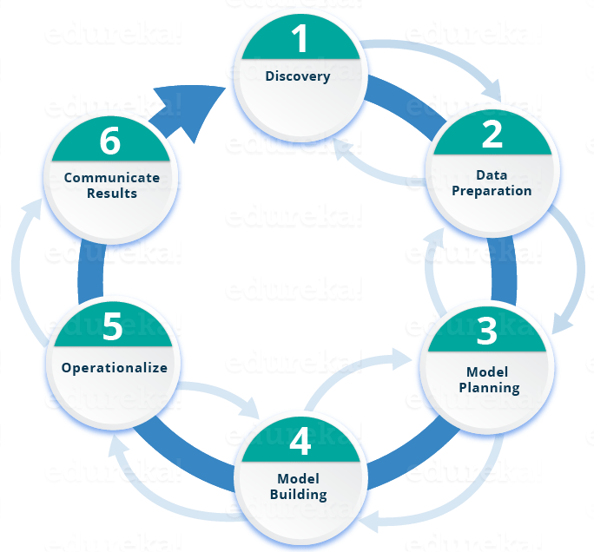
Data Science
Life cycle of data science

Slide 24
Python Data Science
Why Learn Python For Data Science?
Python is no-doubt the best-suited language for a Data Scientist. I have listed down a few points which will help you understand why people go with Python for Data Science:
Python is a free, flexible and powerful open source language
Python cuts development time in half with its simple and easy to read syntax
With Python, you can perform data manipulation, analysis, and visualization
Python provides powerful libraries for Machine learning applications and other scientific computations

Slide 25
Python Data Science
Python Libraries For Data Science
This is the part where the actual power of Python with data science comes into the picture. Python comes with numerous libraries for scientific computing, analysis, visualization etc. Some of them are listed below:
Numpy – NumPy is a core library of Python for Data Science which stands for ‘Numerical Python’. It is used for scientific computing, which contains a powerful n-dimensional array object and provide tools for integrating C, C++ etc. It can also be used as multi-dimensional container for generic data where you can perform various Numpy Operations and special functions.
Pandas – Pandas is an important library in Python for data science. It is used for data manipulation and analysis. It is well suited for different data such as tabular, ordered and unordered time series, matrix data etc.
Matplotlib – Matplotlib is a powerful library for visualization in Python. It can be used in Python scripts, shell, web application servers and other GUI toolkits. You can use different types of plots and how multiple plots work using Matplotlib
Scikit-learn – Scikit learn is one of the main attractions, where in you can implement machine learning using Python. It is a free library which contains simple and efficient tools for data analysis and mining purposes. You can implement various algorithm, such as logistic regression, time series algorithm using scikit-learn.
Reference - https://www.edureka.co/blog/learn-python-for-data-science/

Slide 26
PANDAS
The Pandas library is one of the most preferred tools for data scientists to do data manipulation and analysis, next to matplotlib for data visualization and NumPy, the fundamental library for scientific computing in Python on which Pandas was built.
The fast, flexible, and expressive Pandas data structures are designed to make real-world data analysis significantly easier, but this might not be immediately the case for those who are just getting started with it. Exactly because there is so much functionality built into this package that the options are overwhelming.
https://www.analyticsvidhya.com/blog/2016/01/complete-tutorial-learn-data-science-python-scratch-2/

Slide 27
PANDAS-Cheat Sheet

Slide 28
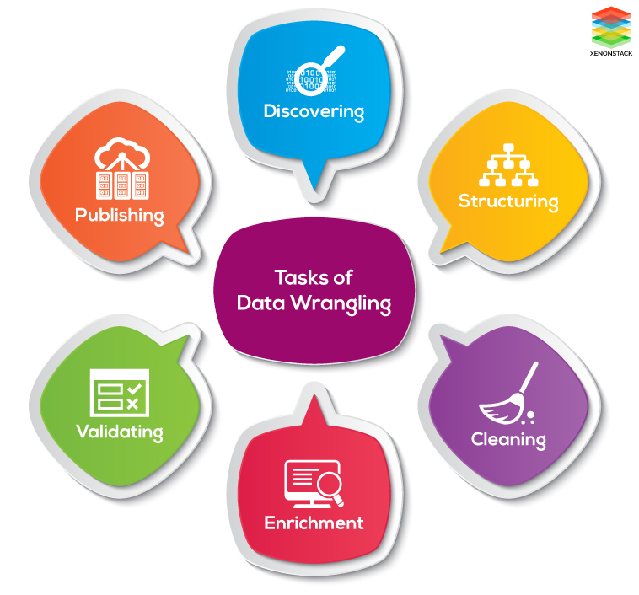
Data wrangling
Data wrangling, sometimes referred to as data munging, is the process of transforming and mapping data from one "raw" data form into another format with the intent of making it more appropriate and valuable for a variety of downstream purposes such as analytics.

Slide 29
NumPy
NumPy is the fundamental package for scientific computing with Python.
It contains among other things:
a powerful N-dimensional array object
sophisticated (broadcasting) functions
tools for integrating C/C++ and Fortran code
useful linear algebra, Fourier transform, and random number capabilities
Besides its obvious scientific uses, NumPy can also be used as an efficient multi-dimensional container of generic data. Arbitrary data-types can be defined. This allows NumPy to seamlessly and speedily integrate with a wide variety of databases.

Slide 30
NumPy-Cheat Sheet

Slide 31
MatplobLib
Data visualization and storytelling with your data are essential skills that every data scientist needs to communicate insights gained from analyses effectively to any audience out there.
Matplotlib is a Python 2D plotting library which produces publication quality figures in a variety of hardcopy formats and interactive environments across platforms. Matplotlib can be used in Python scripts, the Python and IPython shells, the Jupyter notebook, web application servers, and four graphical user interface toolkits.
Matplotlib tries to make easy things easy and hard things possible. You can generate plots, histograms, power spectra, bar charts, errorcharts, scatterplots, etc., with just a few lines of code.

Slide 32
MatplobLib-Cheat Sheet

Slide 33
Thank You
Raghu Prasad Konandur
9845547471

