Slide 1
Major AWS Services
An Overview by Category

Slide 2
AWS
AWS stands for Amazon Web Services.
It is a cloud computing platform provided by Amazon, offering a wide range of on-demand services such as computing power, storage, databases, machine learning, analytics, security, and more — all delivered over the internet ("the cloud").

Slide 3
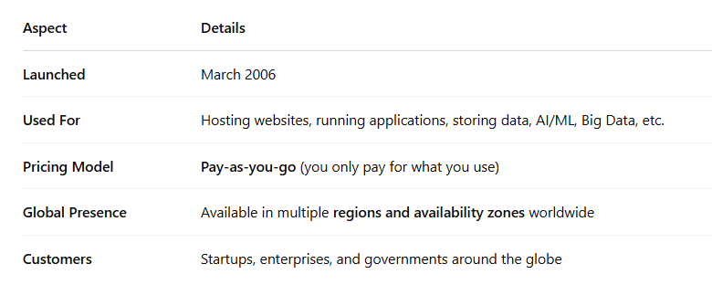
Key Highlights of AWS:

Slide 4
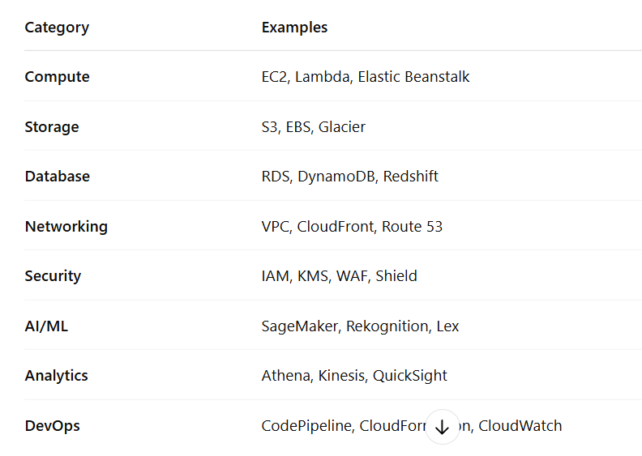
Core Categories of AWS Services:

Slide 5
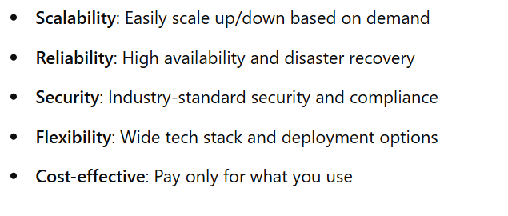
Why Use AWS?:

Slide 6
Compute
EC2 (Elastic Compute Cloud): Virtual servers to run applications.
Lambda: Serverless compute – run code without managing servers.
Elastic Beanstalk: PaaS to deploy web apps with minimal configuration.
ECS / EKS: Container services for Docker (ECS) or Kubernetes (EKS).
Lightsail: Simplified hosting for small applications.

Slide 7
Storage
S3 (Simple Storage Service): Scalable object storage for files, backups, etc.
EBS (Elastic Block Store): Block storage for EC2 instances.
EFS (Elastic File System): File storage that can be shared across EC2 instances.
Glacier / S3 Glacier: Low-cost archival storage.

Slide 8
Database
RDS (Relational Data Service): Managed relational databases (MySQL, PostgreSQL, etc.).
DynamoDB: NoSQL database service.
Aurora: High-performance managed relational database.
Redshift: Data warehousing service for analytics.

Slide 9
Networking & CDN
VPC (Virtual Private Cloud): Isolated cloud network for your resources.
Route 53: Scalable DNS and domain registration service.
CloudFront: Content Delivery Network (CDN).
ELB (Elastic Load Balancer): Distributes traffic across multiple targets.

Slide 10
Security & IAM
IAM (Identify and Access Management): Controls user permissions and access.
KMS (Key Management Service): Create and manage encryption keys.
Shield: DDoS (Distributed Denial of Service) protection service.
WAF (Web Application Firewall): Protects web apps from common attacks.

Slide 11
Monitoring & Management
CloudWatch: Monitoring, logging, and alerting for AWS resources.
CloudTrail: Logs API calls for audit and compliance.
AWS Config: Tracks configuration changes to resources.

Slide 12
Developer Tools
CodeCommit: Source control (Git repository hosting).
CodeBuild: Build service for compiling code.
CodeDeploy: Automates code deployment.
CodePipeline: CI/CD pipeline orchestration.

Slide 13
AI/ML
SageMaker: Build, train, and deploy machine learning models.
Rekognition: Image and video analysis.
Comprehend: Natural Language Processing (text analysis).
Lex: Build conversational interfaces (chatbots).

Slide 14
Analytics
Athena: Query data in S3 using SQL.
Kinesis: Real-time data streaming.
QuickSight: Business Intelligence (BI) dashboard service.

Slide 15
Migration & Hybrid
DMS: Migrate databases to AWS.
Snowball / Snowcone: Physical devices for large data transfers.
Direct Connect: Private, high-speed connection to AWS.

