Slide 1
GIT
Raghu Prasad
www.kaushalya.tech
9845547471

Slide 2
Introduction
Raghu Prasad K S – BE, MS, CEO of Kasuhalya Technologies
Total of 24 years of experience
7 years as a lecturer in an Engineering College
17 Years into IT
Worked with companies like CISCO,CSC,ICICI,First Apex – NTT Data
Currently into Corporate training and consultancy
Worked with corporates and public sector
Technologies – Java,Python,AI,ML,Web technologies,Java Script technologies (MEAN stack),IOT,Test Automation – Selenium,Jmeter,Cloud Computing
CSR Activities
Professional Yoga Trainer and motivational speaker

Slide 3
About Us
Kaushalya Technologies (www.kaushalya.tech) is an educational technology company started by IT Professionals and Academicians.
It has offices in Jakkur and Sahakara Nagara in Bengaluru
Kaushalya Technologies are into IT niche skills training, consultancy and educational application development
We conduct FDP, SDP, Internships for educational institutions.
We conduct Boot camp and niche IT skills training for corporates.

Slide 4
Our Major clients
Educational Institutions
Acharya Institute of Technology, REVA University,Dayanand Sagar University, Nagarjuna Engineering College, Bengaluru
BGSIT- Bellur, Malnad Engineering College-Hassan, NIE-Mysore, MYCEM, Mysore, NIT-Manipur
Sindhi College, SB College of Management, Bengaluru
IT Companies
L & T – Mysore,NextGen-Bengaluru,Philips-Bengaluru,Incarnus-Chennai,Aspire Systems-Chennai, Infidata Technologies – Bengaluru, Edulife- Bengaluru

Slide 5
Course Objectives
Introduction to to GIT
Create and Manage GIT repository

Slide 6
GIT - Introduction
Git is a popular file versioning system used globally by numerous developers for their projects. It is lightweight and swift in its performance as compared to the likes. With a number of UI based tools to assist in Git based versioning, it has become extremely convenient for the developers to use Git Versioning System. Git flaunts features like Cheap local branching, convenient staging areas and multiple workflow configurations.
https://www.javacodegeeks.com/2018/03/git-tutorial-for-beginners.html
https://www.youtube.com/watch?v=SWYqp7iY_Tc

Slide 7
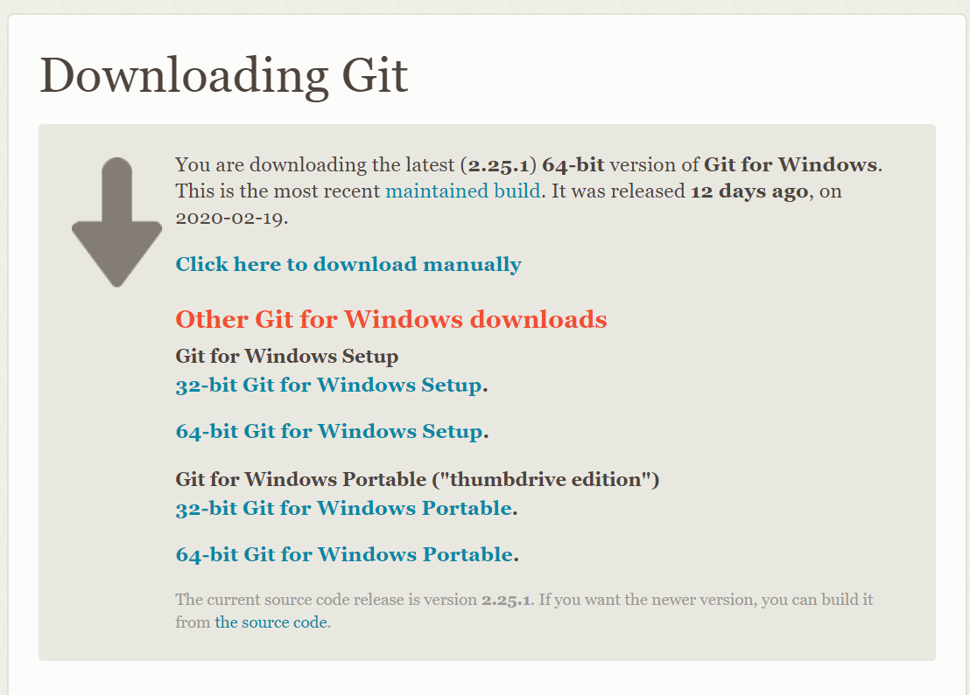
GIT-Setup
1. Download and Install Git from https://git-scm.com/download/win

Slide 8
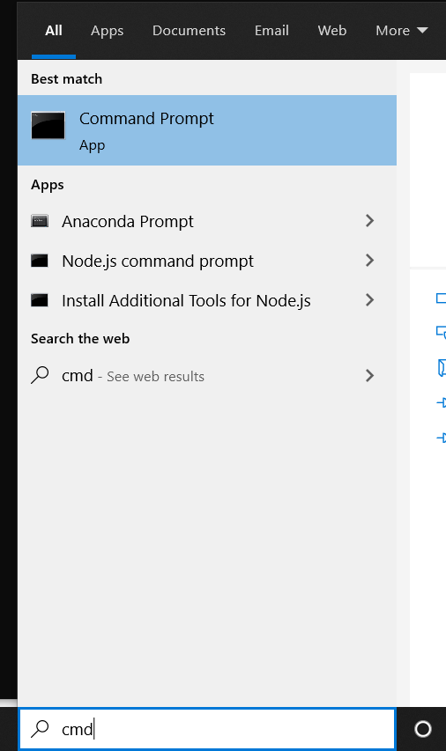
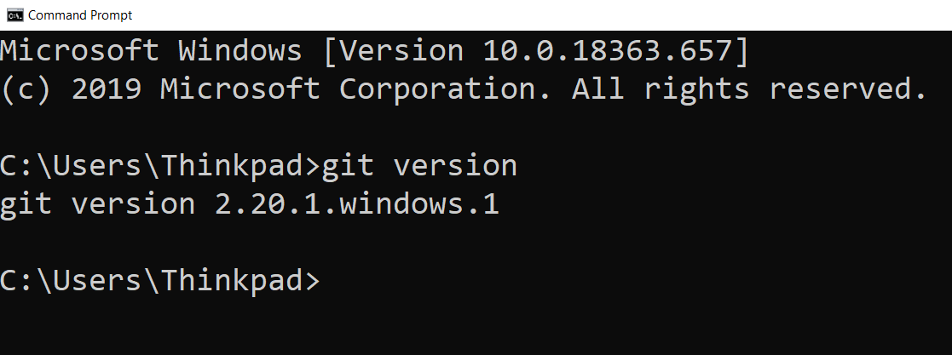
GIT-Setup
2. Check the version of the git using command prompt

Slide 9
Github- Account Creation
GitHub, Inc. is a US-based global company that provides hosting for software development version control using Git. It is a subsidiary of Microsoft, which acquired the company in 2018 for US$7.5 billion. It offers the distributed version control and source code management functionality of Git, plus its own features.
Create an account in Github using https://github.com/join.

Slide 10
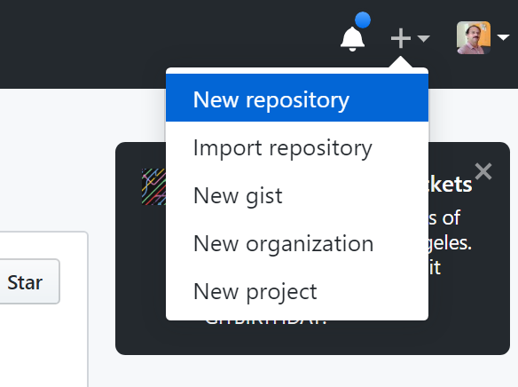
Github- Repository Creation
Login to github and create a repository

Slide 11
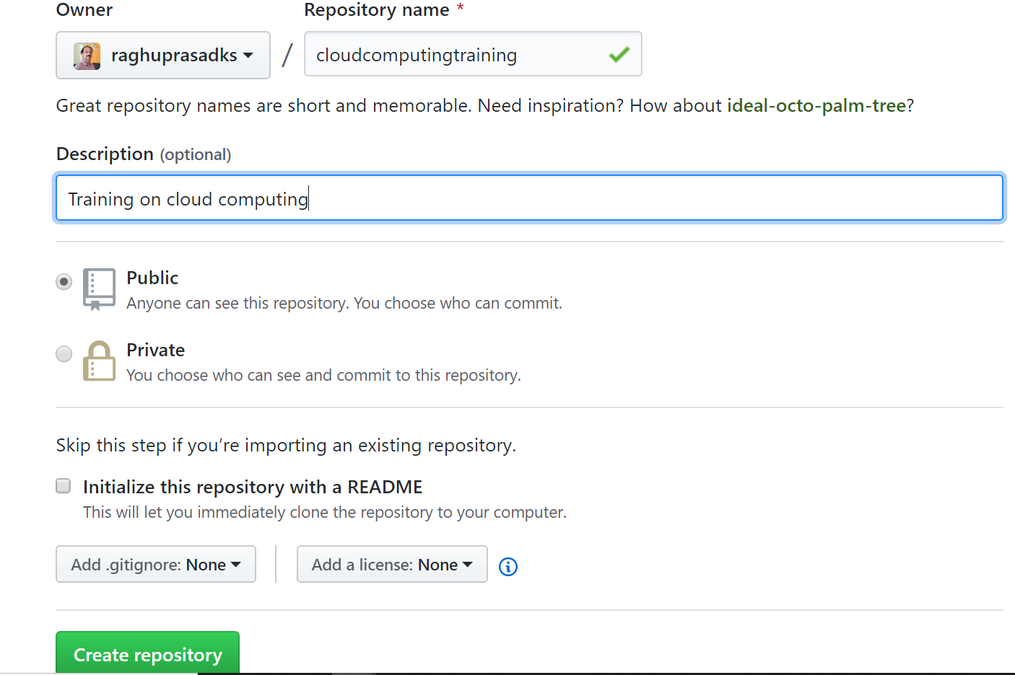
Github- Repository Creation
Create a repository and name it as cloudcomputingtraining

Slide 12
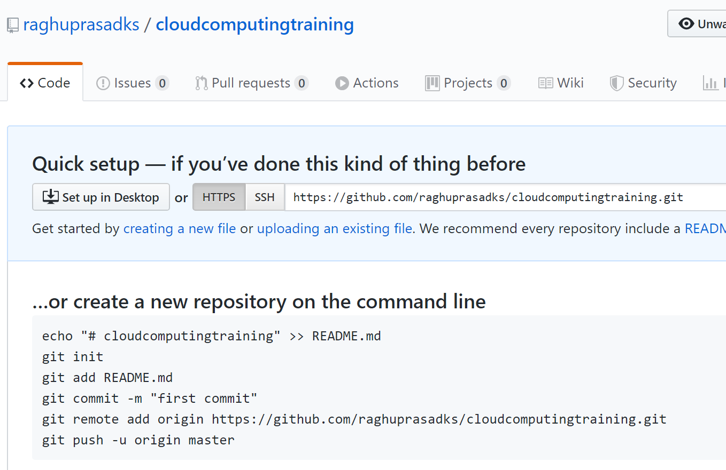
Github- Repository Setup

Slide 13
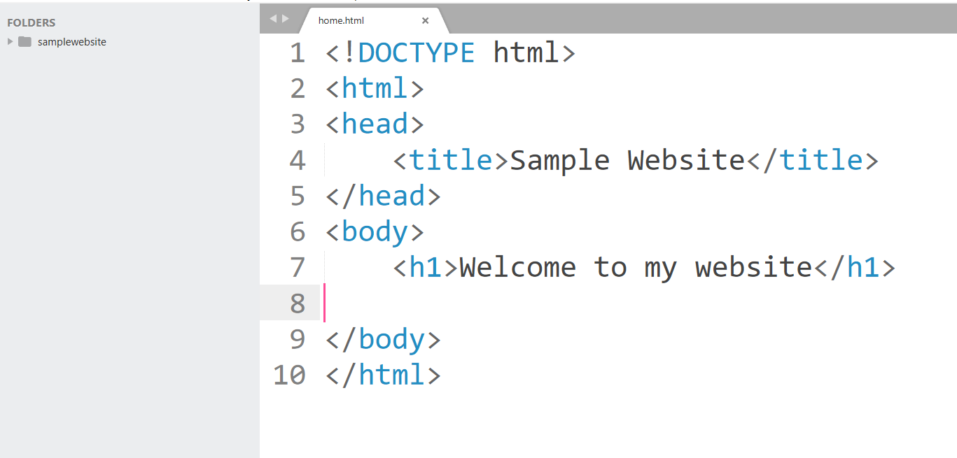
Sample webpage
Create one page html using sublime text
Download Sublime Text 3 using https://www.sublimetext.com/3
Create a webpage and name it as home.html

Slide 14
Source code check-in
1. Go to the folder in which you have created files and issue following commands
git init
git add .
git commit –m “first commit”

Slide 15
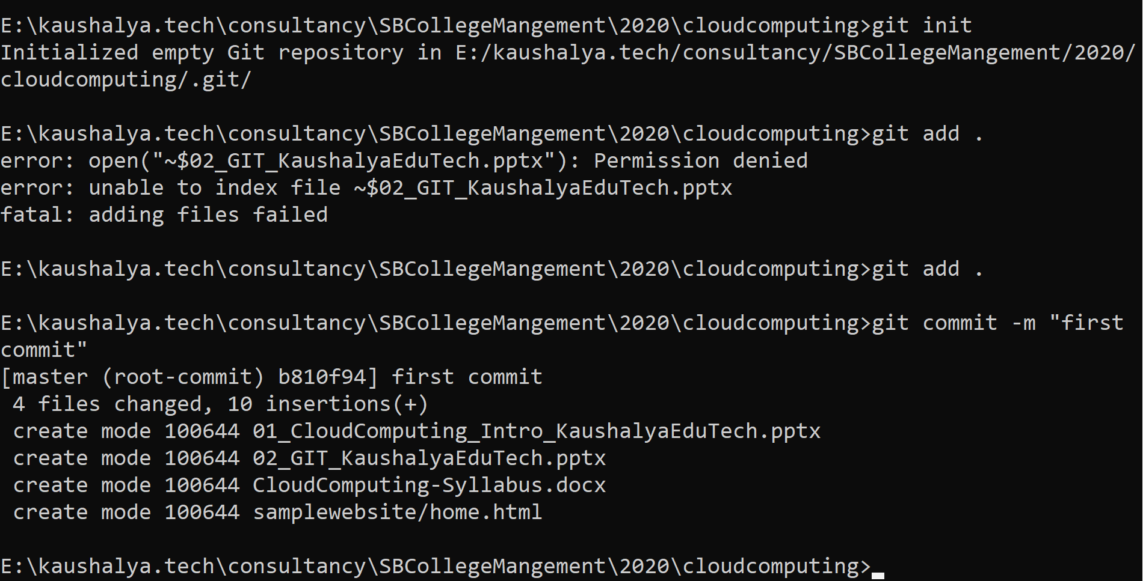
Source code check-in

Slide 16
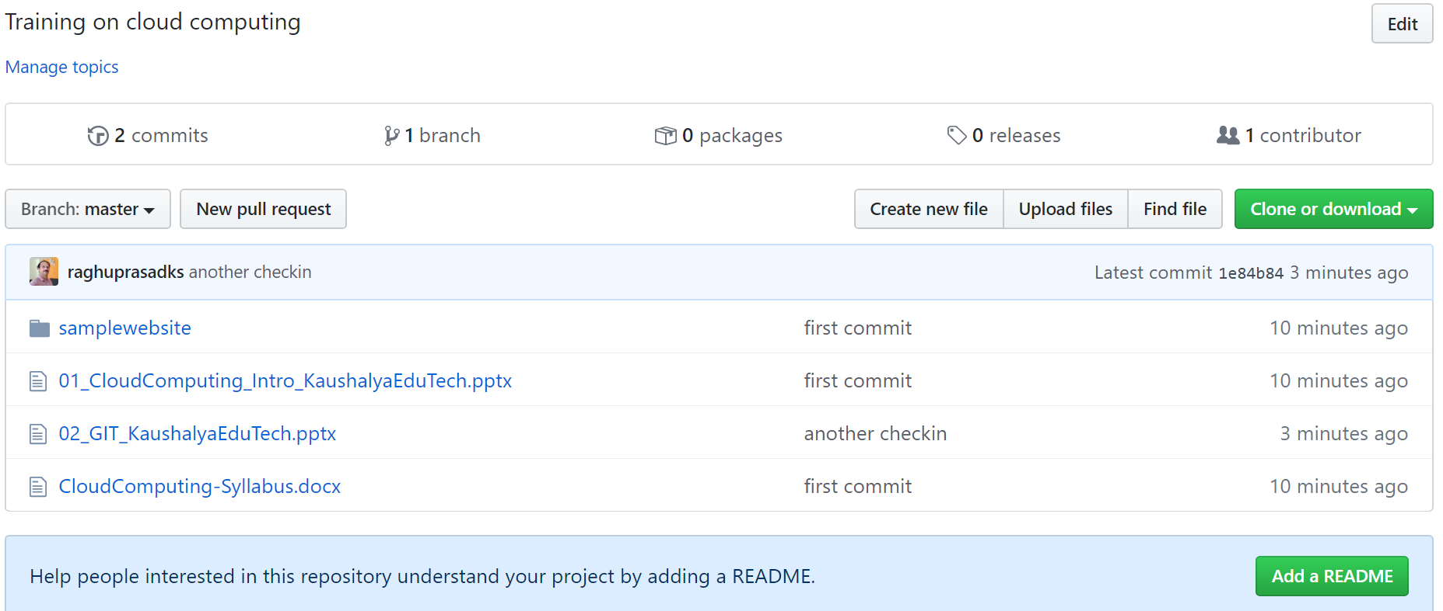
Link local repository with remote
git remote add origin https://github.com/raghuprasadks/cloudcomputingtraining.git
git push -u origin master
Check the pushed code in the github

Slide 17
Why Us
Kaushalya is built by IT Professions having experience in academia
Our vision is to Skill, Up-Skill and Re-Skill in order to bridge the gap between academia and industry
Training is conducted by experienced IT Professionals
Vendors for major educational institutions and corporates

Slide 18

Thank You

