Slide 1
Heroku – Cloud Service Provider
Raghu Prasad
www.kaushalya.tech
9845547471

Slide 2
Introduction
Raghu Prasad K S – BE, MS, CEO of Kasuhalya Technologies
Total of 24 years of experience
7 years as a lecturer in an Engineering College
17 Years into IT
Worked with companies like CISCO,CSC,ICICI,First Apex – NTT Data
Currently into Corporate training and consultancy
Worked with corporates and public sector
Technologies – Java,Python,AI,ML,Web technologies,Java Script technologies (MEAN stack),IOT,Test Automation – Selenium,Jmeter,Cloud Computing
CSR Activities
Professional Yoga Trainer and motivational speaker

Slide 3
About Us
Kaushalya Technologies (www.kaushalya.tech) is an educational technology company started by IT Professionals and Academicians.
It has offices in Jakkur and Sahakara Nagara in Bengaluru
Kaushalya Technologies are into IT niche skills training, consultancy and educational application development
We conduct FDP, SDP, Internships for educational institutions.
We conduct Boot camp and niche IT skills training for corporates.

Slide 4
Our Major clients
Educational Institutions
Acharya Institute of Technology, REVA University,Dayanand Sagar University, Nagarjuna Engineering College, Bengaluru
BGSIT- Bellur, Malnad Engineering College-Hassan, NIE-Mysore, MYCEM, Mysore, NIT-Manipur
Sindhi College, SB College of Management, Bengaluru
IT Companies
L & T – Mysore,NextGen-Bengaluru,Philips-Bengaluru,Incarnus-Chennai,Aspire Systems-Chennai, Infidata Technologies – Bengaluru, Edulife- Bengaluru

Slide 5
Course Objectives
Introduction to Heroku
Deploy static website on heroku

Slide 6
Heroku - Introduction
Heroku is a cloud platform as a service (PaaS) supporting several programming languages. One of the first cloud platforms, Heroku has been in development since June 2007, when it supported only the Ruby programming language, but now supports Java, Node.js, Scala, Clojure, Python, PHP, and Go.For this reason, Heroku is said to be a polyglot platform as it has features for a developer to build, run and scale applications in a similar manner across most languages. Heroku was acquired by Salesforce.com in 2010 for $212 million.

Slide 7
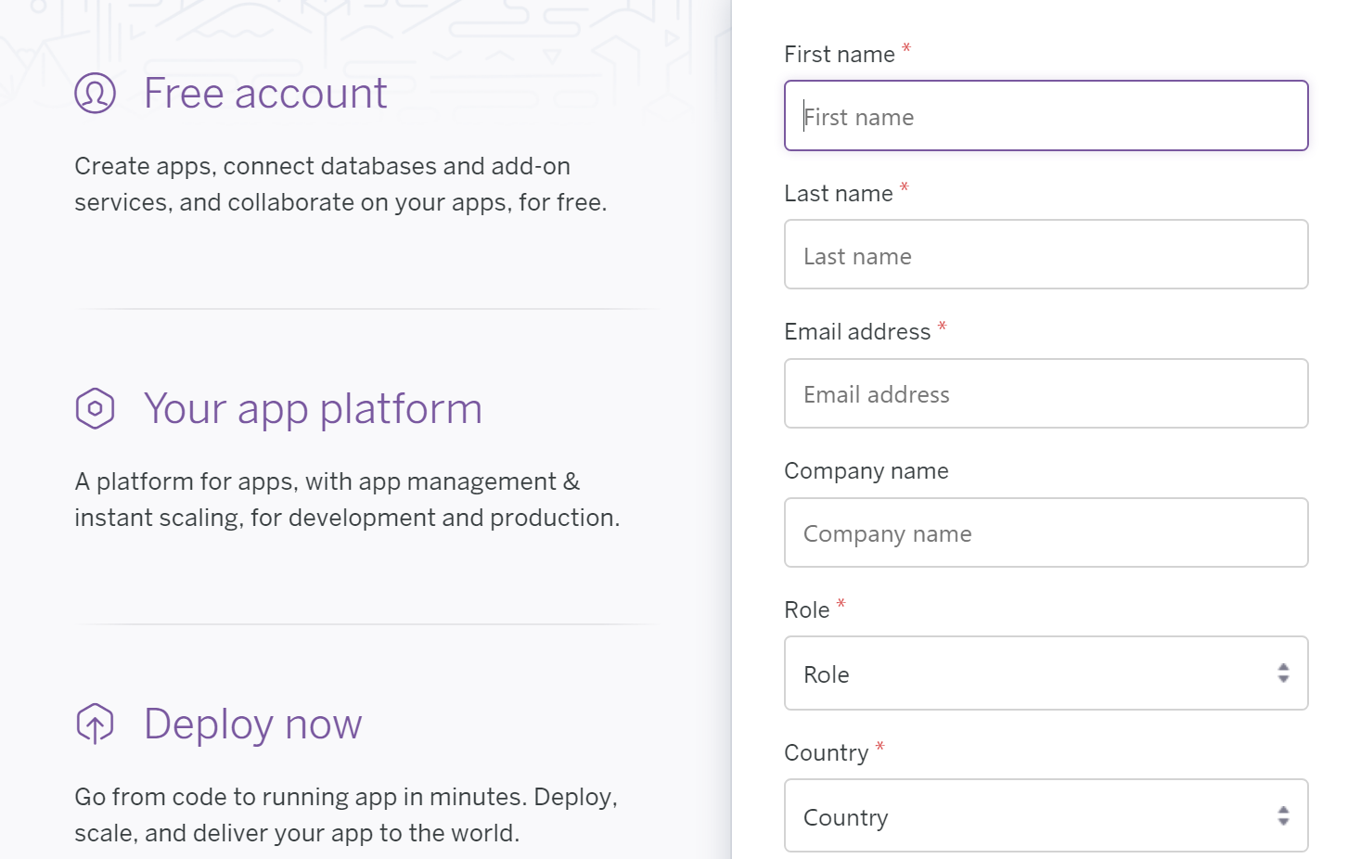
Heroku - Signup
Signup and confirm account creation using mail id

Slide 8
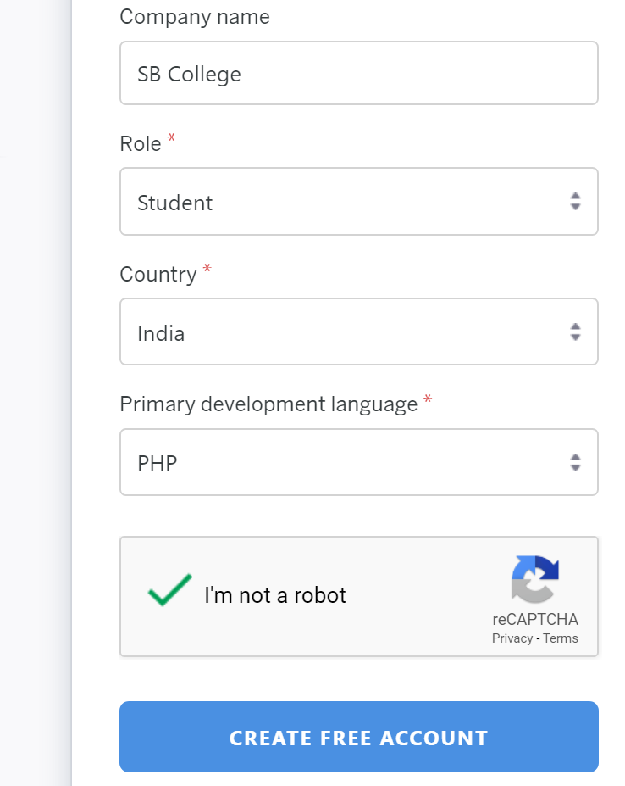
Heroku - Signup
Signup with Heroku using https://signup.heroku.com/

Slide 9

Heroku – Create new app

Slide 10
Why Us
Kaushalya is built by IT Professions having experience in academia
Our vision is to Skill, Up-Skill and Re-Skill in order to bridge the gap between academia and industry
Training is conducted by experienced IT Professionals
Vendors for major educational institutions and corporates

Slide 11

Thank You

