Slide 1
mLab – Database-as-a-Service for MongoDB
Raghu Prasad
www.kaushalya.tech
9845547471

Slide 2
Introduction
Raghu Prasad K S – BE, MS, CEO of Kasuhalya Technologies
Total of 24 years of experience
7 years as a lecturer in an Engineering College
17 Years into IT
Worked with companies like CISCO,CSC,ICICI,First Apex – NTT Data
Currently into Corporate training and consultancy
Worked with corporates and public sector
Technologies – Java,Python,AI,ML,Web technologies,Java Script technologies (MEAN stack),IOT,Test Automation – Selenium,Jmeter,Cloud Computing
CSR Activities
Professional Yoga Trainer and motivational speaker

Slide 3
About Us
Kaushalya Technologies (www.kaushalya.tech) is an educational technology company started by IT Professionals and Academicians.
It has offices in Jakkur and Sahakara Nagara in Bengaluru
Kaushalya Technologies are into IT niche skills training, consultancy and educational application development
We conduct FDP, SDP, Internships for educational institutions.
We conduct Boot camp and niche IT skills training for corporates.

Slide 4
Our Major clients
Educational Institutions
Acharya Institute of Technology, REVA University,Dayanand Sagar University, Nagarjuna Engineering College, Bengaluru
BGSIT- Bellur, Malnad Engineering College-Hassan, NIE-Mysore, MYCEM, Mysore, NIT-Manipur
Sindhi College, SB College of Management, Bengaluru
IT Companies
L & T – Mysore,NextGen-Bengaluru,Philips-Bengaluru,Incarnus-Chennai,Aspire Systems-Chennai, Infidata Technologies – Bengaluru, Edulife- Bengaluru

Slide 5
Course Objectives
Introduction to MongoDB
Create and Manage database using mLab

Slide 6
MongoDB - Introduction
MongoDB is a general purpose, document-based, distributed database built for modern application developers and for the cloud era. No database makes you more productive.
MongoDB is a document database designed for ease of development and scaling.
MongoDB offers both a Community and an Enterprise version of the database

Slide 7
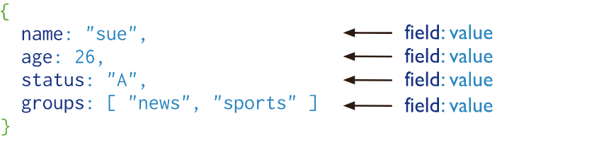
Document Database
A record in MongoDB is a document, which is a data structure composed of field and value pairs. MongoDB documents are similar to JSON objects. The values of fields may include other documents, arrays, and arrays of documents.

Slide 8
Document Database
A record in MongoDB is a document, which is a data structure composed of field and value pairs. MongoDB documents are similar to JSON objects. The values of fields may include other documents, arrays, and arrays of documents.

Slide 9
Document Database
The advantages of using documents are:
Documents (i.e. objects) correspond to native data types in many programming languages.
Embedded documents and arrays reduce need for expensive joins.
Dynamic schema supports fluent polymorphism.
MongoDB stores documents in collections. Collections are analogous to tables in relational databases.
https://docs.mongodb.com/manual/tutorial/getting-started/

Slide 10
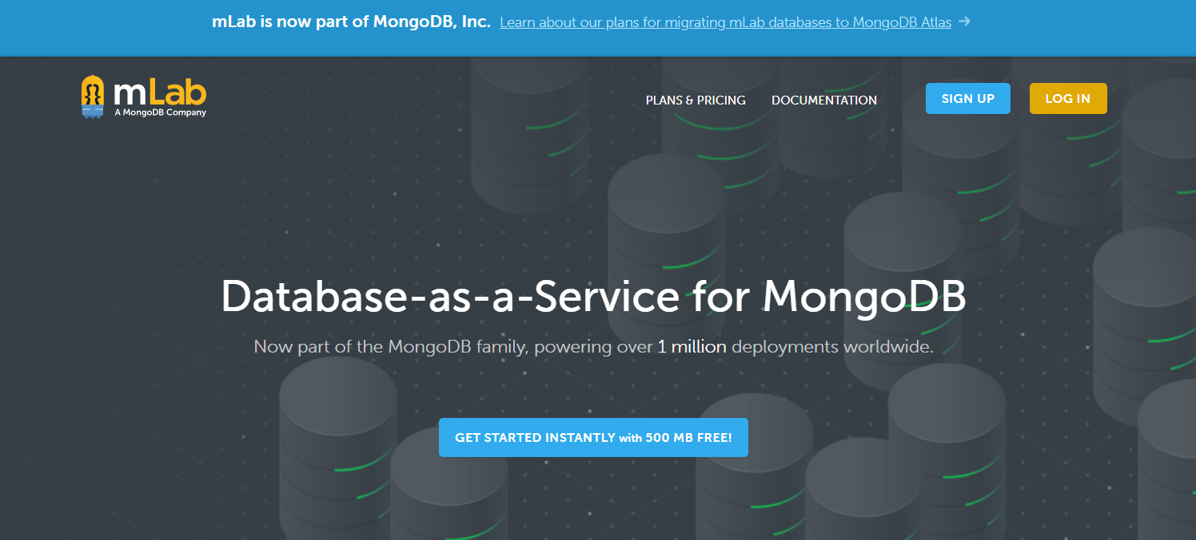
mLab – Cloud Database
Open https://mlab.com/

Slide 11
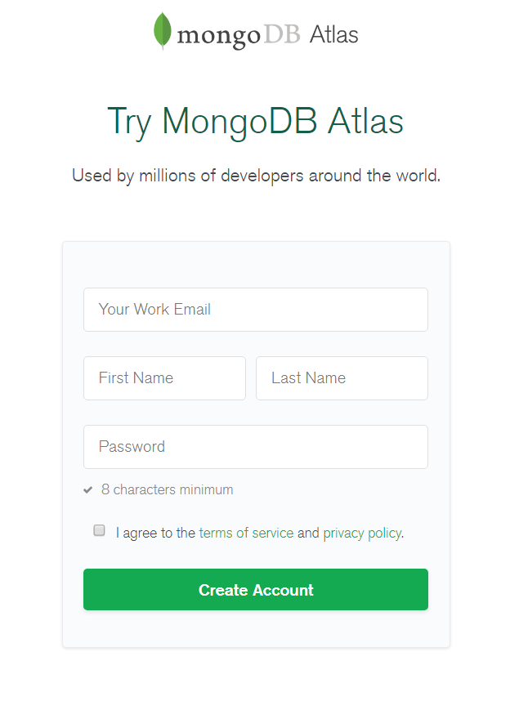
mLab – Cloud Database
SIGN UP

Slide 12
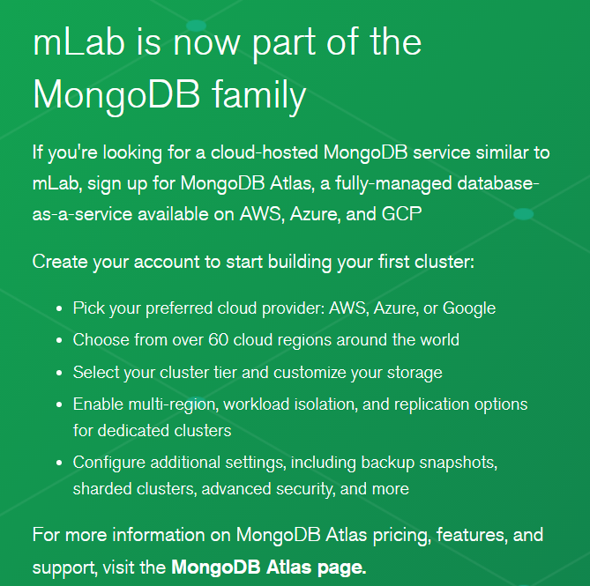
mLab – Cloud Database

Slide 13
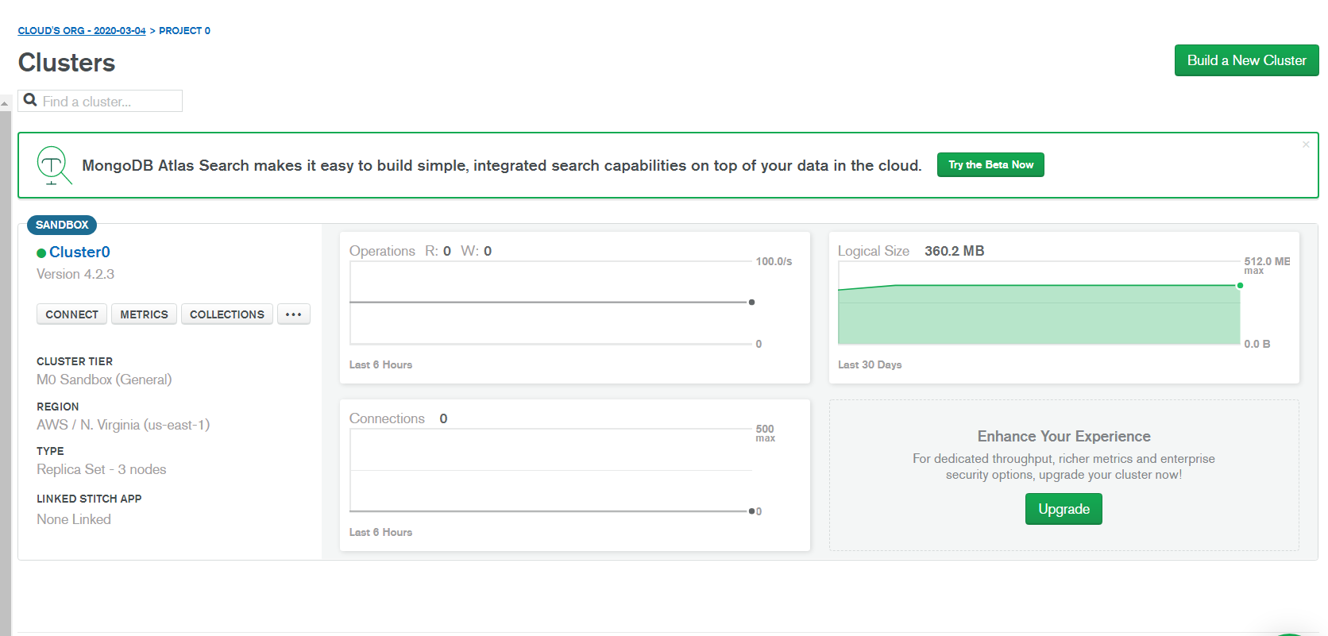
mLab – Cloud Database
Login - https://account.mongodb.com/account/login
Create a cluster

Slide 14
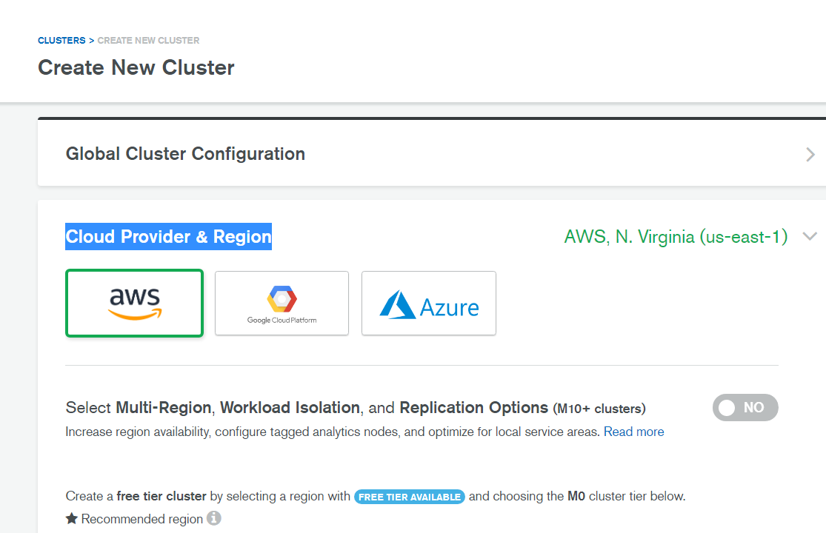
mLab – Cloud Database
Login - https://account.mongodb.com/account/login
Create a cluster

Slide 15
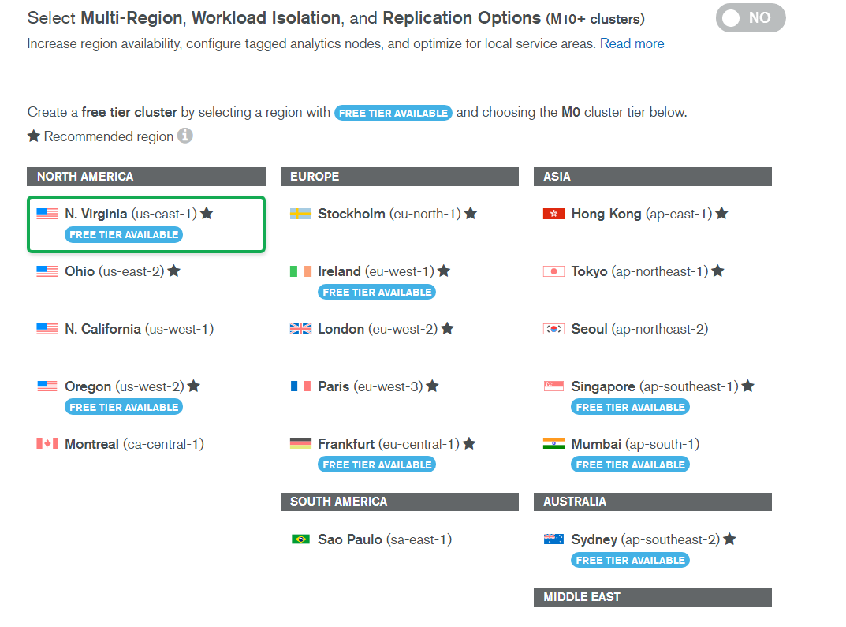
mLab – Cloud Database
Create a cluster

Slide 16
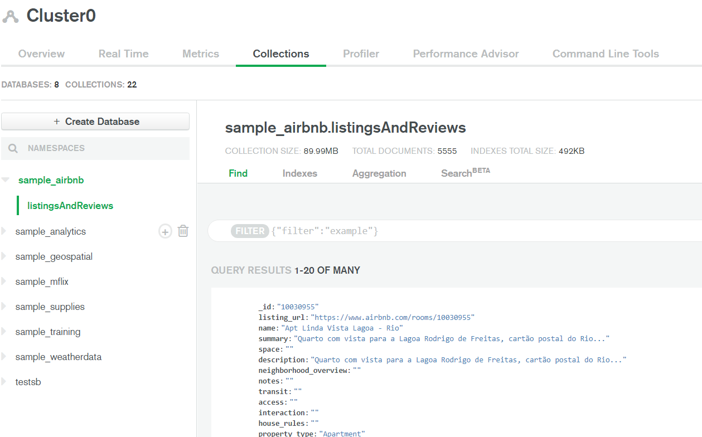
mLab – Cloud Database
Load Collections
Create Database

Slide 17
Why Us
Kaushalya is built by IT Professions having experience in academia
Our vision is to Skill, Up-Skill and Re-Skill in order to bridge the gap between academia and industry
Training is conducted by experienced IT Professionals
Vendors for major educational institutions and corporates

Slide 18

Thank You

