Slide 1
AWS
Raghu Prasad
www.kaushalya.tech
9845547471

Slide 2
Introduction
Raghu Prasad K S – BE, MS, CEO of Kasuhalya Technologies
Total of 24 years of experience
7 years as a lecturer in an Engineering College
17 Years into IT
Worked with companies like CISCO,CSC,ICICI,First Apex – NTT Data
Currently into Corporate training and consultancy
Worked with corporates and public sector
Technologies – Java,Python,AI,ML,Web technologies,Java Script technologies (MEAN stack),IOT,Test Automation – Selenium,Jmeter,Cloud Computing
CSR Activities
Professional Yoga Trainer and motivational speaker

Slide 3
About Us
Kaushalya Technologies (www.kaushalya.tech) is an educational technology company started by IT Professionals and Academicians.
It has offices in Jakkur and Sahakara Nagara in Bengaluru
Kaushalya Technologies are into IT niche skills training, consultancy and educational application development
We conduct FDP, SDP, Internships for educational institutions.
We conduct Boot camp and niche IT skills training for corporates.

Slide 4
Our Major clients
Educational Institutions
Acharya Institute of Technology, REVA University,Dayanand Sagar University, Nagarjuna Engineering College, Bengaluru
BGSIT- Bellur, Malnad Engineering College-Hassan, NIE-Mysore, MYCEM, Mysore, NIT-Manipur
Sindhi College, SB College of Management, Bengaluru
IT Companies
L & T – Mysore,NextGen-Bengaluru,Philips-Bengaluru,Incarnus-Chennai,Aspire Systems-Chennai, Infidata Technologies – Bengaluru, Edulife- Bengaluru

Slide 5
Course Objectives
Introduction to AWS
Create AWS free tier account

Slide 6
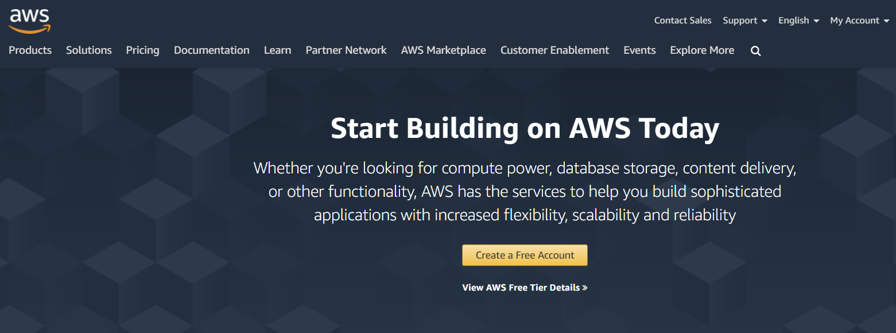
AWS – Create a Free Account
https://aws.amazon.com/

Slide 7
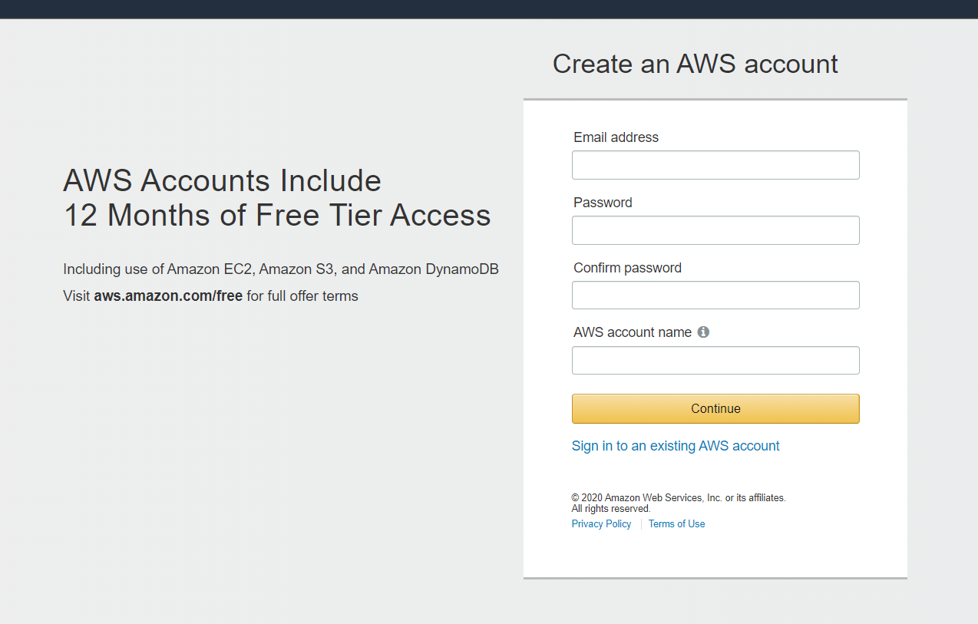
AWS – Create a Free Account
Click on Create a Free Account

Slide 8
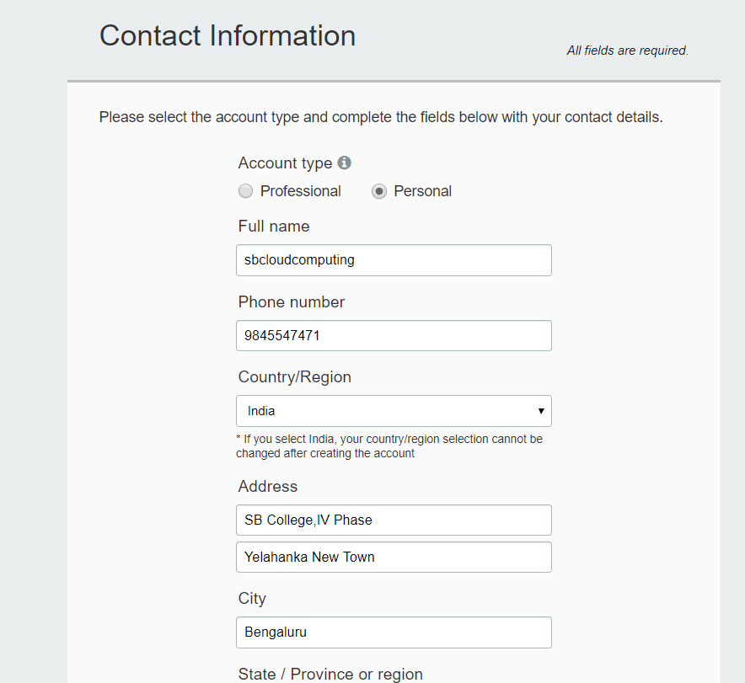
AWS – Create a Free Account

Slide 9
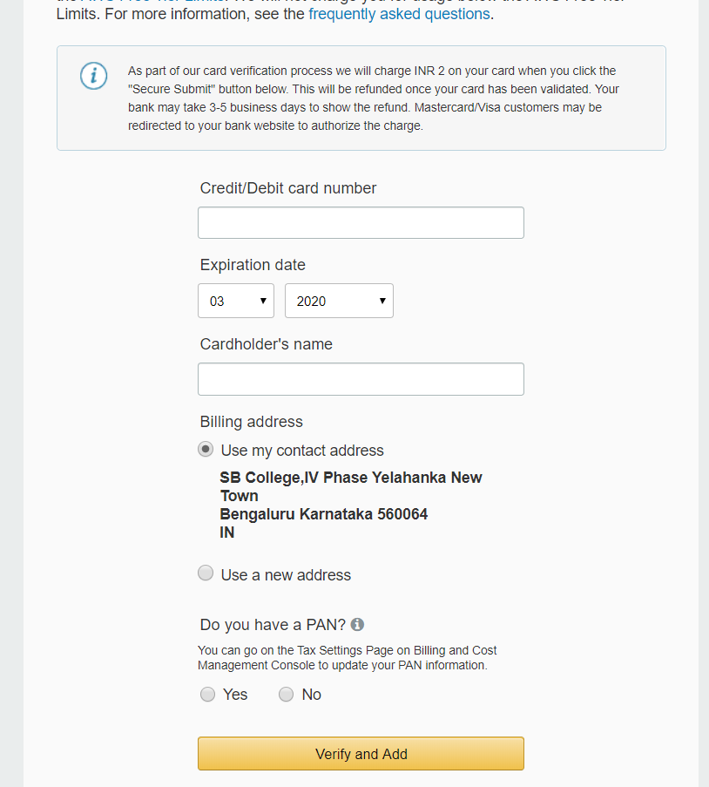
AWS – Payment options

Slide 10
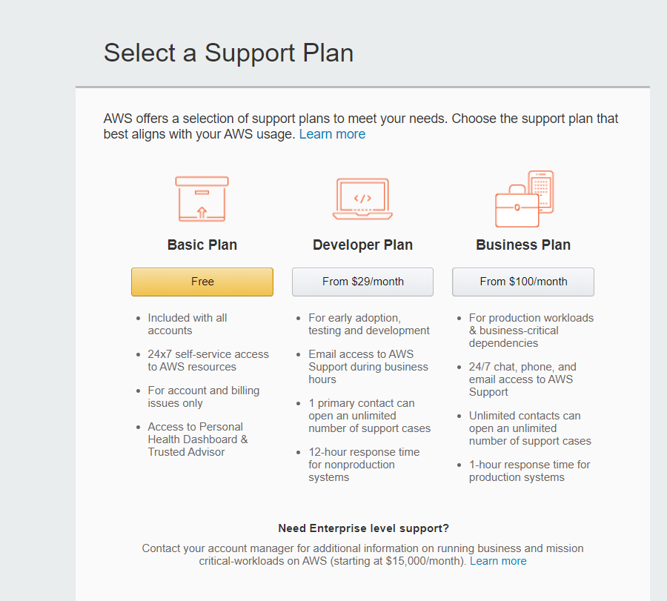
AWS – Support Plan

Slide 11
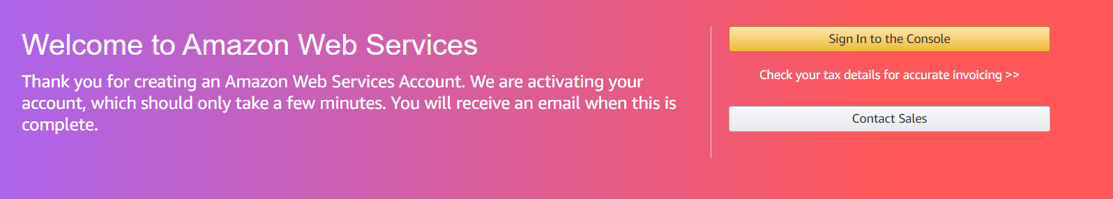
AWS – Confirm through email

Slide 12
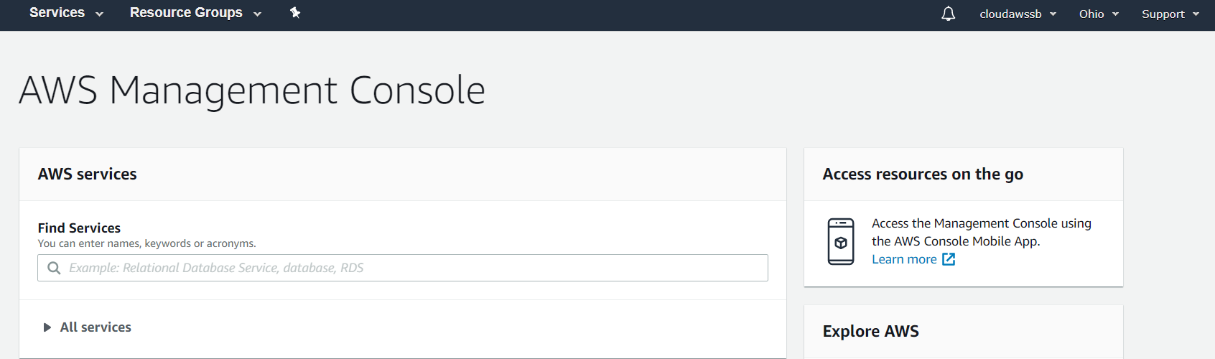
AWS – After Login

Slide 13
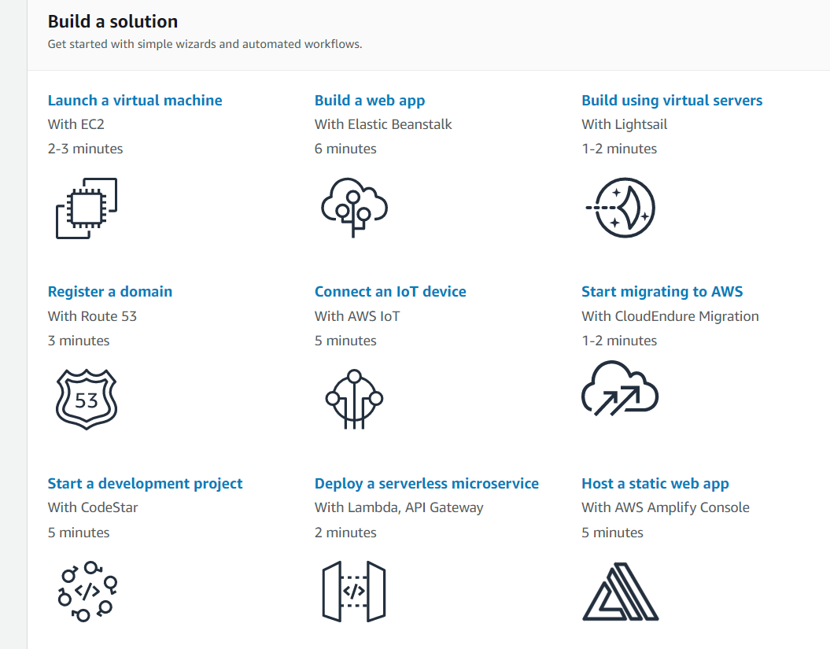
AWS – After Login

Slide 14
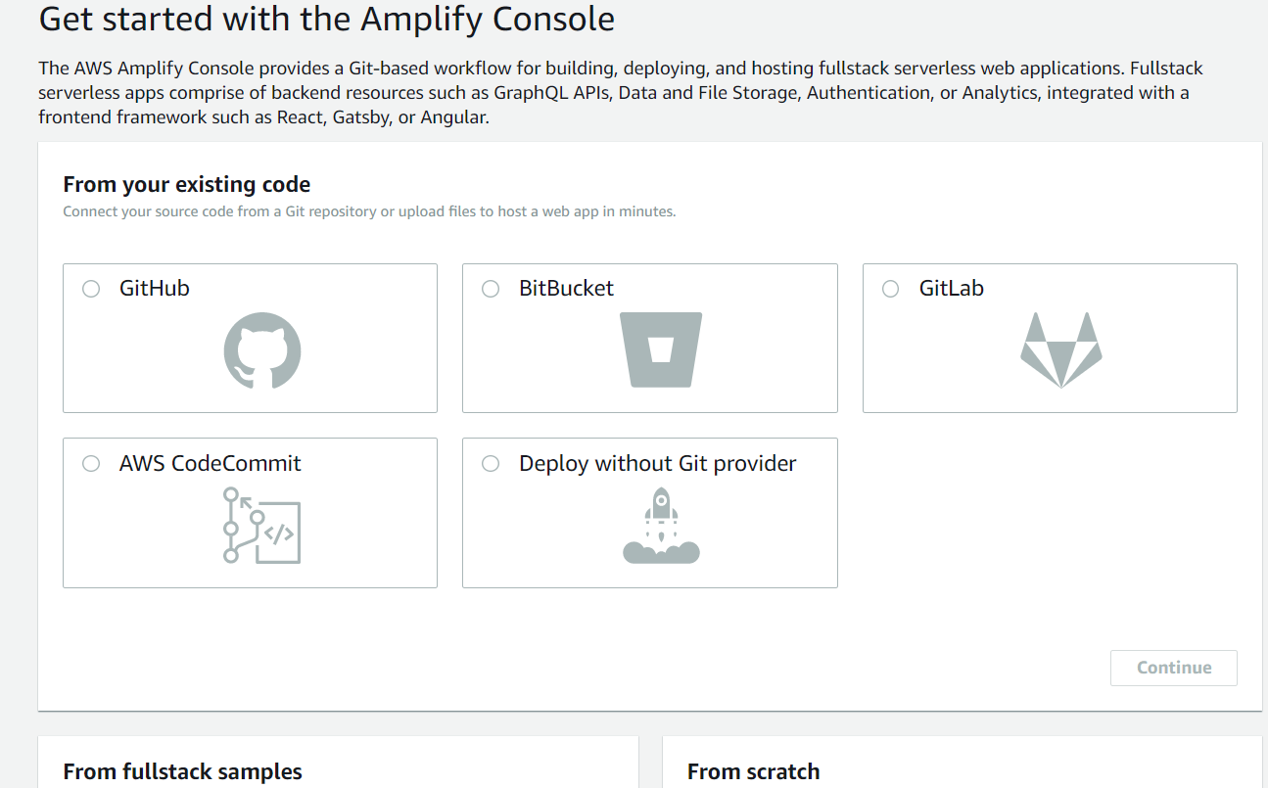
AWS – Host a static website

Slide 15
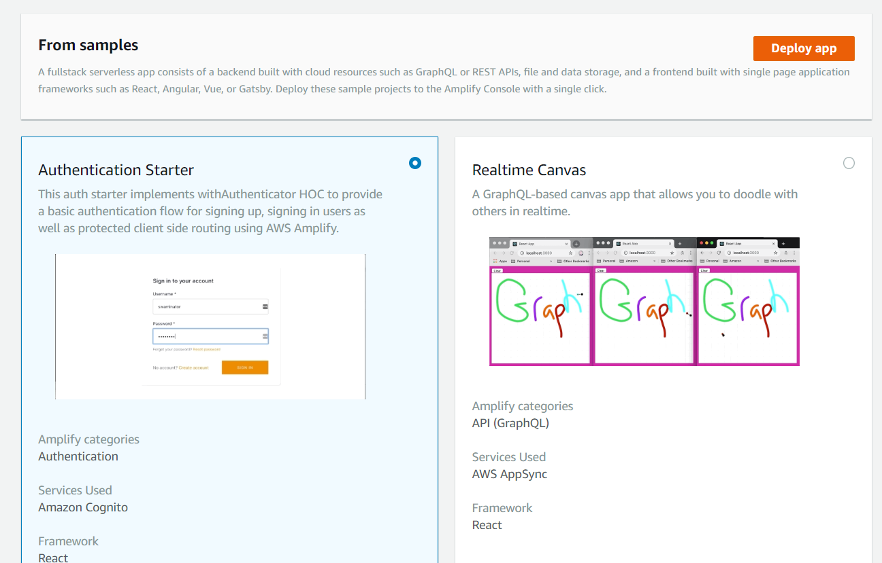
AWS – From Samples

Slide 16
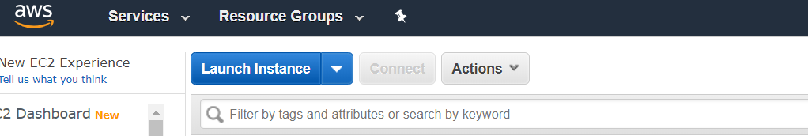
AWS – Compute
EC2 – Elastic Cloud Compute
Launch New Instance

Slide 17
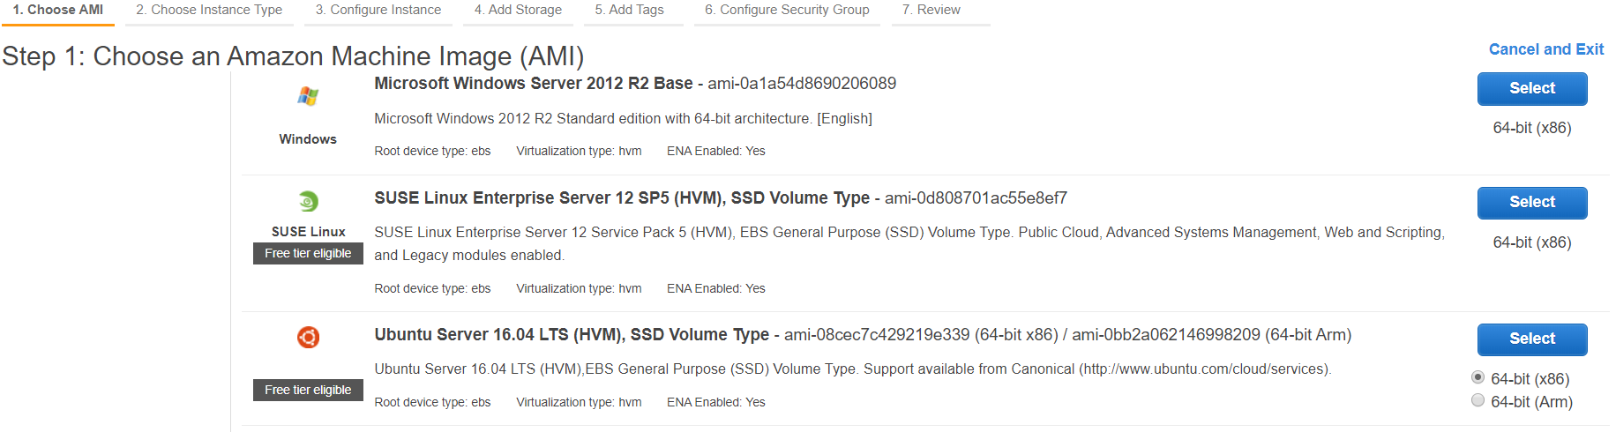
AWS – EC2
EC2 – Elastic Cloud Compute
Select Free tier Ubuntu server

Slide 18
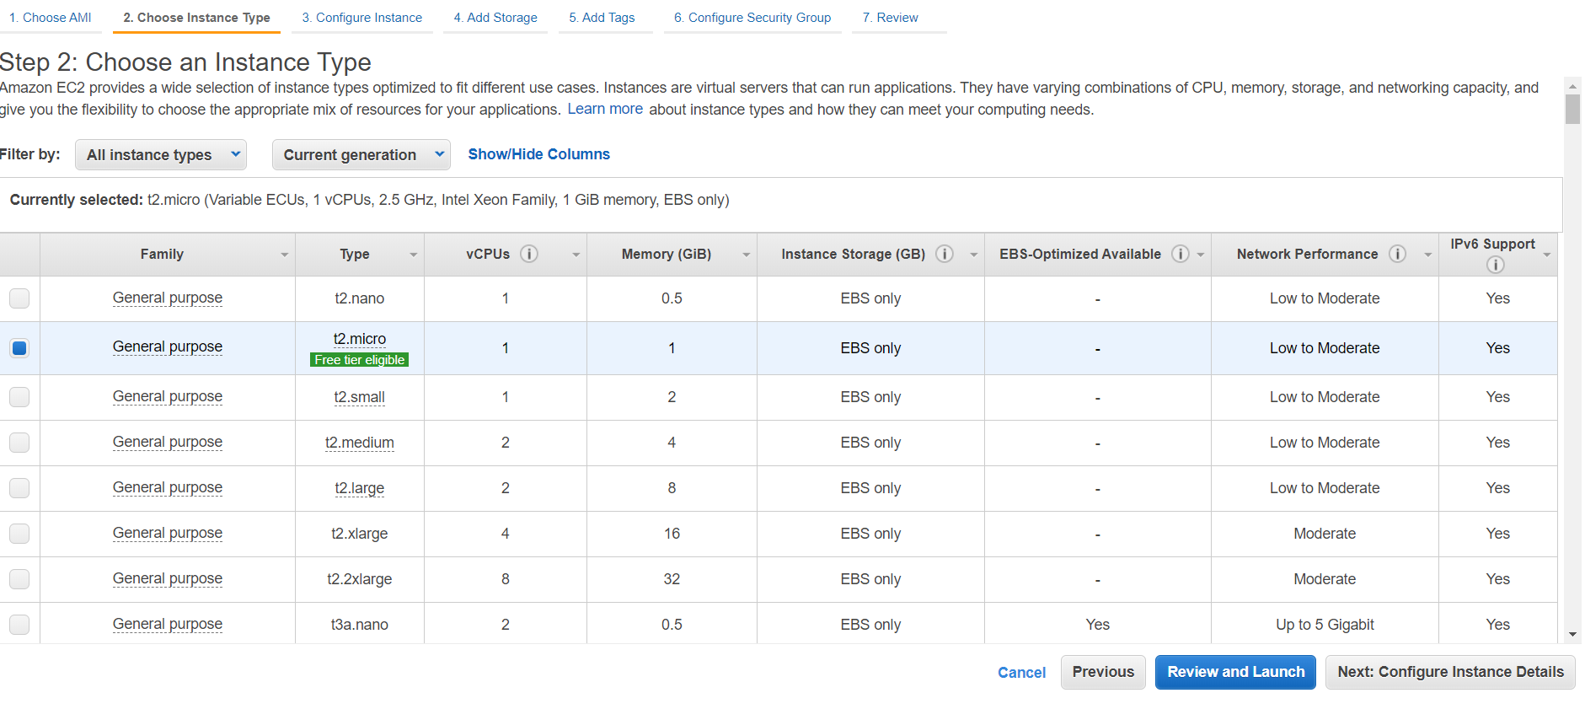
AWS – EC2
Select Free tier Ubuntu server – Click Next

Slide 19
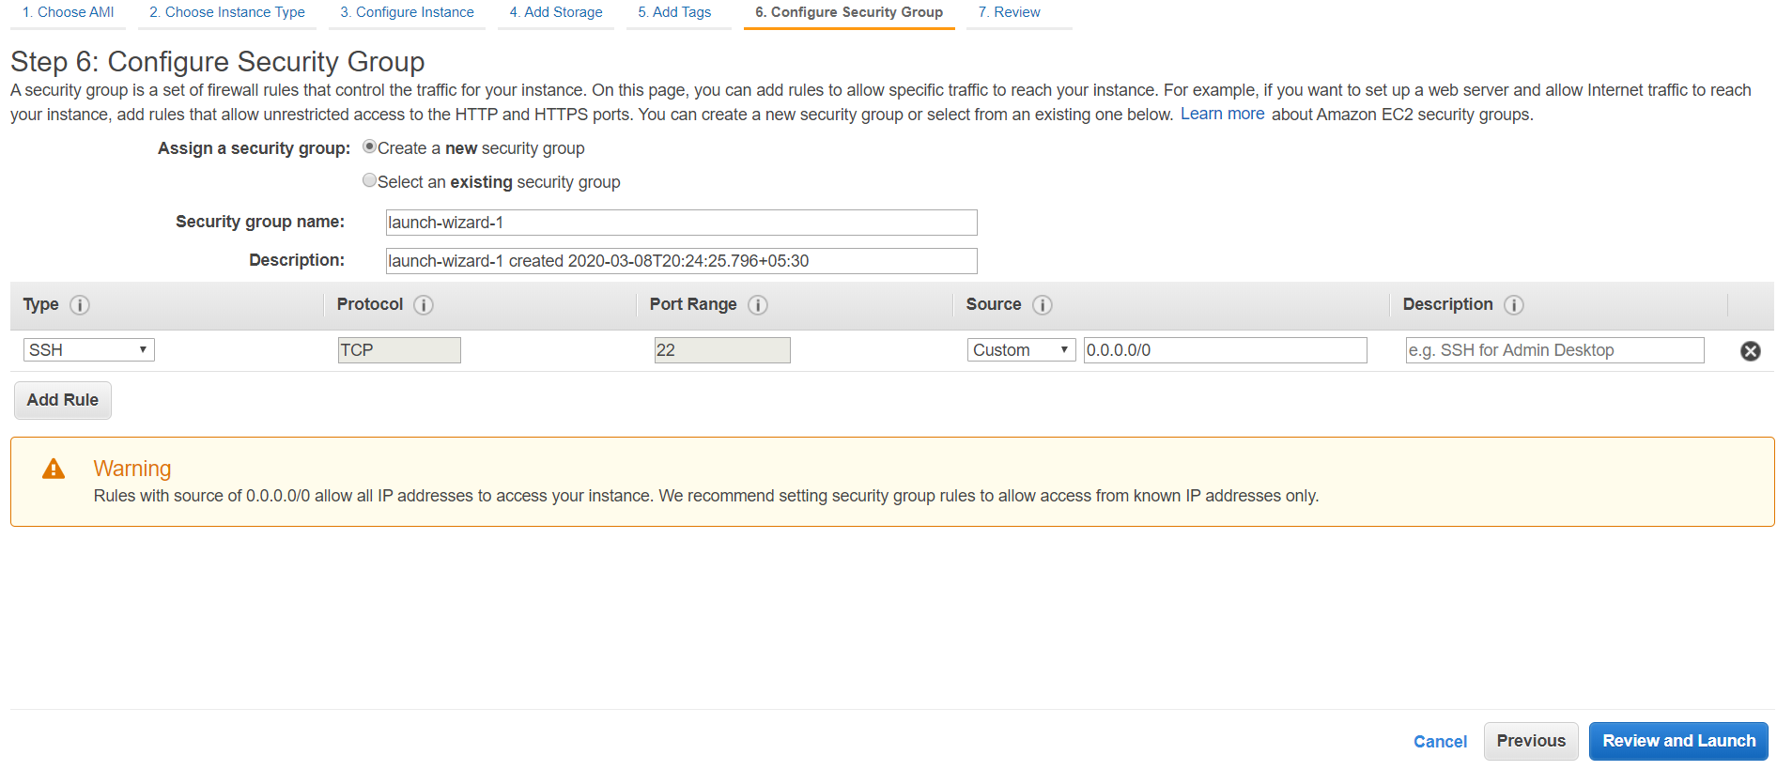
AWS – EC2
Configuration – Security – Source – Any where

Slide 20
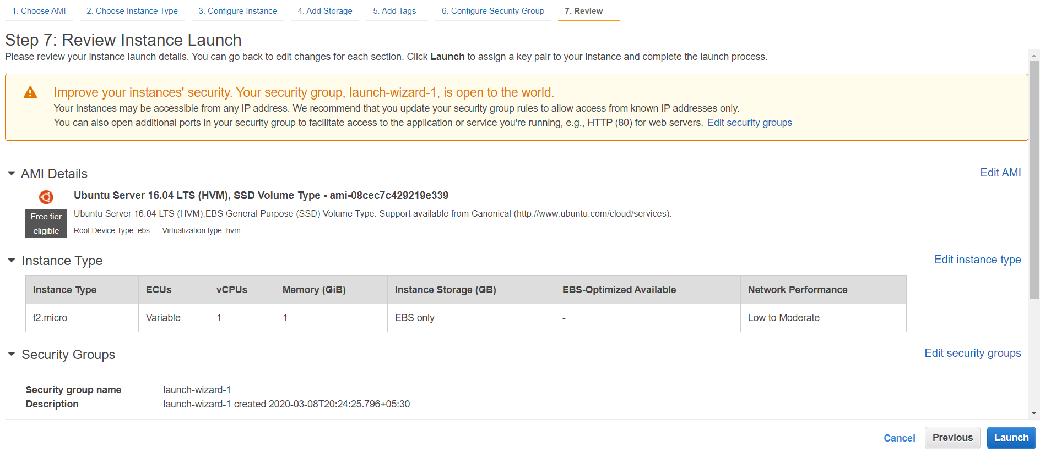
AWS – EC2
7- Review - Launch

Slide 21
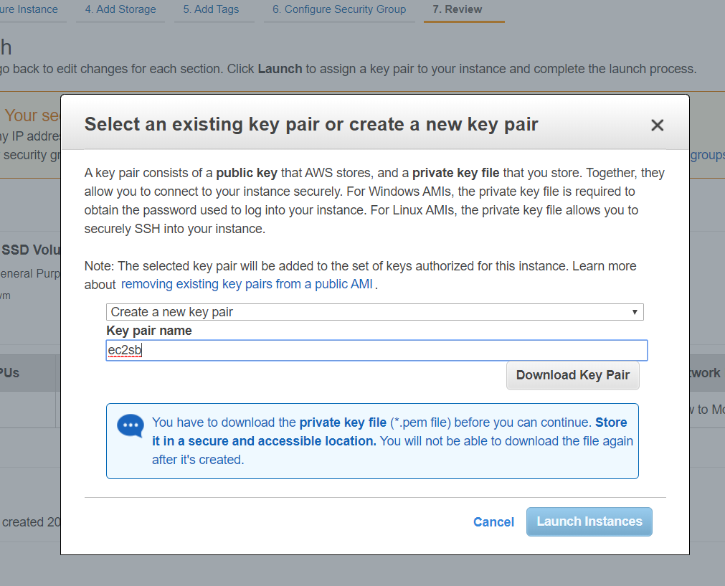
AWS – EC2
7- Review –Create key pair – Download Key Pair- Launch

Slide 22
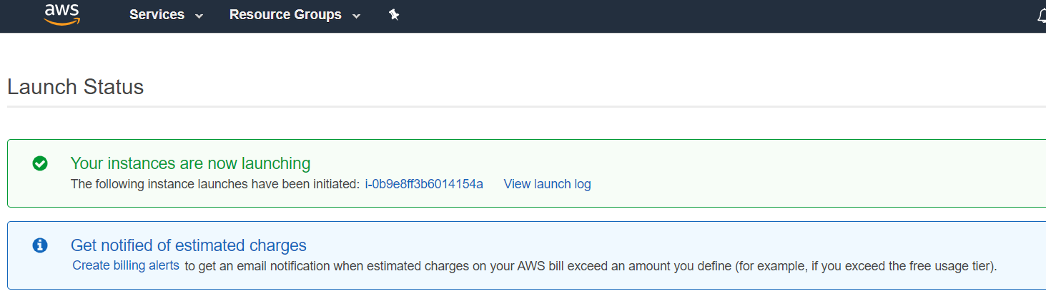
AWS – EC2

Slide 23
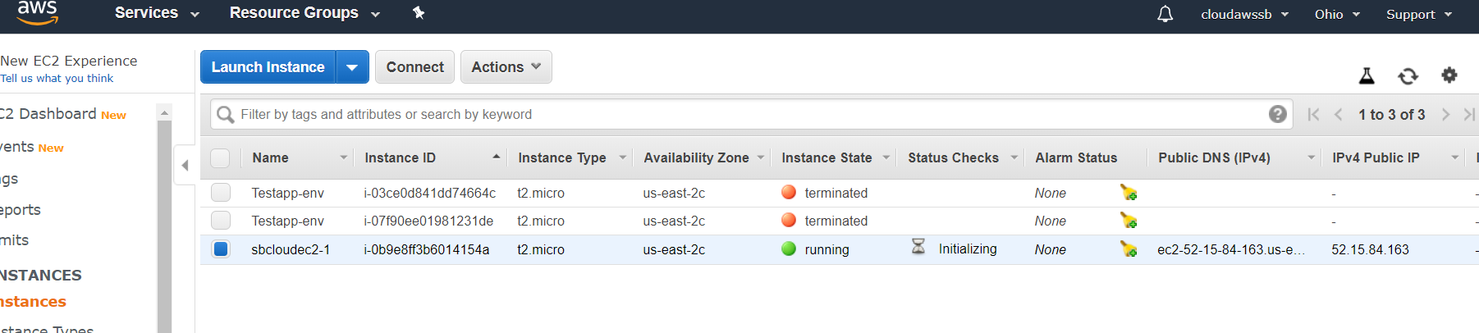
AWS – EC2
View Instances

Slide 24
Why Us
Kaushalya is built by IT Professions having experience in academia
Our vision is to Skill, Up-Skill and Re-Skill in order to bridge the gap between academia and industry
Training is conducted by experienced IT Professionals
Vendors for major educational institutions and corporates

Slide 25

Thank You

