Slide 1
AWS – EC2- Webserver
Raghu Prasad
www.kaushalya.tech
9845547471

Slide 2
Introduction
Raghu Prasad K S – BE, MS, CEO of Kasuhalya Technologies
Total of 24 years of experience
7 years as a lecturer in an Engineering College
17 Years into IT
Worked with companies like CISCO,CSC,ICICI,First Apex – NTT Data
Currently into Corporate training and consultancy
Worked with corporates and public sector
Technologies – Java,Python,AI,ML,Web technologies,Java Script technologies (MEAN stack),IOT,Test Automation – Selenium,Jmeter,Cloud Computing
CSR Activities
Professional Yoga Trainer and motivational speaker

Slide 3
About Us
Kaushalya Technologies (www.kaushalya.tech) is an educational technology company started by IT Professionals and Academicians.
It has offices in Jakkur and Sahakara Nagara in Bengaluru
Kaushalya Technologies are into IT niche skills training, consultancy and educational application development
We conduct FDP, SDP, Internships for educational institutions.
We conduct Boot camp and niche IT skills training for corporates.

Slide 4
Our Major clients
Educational Institutions
Acharya Institute of Technology, REVA University,Dayanand Sagar University, Nagarjuna Engineering College, Bengaluru
BGSIT- Bellur, Malnad Engineering College-Hassan, NIE-Mysore, MYCEM, Mysore, NIT-Manipur
Sindhi College, SB College of Management, Bengaluru
IT Companies
L & T – Mysore,NextGen-Bengaluru,Philips-Bengaluru,Incarnus-Chennai,Aspire Systems-Chennai, Infidata Technologies – Bengaluru, Edulife- Bengaluru

Slide 5
Course Objectives
Introduction to EC2
Install Apache Server

Slide 6
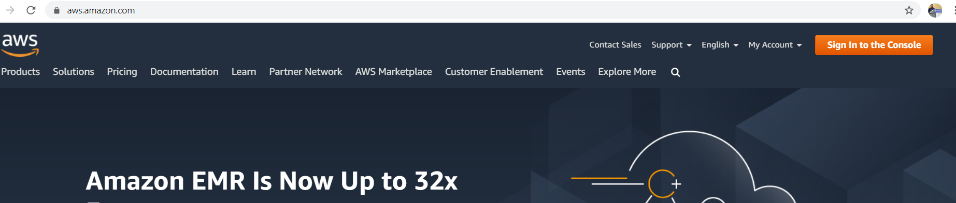
AWS – Sign in to the console
https://aws.amazon.com/

Slide 7
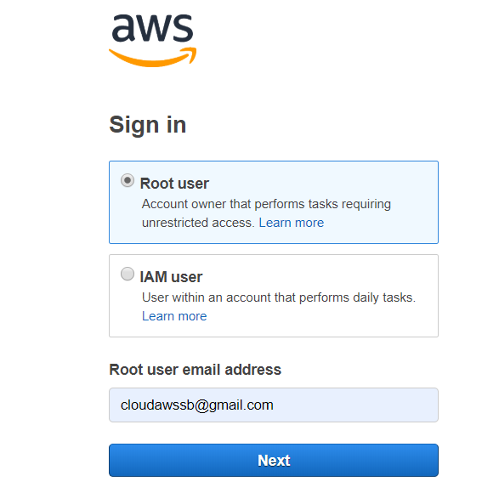
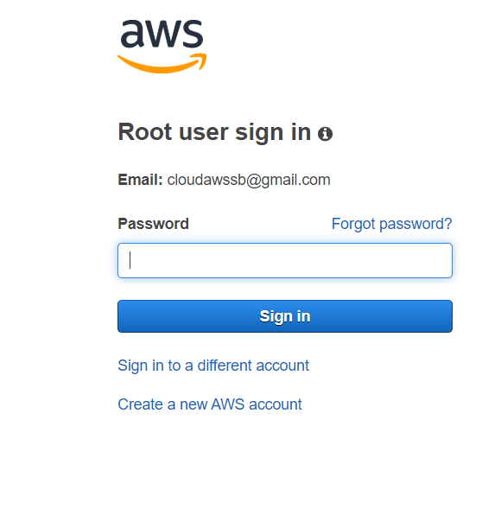
AWS – Sign in to the console
Sign in as root user

Slide 8
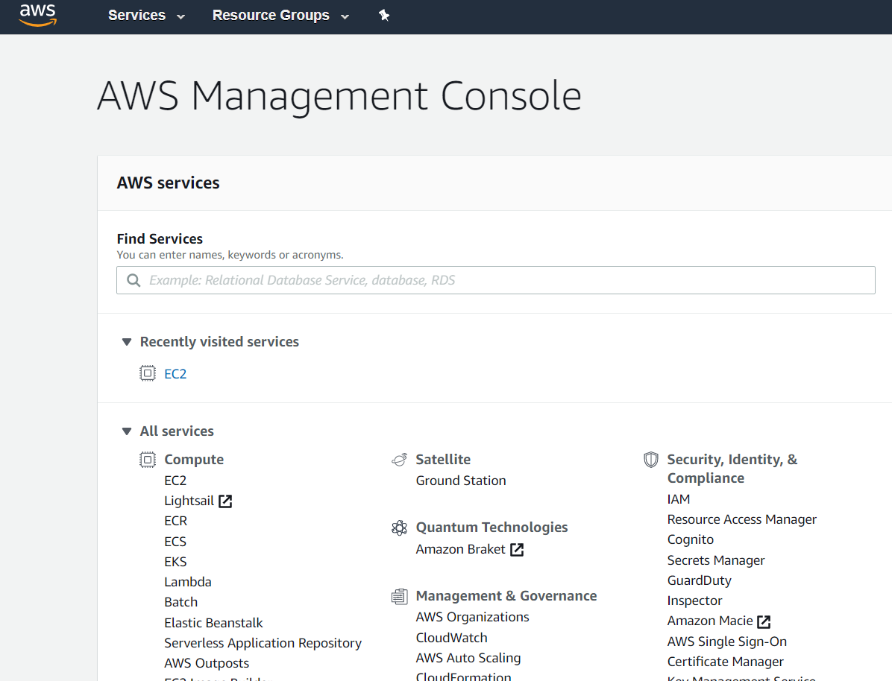
AWS – AWS Services
Home page

Slide 9
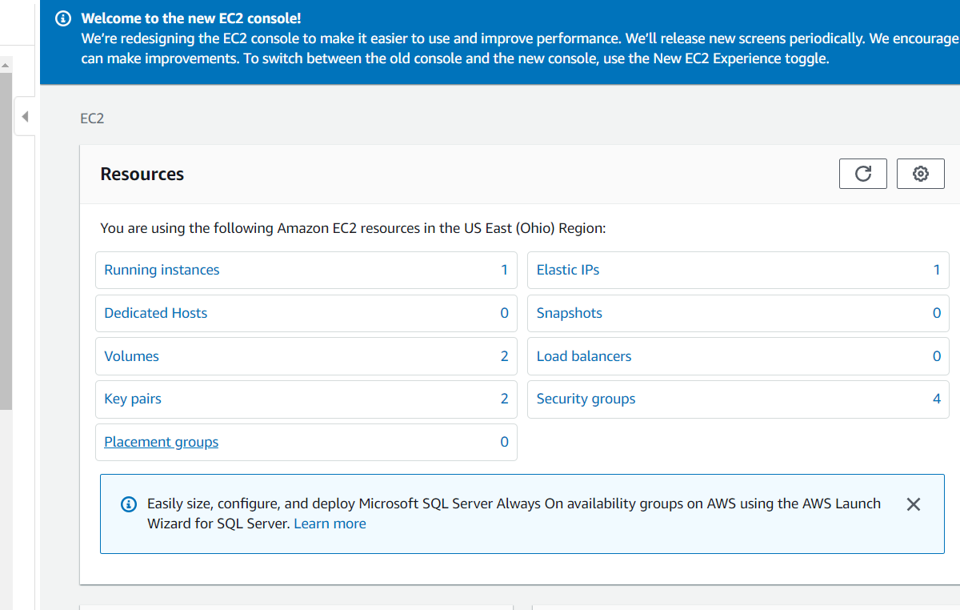
AWS – Compute - EC2
Click on EC2

Slide 10
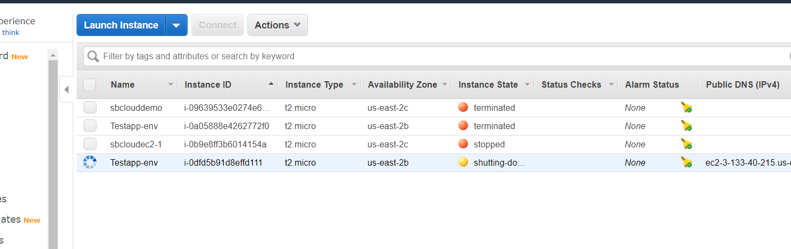
AWS – Compute - EC2
Running Instances – Click on Launch Instance

Slide 11
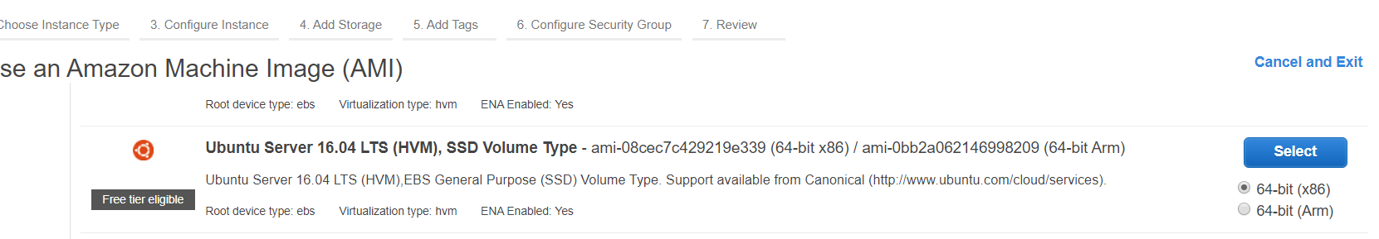
AWS – Compute - EC2
Launch Instance – Ubuntu – Free tier and click Review and launch

Slide 12
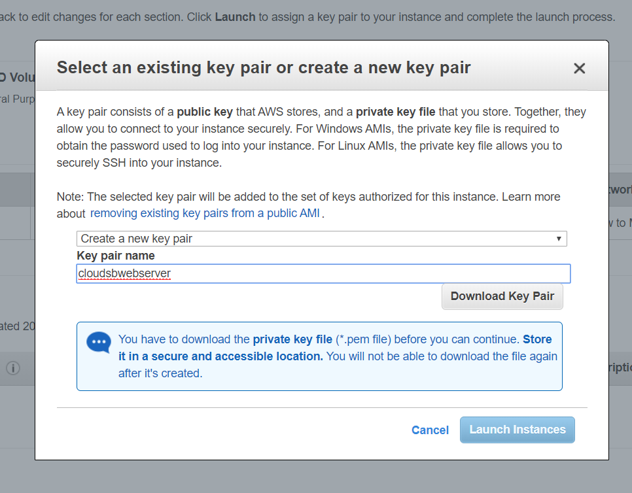
AWS – Compute - EC2
Download key value pair

Slide 13
AWS – Compute - EC2
Download key value pair and Launch Instances

Slide 14
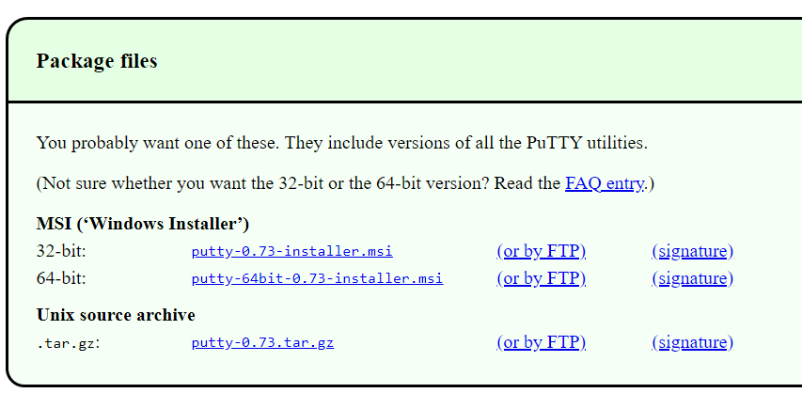
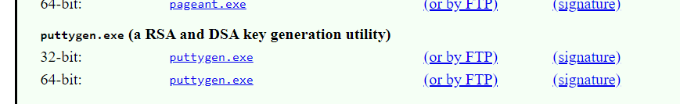
AWS – Compute - EC2
Copy downloaded file to a folder
Download putty and puttygen from https://www.putty.org/

Slide 15
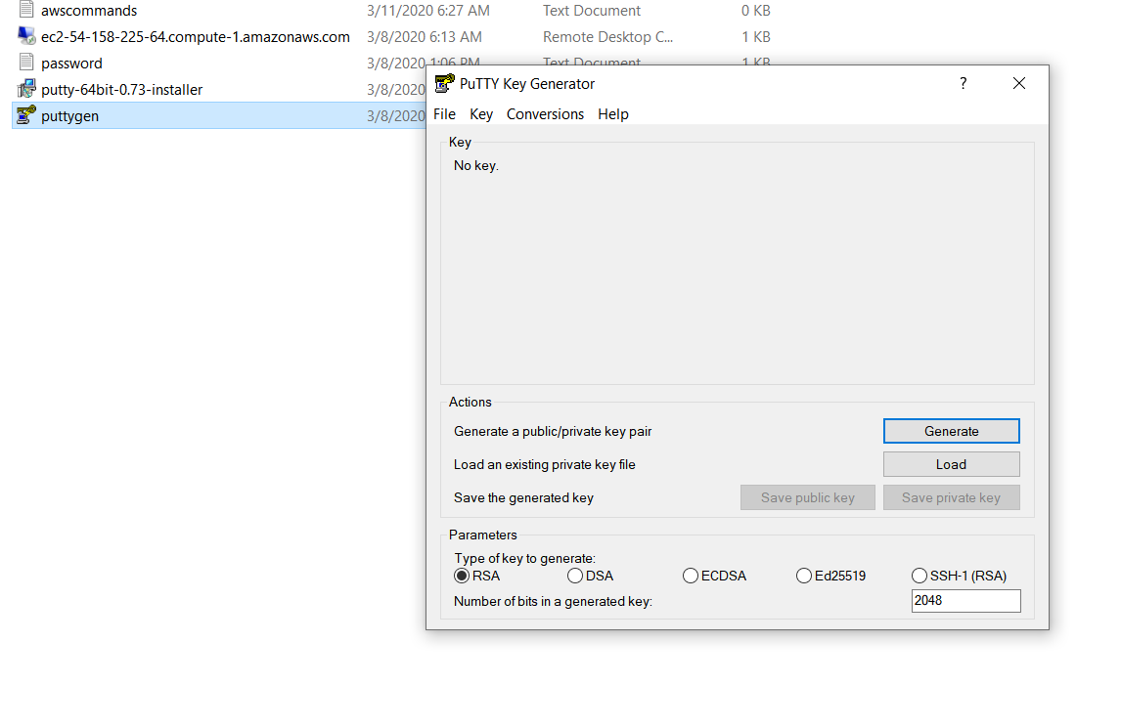
AWS – Compute - EC2
Install putty
Click on puttygen

Slide 16
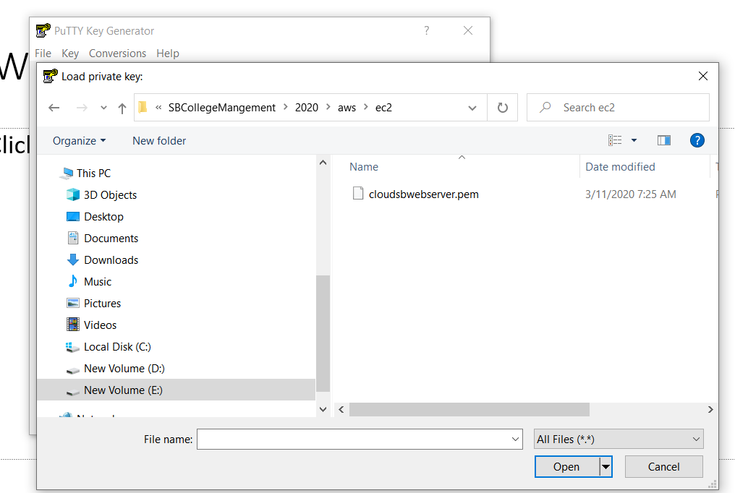
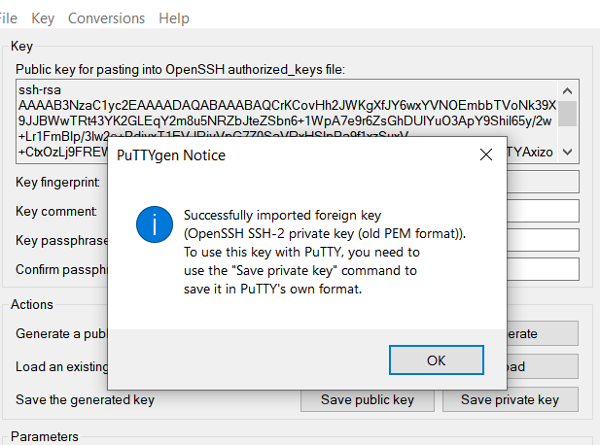
AWS – Compute - EC2
Click on Load and select downloaded pem file

Slide 17
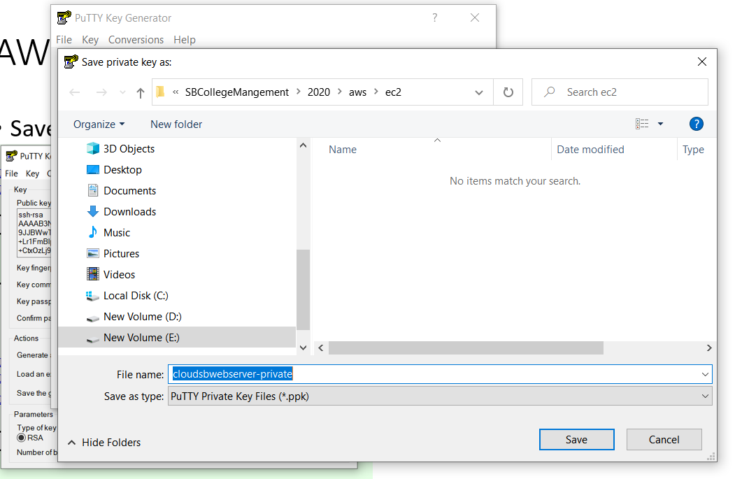
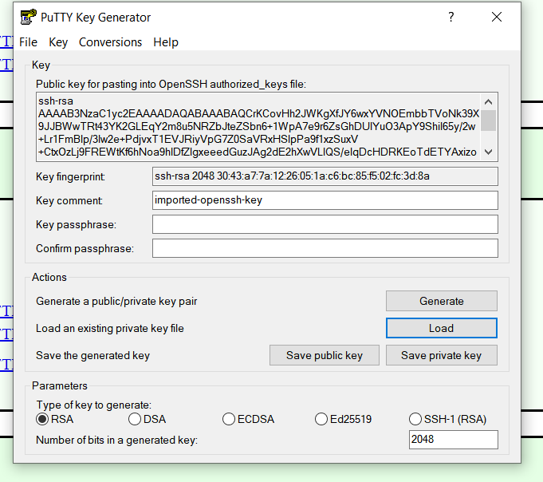
AWS – Compute - EC2
Save private and public key

Slide 18
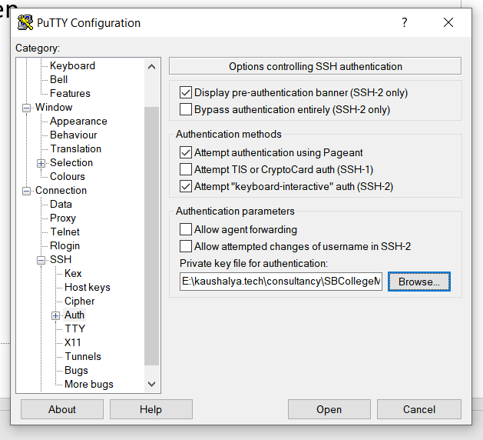
AWS – Compute - EC2
Browse the private key and open

Slide 19
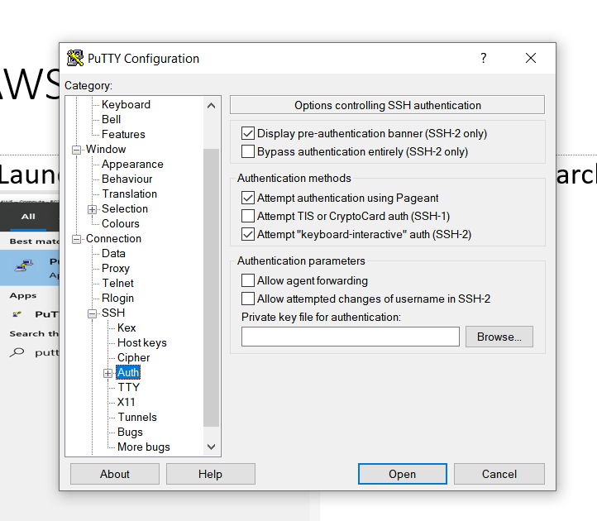
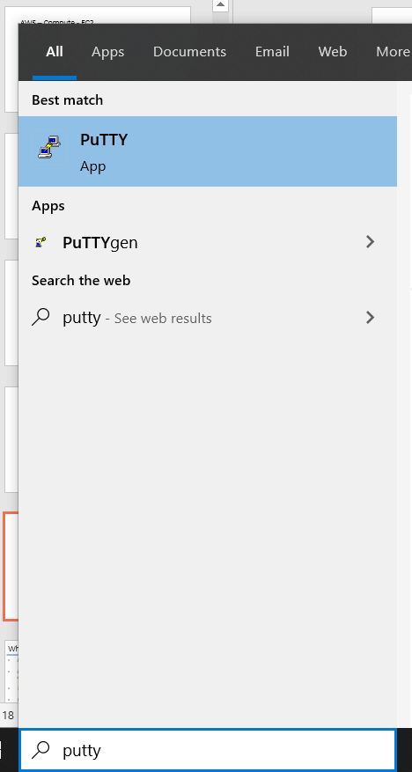
AWS – Compute - EC2
Launch putty by searching in the windows search
Click on SSH and Auth

Slide 20
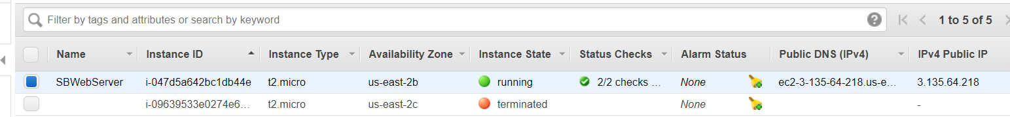
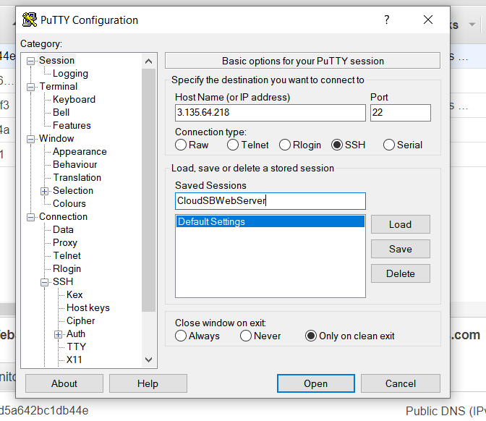
AWS – Compute - EC2
IPV4 address of the EC2 Instance and Save the instance in putty

Slide 21
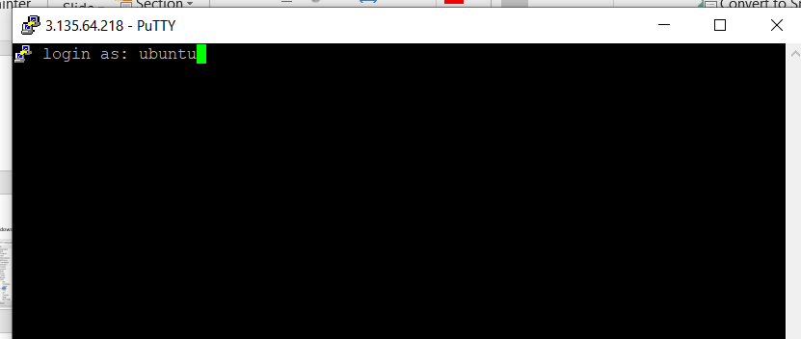
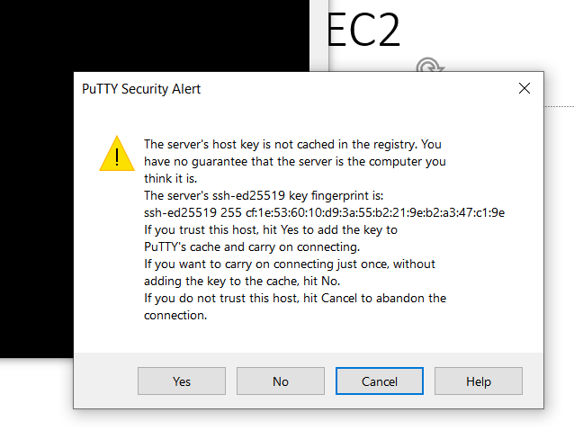
AWS – Compute - EC2
Open the instance anc click Yes and Login as ubuntu

Slide 22
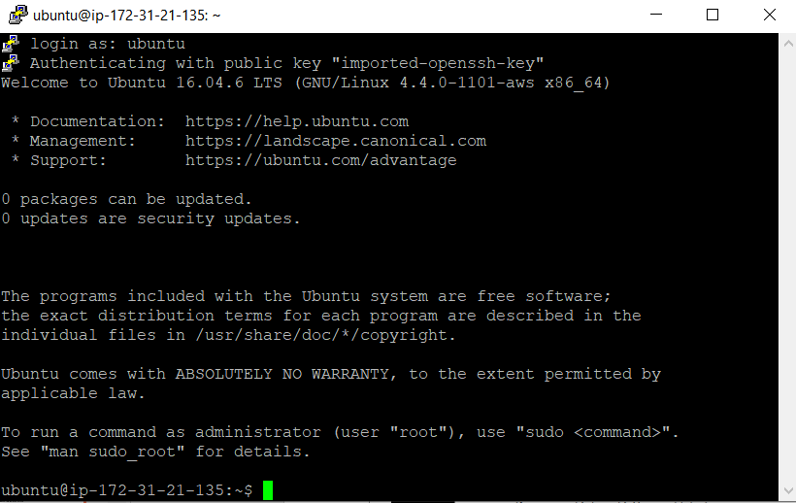
AWS – Compute - EC2
Open the instance anc click Yes and Login as ubuntu

Slide 23
AWS – Compute - EC2
Few commands used to install and run apache server
netstat –antp
apt-get –h
sudo apt-get update
sudo apt-get install apache2
sudo service apache2 stop
sudo service apache2 start

Slide 24
Why Us
Kaushalya is built by IT Professions having experience in academia
Our vision is to Skill, Up-Skill and Re-Skill in order to bridge the gap between academia and industry
Training is conducted by experienced IT Professionals
Vendors for major educational institutions and corporates

Slide 25

Thank You

