Slide 1
FULLSTACK Web Application Development using C#,.Net ,MVC
Raghu Prasad K S
SME
9845547471

Slide 2
Introduction
Raghu Prasad – BE, MS
Total of 27 years of experience
7 years as a lecturer in Engineering College
20 Years into IT
Worked with companies like CISCO, CSC, ICICI, First Apex – NTT Data
Currently into Corporate training, consultancy and application development
Worked with corporates and public sector
Technologies – Java, Python, C#,.Net Framework DataSciences, Web Technologies, Java Script technologies (MEAN stack), IOT, Test Automation – Selenium, Jmeter,Block Chain

Slide 3
Course Outline
Introduction to FULLSTACK Web Application Development
Technologies related to FULLSTACK web application
C#,.Net
Web application architecture

Slide 4
Course Objectives
Learn and explore FULLSTACK application development using Java and Angular
Learn by coding
Develop end to end module of a full Web Application Development
Develop web application using agile process

Slide 5
FULLSTACK Web Application Development
Full stack developer Simile
Defining, describing, and drawing you a picture…
I’m going to use the most popular example to define a full-stack developer. If there’s one person who wore many hats in his lifetime, it’s Leonardo Da Vinci. He was a painter, scientist, mathematician, cartographer, geologist, astronomer, historian, musician, and sculptor. People believe that diverse experiences fed into his creative genius, making him a nonpareil innovator.
If this extraordinary Renaissance man was a programmer today, he would be what we call a “full-stack” developer. Murky picture becoming a little clearer, I hope.

Slide 6
FULLSTACK Web Application Development
Full stack development: It refers to the development of both front end(client side) and back end(server side) portions of web application.
Full stack web Developers: Full stack web developers have the ability to design complete web application and websites. They work on the frontend, backend, database and debugging of web application or websites.

Slide 7
Technologies related to FULLSTACK development
Front end: It is the visible part of website or web application which is responsible for user experience. The user directly interacts with the front end portion of the web application or website.
Languages – HTML/CSS/Java Script/AJAX
Frameworks and Libraries – Angular, React, Bootstrap, Jquery, SAAS,.Net
Back end: It refers to the server-side development of web application or website with a primary focus on how the website works. It is responsible for managing the database through queries and APIs by client-side commands
Languages – PHP/C++/Java/Python/JavaScript-Node.js/C#
Frameworks and Libraries – Express, Django, Rails, Laravel, Spring,.Net
Database – Oracle, MySQL, MongoDB, MSSQL, PostgreSQL,MS-SQL

Slide 8
Technologies related to FULLSTACK development
Popular Stacks
MEAN (Mongo, Express, Angular, Node)
MERN (Mongo, Express, React, Node)
Django (Django, Python,MySQL)
Rails or Ruby on Rails (Ruby, PHP,MySQL)
LAMP (Linux, Apache, MySQL, PHP)
.Net (C#,MS-SQL)
Hybrid Stacks
Angular, Java,Spring
React, Java,Spring
Angular, Python,Django
Angular/React,.Net WebAPI

Slide 9
Tips to choose Web Tech Stack
Define project requirement – both functional and non functional requirement
Non functional
Scalability
Availability
Security
Maintainability
Development time
Development cost

Slide 10

FullStack Developer

Slide 11
Key skills of a FullStack Developer
Understand customer need and develop a use case
Convert use case into wire frame and user interface
Understand and implement responsive webdesign
Develop front end code
Understand project architecture and implement relevant design pattern.
Develop web services for backend integration
Understand the mechanism of interfacing with third party softwares
Such as ERP,payment gateway,etc
Develop backend code and interface with database (RDBMS,NoSQL,ORM)
Unit and integration testing

Slide 12
.Net
.NET is a software framework which is designed and developed by Microsoft. The first version of .Net framework was 1.0 which came in the year 2002. In easy words, it is a virtual machine for compiling and executing programs written in different languages like C#, VB.Net etc.
It is used to develop Form-based applications, Web-based applications and Web services. There is a variety of programming languages available on the .Net platform, VB.Net and C# being the most common ones are . It is used to build applications for Windows, phone, web etc. It provides a lot of functionalities and also supports industry standards.

Slide 13
Basic Architecture and Component Stack of .NET Framework
The first three components from bottom are considered as the basic architecture of .Net framework which came in the year 2005 and after this more components were added by Microsoft in the .Net Framework as following :_

Slide 14
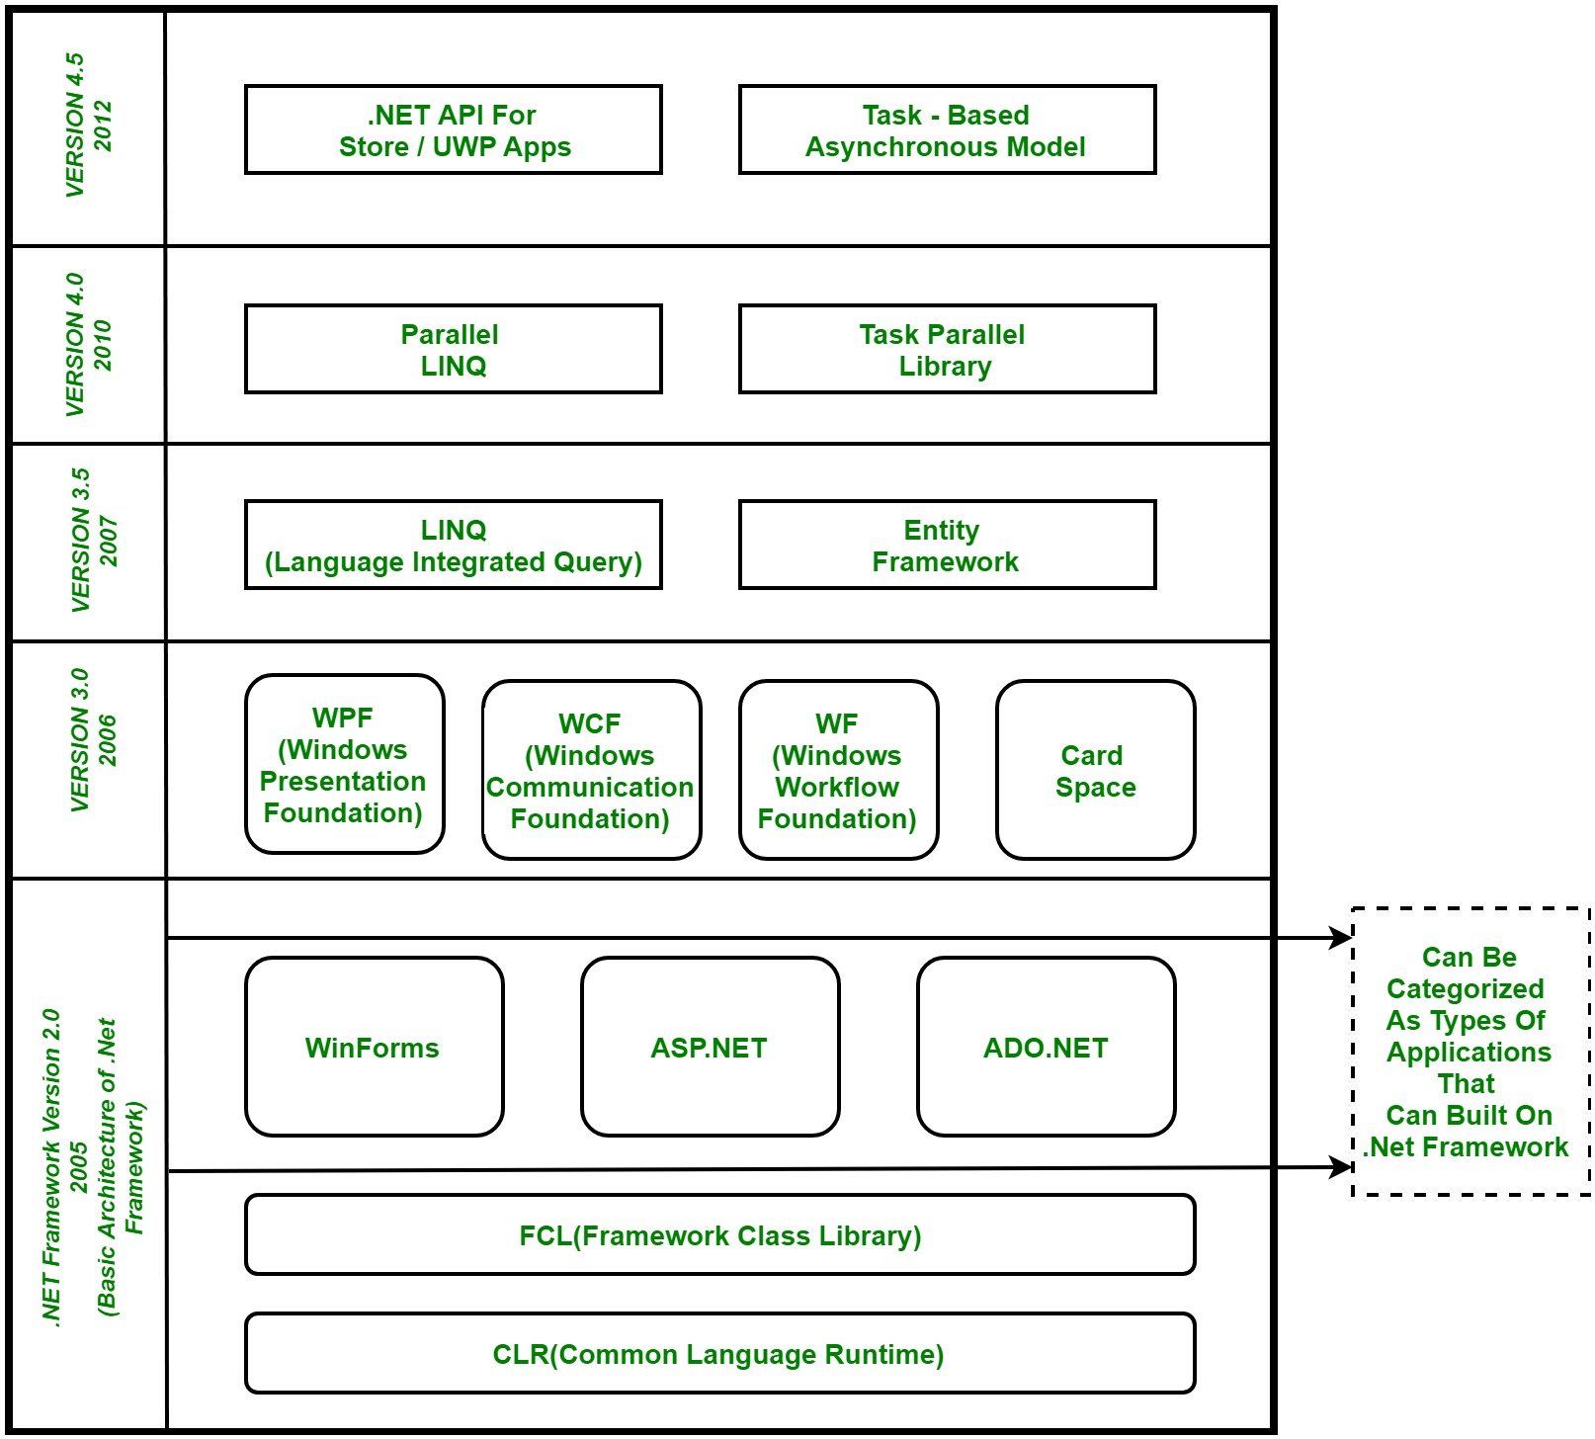
Basic Architecture and Component Stack of .NET Framework

Slide 15
Basic Architecture and Component Stack of .NET Framework
1. CLR (Common Language Runtime) : It is a run-time environment which executes the code written in any .NET programming language. .Net framework provides the support for many languages like C#, F#, C++, Cobra, Jscript.Net, VB.Net, Oxygene etc
2. FCL (Framework Class Library) : A large number of class libraries are present in this framework which is known as FCL.
3. Types of Applications : Mainly the applications which are built in .Net framework is divided into the following three categories :
WinForms : Form – Based applications are considered under this category. In simple terms, we can say client based applications which read and writes the file system comes under this category.
ASP .NET : Web-Based applications come under this category. ASP.Net is a framework for web and it provides the awesome integration of HTML, CSS and JavaScript which makes it useful to develop the web applications, websites and web services. Web services were added in .Net Framework 2.0 and considered as a part of ASP.NET web applications.
ADO .NET : It includes the application which are developed to communicate with the database like MS SQL Server, Oracle etc. comes. It mainly consists of classes that can be used to connect, retrieve, insert and delete data.

Slide 16
Basic Architecture and Component Stack of .NET Framework
4. WPF (Windows Presentation Foundation) : Windows Presentation Foundation (WPF) is a graphical subsystem given by Microsoft which uses DirectX and is used in Windows-based applications for rendering UI (User Interface). WPF was initially released as part of .NET Framework 3.0 in 2006 and previously known as “Avalon”.
5. WCF (Windows Communication Foundation) : It is a framework for building connected and service-oriented applications used to transmit the data as asynchronous from one service endpoint to another service point. It was previously known as the Indigo.
6. WF (Windows Workflow Foundation) : It is a technology given by Microsoft which provides a platform for building workflows within .Net applications.
7. Card Space : It is a Microsoft .NET Framework software client which is designed to let users provide their digital identity to online services in a secure, simple and trusted way.
8. LINQ (Language Integrated Query) : It is introduced in .Net framework version 3.5. Basically, it is a query language used to make the query for data sources with VB or C# programming languages.

Slide 17
Basic Architecture and Component Stack of .NET Framework
9. Entity Framework : It is open–source ORM (Object Relational Mapping) based framework which comes into .Net Framework version 3.5. It enables the .Net developer to work with database using .Net objects. Before entity framework, .Net developers have performed a lot of things related database. Like to open a connection to the database, developers have to create a Data Set to fetch or submit the data to the database, convert data from the Data Set to .NET objects or vice-versa. It creates the difficulties for developers and also it was the error-prone process, then “Entity Framework” comes to automate all these database related activities for the application. So, Entity Framework allows the developers to work at a higher level of abstraction.
Note : REST (Representational State Transfer) and AJAX were added in .Net Framework 3.5 as an extension and services of ASP.NET for enhancing web services of .NET Framework.
10. Parallel LINQ (Language Integrated Query) : It comes in .Net Framework version 4.0 and also termed as PLINQ. It provides a concurrent query execution engine for LINQ. It executes the LINQ in parallel such that it tries to use as much processing power system on which it is executing.

Slide 18
Basic Architecture and Component Stack of .NET Framework
11. TPL (Task Parallel Library) : It is a set of public types and APIs. It allows the developers to be more productive by simplifying the process of adding concurrency and parallelism to .Net applications.
12. .NET API For Store/UWP Apps : In 2012, Microsoft added some APIs for creating UWP(Universal Windows Platform) apps for Windows using C# or VB.
13. Task-Based Asynchronous Model : It is model used to describe the asynchronous operations and tasks in .Net Framework.
Reference : https://www.geeksforgeeks.org/c-sharp-net-framework-basic-architecture-component-stack/

Slide 19
Web Application Architecture
The web application architecture describes the interactions between applications, databases, and middleware systems on the web. It ensures that multiple applications work simultaneously.
Service Oriented Architecture (SOA)
Model View Controller (MVC)
Single Page Applications (SPA)
Microservices

Slide 20
Web Application Architecture – SOA
Service-Oriented Architecture (SOA) is a style of software design where services are provided to the other components by application components, through a communication protocol over a network. Its principles are independent of vendors and other technologies. In service oriented architecture, a number of services communicate with each other, in one of two ways: through passing data or through two or more services coordinating an activity. This is just one definition of Service-Oriented Architecture.

Slide 21
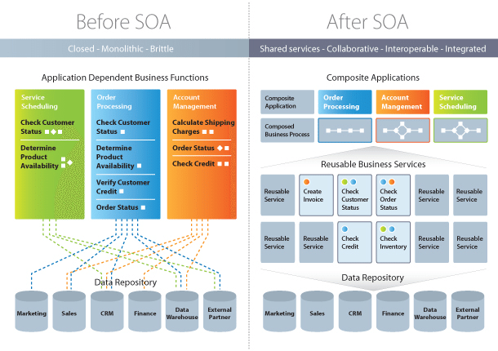
Web Application Architecture – SOA

Slide 22
Web Application Architecture – SOA
Characteristics of SOA
Business value
Strategic goals
Intrinsic inter-operability
Shared services
Flexibility
Evolutionary refinement

Slide 23
Web Application Architecture – SOA
Implementing SOA
Simple Object Accessing Protocol (SOAP)
In a nutshell, SOAP “is a messaging protocol specification for exchanging structured information in the implementation of web services in computer networks.
Representational State Transfer (REST)
It means when a RESTful API is called, the server will transfer to the client a representation of the state of the requested resource.

Slide 24
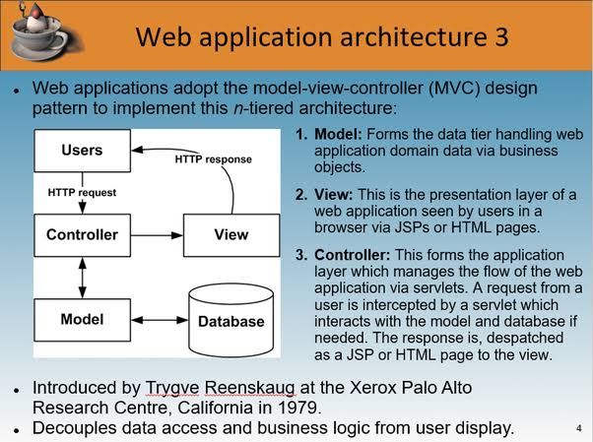
Web Application Architecture - MVC

Slide 25
Web Application Architecture - MVC
MVC – Advantages
Multiple developers can work with the three layers (Model, View, and Controller) simultaneously
Offers improved scalability, that supplements the ability of the application to grow
As components have a low dependency on each other, they are easy to maintain
A model can be reused by multiple views which provides reusability of code
Adoption of MVC makes an application more expressive and easy to understand
Extending and testing of the application becomes easy

Slide 26
Web Application Architecture – SPA’s
Single-Page Applications (SPAs) – Instead of loading completely new pages from the server each time for a user action, single page web applications allows for a dynamic interaction by means of providing updated content to the current page.
AJAX, a concise form of Asynchronous JavaScript and XML, is the foundation for enabling page communications and hence, making SPAs a reality. Because single-page applications prevent interruptions in user experience, they, in a way, resemble traditional desktop applications.
SPAs are designed in a way so that they request for most necessary content and information elements. This leads to the procurement of an intuitive as well as interactive user experience.

Slide 27
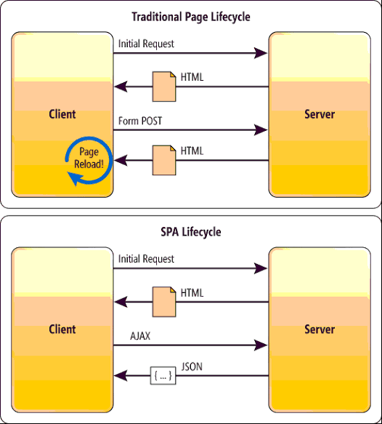
Web Application Architecture – SPA’s

Slide 28
Web Application Architecture – Microservices
Microservices – These are small and lightweight services that execute a single functionality. The Microservices Architecture framework has a number of advantages that allows developers to not only enhance productivity but also speed up the entire deployment process. The components making up an application build using the Microservices Architecture aren’t directly dependent on each other. As such, they don’t necessitate to be built using the same programming language. Hence, developers working with the Microservices Architecture are free to pick up a technology stack of choice. It makes developing the application simpler and quicker.

Slide 29
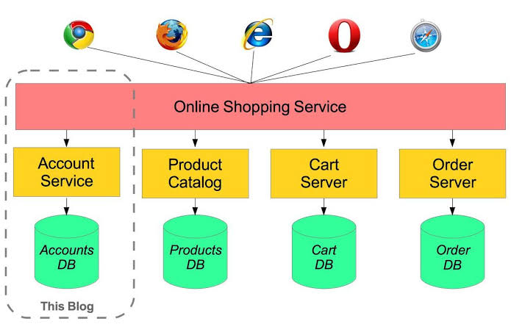
Web Application Architecture – Microservices

Slide 30
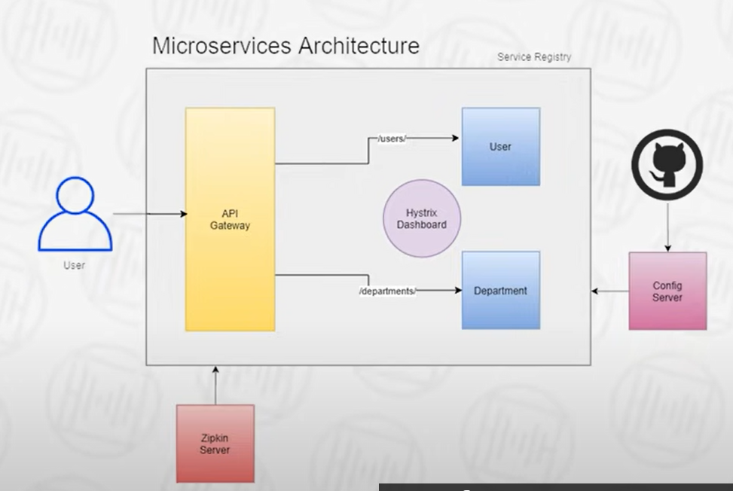
Web Application Architecture – Microservices

Slide 31
Q&A Session
Thanks

