Slide 1
Collections in C#
Raghu Prasad Konandur
SME
Steller

Slide 2
Introduction
Raghu Prasad – BE, MS
Total of 27 years of experience
7 years as a lecturer in an Engineering College
20 Years into IT
Worked with companies like CISCO,CSC,ICICI,First Apex – NTT Data
Currently into Corporate training and consultancy
Worked with corporates and public sector
Service Offerings – In person/On-line/Corporate/Academic Institutes
Consultancy – Consultant to vendor of Atal Tinkering Lab/ECIL-ECIT, Incarnus – Healthcare Service Provider, Automation Spectrum Pty Ltd,Australia,Tech Varaha,Bengaluru
Technologies – Java,Python,C#,.Net,Web technologies,Java Script technologies (MEAN stack),IOT,Test Automation,Machine Learning,Artificial Intelligence,Blockchain and ERP
Corporate Customers – iLink,Sony,IQVIA,ITC Infotech,Philips,L & T,NextGen,Incarnus,Aspire system,Netwoven,SkillUpRight
Academic Customers - BGS-IT,Sindhi College,Malnad Enginering College,S B College of Management, REVA University,Nagarjuna Engineering College,Dayanand Sagar University,Acharya Institute of Technology,NIE Mysore,NIT-Imphal, AMC College, Kristu Jayanti College,SIT Tumakuru,etc

Slide 3
Topics
Introduction to Collections
Types of Collections

Slide 4
Introduction to Collections
C# collection types are designed to store, manage and manipulate similar data more efficiently. Data manipulation includes adding, removing, finding, and inserting data in the collection. Collection types implement the following common functionality:
Adding and inserting items to a collection
Removing items from a collection
Finding, sorting, searching items
Replacing items
Copy and clone collections and items
Capacity and Count properties to find the capacity of the collection and number of items in the collection

Slide 5
Introduction to Collections
.NET supports two types of collections, generic collections and non-generic collections. Prior to .NET 2.0, it was just collections and when generics were added to .NET, generics collections were added as well.
Generic collections with work generic data type. Learn more about generics here: Generics in C#.

Slide 6
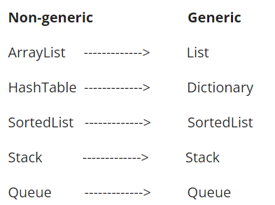
Types of Collections
The following table lists and matches these classes.
1. Non-Generic
In non-generic collections, each element can represent a value of a different type. The collection size is not fixed. Items from the collection can be added or removed at runtime.
C# ArrayList
ArrayList class is a collection that can be used for any types or objects.
Arraylist is a class that is similar to an array, but it can be used to store values of various types.
An Arraylist doesn't have a specific size.
Any number of elements can be stored.

Slide 7
Types of Collections
The following table lists and matches these classes.
1. Non-Generic
In non-generic collections, each element can represent a value of a different type. The collection size is not fixed. Items from the collection can be added or removed at runtime.
C# ArrayList
ArrayList class is a collection that can be used for any types or objects.
Arraylist is a class that is similar to an array, but it can be used to store values of various types.
An Arraylist doesn't have a specific size.
Any number of elements can be stored.

Slide 8
Types of Collections
C# HashSet is an unordered collection of the unique elements. It was introduced in .NET 3.5 and is found in System.Collections.Generic namespace.
It is used in a situation where we want to prevent duplicates from being inserted in the collection.
As far as performance is concerned, it is better in comparison to the list.

Slide 9
Thank You
Raghu Prasad Konandur
9845547471

