Slide 1
Introduction to .NET
Raghu Prasad Konandur
SME

Slide 2
Introduction
Raghu Prasad – BE, MS
Total of 27 years of experience
7 years as a lecturer in an Engineering College
20 Years into IT
Worked with companies like CISCO,CSC,ICICI,First Apex – NTT Data
Currently into Corporate training and consultancy
Worked with corporates and public sector
Service Offerings – In person/On-line/Corporate/Academic Institutes
Consultancy – Consultant to vendor of Atal Tinkering Lab/ECIL-ECIT, Incarnus – Healthcare Service Provider, Automation Spectrum Pty Ltd,Australia,Tech Varaha,Bengaluru
Technologies – Java,Python,C#,.Net,Web technologies,Java Script technologies (MEAN stack),IOT,Test Automation,Machine Learning,Artificial Intelligence,Blockchain and ERP
Corporate Customers – iLink,Sony,IQVIA,ITC Infotech,Philips,L & T,NextGen,Incarnus,Aspire system,Netwoven,SkillUpRight
Academic Customers - BGS-IT,Sindhi College,Malnad Enginering College,S B College of Management, REVA University,Nagarjuna Engineering College,Dayanand Sagar University,Acharya Institute of Technology,NIE Mysore,NIT-Imphal, AMC College, Kristu Jayanti College,SIT Tumakuru,etc

Slide 3
Topics
Introduction to .NET
Application Execution
Assemblies

Slide 4
Introduction to .NET
.NET is a free, cross-platform, open source developer platform for building many different types of applications.
With .NET, you can use multiple languages, editors, and libraries to build for web, mobile, desktop, games, IoT, and more.
Languages
You can write .NET apps in C#, F#, or Visual Basic.
C# is a simple, modern, object-oriented, and type-safe programming language.
F# is a programming language that makes it easy to write succinct, robust, and performant code.
Visual Basic is an approachable language with a simple syntax for building type-safe, object-oriented apps.

Slide 5
Introduction to .NET
Cross Platform
Whether you're working in C#, F#, or Visual Basic, your code will run natively on any compatible operating system. You can build many types of apps with .NET. Some are cross-platform, and some target a specific set of operating systems and devices.
One consistent API
.NET provides a standard set of base class libraries and APIs that are common to all .NET applications.

Slide 6
Introduction to .NET
One consistent API
.NET provides a standard set of base class libraries and APIs that are common to all .NET applications.
Each app model can also expose additional APIs that are specific to the operating systems it runs on, or the capabilities it provides. For example, ASP.NET is the cross-platform web framework that provides additional APIs for building web apps that run on Linux or Windows.

Slide 7
Introduction to .NET
Libraries
To extend functionality, Microsoft and others maintain a healthy .NET package ecosystem.
NuGet is a package manager built specifically for .NET that contains over 100,000 packages.
Application models
You can build many types of apps with .NET. To help you build apps faster, app models are built on top of the base libraries.

Slide 8
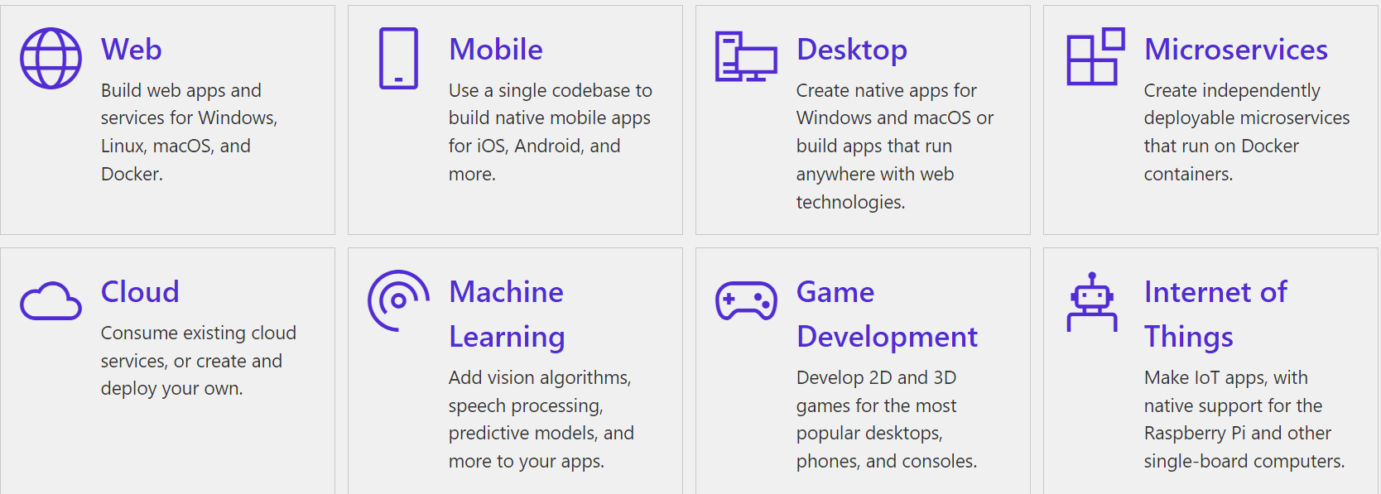
Introduction to .NET
Application models

Slide 9
Introduction to .NET
Download and Install
To start building .NET apps, download and install the .NET SDK (Software Development Kit).
https://dotnet.microsoft.com/en-us/learn/dotnet/hello-world-tutorial/install
Check everything installed correctly
Type dotnet in command prompt

Slide 10
Introduction to .NET
Create your app
In your command prompt, run the following command to create your app:
dotnet new console –o MyApp –f net6.0
What do these commands mean?
The dotnet new console command creates a new console app for you.
The -o parameter creates a directory named MyApp where your app is stored and populates it with the required files.
The -f parameter indicates you're creating a .NET 6 application.
The command cd MyApp changes your current directory to the one just created for the new app.

Slide 11
Introduction to .NET
Run your app
In your command prompt, run the following command:
dotnet run

Slide 12
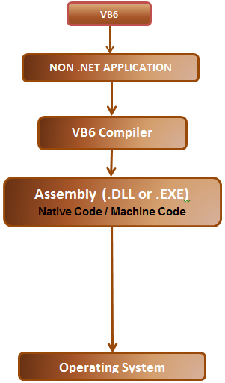
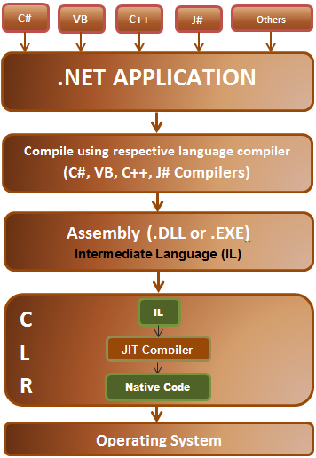
Application Execution

Slide 13
Application Execution
Common Language Runtime (CLR)
Intermediate Language (IL)/Common Intermediate language (CIL)/Microsoft Intermediate language (MSIL)
.NET the application execution consists of 2 steps 1. Language compiler, compiles the Source Code into Intermediate Language (IL) 2. JIT compiler in CLR converts, the IL into native code which can then be run on the underlying operating system.

Slide 14
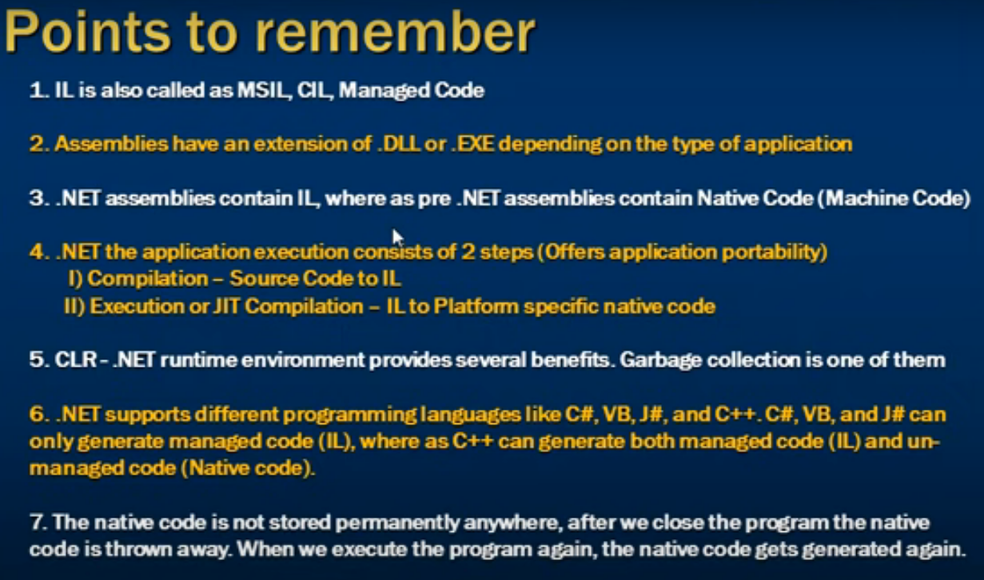
Application Execution

Slide 15
Assemblies in .NET
Assemblies are the fundamental units of deployment, version control, reuse, activation scoping, and security permissions for .NET-based applications. An assembly is a collection of types and resources that are built to work together and form a logical unit of functionality. Assemblies take the form of executable (.exe) or dynamic link library (.dll) files, and are the building blocks of .NET applications. They provide the common language runtime with the information it needs to be aware of type implementations.

Slide 16
Assemblies in .NET
Assemblies have the following properties:
Assemblies are implemented as .exe or .dll files.
For libraries that target .NET Framework, you can share assemblies between applications by putting them in the global assembly cache (GAC). You must strong-name assemblies before you can include them in the GAC. For more information, see Strong-named assemblies.
Assemblies are only loaded into memory if they're required. If they aren't used, they aren't loaded. Therefore, assemblies can be an efficient way to manage resources in larger projects.
You can programmatically obtain information about an assembly by using reflection. For more information, see Reflection (C#) or Reflection (Visual Basic).
You can load an assembly just to inspect it by using the MetadataLoadContext class on .NET and .NET Framework. MetadataLoadContext replaces the Assembly.ReflectionOnlyLoad methods.

Slide 17
Global Assembly Cache (GAC)
Each computer where the Common Language Runtime is installed has a machine-wide code cache called the Global Assembly Cache. The Global Assembly Cache stores assemblies specifically designated to be shared by several applications on the computer.
You should share assemblies by installing them into the Global Assembly Cache only when you need to. As a general guideline, keep assembly dependencies private, and locate assemblies in the application directory unless sharing an assembly is explicitly required. In addition, it is not necessary to install assemblies into the Global Assembly Cache to make them accessible to COM interop or unmanaged code.

Slide 18
Reference
https://csharp-video-tutorials.blogspot.com/2012/07/net-program-execution-part-1.html
https://www.geeksforgeeks.org/what-is-reflection-in-c-sharp/

Slide 19
Thank You
Raghu Prasad Konandur
9845547471

