Slide 1
Networking Concepts: Protocols, OSI Model & Packet Flow
Conversation Summary in PPT format

Slide 2
OSI Model (7 Layers)
Open System Interconnection (OSI)
Layer 7: Application → HTTP, FTP, SMTP
Layer 6: Presentation → TLS/SSL, JPEG, MP3
Layer 5: Session → NetBIOS, RPC
Layer 4: Transport → TCP/UDP, Ports
Layer 3: Network → IP, ICMP, Routing
Layer 2: Data Link → Ethernet, ARP, Switches
Layer 1: Physical → Cables, Wi-Fi signals

Slide 3
OSI Model – Table Summary
Layer | Name | Unit of Data | Examples
7 | Application | Data | HTTP, FTP, DNS, SMTP
6 | Presentation | Data | SSL/TLS, JPEG, MP3
5 | Session | Data | NetBIOS, RPC
4 | Transport | Segment | TCP, UDP
3 | Network | Packet | IP, ICMP, IPsec
2 | Data Link | Frame | Ethernet, Wi-Fi, ARP
1 | Physical | Bits | Cables, Hubs, Wi-Fi signals

Slide 4
Common Protocols and Ports
Key Protocols, Expansions, and Ports:
HTTP (HyperText Transfer Protocol) - Port 80/TCP
HTTPS (HyperText Transfer Protocol Secure) - Port 443/TCP
FTP (File Transfer Protocol) - Ports 20, 21/TCP
SFTP (SSH File Transfer Protocol) - Port 22/TCP
SSH (Secure Shell) - Port 22/TCP
Telnet (Teletype Network) - Port 23/TCP
SMTP (Simple Mail Transfer Protocol) - Ports 25, 465, 587/TCP
IMAP (Internet Message Access Protocol) - Port 143/TCP, IMAPS 993/TCP
POP3 (Post Office Protocol v3) - Port 110/TCP, POP3S 995/TCP
DNS (Domain Name System) - Port 53/TCP & UDP
DHCP (Dynamic Host Configuration Protocol) - Ports 67/68/UDP
SNMP (Simple Network Management Protocol) - Ports 161/162/UDP
LDAP (Lightweight Directory Access Protocol) - Port 389/TCP/UDP, LDAPS 636/TCP
RDP (Remote Desktop Protocol) - Port 3389/TCP/UDP
NTP (Network Time Protocol) - Port 123/UDP
TFTP (Trivial File Transfer Protocol) - Port 69/UDP
MySQL (Database Service) - Port 3306/TCP
PostgreSQL (Database Service) - Port 5432/TCP
SMB (Server Message Block) - Port 445/TCP
NetBIOS (Network Basic Input/Output System) - Ports 137-139/TCP & UDP

Slide 5
Ping vs ARP vs ICMP
ARP - (Address Resolution Protocol)
ICMP (Internet Control Message Protocol)
ARP (Layer 2) → Resolves IP to MAC
ICMP (Layer 3) → Used for diagnostics (Ping, Traceroute)
Ping → Utility that uses ICMP Echo Request/Reply
Ping often relies on ARP first in local networks

Slide 6
Mapping Real-World Examples to OSI
Ping → Uses ICMP (Layer 3) + ARP (Layer 2)
ARP → Layer 2 protocol to resolve IP→MAC
HTTP/HTTPS → Layer 7 protocol
TLS/SSL encryption at Layer 6
TCP/UDP ports at Layer 4
Encapsulation: Data flows down OSI layers
Decapsulation: Receiver strips headers upwards

Slide 7
Encapsulation & Decapsulation
HTTP request created at Application layer
TLS encrypts (Presentation layer)
TCP segments created (Transport layer)
IP packets formed with addressing (Network layer)
Framed with MAC addresses (Data Link layer)
Converted into signals (Physical layer)
Receiver performs reverse decapsulation

Slide 8
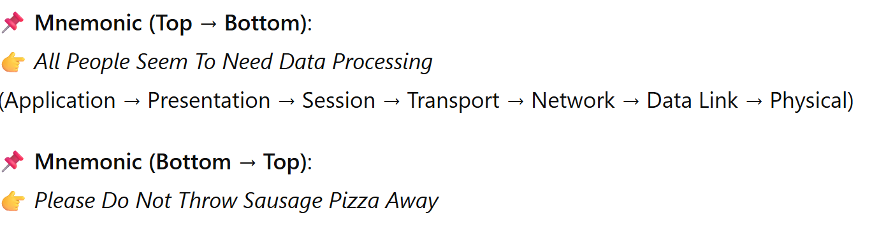
Easy Way to Remember the Layers

Slide 9
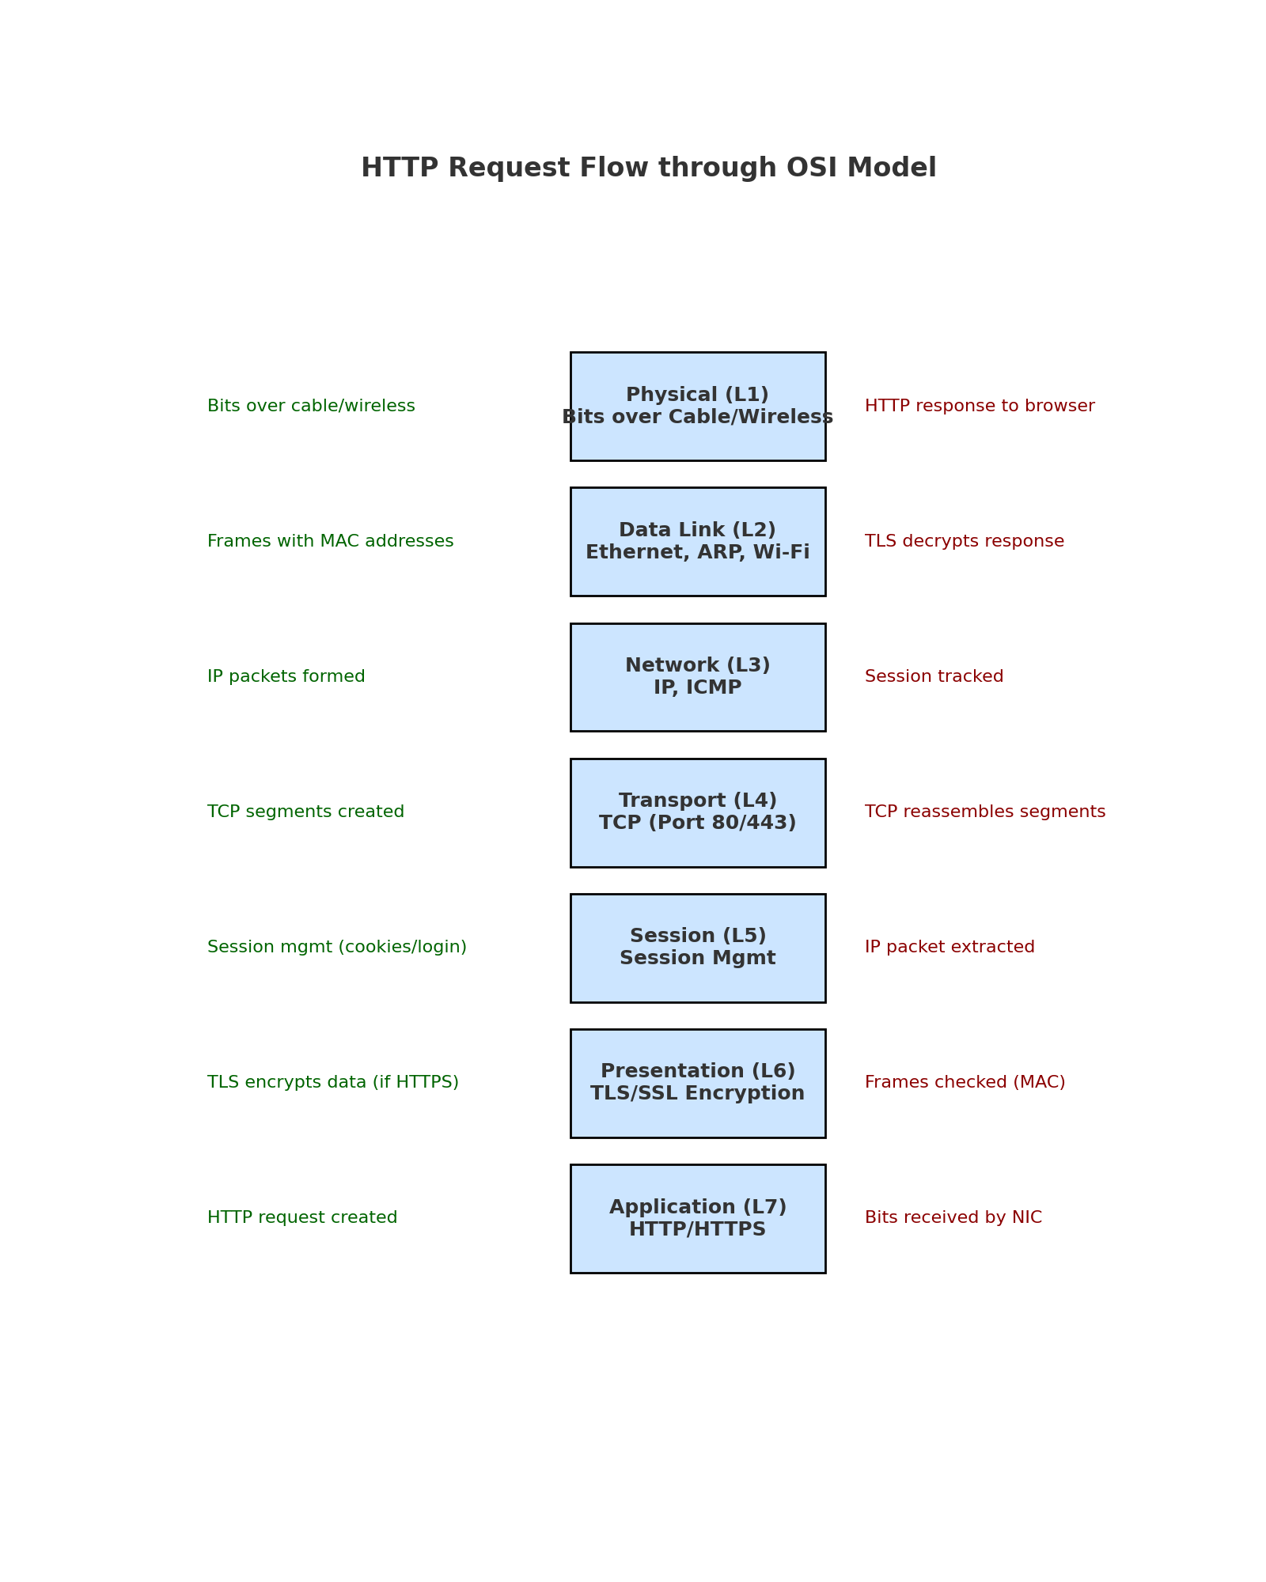
OSI Flow Diagram

Slide 10
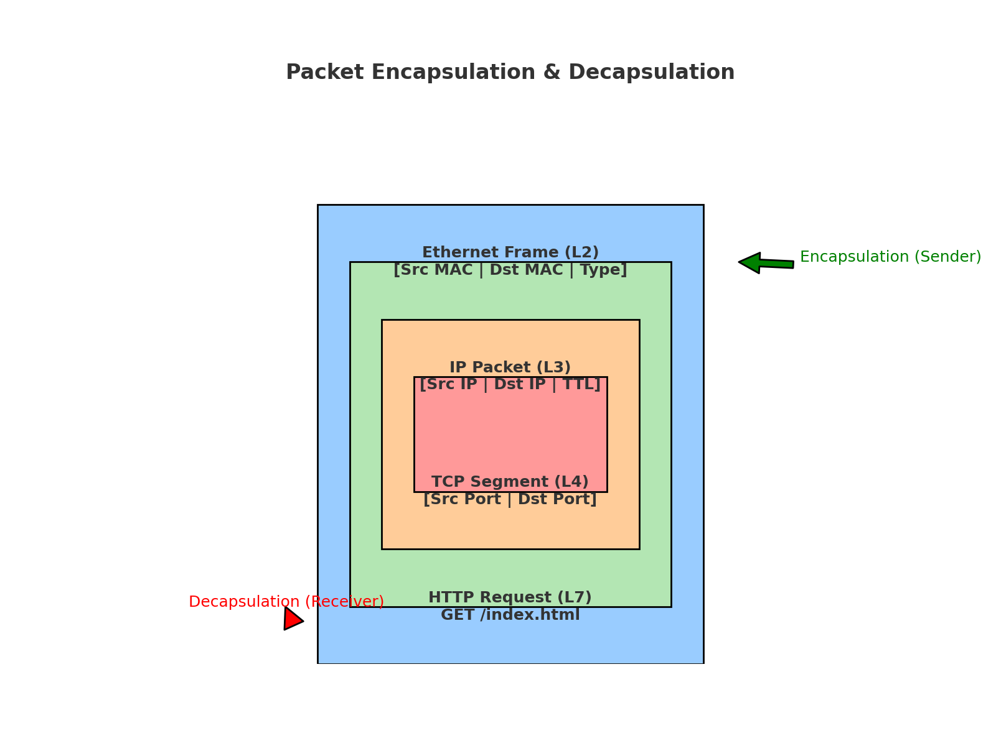
Packet Encapsulation & Decapsulation

Slide 11
Case Study: Ping google.com
Step-by-Step OSI Mapping for Ping:
Application (L7): User runs 'ping google.com'
Presentation (L6): No encryption used for ICMP
Session (L5): No session management for ping
Transport (L4): Ping does not use TCP/UDP, uses ICMP directly
Network (L3): ICMP Echo Request created with source & destination IP
Data Link (L2): ARP resolves IP → MAC if within same LAN
Physical (L1): Frame sent as bits over Ethernet/Wi-Fi
Reverse process (Decapsulation) happens when Echo Reply is received

