Slide 1

You Look At Once (YOLO)
Raghu Prasad Konandur
9845547471
www.kaushalya.tech
raghuprasadkonandur@kaushalya.tech

Slide 2
Introduction to YOLO
YOLO is an algorithm that uses neural networks to provide real-time object detection. This algorithm is popular because of its speed and accuracy. It has been used in various applications to detect traffic signals, people, parking meters, and animals.
Object detection is a phenomenon in computer vision that involves the detection of various objects in digital images or videos. Some of the objects detected include people, cars, chairs, stones, buildings, and animals.
This phenomenon seeks to answer two basic questions:
What is the object? This question seeks to identify the object in a specific image.
Where is it? This question seeks to establish the exact location of the object within the image.

Slide 3
Introduction to YOLO
Object detection consists of various approaches such as fast R-CNN, Retina-Net, and Single-Shot MultiBox Detector (SSD). Although these approaches have solved the challenges of data limitation and modeling in object detection, they are not able to detect objects in a single algorithm run. YOLO algorithm has gained popularity because of its superior performance over the aforementioned object detection techniques.
YOLO algorithm employs convolutional neural networks (CNN) to detect objects in real-time. As the name suggests, the algorithm requires only a single forward propagation through a neural network to detect objects.
This means that prediction in the entire image is done in a single algorithm run. The CNN is used to predict various class probabilities and bounding boxes simultaneously.

Slide 4
Why the YOLO algorithm is important
YOLO algorithm is important because of the following reasons:
Speed: This algorithm improves the speed of detection because it can predict objects in real-time.
High accuracy: YOLO is a predictive technique that provides accurate results with minimal background errors.
Learning capabilities: The algorithm has excellent learning capabilities that enable it to learn the representations of objects and apply them in object detection.

Slide 5
How YOLO works
YOLO algorithm works using the following three techniques:
Residual blocks (grids – standard 19 X 19)
Bounding box regression
Intersection Over Union (IOU)

Slide 6
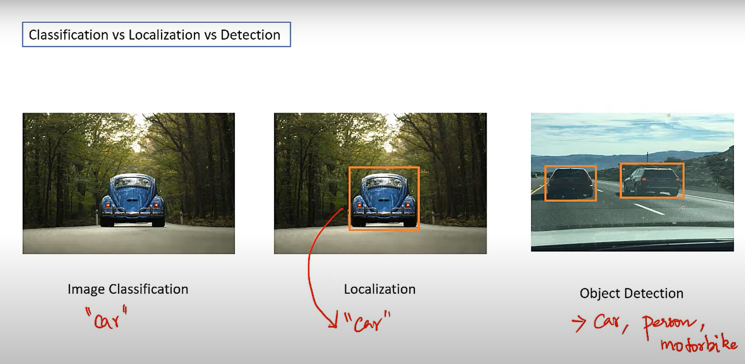
Classification vs Localization vs Detection

Slide 7
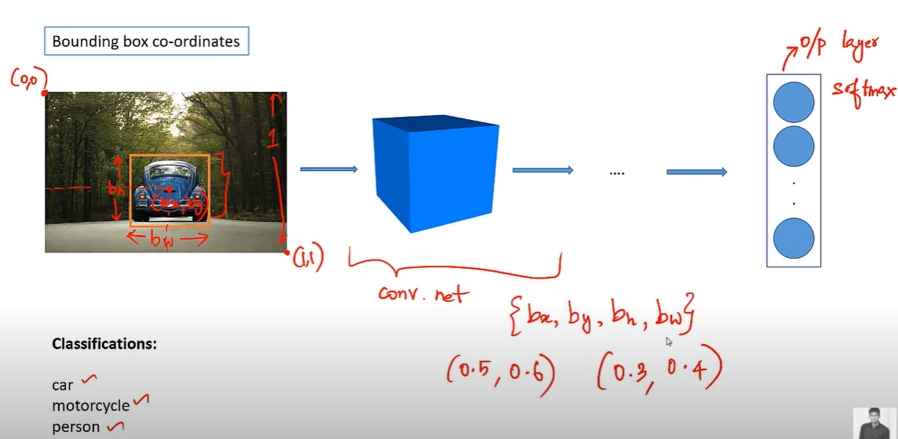
Bounding box co-ordinates

Slide 8
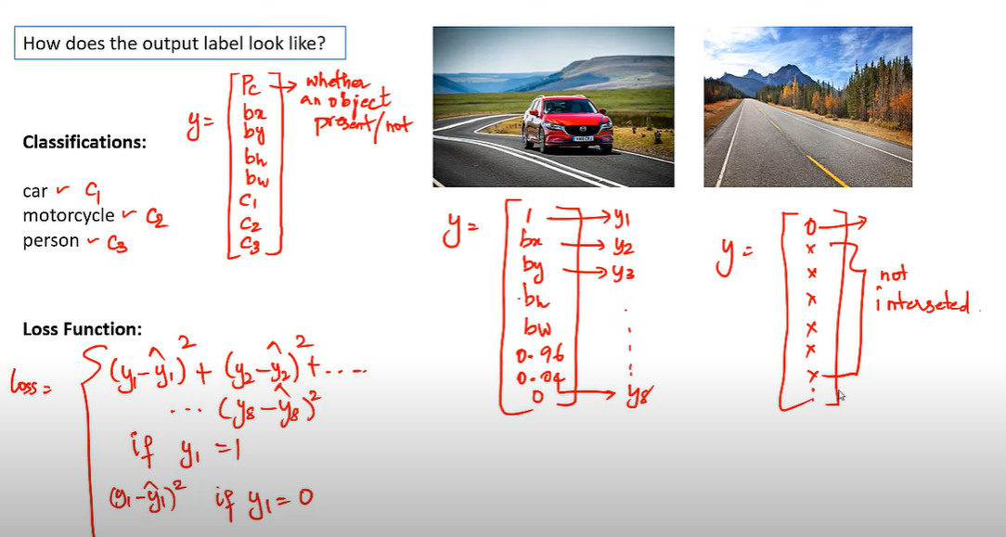
Output Label

Slide 9
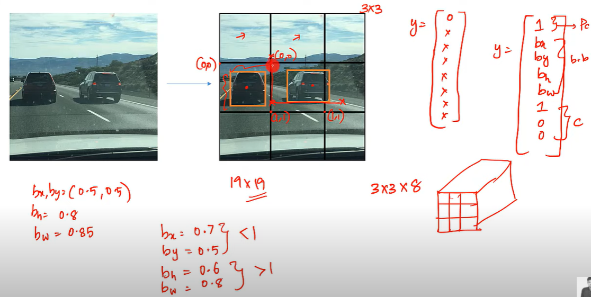
Output Label

Slide 10
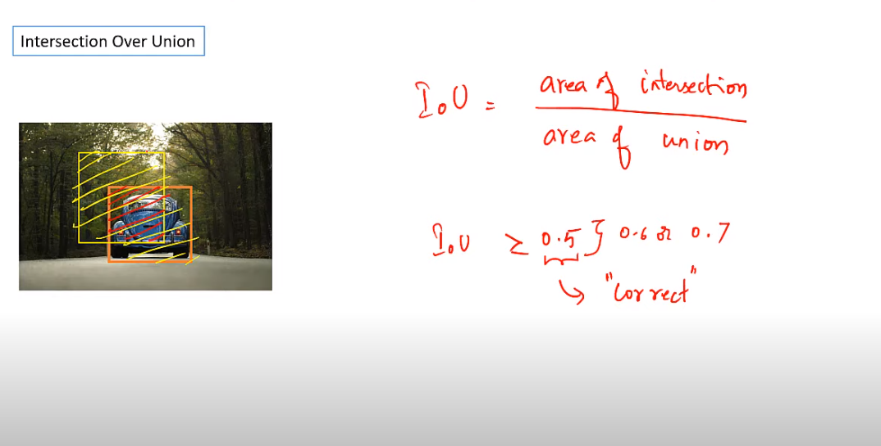
Insertion Over Union

Slide 11
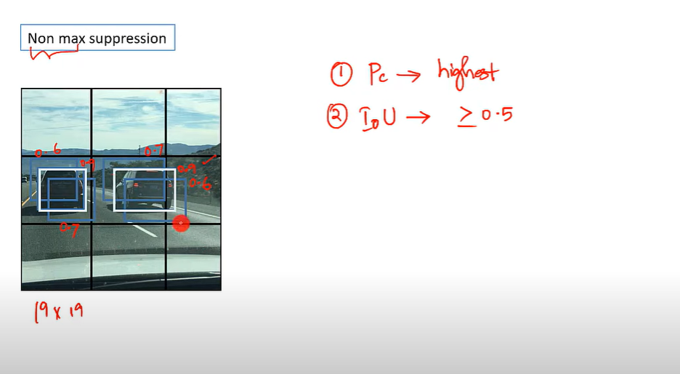
Non max supression

Slide 12
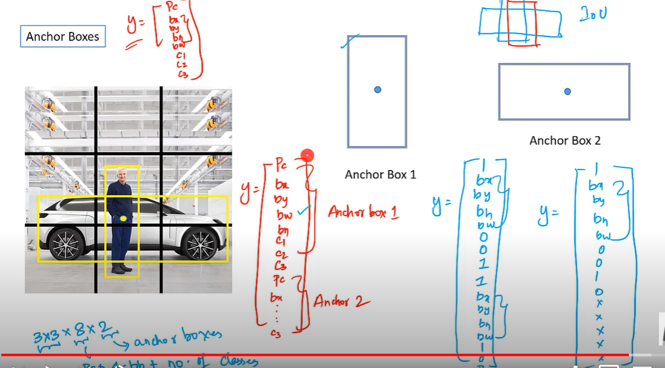
Anchor Boxes

Slide 13
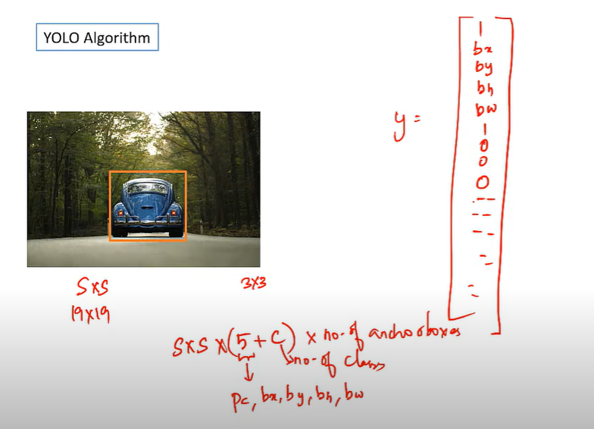
Summary

Slide 14
Applications of YOLO
Autonomous driving: YOLO algorithm can be used in autonomous cars to detect objects around cars such as vehicles, people, and parking signals. Object detection in autonomous cars is done to avoid collision since no human driver is controlling the car.
Wildlife: This algorithm is used to detect various types of animals in forests. This type of detection is used by wildlife rangers and journalists to identify animals in videos (both recorded and real-time) and images. Some of the animals that can be detected include giraffes, elephants, and bears.
Security: YOLO can also be used in security systems to enforce security in an area. Let’s assume that people have been restricted from passing through a certain area for security reasons. If someone passes through the restricted area, the YOLO algorithm will detect him/her, which will require the security personnel to take further action.

Slide 15
Thank You
Raghu Prasad Konandur
9845547471
www.kaushalya.tech
raghuprasadkonandur@kaushalya.tech

