Slide 1

Generative Adversarial Networks (GAN)
Raghu Prasad Konandur
9845547471
www.kaushalya.tech
raghuprasadkonandur@kaushalya.tech

Slide 2
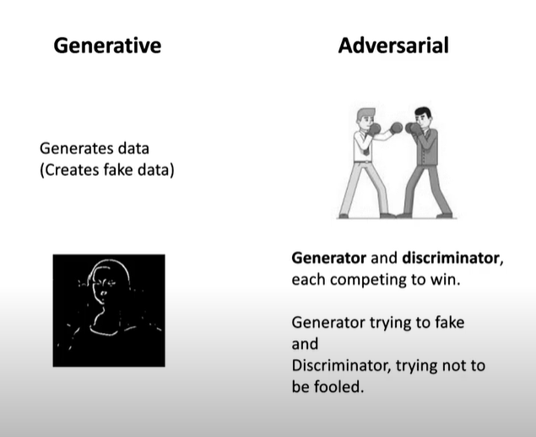
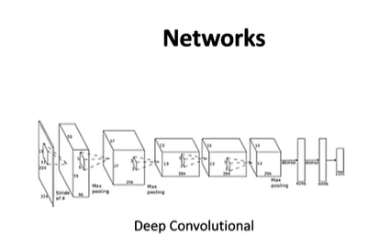
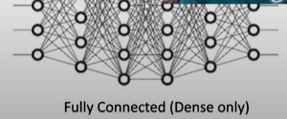
Introduction to GAN

Slide 3
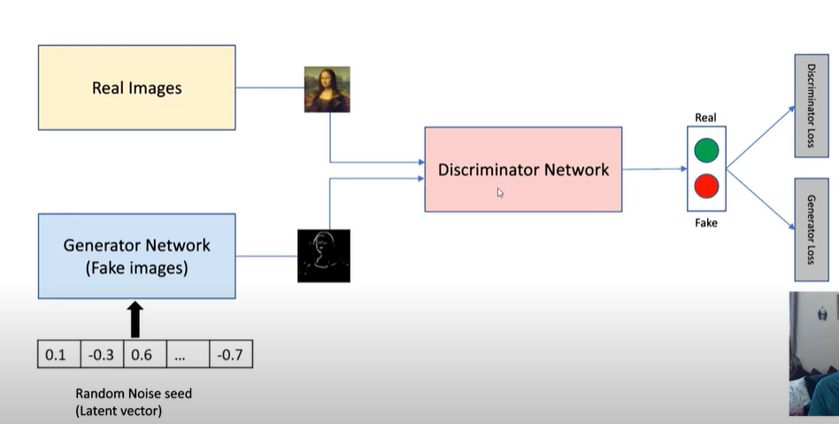
Introduction to GAN

Slide 4
Introduction to GAN

Slide 5
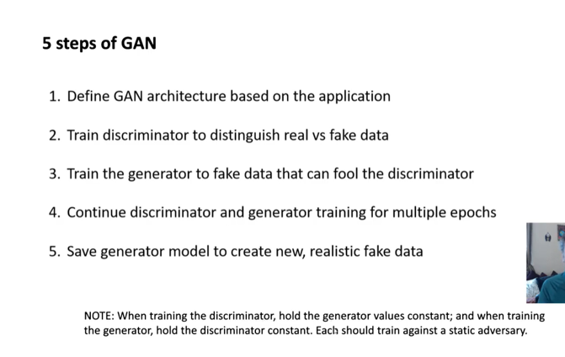
Introduction to GAN

Slide 6
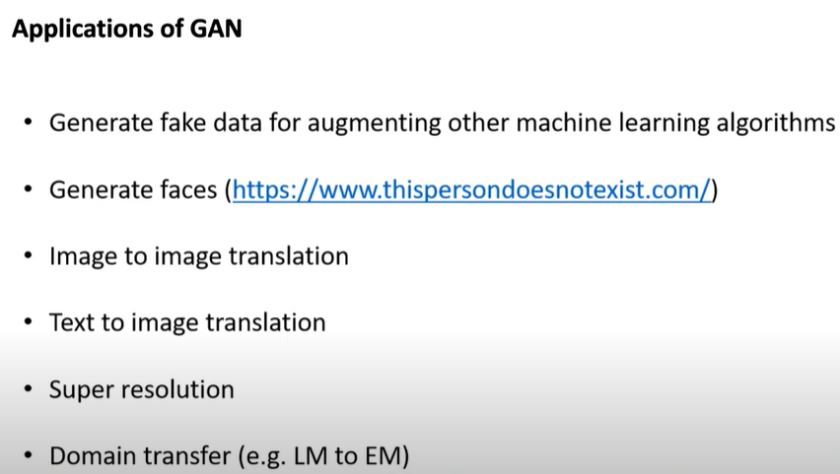
Introduction to GAN

Slide 7
Thank You
Raghu Prasad Konandur
9845547471
www.kaushalya.tech
raghuprasadkonandur@kaushalya.tech

