Slide 1

End to End Deployement
Raghu Prasad Konandur
9845547471
www.kaushalya.tech
raghuprasadkonandur@kaushalya.tech

Slide 2
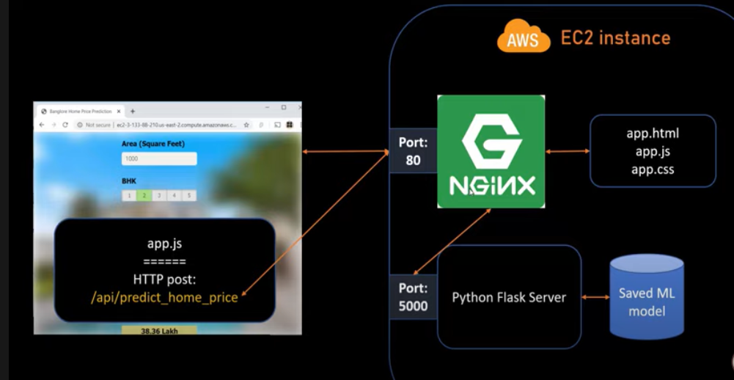
End to End Deployment

Slide 3
Thank You
Raghu Prasad Konandur
9845547471
www.kaushalya.tech
raghuprasadkonandur@kaushalya.tech

