Slide 1

End to End Deep Learning Project
Raghu Prasad Konandur
9845547471
www.kaushalya.tech
raghuprasadkonandur@kaushalya.tech

Slide 2
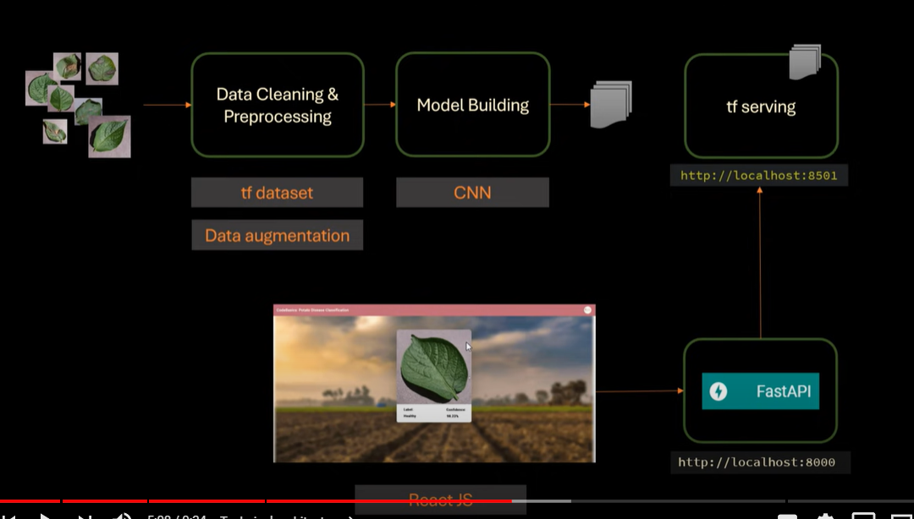
Architecture-Potato Disease identification

Slide 3
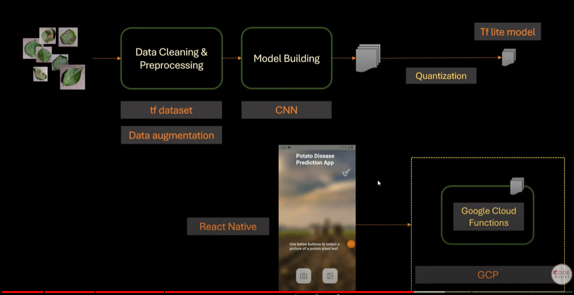
Architecture-Mobile App

Slide 4
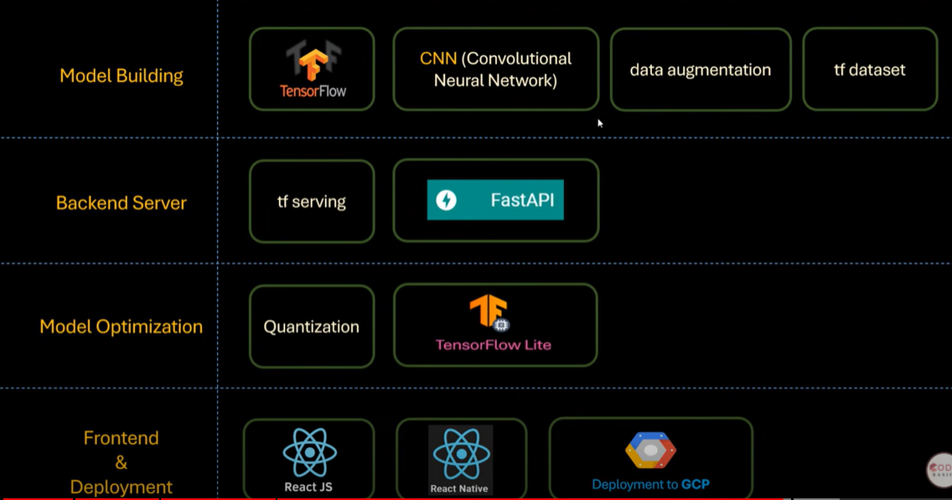
Overall Architecture

Slide 5
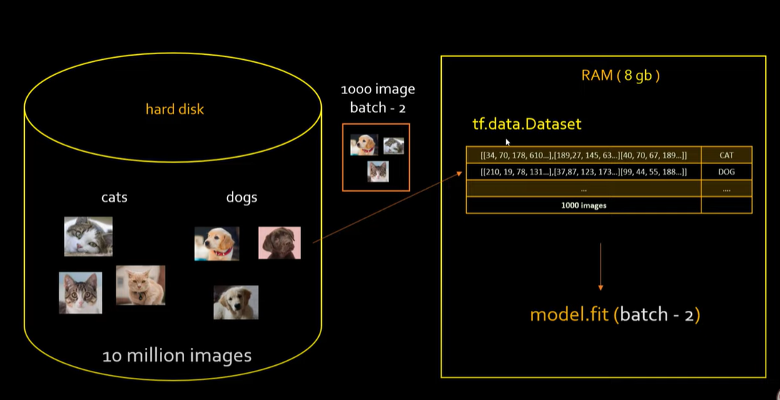
Tf.data.Dataset

Slide 6
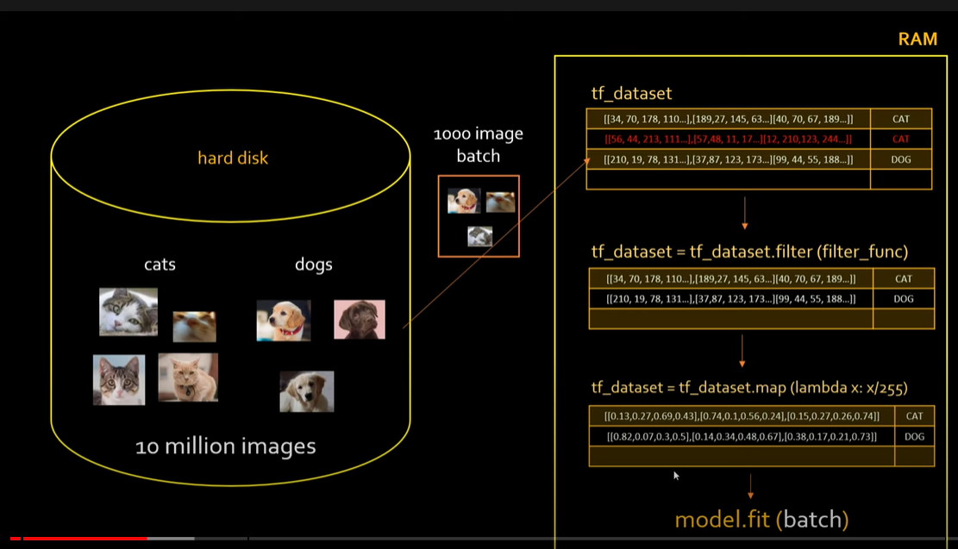
Tf.data.Dataset

Slide 7
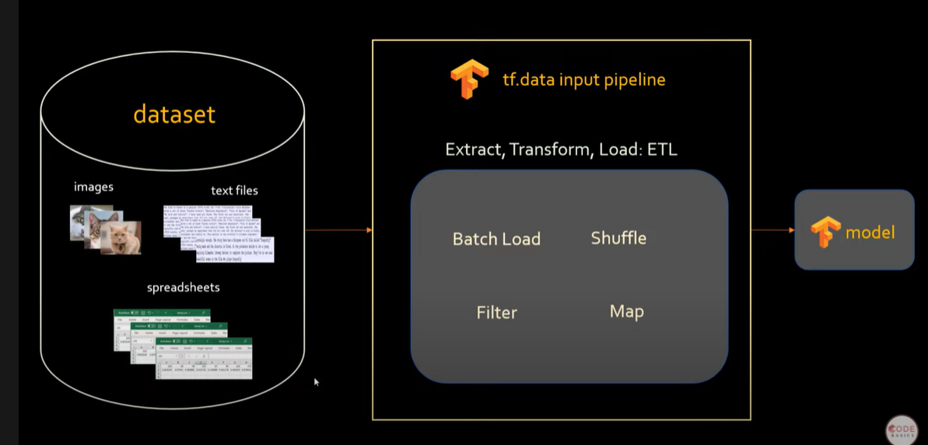
Tf.data.Dataset

Slide 8
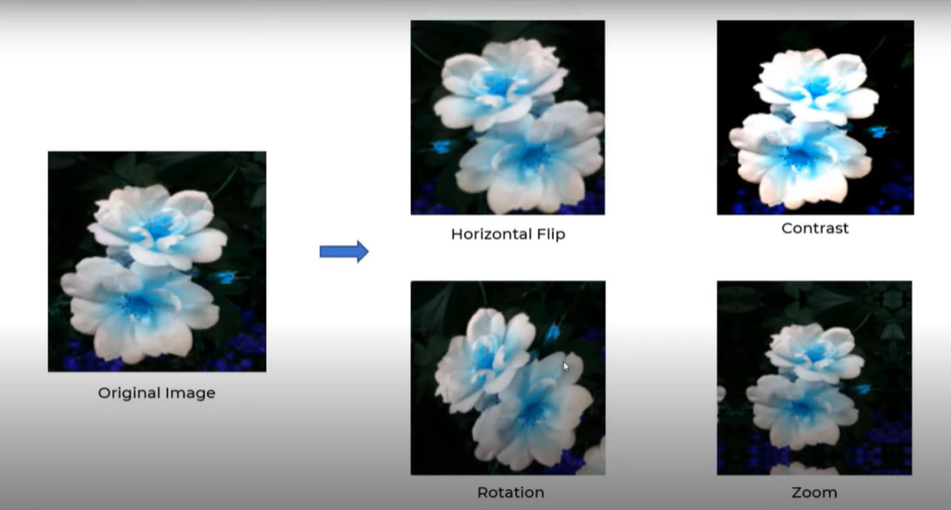
Augmentation

Slide 9
Thank You
Raghu Prasad Konandur
9845547471
www.kaushalya.tech
raghuprasadkonandur@kaushalya.tech

