Slide 1
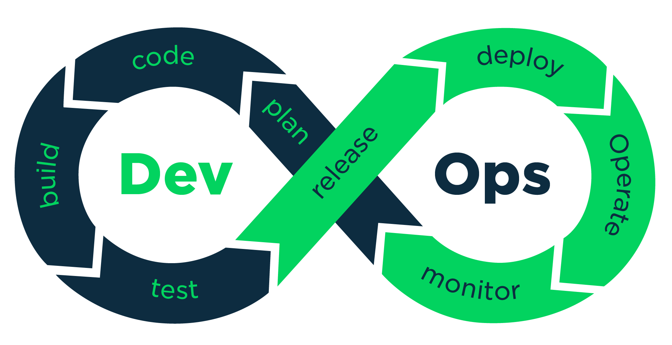
Workshop on DevOps
Raghu Prasad
9845547471
www.kaushalya.tech
CEO

Slide 2
Introduction
Raghu Prasad – BE, MS
Total of 30 years of experience
7 years as a lecturer in an Engineering College
23 Years into IT
Worked with companies like CISCO,CSC,ICICI,First Apex – NTT Data
Currently into Corporate training and consultancy
Worked with corporates and public sector
Service Offerings – In person/On-line/Corporate/Academic Institutes
Consultancy – Consultant to vendor of Atal Tinkering Lab/ECIL-ECIT, Incarnus – Healthcare Service Provider
Technologies – Java,Python,Web technologies,Java Script technologies (MEAN stack),IOT,Test Automation,Machine Learning,Artificial Intelligence,ERP,.NET,Cloud Computing,Devops,MLOps
Customers – ILinkDigital,Operative,Flatworld,IQVIA,Sony,Philips,L & T,NextGen,Incarnus,Aspire system,
NewHorizonCollege Of Engineering,NIE Mysore,Acharya College Of Engineering,SIT-Tumakuru,BGS-IT,Sindhi College,Malnad Enginering College,S B College of Management, REVA University,Nagarjuna Engineering College,Dayanand Sagar University,NIT-Imphal,Presidency University,SaiVidya Institute of Technology

Slide 3
Topics
Life Cycle of Software Deployment
Life Cycle of Datascience Project
Agile Development
Devops
Docker Container
Docker Hub

Slide 4
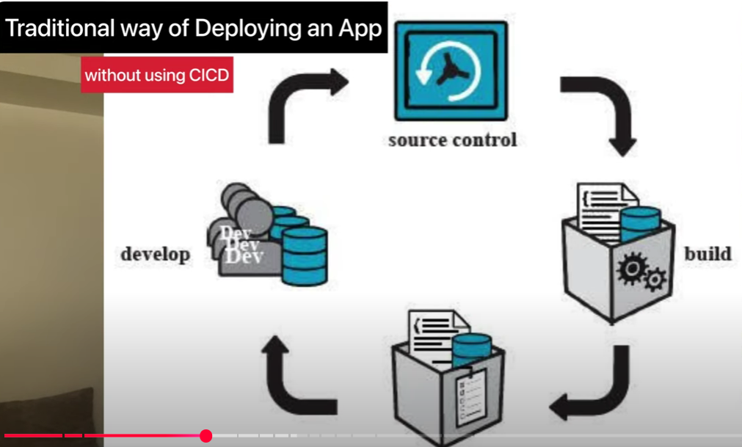
Life Cycle of a Software Deployment

Slide 5
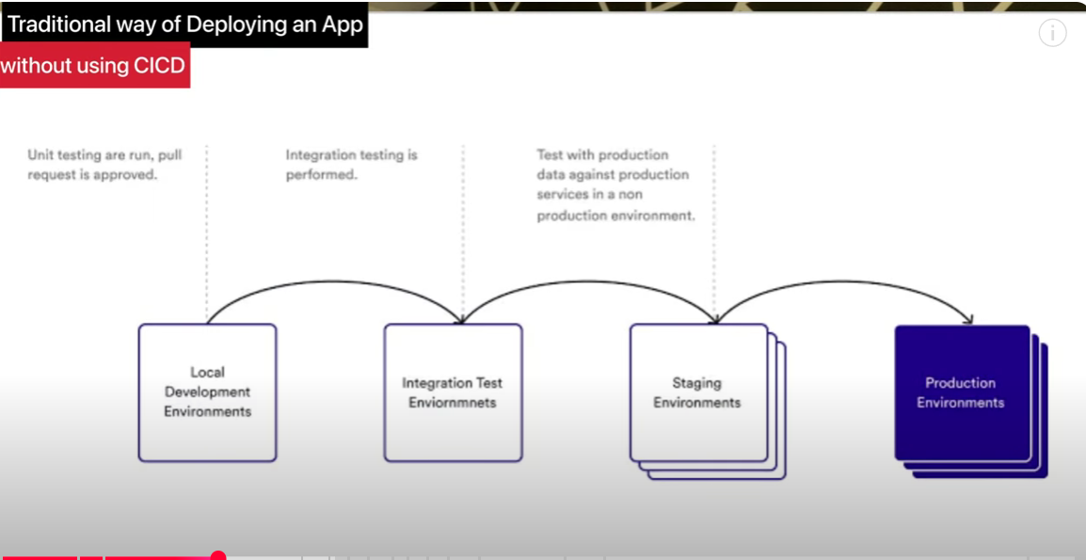
Life Cycle of a Software Deployment

Slide 6
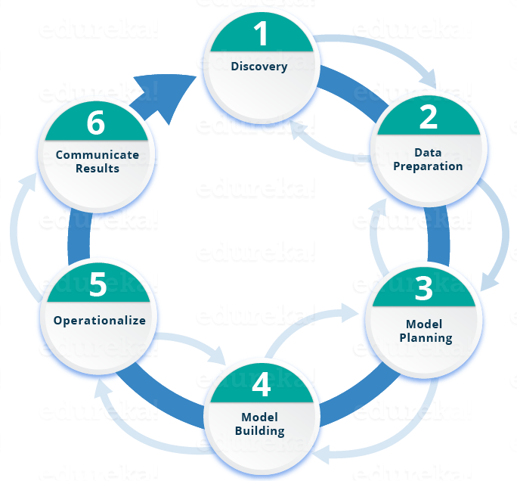
Life Cycle of DataScience Project

Slide 7
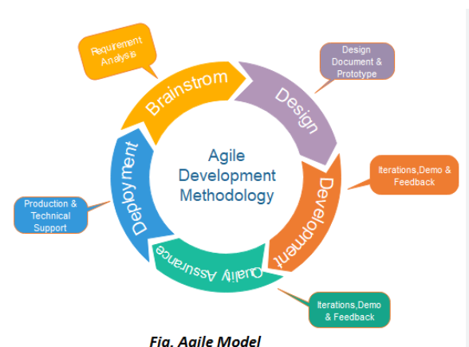
Agile Development Methodology

Slide 8
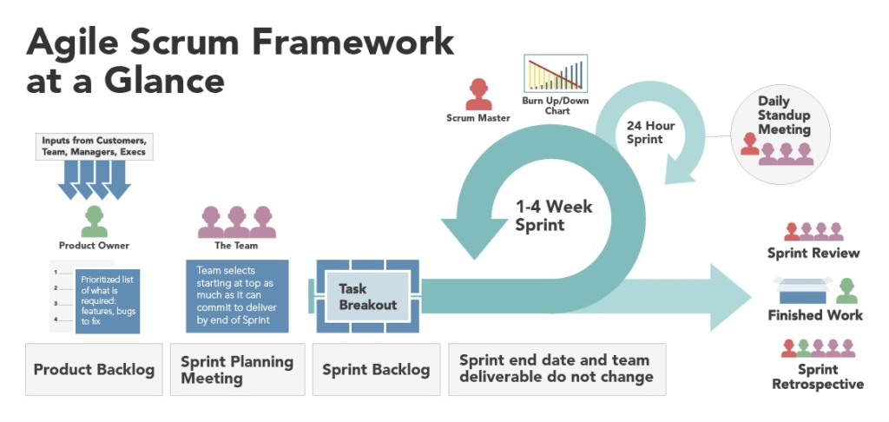
Agile Scrum Framework for development

Slide 9
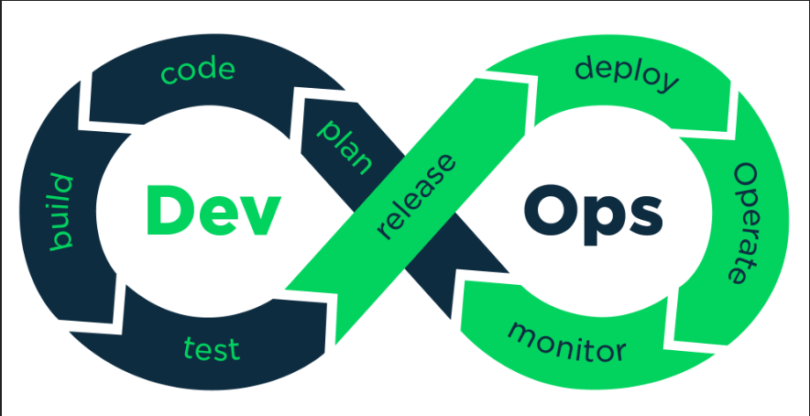
Introduction to DevOps

Slide 10
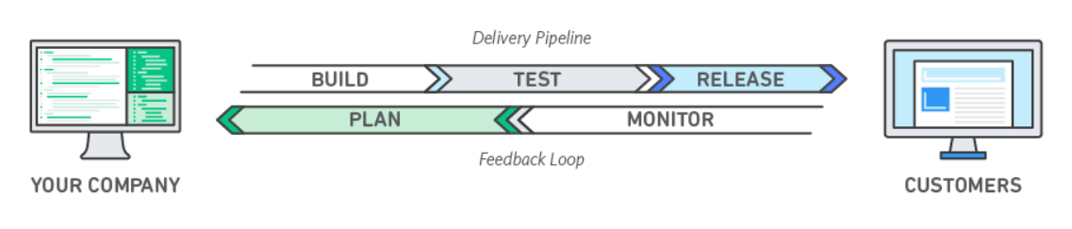
DevOps
DevOps is the combination of cultural philosophies, practices, and tools that increases an organization’s ability to deliver applications and services at high velocity: evolving and improving products at a faster pace than organizations using traditional software development and infrastructure management processes.

Slide 11
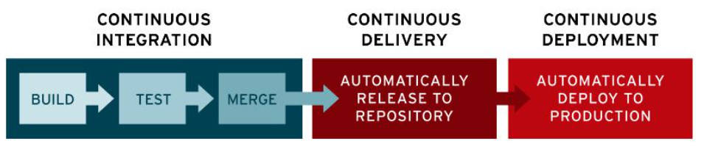
CI/CD
CI/CD stands for continuous integration and continuous delivery or deployment. Discover why CI/CD is important for DevOps teams and how to start a career in this growing field.

Slide 12
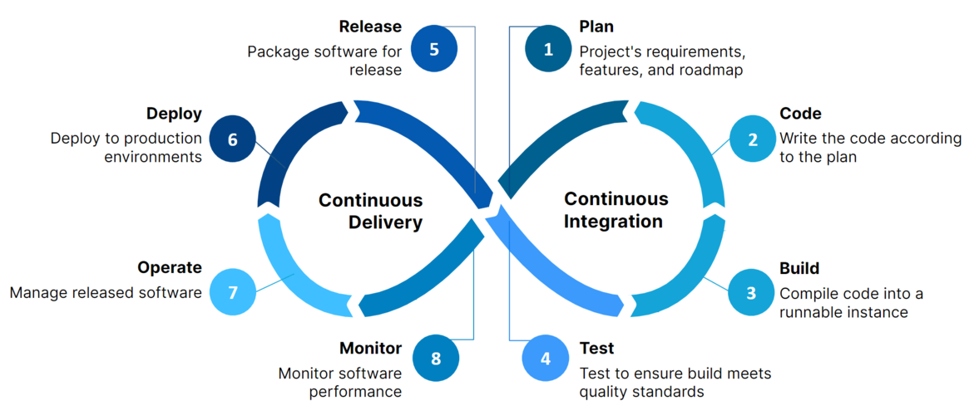
DevOps - CICD

Slide 13
Docker
Docker is a set of platform as a service products that use OS-level virtualization to deliver software in packages called containers.
Docker is a software platform that allows you to build, test, and deploy applications quickly.
The service has both free and premium tiers. The software that hosts the containers is called Docker Engine.
It was first released in 2013 and is developed by Docker, Inc.
Docker packages software into standardized units called containers that have everything the software needs to run including libraries, system tools, code, and runtime.
Using Docker, you can quickly deploy and scale applications into any environment
and know your code will run.
https://aws.amazon.com/docker/

Slide 14
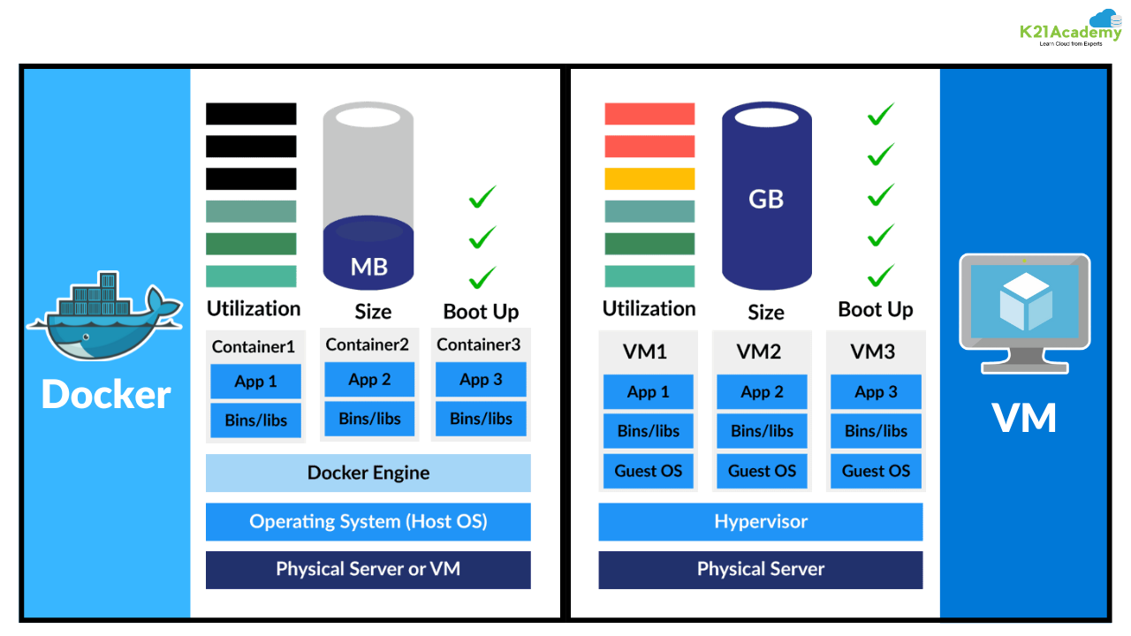
Docker Vs VM

Slide 15
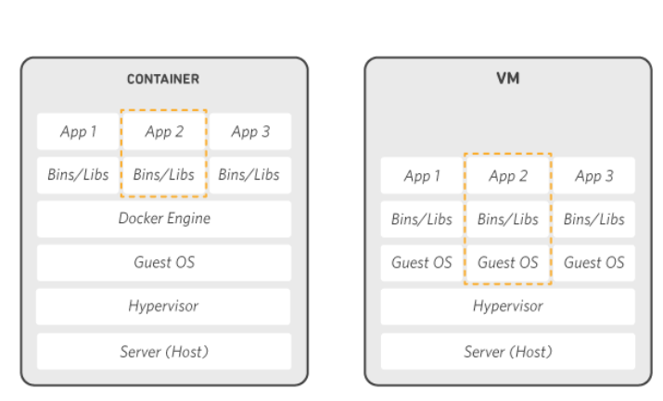
How Docker Works

Slide 16
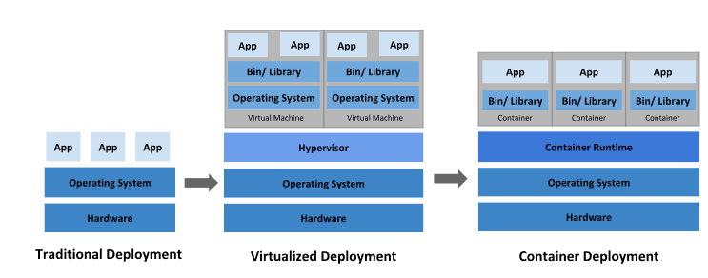
Kubernetes
Kubernetes (also known as k8s or “kube”) is an open source container orchestration platform that automates many of the manual processes involved in deploying, managing, and scaling containerized applications.

Slide 17
Learning Path – Devops
Agile Development
Version Control – (git)
Coding (Python)
Docker and Docker Hub
Github actions – (CI/CD)
Jenkins
AWS
Monitoring

Slide 18
Thank You
Raghu Prasad
9845547471
www.kaushalya.tech

