Slide 1
Kupernetes

Slide 2
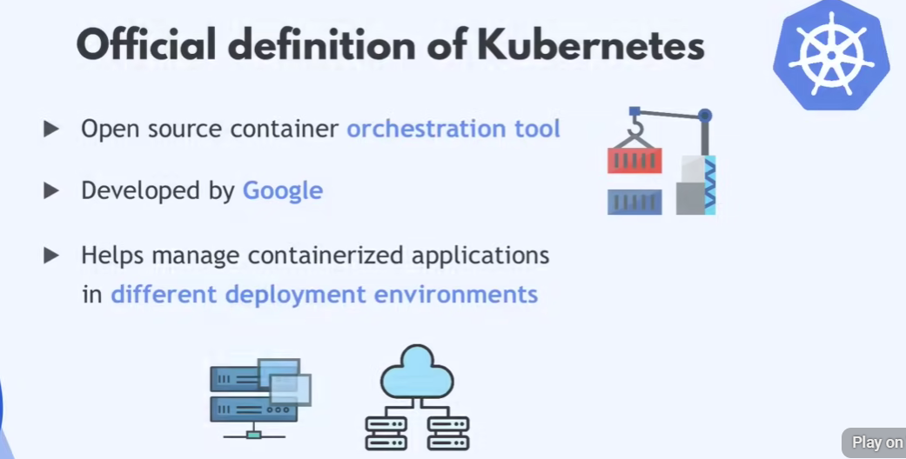
Introduction to Kubernetes

Slide 3
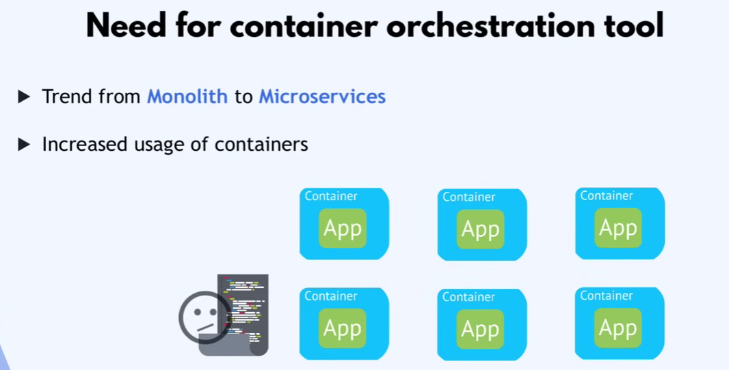
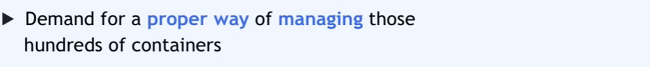
Need for container orchestration tool

Slide 4
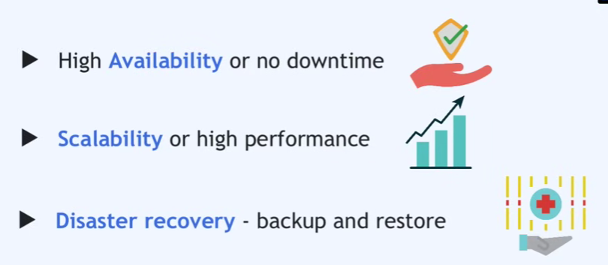
Features of Kubernets

