Slide 1
DevOps Introduction
Raghu Prasad K S
www.kaushalya.tech

Slide 2
Introduction
Raghu Prasad – BE, MS
Total of 29 years of experience
7 years as a lecturer in Engineering College
22 Years into IT
Worked with companies like CISCO, CSC, ICICI, First Apex – NTT Data
Currently into Corporate training, consultancy and application development
Worked with corporates and public sector
Technologies – Java, Python, C#,.Net Framework DataSciences, Web Technologies, Java Script technologies (MEAN/MERN stack), IOT, Test Automation – Selenium, Jmeter,Block Chain,Cloud,DevOps,MLOps

Slide 3
Introduction to DevOps
DevOps is a methodology in the software development and IT industry.
Used as a set of practices and tools, DevOps integrates and automates the work of software development (Dev) and IT operations (Ops) as a means for improving and shortening the systems development life cycle

Slide 4
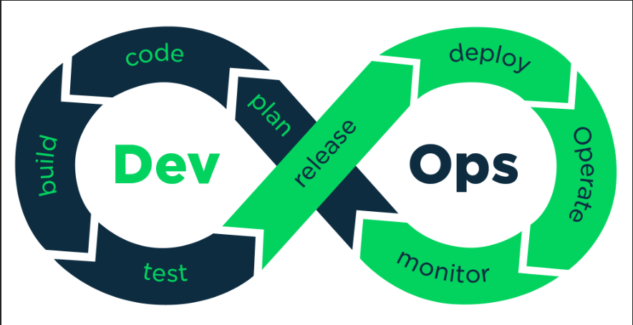
Introduction to DevOps

Slide 5
Learning Path
Agile Development
Version Control – (git)
Coding (Python/Java Script)
Github actions – (CI/CD)
Docker
AWS
Jenkins – (CI/CD)
Kubernetes
Infrastructure as Code (Terraform)
Ansible (Configuration Management)
Monitoring

Slide 6
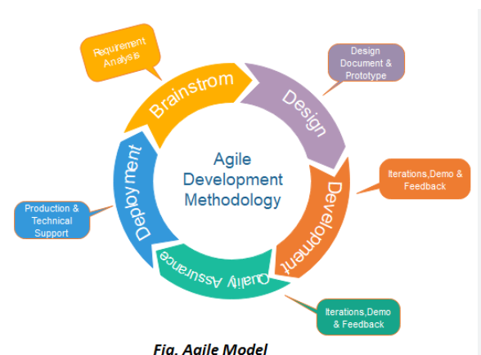
Agile

Slide 7
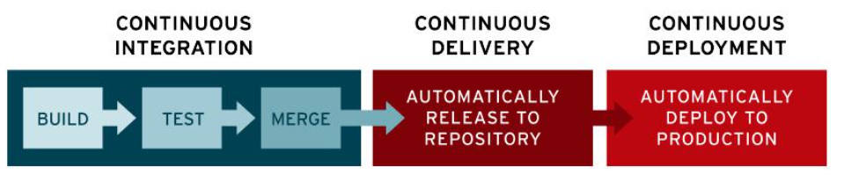
CI/CD

Slide 8
Docker
Docker is a set of platform as a service products that use OS-level virtualization to deliver software in packages called containers.
Docker is a software platform that allows you to build, test, and deploy applications quickly.
The service has both free and premium tiers. The software that hosts the containers is called Docker Engine.
It was first released in 2013 and is developed by Docker, Inc.
Docker packages software into standardized units called containers that have everything the software needs to run including libraries, system tools, code, and runtime.
Using Docker, you can quickly deploy and scale applications into any environment
and know your code will run.
https://aws.amazon.com/docker/

Slide 9
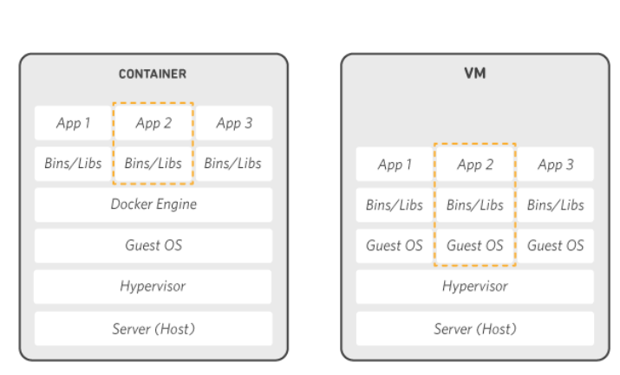
How Docker Works

Slide 10
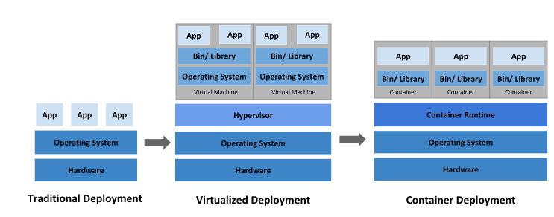
Kubernetes
Kubernetes (also known as k8s or “kube”) is an open source container orchestration platform that automates many of the manual processes involved in deploying, managing, and scaling containerized applications.

Slide 11
Ansible
Ansible is a suite of software tools that enables infrastructure as code.
It is open-source and the suite includes software provisioning,
configuration management, and application deployment functionality
https://www.geeksforgeeks.org/difference-between-terraform-vs-ansible/

Slide 12
Terraform
Terraform is an infrastructure as code (IaC) solution that focuses on managing infrastructure resources.
Terraform controls the dependencies of reusable infrastructure components by encapsulating them in modules.

Slide 13
Jenkins
Jenkins is an open source automation server.
It helps automate the parts of software development related to building,
testing, and deploying, facilitating continuous integration, and continuous delivery.
It is a server-based system that runs in servlet containers such as Apache Tomcat.
It supports version control tools, including AccuRev, CVS, Subversion, Git, Mercurial,
Perforce, ClearCase, and RTC, and can execute Apache Ant, Apache Maven, and sbt based
projects as well as arbitrary shell scripts and Windows batch commands.

Slide 14
Grafana
The Kubernetes Monitoring solution in Grafana Cloud ingests a set of default metrics at a 60-second scrape interval. The set of alerting rules helps with setting up and running alerts for clusters and their workloads.

Slide 15
Demo
Demo of Docker – Deploying sample React Application
Q & A

