Slide 1
Angular
Raghu Prasad
9845547471

Slide 2

Introduction
Raghu Prasad – BE, MS
Total of 27 years of experience
7 years as a lecturer in an Engineering College
20 Years into IT
Worked with companies like CISCO,CSC,ICICI,First Apex – NTT Data
Currently into Corporate training and consultancy
Worked with corporates and public sector
Service Offerings – In person/On-line/Corporate/Academic Institutes
Technologies – Java,Python,Web technologies,Java Script technologies (MEAN/MERN stack),IOT,Test Automation,Machine Learning,Artificial Intelligence,Account Management,ERP,Digital Marketing
Customers – L & T,NextGen,Incarnus,BGS-IT,Sindhi College

Slide 3
Topics
Introduction to Angular – What and Why
Architecture
Release History

Slide 4

What is Angular ?
Frontend JavaScript framework
Created & maintained by Google
Used to build powerful front-end applications
Part of the very powerful MEAN stack
Angular and AngularJS are NOT the same

Slide 5
Why to use Angular ?
Rapid Development & Code Generation
Code Organization & Productivity
Dynamic Content
Cross Platform
Unit Testing Ready

Slide 6
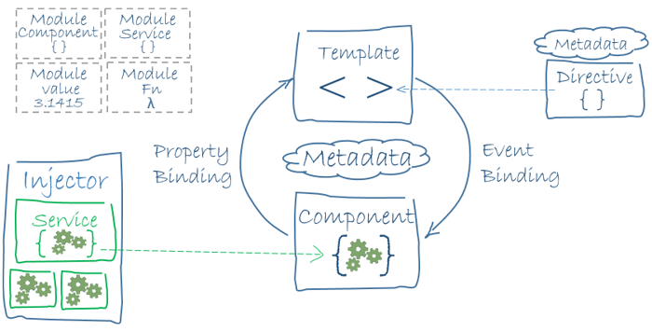
Architecture

Slide 7
Core Features
Components
Services
Routing
Testing
Build Tools
Data Binding
Templating
HTTP Module
Observables
Form Module
Directives
Pipes
Dependency Injection
Animation
TypeScript

Slide 8
Architecture Overview
Angular is a platform and framework for building client applications in HTML and TypeScript. Angular is itself written in TypeScript. It implements core and optional functionality as a set of TypeScript libraries that you import into your apps.
Modules (NgModules)
The basic building blocks of an Angular application are NgModules, which provide a compilation context for components. NgModules collect related code into functional sets; an Angular app is defined by a set of NgModules. An app always has at least a root module (AppModule-app.module.ts - @NgModule) that enables bootstrapping, and typically has many more feature modules.

Slide 9
Architecture Overview
Components
Components define views, which are sets of screen elements that Angular can choose among and modify according to your program logic and data. Every app has at least a root component.(app.component.ts)
Components use services, which provide specific functionality not directly related to views. Service providers can be injected into components as dependencies, making your code modular, reusable, and efficient.
Both components (@Component) and services (@Injectable) are simply classes, with decorators that mark their type and provide metadata that tells Angular how to use them.

Slide 10
Architecture Overview
The metadata for a component class associates it with a template that defines a view. A template combines ordinary HTML with Angular directives and binding markup that allow Angular to modify the HTML before rendering it for display.
The metadata for a service class provides the information Angular needs to make it available to components through Dependency Injection (DI).
An app's components typically define many views, arranged hierarchically. Angular provides the Router service to help you define navigation paths among views. The router provides sophisticated in-browser navigational capabilities.

Slide 11
Architecture Overview
Templates, directives, and data binding
A template combines HTML with Angular markup that can modify the HTML elements before they are displayed. Template directives provide program logic, and binding markup connects your application data and the document object model (DOM). Event binding lets your app respond to user input in the target environment by updating your application data.
Property binding lets you interpolate values that are computed from your application data into the HTML

Slide 12
Architecture Overview
Templates, directives, and data binding
Before a view is displayed, Angular evaluates the directives and resolves the binding syntax in the template to modify the HTML elements and the DOM, according to your program data and logic.
Angular supports two-way data binding, meaning that changes in the DOM, such as user choices, can also be reflected back into your program data.
Your templates can also use pipes to improve the user experience by transforming values for display. Use pipes to display, for example, dates and currency values in a way appropriate to the user's locale. Angular provides predefined pipes for common transformations, and you can also define your own.

Slide 13
Architecture Overview
Services and dependency injection
For data or logic that is not associated with a specific view, and that you want to share across components, you create a service class. A service class definition is immediately preceded by the @Injectable decorator. The decorator provides the metadata that allows your service to be injected into client components as a dependency.
Dependency injection (or DI) lets you keep your component classes lean and efficient. They don't fetch data from the server, validate user input, or log directly to the console; they delegate such tasks to services.

Slide 14
Architecture Overview
Routing
The Angular Router NgModule provides a service that lets you define a navigation path among the different application states and view hierarchies in your app. It is modelled on the familiar browser navigation conventions:
Enter a URL in the address bar and the browser navigates to a corresponding page.
Click links on the page and the browser navigates to a new page.
Click the browser's back and forward buttons and the browser navigates backward and forward through the history of pages you've seen.
The router maps URL-like paths to views instead of pages. When a user performs an action, such as clicking a link, that would load a new page in the browser, the router intercepts the browser's behavior, and shows or hides view hierarchies
If the router determines that the current application state requires particular functionality, and the module that defines it has not been loaded, the router can lazy-load the module on demand.

Slide 15
Architecture Overview
Angular cheet sheet
https://angular.io/guide/cheatsheet

Slide 16
Installing Angular
Ways To Install & Setup Angular
Angular CLI
Quickstart Seeds
From Absolute Scratch
Dependencies
Node.js & NPM

Slide 17
Major Version History
AngularJS/Angular 1
Angular 2
Angular 4
Angular 5
Angular 6/7/8/9/10/11/12/13
Angular 3 was skipped

Slide 18
AngularJS/Angular 1
Released in 2010
Competed with Ember,Backbone.js,etc
Used Controllers and Scope

Slide 19
Angular 2
Released in 2015
Complete Re-write of the Framework
Controllers and Scope are out
Components are in
No backward compatability

Slide 20
Angular 4/Angular
Released in 2017
Just Called “Angular” From now on
Backward compatibility with Angular 2
Reduced Size/More Compact/Faster Compiler
Most Changes under the hood

Slide 21
Angular 5/Angular
Backward compatibility with Angular 2 and 4
Most Changes under the hood
Most focus on speed and size
New HTTP module (old one is deprecated)
Changes with Pipes

Slide 22
Thank You

