Slide 1
Node
Raghu Prasad K S
www.kaushalya.tech
9845547471

Slide 2
Introduction
Raghu Prasad – BE, MS
Total of 27 years of experience
7 years as a lecturer in Engineering College
20 Years into IT
Worked with companies like CISCO,CSC,ICICI,First Apex – NTT Data
Currently into Corporate training and consultancy
Worked with corporates and public sector
Technologies – Java,Python,Data Sciences,Web technologies,Java Script technologies (MEAN/MERN stack),IOT,Test Automation – Selenium,JMeter

Slide 3
Course Outline
Introduction to Node
Features of Node
Getting Started with Node
Hands-on

Slide 4
Objectives
Learn Node
Understand the usages of Node
Understand the applications built on Node
Understand the domains
Hands-on coding

Slide 5
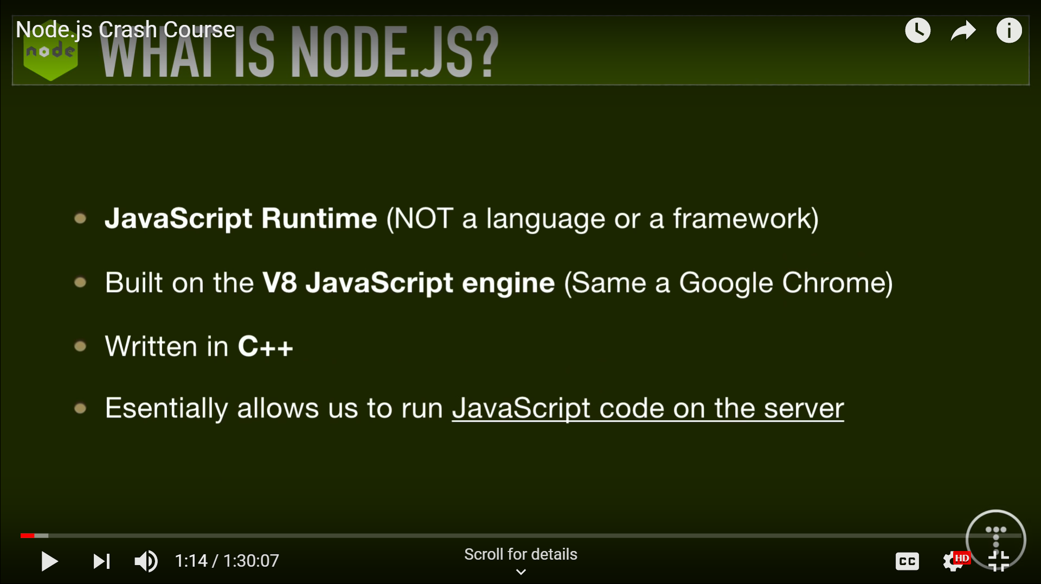

Slide 6
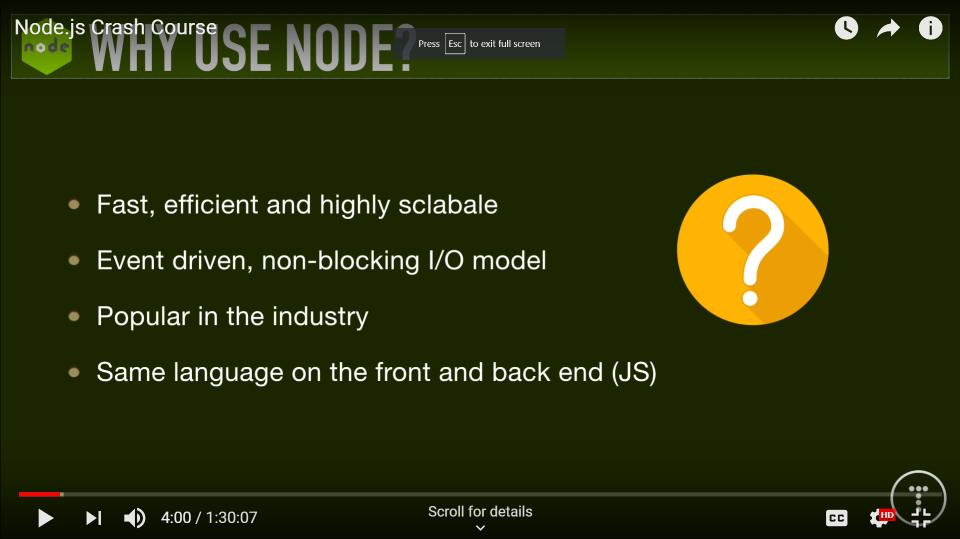

Slide 7
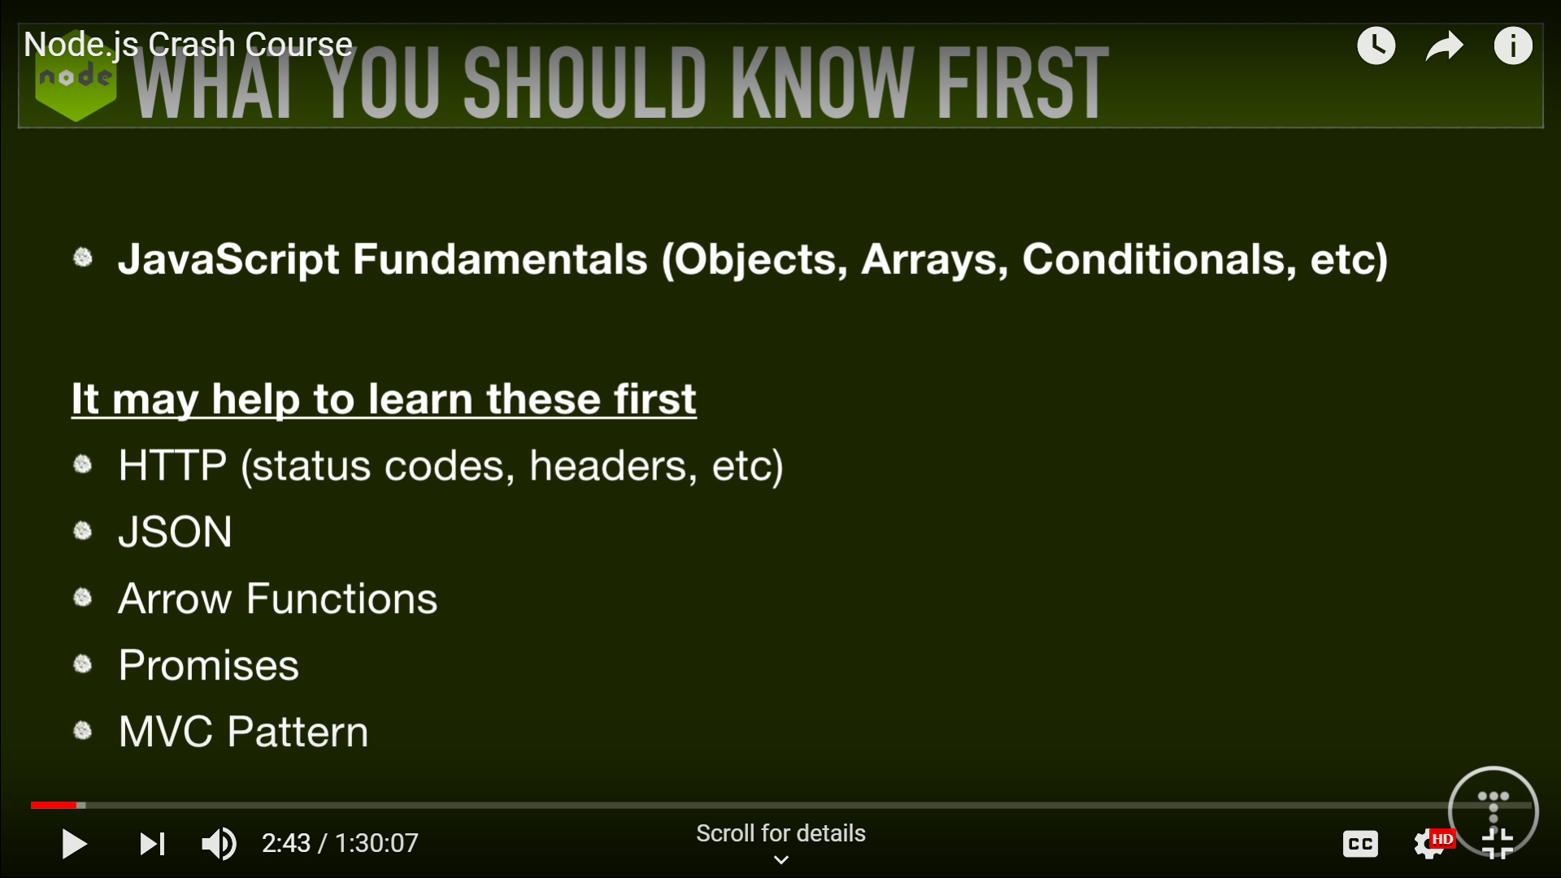

Slide 8
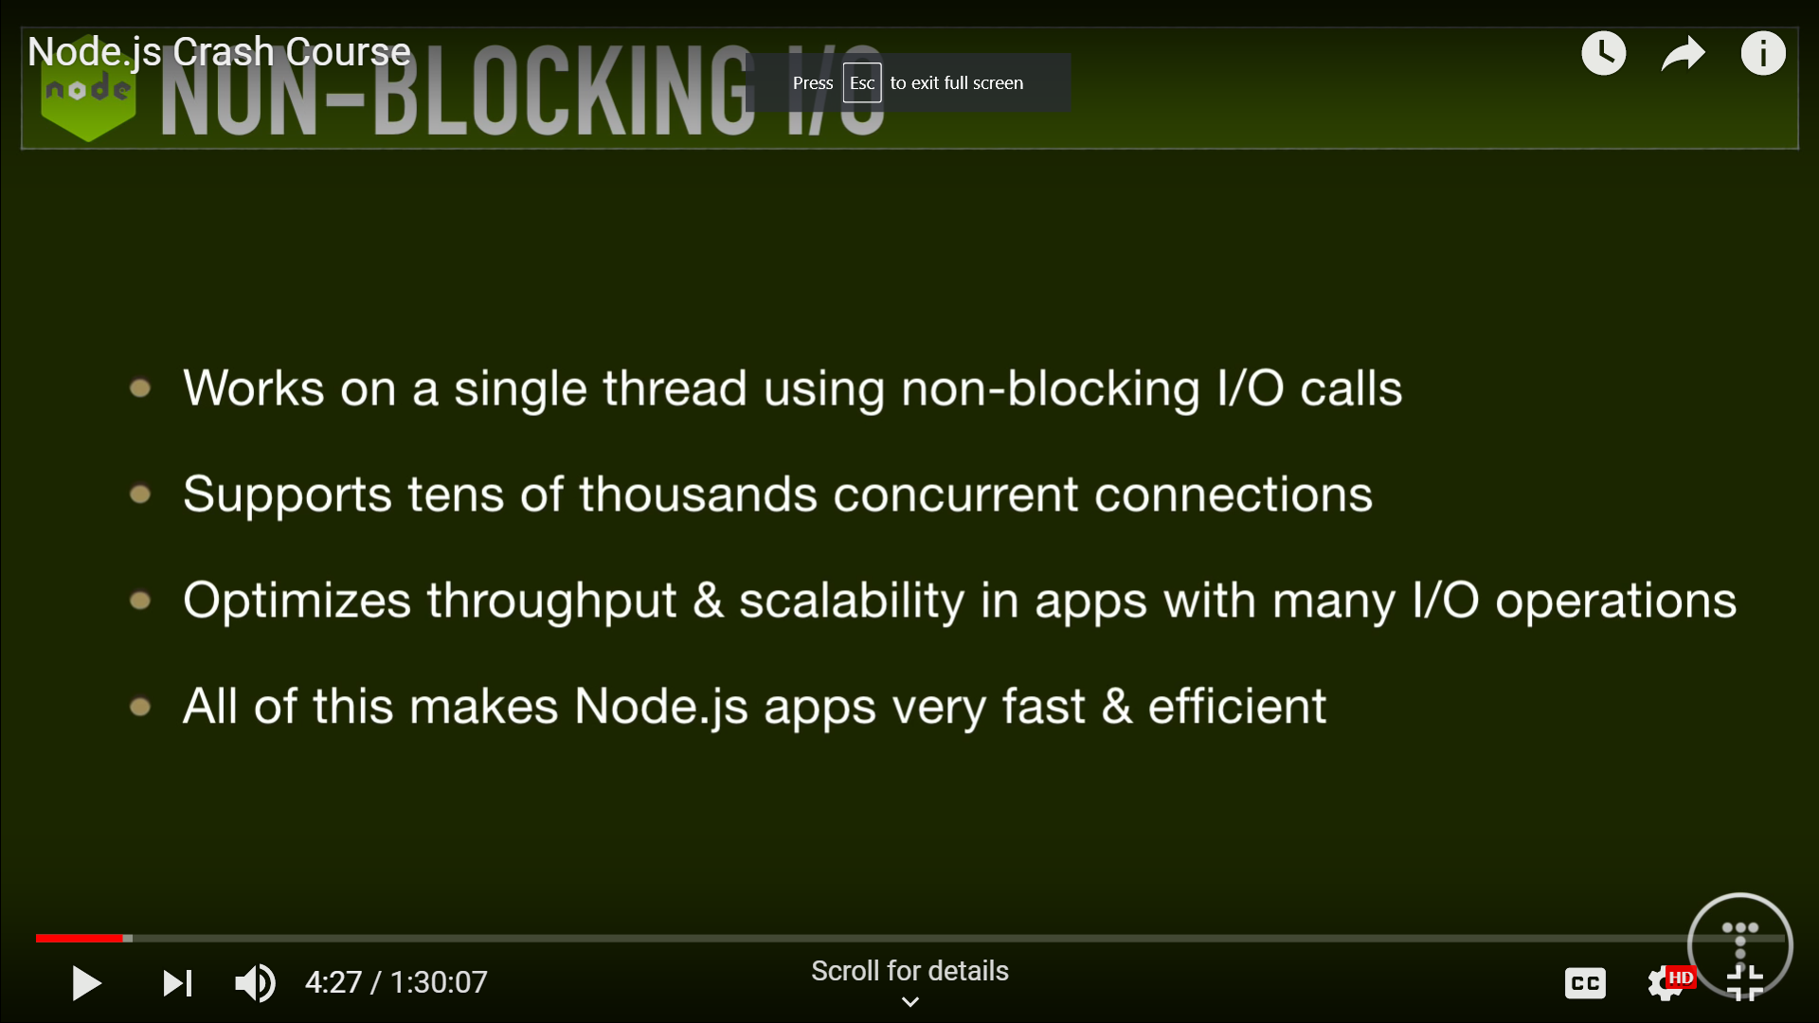

Slide 9
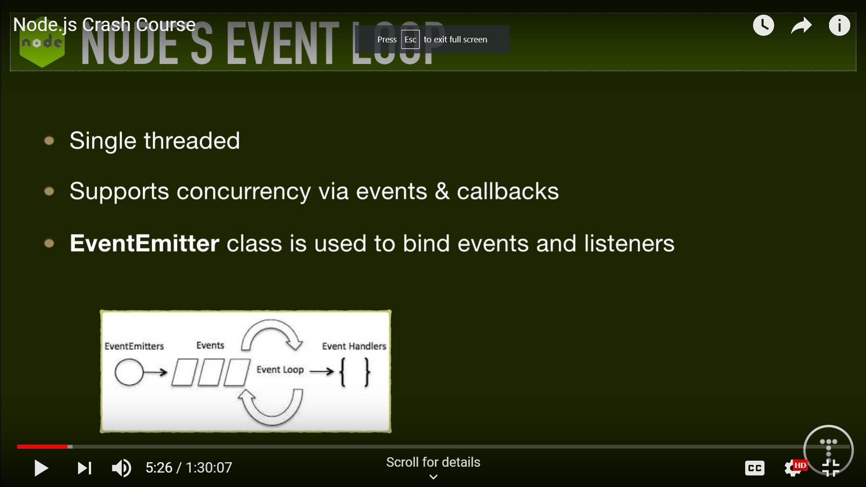

Slide 10
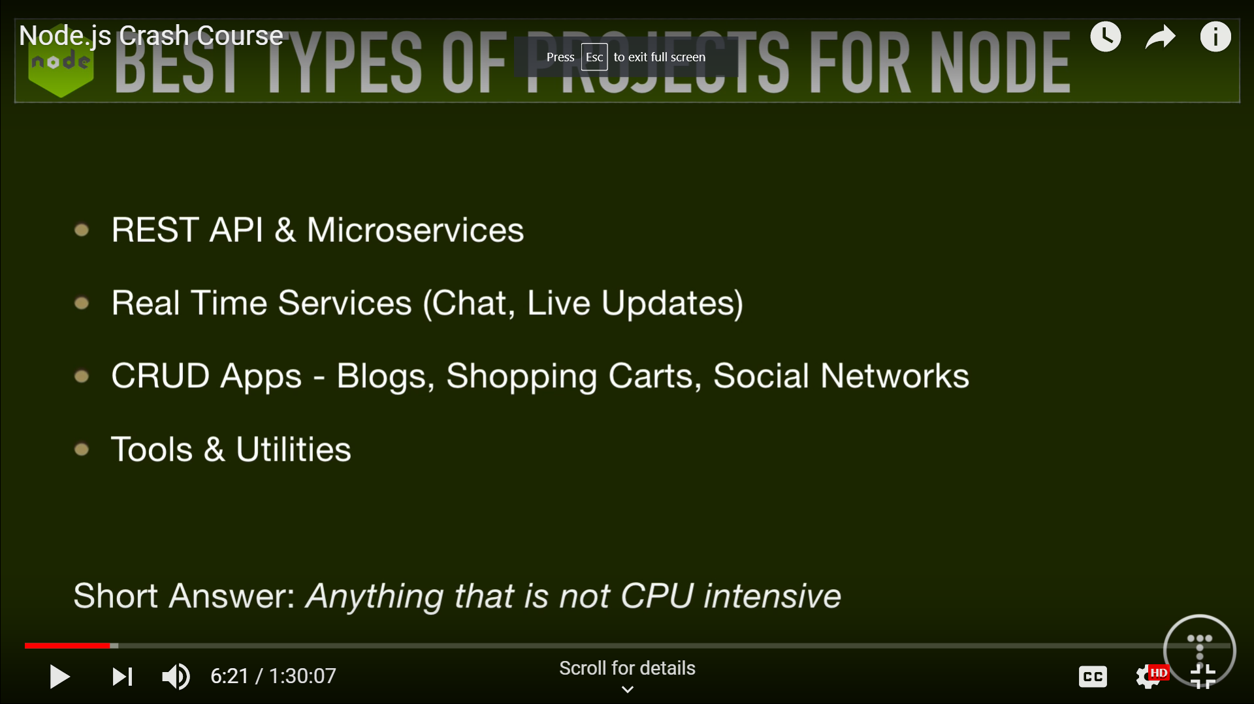

Slide 11
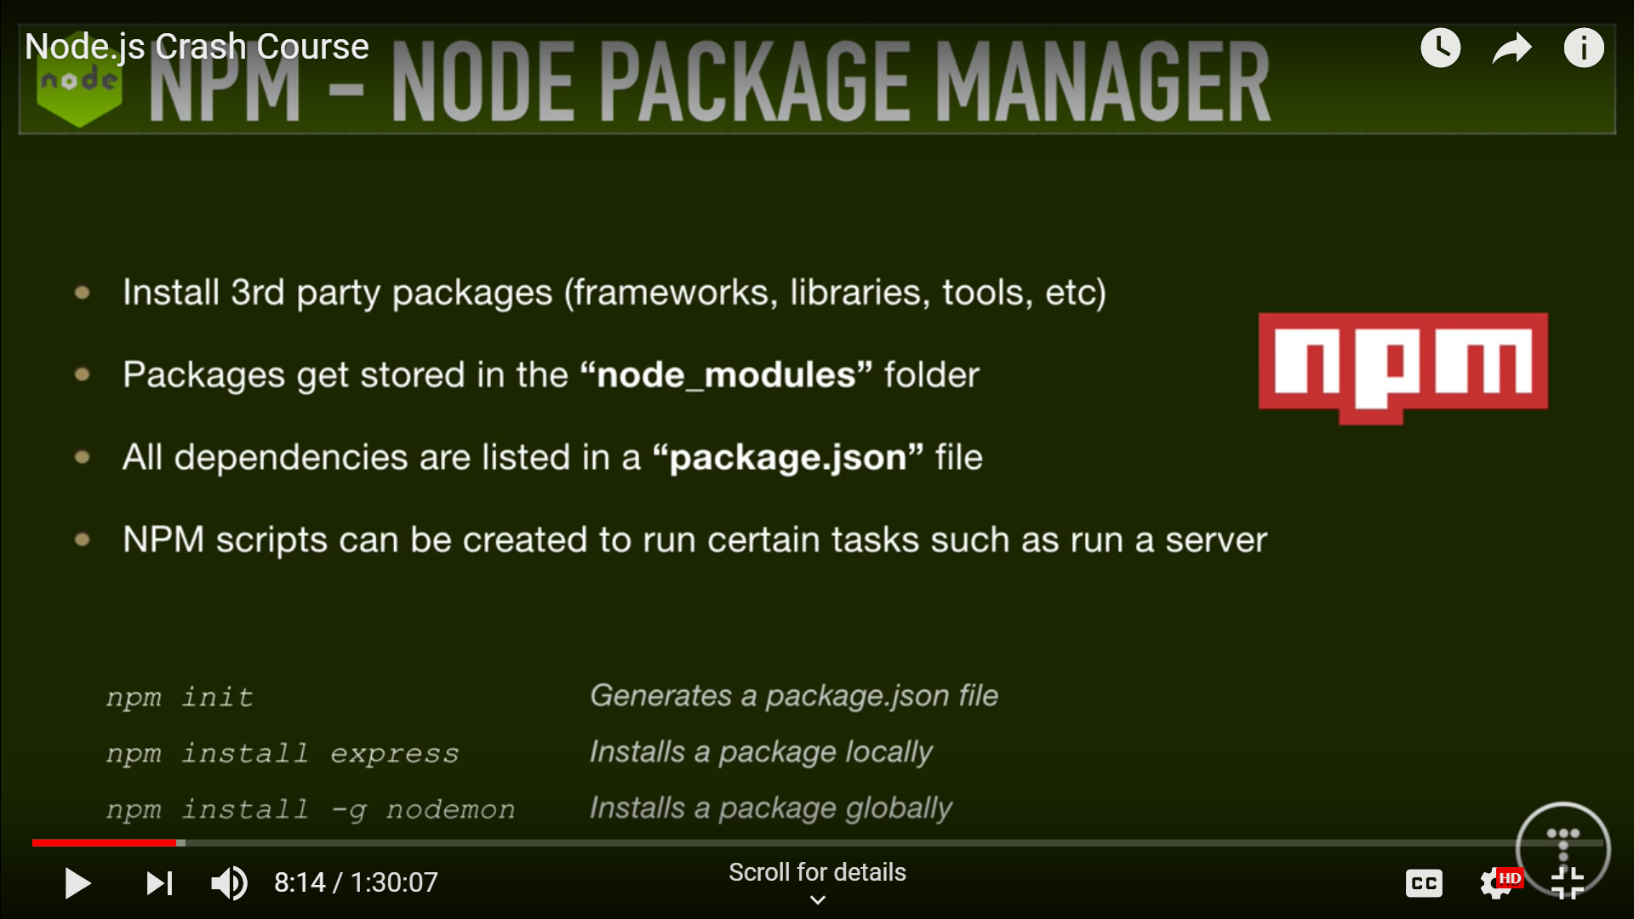

Slide 12
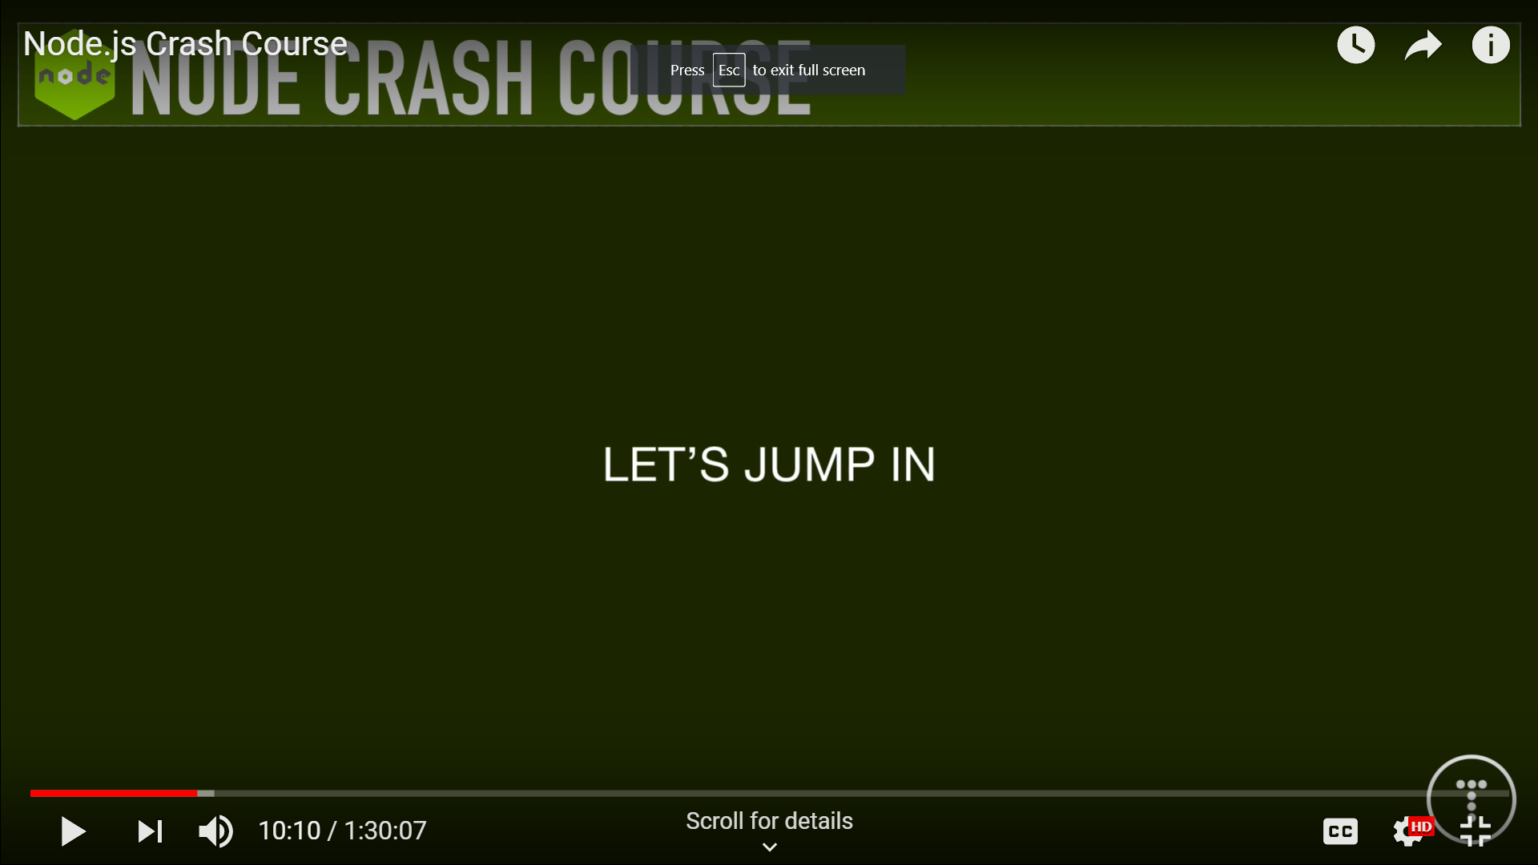

Slide 13
https://trio.dev/blog/companies-use-node-js
Thank You

