Slide 1
Global PROGRAM on Building and Managing Containers: Docker and Kubernetes
Raghu Prasad
9845547471
www.kaushalya.tech
CEO

Slide 2
Introduction
Raghu Prasad – BE, MS
Total of 30 years of experience
7 years as a lecturer in an Engineering College
23 Years into IT
Worked with companies like CISCO,CSC,ICICI,First Apex – NTT Data
Currently into Corporate training and consultancy
Worked with corporates and public sector
Service Offerings – In person/On-line/Corporate/Academic Institutes
Consultancy – Consultant to vendor of Atal Tinkering Lab/ECIL-ECIT, Incarnus – Healthcare Service Provider
Technologies – Java,Python,Web technologies,Java Script technologies (MEAN stack),IOT,Test Automation,Machine Learning,Artificial Intelligence,ERP,.NET,Cloud Computing,Devops,MLOps
Customers – ILinkDigital,Operative,Flatworld,IQVIA,Sony,Philips,L & T,NextGen,Incarnus,Aspire system,
NewHorizonCollege Of Engineering,NIE Mysore,Acharya College Of Engineering,SIT-Tumakuru,BGS-IT,Sindhi College,Malnad Enginering College,S B College of Management, REVA University,Nagarjuna Engineering College,Dayanand Sagar University,NIT-Imphal

Slide 3
Topics
Life Cycle of ML Project
Agile Development
Docker Container
Docker Hub
Kubernetes
Docker Demo
DevOps

Slide 4
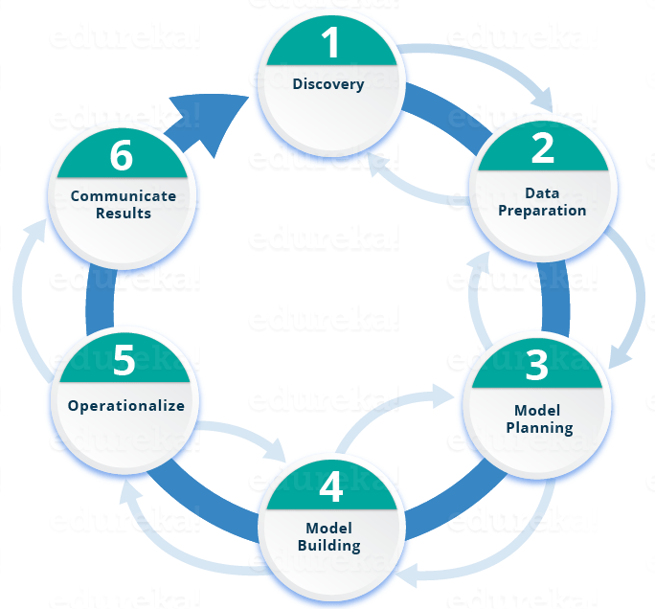
Life Cycle of ML Project

Slide 5
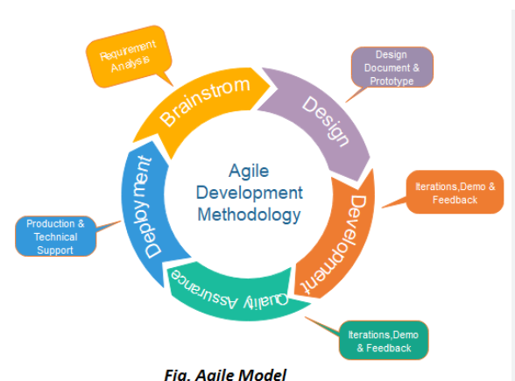
Agile Development Methodology

Slide 6
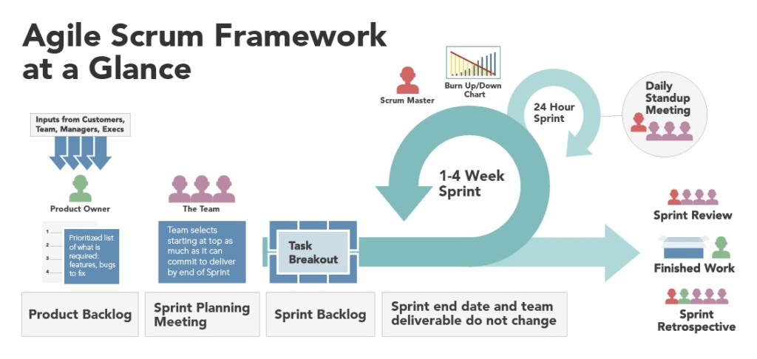
Agile Scrum Framework for development

Slide 7
Docker
Docker is a set of platform as a service products that use OS-level virtualization to deliver software in packages called containers.
Docker is a software platform that allows you to build, test, and deploy applications quickly.
The service has both free and premium tiers. The software that hosts the containers is called Docker Engine.
It was first released in 2013 and is developed by Docker, Inc.
Docker packages software into standardized units called containers that have everything the software needs to run including libraries, system tools, code, and runtime.
Using Docker, you can quickly deploy and scale applications into any environment
and know your code will run.
https://aws.amazon.com/docker/

Slide 8
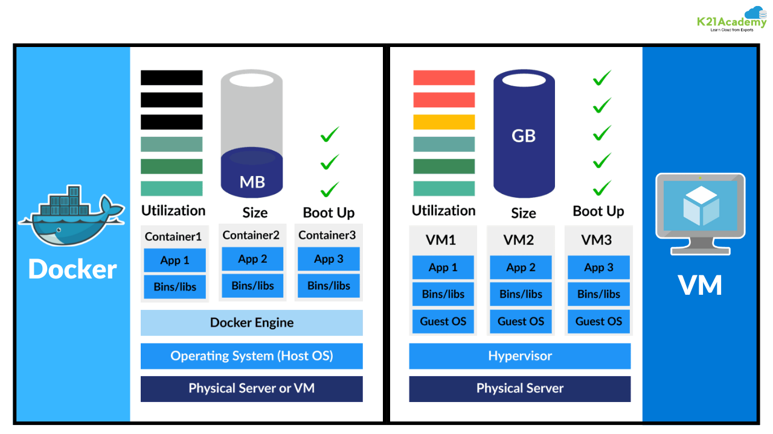
Docker Vs VM

Slide 9
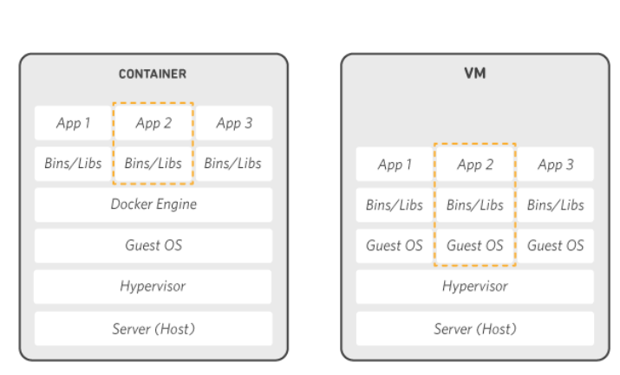
How Docker Works

Slide 10
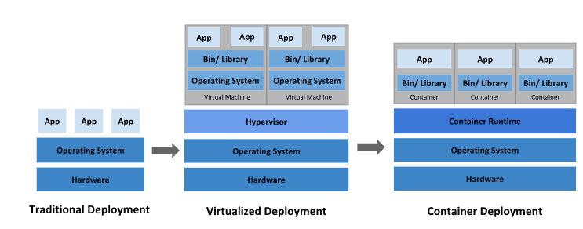
Kubernetes
Kubernetes (also known as k8s or “kube”) is an open source container orchestration platform that automates many of the manual processes involved in deploying, managing, and scaling containerized applications.

Slide 11
Learning Path – Docker and Kubernetes
Agile Development
Version Control – (git)
Coding (Python)
Github actions – (CI/CD)
Docker and Docker Hub
AWS Kubernetes
Monitoring

Slide 12
Introduction to DevOps
DevOps is a methodology in the software development and IT industry.
Used as a set of practices and tools, DevOps integrates and automates the work of software development (Dev) and IT operations (Ops) as a means for improving and shortening the systems development life cycle

Slide 13
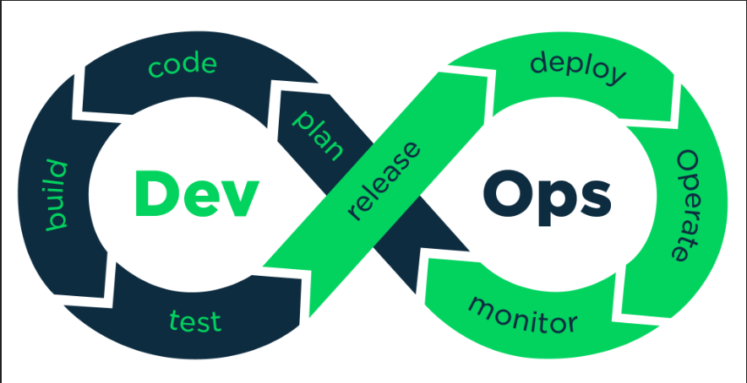
Introduction to DevOps

Slide 14
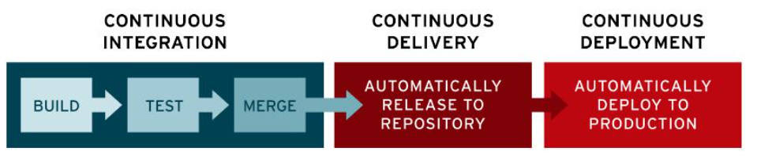
CI/CD

Slide 15
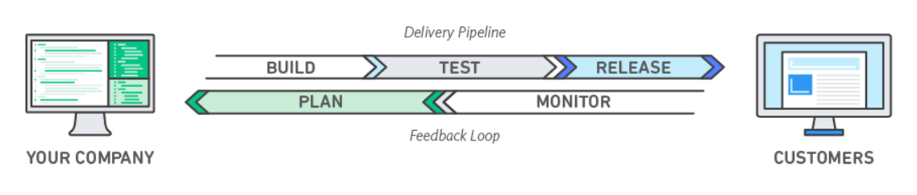
DevOps
DevOps is the combination of cultural philosophies, practices, and tools that increases an organization’s ability to deliver applications and services at high velocity: evolving and improving products at a faster pace than organizations using traditional software development and infrastructure management processes.

Slide 16
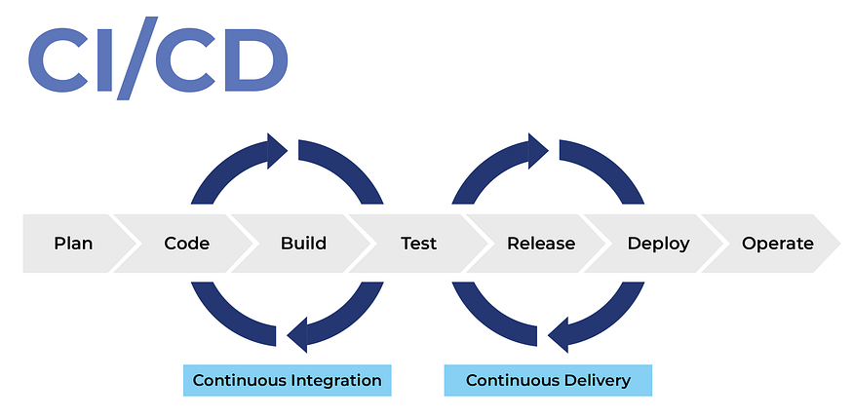
DevOps - CICD

Slide 17
Thank You
Raghu Prasad
9845547471
www.kaushalya.tech

