Slide 1
Python
Raghu Prasad K S
www.kaushalya.tech
9845547471

Slide 2
Introduction
Raghu Prasad – BE, MS
Total of 24 years of experience
7 years as a lecturer in Engineering College
17 Years into IT
Worked with companies like CISCO,CSC,ICICI,First Apex – NTT Data
Currently into Corporate training and consultancy
Worked with corporates and public sector
Technologies – Java,Python,AI,ML,Web technologies,Java Script technologies (MEAN stack),IOT,Test Automation – Selenium,JMeter

Slide 3
Course Outline
Introduction to Python
Installation of Python and getting started with python
Introduction to IDE and Installation of Anaconda
Features of Python
Object Orientation
File Operations

Slide 4
Objectives
Learn Python
Understand the usages of Python
Understand the applications built on Python
Understand the domains
Hands-on coding

Slide 5
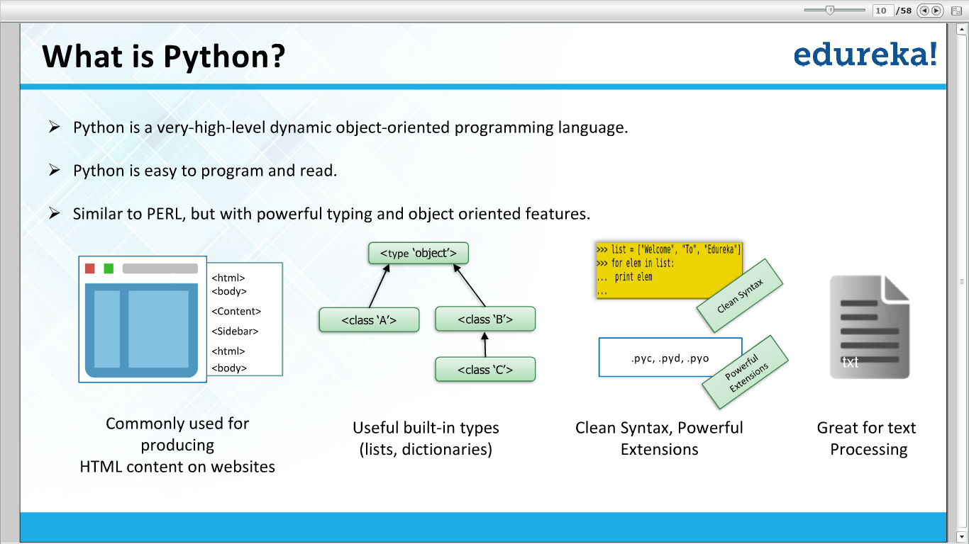

Slide 6
Python implementations
CPYTHON
PyPy
IRONPYTHON
JYTHON

Slide 7
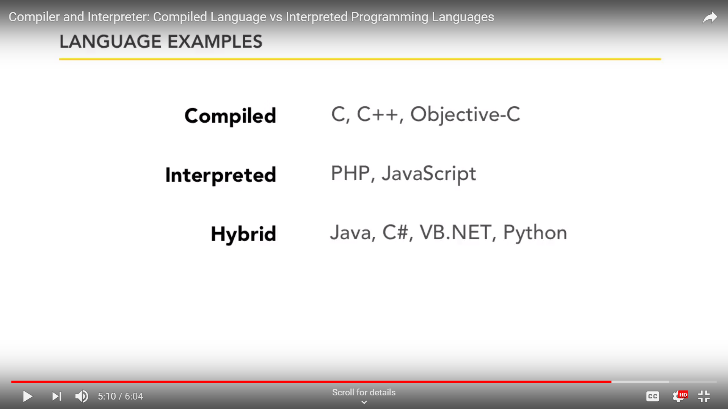
Compiled and Interpreted Languages

Slide 8
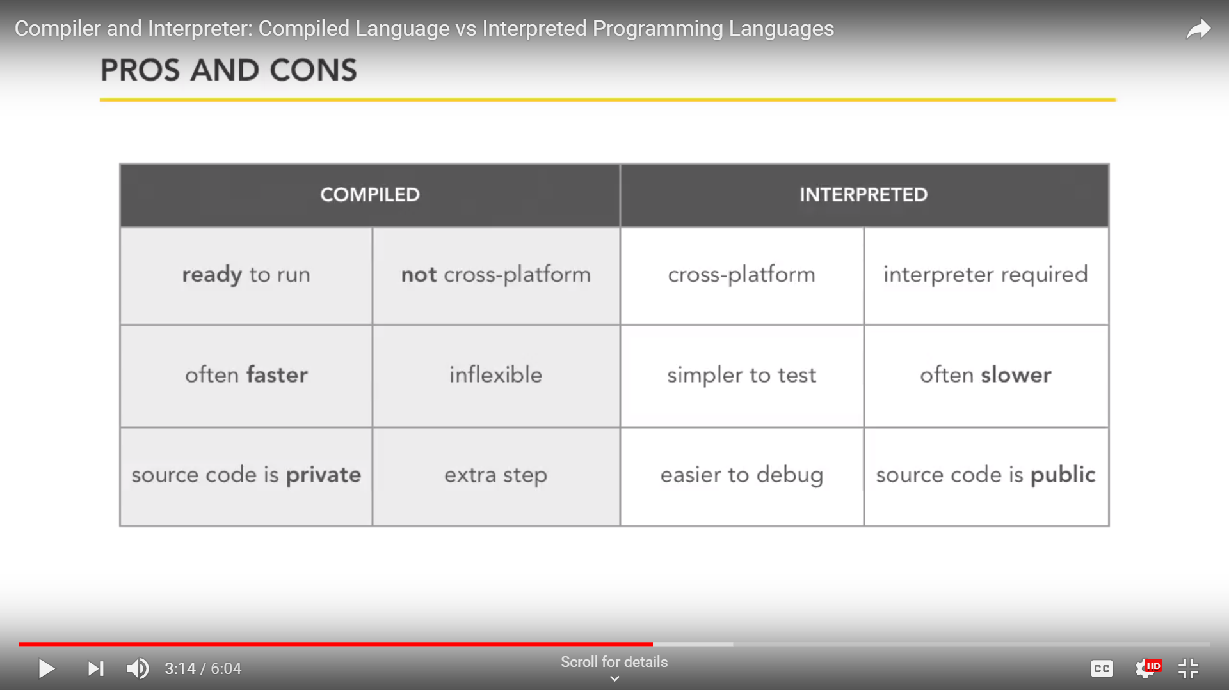
Compiled and Interpreted Languages

Slide 9
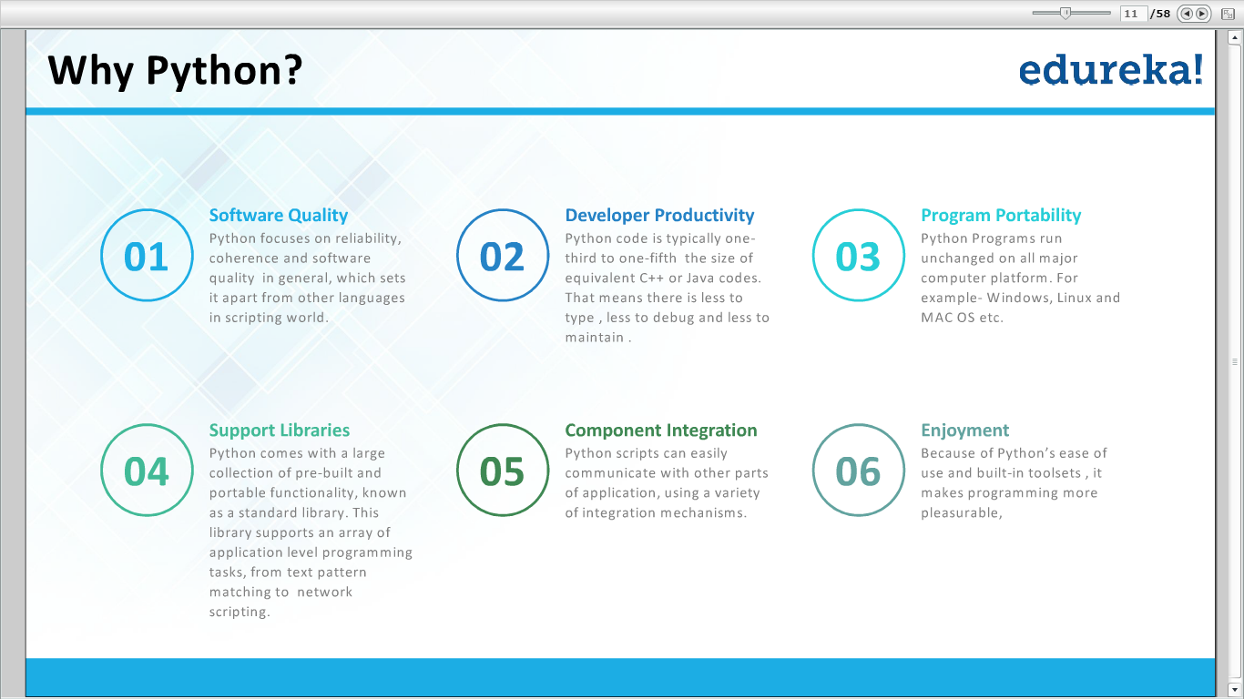

Slide 10
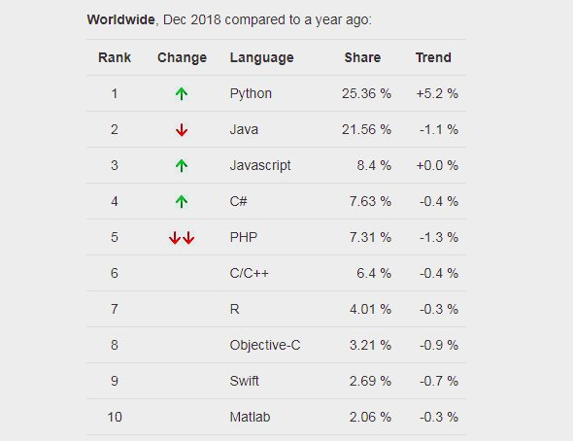
Top 5 Programming Languages

Slide 11
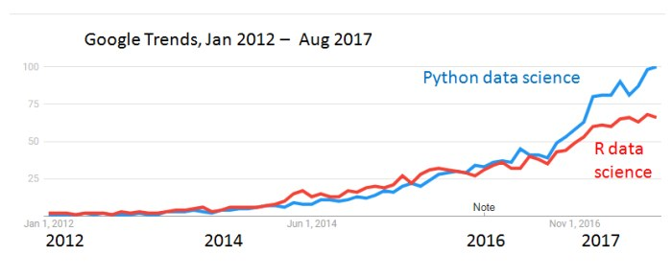
Google trends in Datasciences

Slide 12
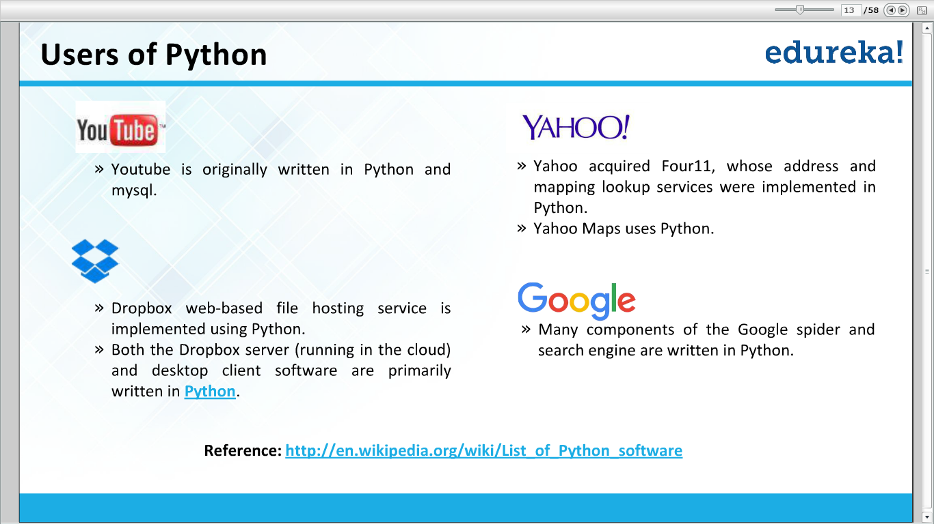

Slide 13
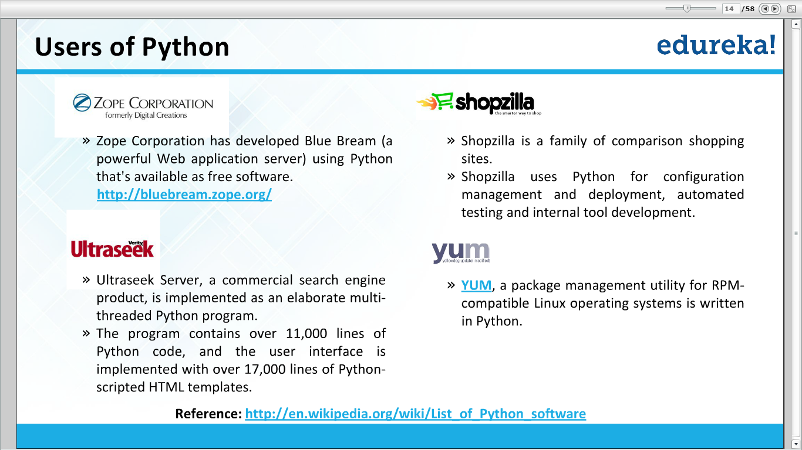

Slide 14
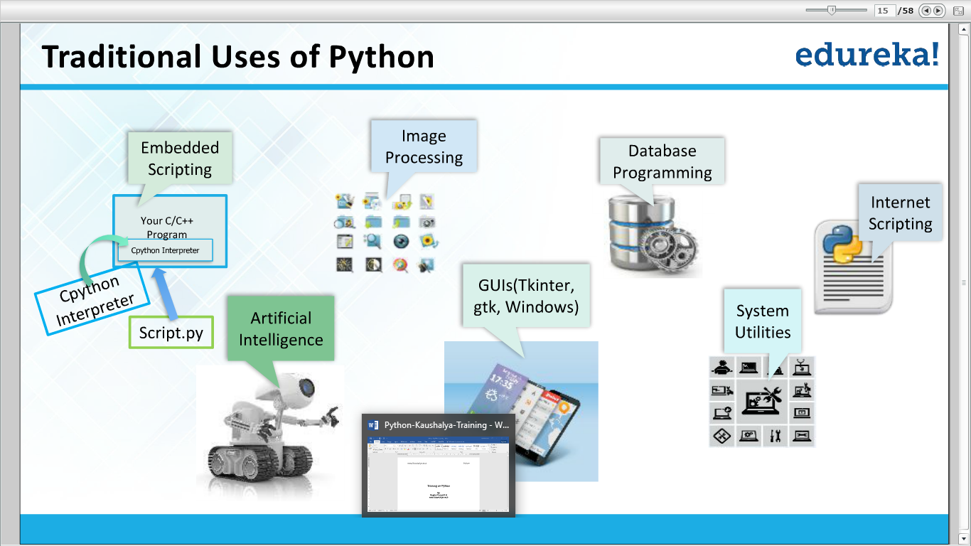

Slide 15
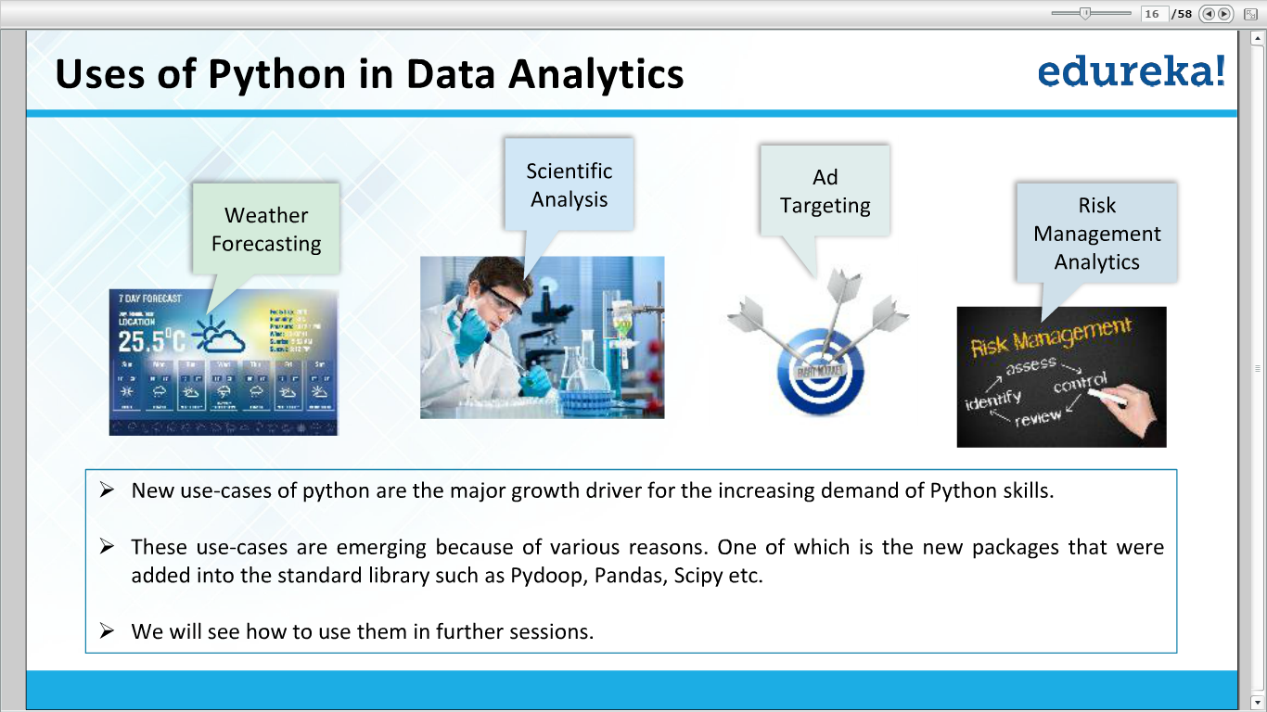

Slide 16
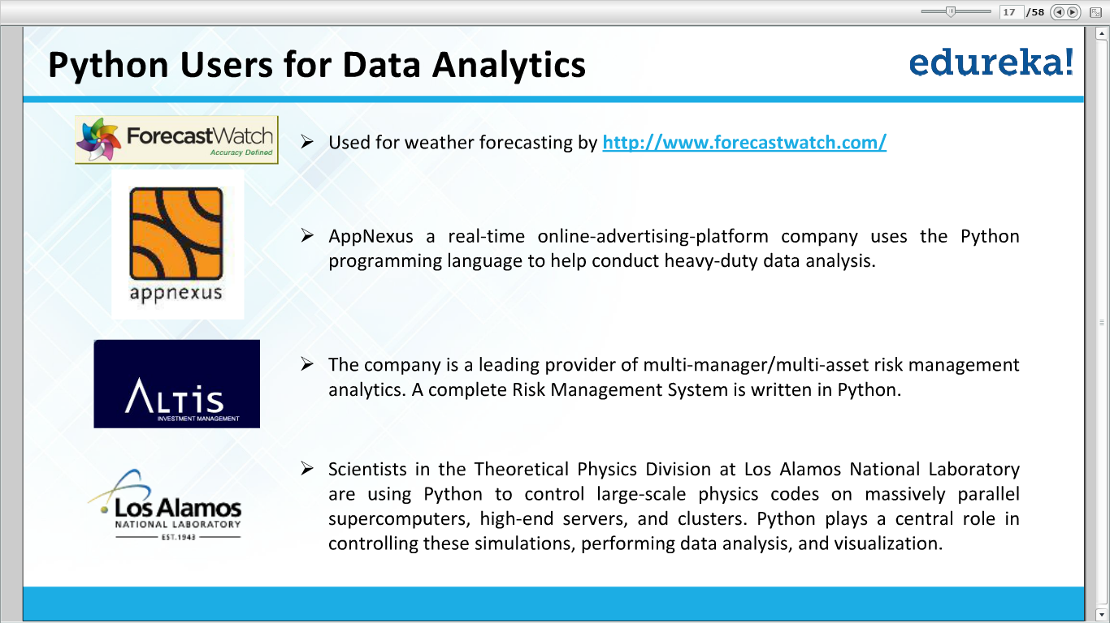

Slide 17
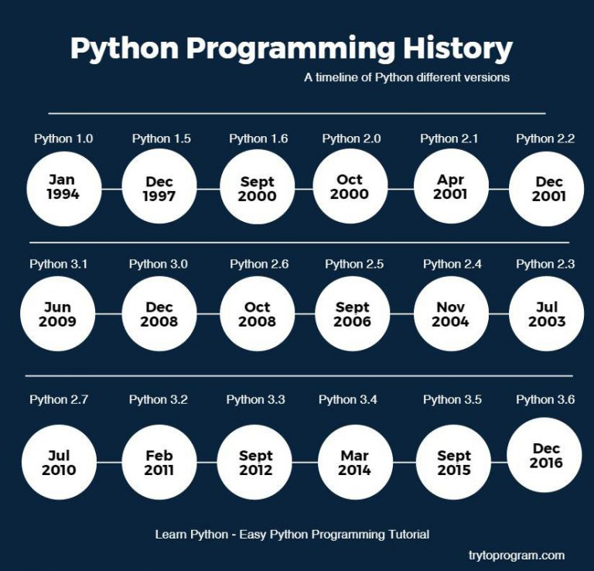
Python History

Slide 18
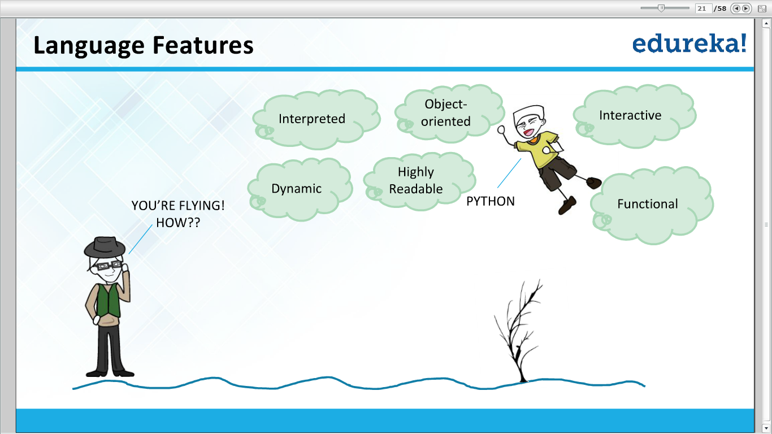

Slide 19
Thank You

