Slide 1
DART Programming Language Raghu Prasad K S www.Kaushalya.tech 9845547471

Slide 2
What is Dart?
Dart is an object oriented language
Dart is an open source and scalable programming language with many built-in libraries
Useful for developing web, server and mobile applications
optionally typed, and single threaded programming language.
Similar to other OOP languages it supports classes, objects and methods.

Slide 3
DART LANGUAGE: ORIGINS
Developed by Google
Dart was unveiled at the GOTO conference in Aarhus, Denmark, October 10, 2011.
Founded by Lars Bak and Kasper Lund, Legacy developers of V8 JavaScript Engine used in Chrome
The first version Dart 1.0 was released on November 14, 2013
Latest version (DART 2.2) was released on February 26, 2019.

Slide 4
DART LANGUAGE: INFLUENCES
Object Model: Smalltalk
Syntax: JavaScript, Java, C#
Isolates: Erlang
Compilation Strategy: Dart itself

Slide 5
Concepts
Everything is an object
Even numbers, Booleans, functions and null are objects
Every object is an instance of a class that inherit from Object
Dart doesn’t support keywords public, private and protected
If an identifier starts with an underscore(_), it is private to its library
Dart tools can report two kinds of problems: warnings and errors

Slide 6
Cont.….
Dart has two runtime modes: production and checked.
Production mode is the default runtime mode of a Dart program, optimized for speed. Production mode ignores assert statements and static types.
Checked mode is a developer-friendly mode that helps you catch some type errors during runtime

Slide 7
Example Dart Program
Main()
{
// 'var' declares a variable. dartanalyzer infers the type.
var a = “start”;
print(a);
// The type can also be declared:
num b=21;
print(b);
// final variables cannot be changed once declared
final num c=100;
print(c);
// const variables are compile-time constants
const double d=45.00;
print(d);
}

Slide 8
Dart Environment
Dart Editor: An editor similar to sublime text, notepad++ etc.
Dartium: a Web browser with Dart included (based on Chromium)
Dart2js: used to convert dart script to java script.
pub: a Package Manager
Dart editor
Dart Tools
Dartium
dart2js
pub

Slide 9
Data Types & Operators
Dart supports following set of data types: Numbers, Strings, Booleans, Lists, Maps
Dart supports following operators: *, /, %, ~,+, -, << ,>>, & ,^ ,|, >=, >, <=, <, ==, !=, &&, ||, ??, expr++, expr--, -expr, !expr etc.
“stdout” & “stdin” provides the standard output, input streams respectively, and “stderr” is used for errors.
Dart has two conditional operators which acts as an alternative to if else statements −
condition ? expr1 : expr2
If condition is true, then expr1 (and returns its value) get evaluated; otherwise expr2 will be evaluated.
expr1 ?? expr2
If expr1 is not null, then it gets evaluated its value is returned; otherwise it evaluates the expr2.

Slide 10
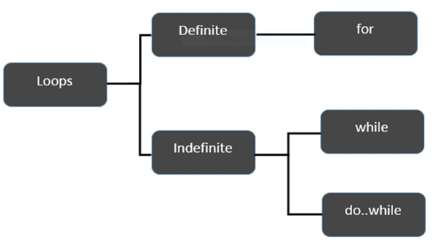
Loops
The for loop executes the code block for a specified number of times.
Syntax: for ( initial_count_value, termination condition, step) {
//statements
}
Example:
void main() {
var num = 5;
var factorial = 1;
for( var I = num; I >= 1; i--) {
factorial *= 1;
}
print(factorial);
}

Slide 11
The while loop executes the instructions each time the condition specified evaluates to true.
Syntax: While (expression) {
//statements
}
Example:
void main() {
var num = 5;
var factorial = 1;
while(num>=1) {
factorial = factorial*num;
num --;
}
print(“The factorial is ${factorial}”);
}

Slide 12
The do…while loop is similar to while loop except that the condition is checked after the statements are executed.
Syntax: do {
// statements to be executed
} while(expression);
Example:
void main() {
var n =10;
do {
print(n);
n--;
}
while(n>=0);
}

Slide 13
Functions
Dart has similar function implementation to languages such as Java and C#.
For functions that contain just one expression, we can use a shorthand syntax
The syntax of the short hand function is:
Function_name() => expression;
Only an expression, not a statement, can appear between arrow (=>) and semicolon (;). For example, you can’t put an if statement there, but you can use a conditional expression.

Slide 14
Example of Functions:
// A simple function definition
yell(str) => str.toUpperCase();
// Functions can have type annotations
List lines(String str) {
return str.split('\n');
}
main() {
var poemLines = lines(poem);
print(yell(poemLines.first));
// functions are first-class
var whisper = (String str) => str.toLowerCase();
print(poemLines.map(whisper).last);
}
const poem = '''
The wren
Earns his living
Noiselessly.''';

Slide 15
Output:
Output:$ dart functions.dart
THE WREN
noiselessly.

Slide 16
Encapsulation & Inheritance
Dart introduces its own library based encapsulation model.
In Dart there is no need to encapsulate class field, instead we do the encapsulation with getters and setters.
Dart supports single inheritance on a class-by-class basis, which indicates that it can inherit properties from only one class at a time.
Dart implements inheritance with the “extends” keyword.

Slide 17
Applications
DART is mainly used to build single page web applications like Gmail, Google Maps, and Google Instant Search etc.
Chrome Dev Editor- An open source IDE for developing Chrome packaged apps as well as Dart web apps.
Soundtrap - It is a web application used for recording music with your browser is built with Dart.
Blossom – It is an agile project management tool built with Dart.
Google internal tool for marketing - Built with AngularDart.

