Slide 1

Transformers
Revolutionizing Teaching and Learning
Raghu Prasad K S
CEO
www.Kaushalya.tech
9845547471

Slide 2
Transformers of LLM
Transformers are the foundational architecture behind most modern Large Language Models (LLMs) such as GPT, BERT, LLaMA, Mistral, and others.

Slide 3
What is a Transformer?
A Transformer is a deep learning model architecture designed for handling sequential data (like text), using a mechanism called self-attention to understand the relationships between words in a sequence.

Slide 4
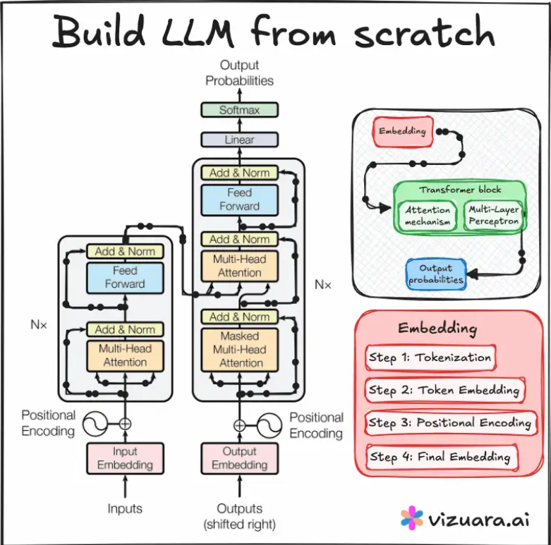
LLM

Slide 5
Core Components of a Transformer
• Input Embedding: Converts each word/token into a vector (dense representation).
• Positional Encoding: Adds information about the order of words.
• Multi-Head Self-Attention: Computes attention scores to identify important words.
• Feed-Forward Neural Network: Applies transformations independently to each word.
• Residual Connections & Layer Norm: Help in stable training.
• Stacked Layers: Multiple encoder/decoder blocks are stacked.

Slide 6
Attention Mechanism
Each word is transformed into:
- Query (Q)
- Key (K)
- Value (V)
Attention(Q, K, V) = softmax(QK^T / sqrt(dk)) * V
This helps the model focus on important parts of the text.

Slide 7
Transformer Variants
• Encoder-only (e.g., BERT): Used for understanding tasks like classification.
• Decoder-only (e.g., GPT): Used for generation tasks like text completion.
• Encoder-Decoder (e.g., T5, BART): Used for translation, summarization, QA.

Slide 8
How Transformers Enable LLMs
• Used in decoder-only transformers (like GPT).
• Trained on massive text corpora.
• Scalable to billions of parameters.
• Capable of contextual understanding using attention.

Slide 9
Illustration of Transformer Flow (Decoder-only)
Text → Tokenizer → Embedding → Positional Encoding
↓
+------------------------+
| Decoder Block (×N) |
| - Self-Attention |
| - FFN |
+------------------------+
↓
Output

Slide 10
Real-World Use Cases
• Chatbots (e.g., ChatGPT, Claude)
• Summarization (e.g., news, emails)
• Translation (e.g., Google Translate, DeepL)
• Code generation (e.g., Copilot)
• Image captioning (vision-language transformers)

Slide 11
Visualization of Transformer
https://poloclub.github.io/transformer-explainer/

