Slide 1

Introduction to Deeplearning
Raghu Prasad Konandur
9845547471
www.kaushalya.tech
raghuprasadkonandur@kaushalya.tech

Slide 2
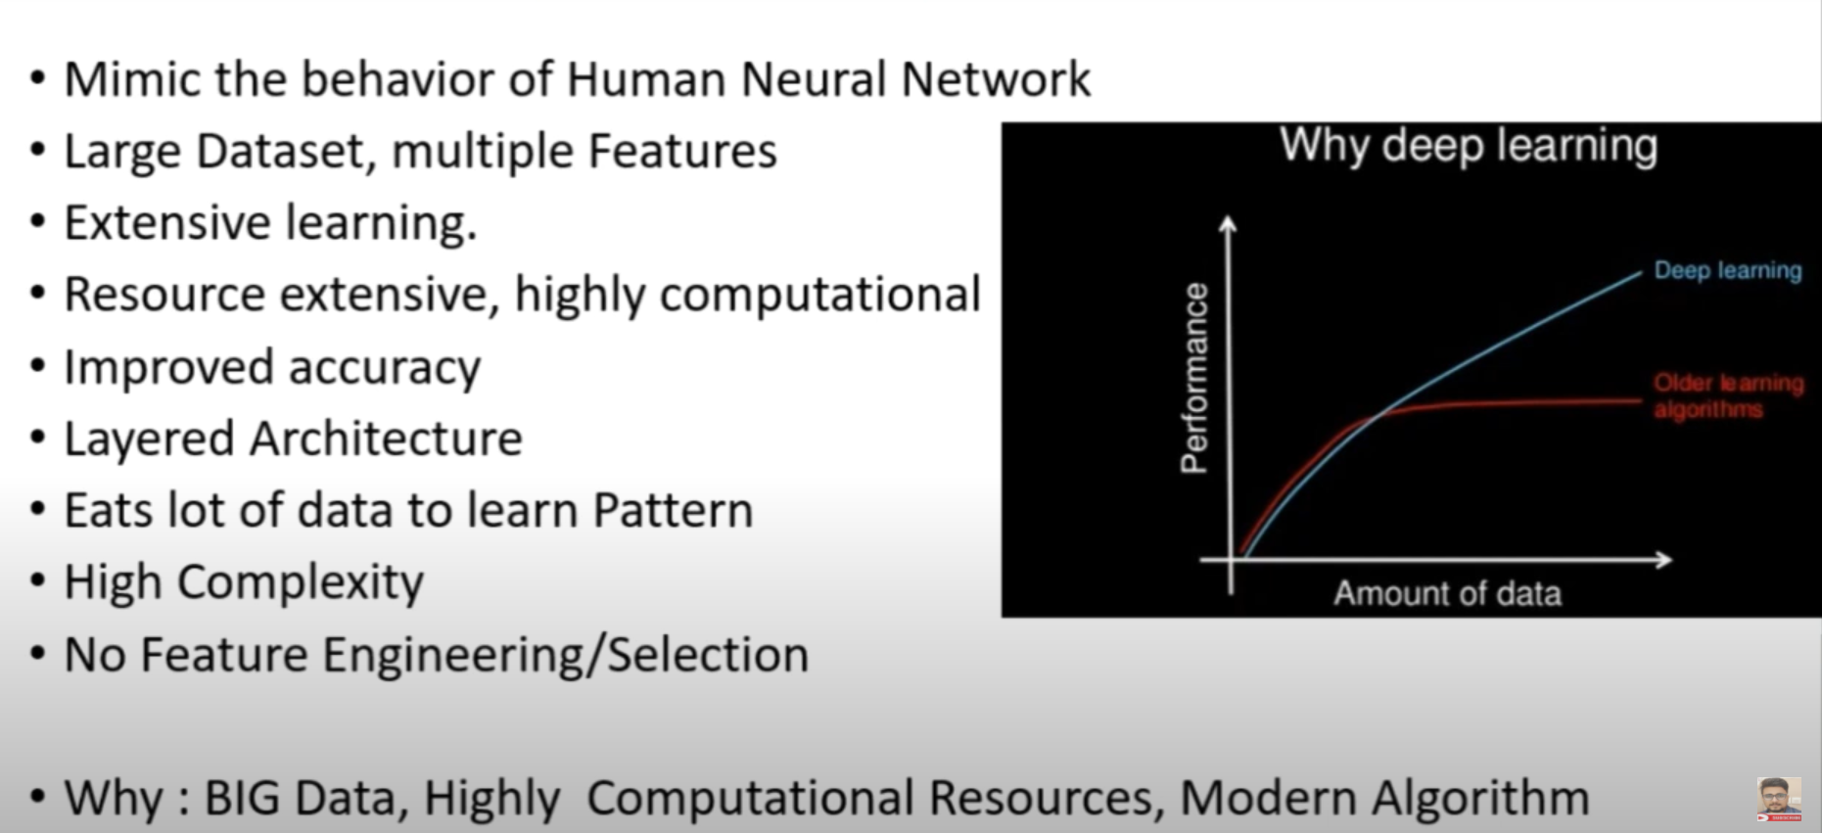
Introduction

Slide 3
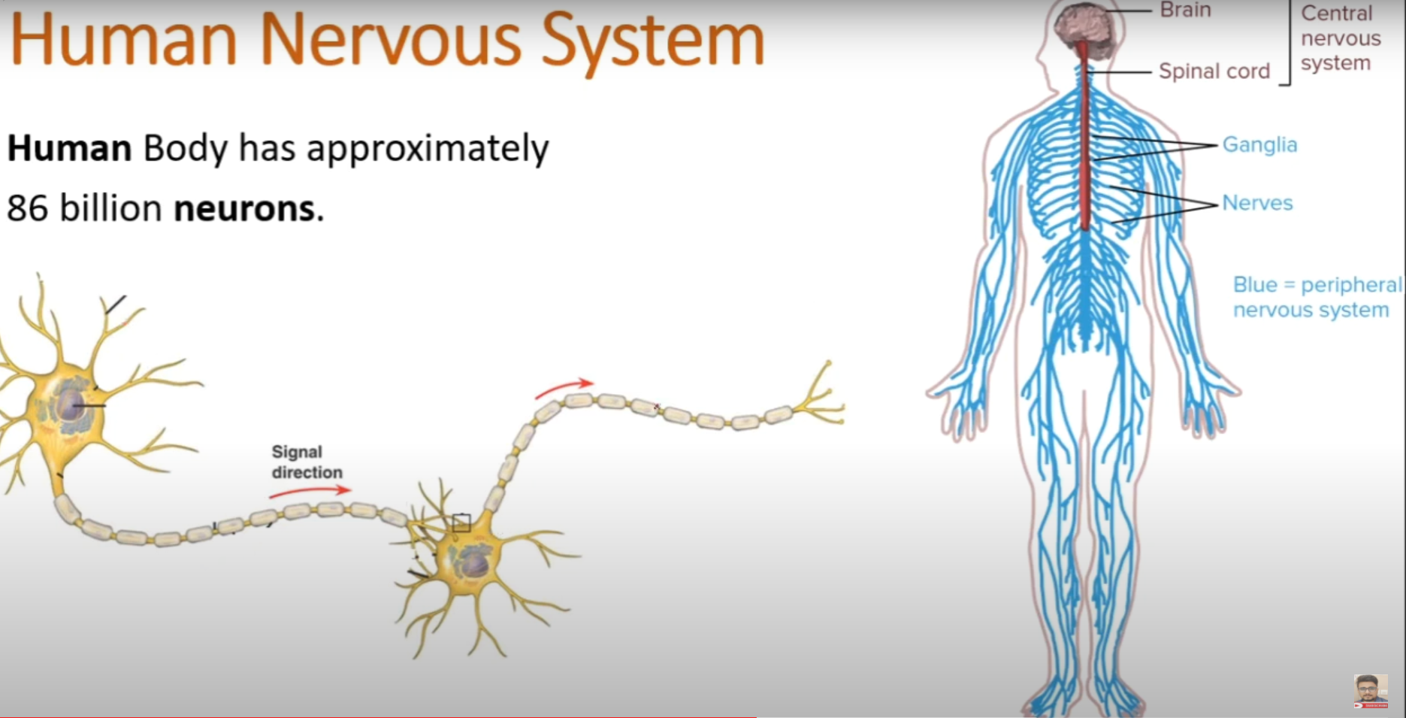
Introduction

Slide 4
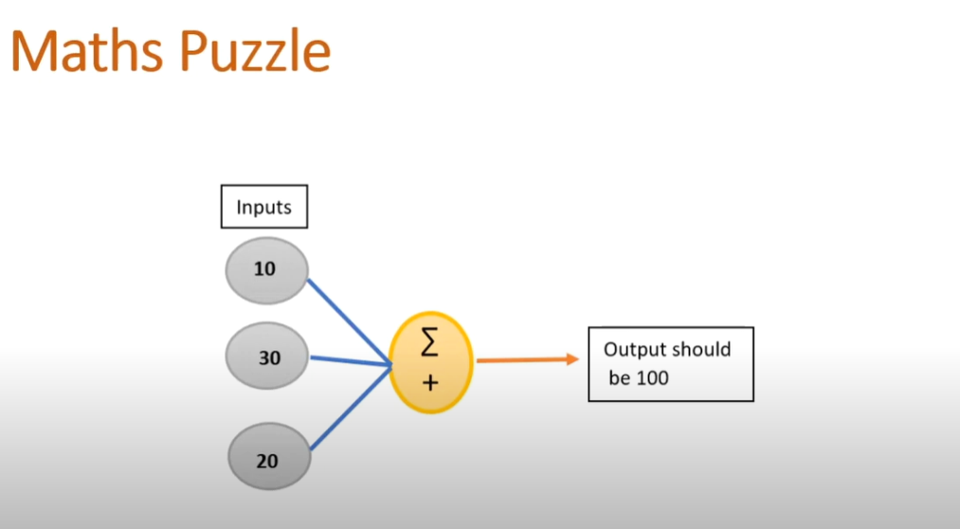
Introduction

Slide 5
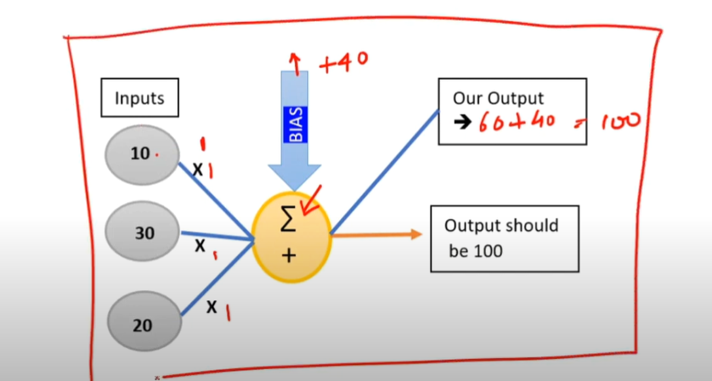
Introduction

Slide 6
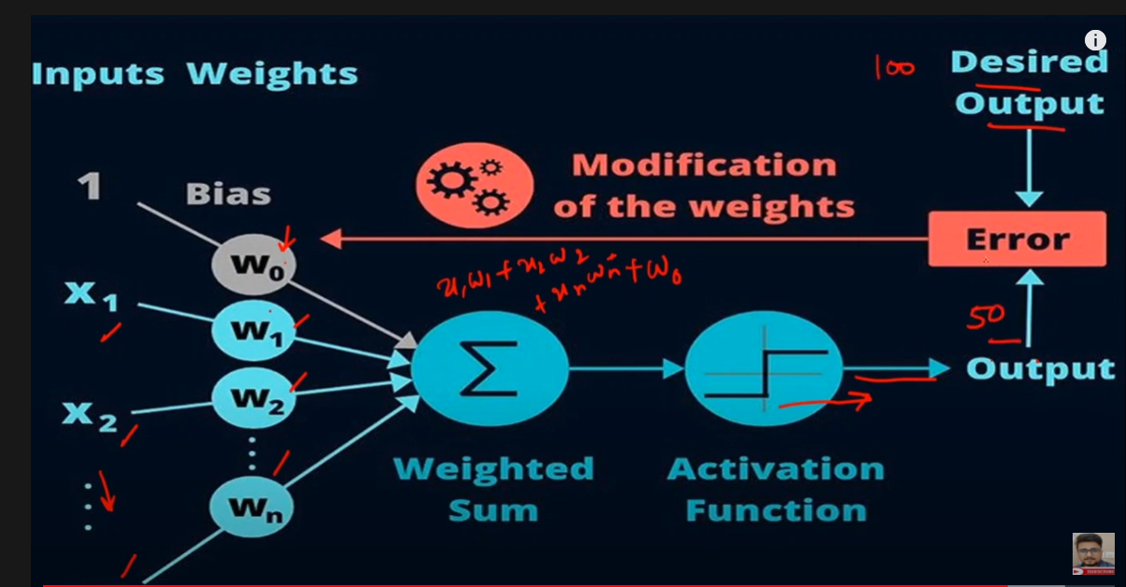
Introduction

Slide 7
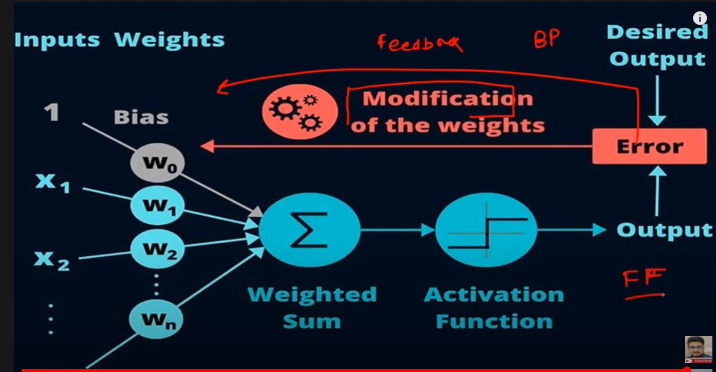
Introduction

Slide 8
Deeplearning Types
Artificial Neural Network(ANN)
Convolutional Neural Network (CNN)
Recurrent Neural Network (RNN)

Slide 9
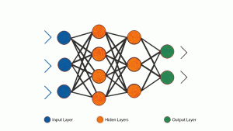
ANN
A single perceptron (or neuron) can be imagined as a Logistic Regression. Artificial Neural Network, or ANN, is a group of multiple perceptrons/ neurons at each layer. ANN is also known as a Feed-Forward Neural network because inputs are processed only in the forward direction:
ANN consists of 3 layers – Input, Hidden and Output. The input layer accepts the inputs, the hidden layer processes the inputs, and the output layer produces the result. Essentially, each layer tries to learn certain weights

Slide 10
ANN
ANN can be used to solve problems
related to:
Tabular data
Image data
Text data

Slide 11
ANN
Challenges with Artificial Neural Network (ANN)
While solving an image classification problem using ANN, the first step is to convert a 2-dimensional image into a 1-dimensional vector prior to training the model. This has two drawbacks:
The number of trainable parameters increases drastically with an increase in the size of the image
ANN loses the spatial features of an image. Spatial features refer to the arrangement of the pixels in an image. I will touch upon this in detail in the following sections
One common problem in all these neural networks is the Vanishing and Exploding Gradient. This problem is associated with the backpropagation algorithm. The weights of a neural network are updated through this backpropagation algorithm by finding the gradients:

Slide 12
CNN
Convolutional neural networks (CNN) are one of the most popular models used today.
This neural network computational model uses a variation of multilayer perceptrons and contains one or more convolutional layers that can be either entirely connected or pooled.
These convolutional layers create feature maps that record a region of image which is ultimately broken into rectangles and sent out for nonlinear processing.
Advantages:
Very High accuracy in image recognition problems.
Automatically detects the important features without any human supervision.
Weight sharing.
Disadvantages:
CNN do not encode the position and orientation of object.
Lack of ability to be spatially invariant to the input data.
Lots of training data is required.
C

Slide 13
RNN
Recurrent neural networks (RNN) are more complex.
They save the output of processing nodes and feed the result back
into the model (they did not pass the information in one direction only).
This is how the model is said to learn to predict the outcome of a layer.
Each node in the RNN model acts as a memory cell, continuing the computation and implementation of operations.
If the network’s prediction is incorrect, then the system
self-learns and continues working towards the correct prediction during backpropagation.

Slide 14
RNN
Disadvantages:
Gradient vanishing and exploding problems.
Training an RNN is a very difficult task.
It cannot process very long sequences if using
tanh or relu as an activation function.

Slide 15
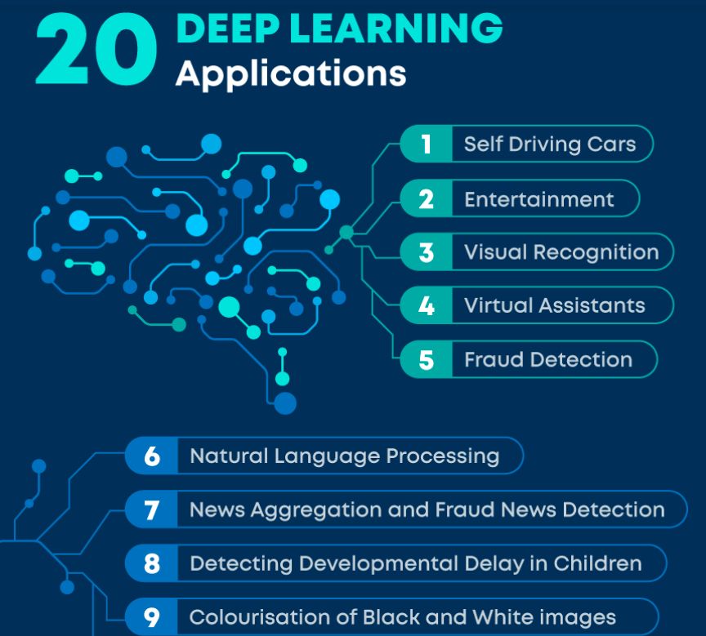
Deeplearning Applications

Slide 16
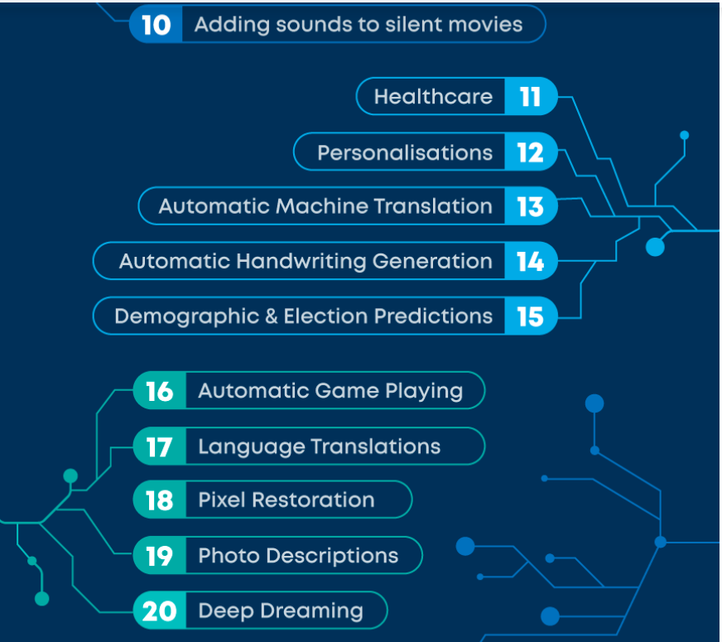
Deeplearning Applications

Slide 17
Deeplearning Applications
https://www.mygreatlearning.com/blog/deep-learning-applications/
https://serokell.io/blog/deep-learning-and-neural-network-guide
https://www.analyticsvidhya.com/blog/2020/02/cnn-vs-rnn-vs-mlp-analyzing-3-types-of-neural-networks-in-deep-learning/
https://www.geeksforgeeks.org/difference-between-ann-cnn-and-rnn/

Slide 18
Thank You
Raghu Prasad Konandur
9845547471
www.kaushalya.tech
raghuprasadkonandur@kaushalya.tech

