Slide 1

Generative AI
Raghu Prasad K S
CEO
www.Kaushalya.tech
9845547471

Slide 2
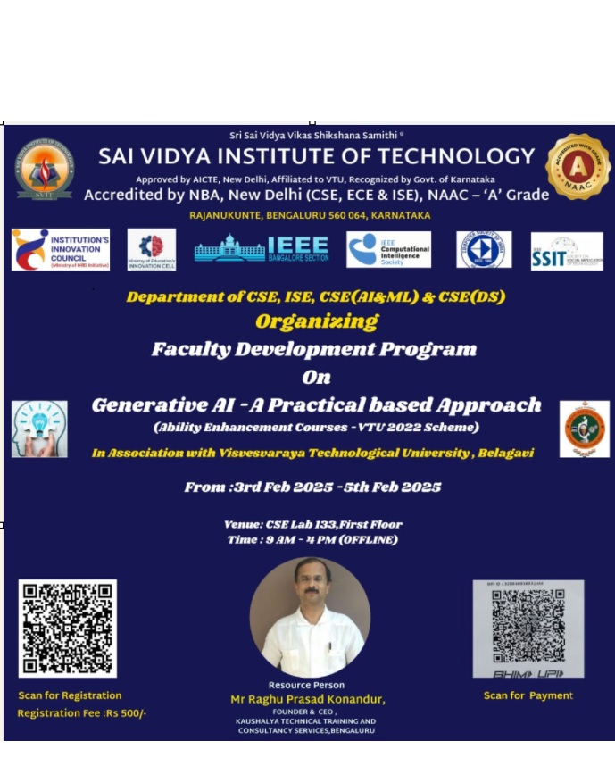

Slide 3
Introduction
Raghu Prasad – BE, MS
Total of 30 years of experience
7 years as a lecturer in an Engineering College
23 Years into IT
Worked with companies like CISCO,CSC,ICICI,First Apex – NTT Data
Currently into Corporate training and consultancy
Worked with corporates and public sector
Service Offerings – In person/On-line/Corporate/Academic Institutes
Consultancy – Consultant to vendor of Atal Tinkering Lab/ECIL-ECIT, Incarnus – Healthcare Service Provider, Automation Spectrum Pty Ltd,Australia,Tech Varaha,Bengaluru
Technologies – Java,Python,Web technologies,Java Script technologies (MEAN/MERN stack),IOT,Test Automation,Machine Learning,Artificial Intelligence and block chain,Tableau,Power BI,Cloud Computing
Corporate Customers – IQVIA,ITC Infotech,Philips,L & T,NextGen,Incarnus,Aspire system,Netwoven,SkillUpRight
Academic Customers – New Horizon College of Engineering,BGS-IT,Sindhi College,Malnad Enginering College,S B College of Management, REVA University,Nagarjuna Engineering College,Dayanand Sagar University,Acharya Institute of Technology,NIE Mysore,NIT-Imphal, AMC College, Kristu Jayanti College,SIT,SVIT etc

Slide 4
Agenda
Introduction to AI
Generative AI Models
Building Chatbot using Generative AI
Chatbot use cases
High Level Architecture
Technology Stack
Demonstration of chatbots – eKaushalya
Hands-on Session

Slide 5
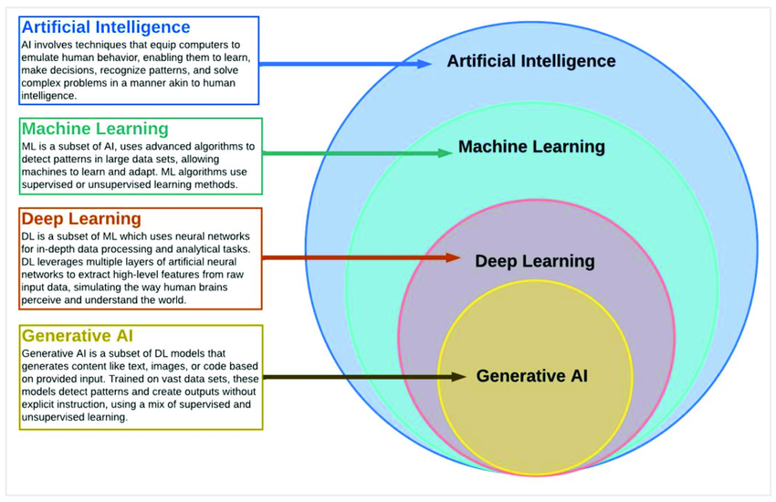
Introduction to AI

Slide 6
Generative AI Overview
- Generative AI produces text, images, and more by learning patterns from data.
- Key Technologies: GPT-3, GPT-4, Gemini, LLaMA,MISTRAL,LangChain, Huggingface
- Why use Generative AI for Chatbots?
- Context-aware and adaptive responses.
- Superior conversational ability compared to rule-based systems.

Slide 7
Building a Chatbot using Generative AI
- Generative AI uses deep learning models to generate human-like responses.
- Chatbots enhance user engagement and provide scalable customer support.
- Transforming industries like healthcare, retail, and education.

Slide 8
Use Cases for Chatbots
- Customer Service: Automating FAQs and resolving common queries.
- Virtual Assistants: Siri, Alexa, or custom assistants for businesses.
- Education: Tutoring and answering student questions interactively.
- E-commerce: Product recommendations and order tracking.

Slide 9
High-Level Architecture
- Input: Text or voice query from the user.
- Preprocessing: Tokenization, intent recognition, and context handling.
- Generative AI: Processes input and generates a response.
- Postprocessing: Ensures response clarity and format.

Slide 10
Technology Stack
- Languages: Python for backend; JavaScript (React) for frontend.
- Platforms: OpenAI, Hugging Face, Google Cloud AI, Azure AI.
- Frameworks: Flask/Django for APIs, integration libraries (Twilio for SMS).

Slide 11
Steps to Build the Chatbot
1. Define Use Cases: Identify target users and key features.
2. Prepare Data: Gather, clean, and preprocess datasets.
3. Select AI Model: Use pre-trained models like GPT-3 or custom models.
4. Integrate UI: Build an intuitive interface (React, Angular).
5. Test and Optimize: Continuous performance monitoring and tweaking.

Slide 12
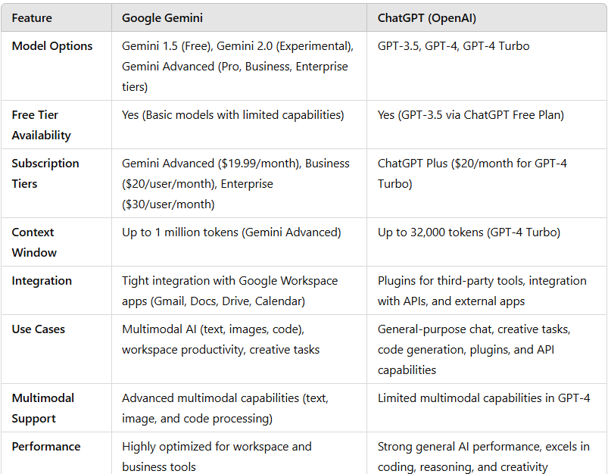
Model Selection

Slide 13
Integration with User Interface
- Best Practices: User-friendly design, clear prompt area.
- Integration Options: Website embedding, platform-specific bots (Slack, WhatsApp).

Slide 14
Challenges and Solutions
- Challenges:
- Handling ambiguous queries.
- Ensuring response relevance and ethical use.
- Managing scalability for high traffic.
- Solutions:
- Continuous fine-tuning with real-world data.
- Setting up rate limiters and security filters.

Slide 15
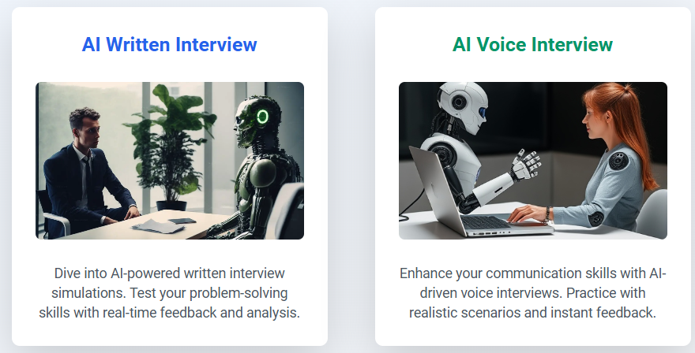
Demonstration of AI Chatbot
www.kauhalya.tech
Click ekaushalya link
Sign Up and Login

Slide 16
Hands-on Session
Translator
https://huggingface.co/spaces/raghuprasadks/presidencygeminitranslator
Gemini Chatbot
https://huggingface.co/spaces/raghuprasadks/presidencygeminichat
Gpt Clone
https://huggingface.co/spaces/raghuprasadks/presidencygptclone

Slide 17
Conclusion
- Recap:
- Q & A
Thanks
Raghu Prasad Konandur
9845547471
www.Kaushalya.tech
raghuprasadkonandur@kaushalya.tech

