Slide 1
Introduction to C#
Raghu Prasad Konandur
SME

Slide 2
Introduction
Raghu Prasad – BE, MS
Total of 27 years of experience
7 years as a lecturer in an Engineering College
20 Years into IT
Worked with companies like CISCO,CSC,ICICI,First Apex – NTT Data
Currently into Corporate training and consultancy
Worked with corporates and public sector
Service Offerings – In person/On-line/Corporate/Academic Institutes
Consultancy – Consultant to vendor of Atal Tinkering Lab/ECIL-ECIT, Incarnus – Healthcare Service Provider, Automation Spectrum Pty Ltd,Australia,Tech Varaha,Bengaluru
Technologies – Java,Python,C#,.Net,Web technologies,Java Script technologies (MEAN stack),IOT,Test Automation,Machine Learning,Artificial Intelligence,Blockchain and ERP
Corporate Customers – iLink,Sony,IQVIA,ITC Infotech,Philips,L & T,NextGen,Incarnus,Aspire system,Netwoven,SkillUpRight
Academic Customers - BGS-IT,Sindhi College,Malnad Enginering College,S B College of Management, REVA University,Nagarjuna Engineering College,Dayanand Sagar University,Acharya Institute of Technology,NIE Mysore,NIT-Imphal, AMC College, Kristu Jayanti College,SIT Tumakuru,etc

Slide 3
Topics
Introduction to C#
Why to use C#
Future of C#
Environmental Setup
Getting started with HelloWorld
Variables
Datatypes
Operators
User Input
Conditional Statements
Loops
Arrays
Assignment

Slide 4
Introduction to C#
C# is pronounced "C-Sharp".
It is an object-oriented programming language created by Microsoft that runs on the .NET Framework.
C# has roots from the C family, and the language is close to other popular languages like C++ and Java.
The first version was released in year 2002. The latest version, C# 8, was released in September 2019.
C# is used for:
Mobile applications
Desktop applications
Web applications
Web services
Web sites
Games
VR
Database applications
And much, much more!

Slide 5
Why use C#
It is one of the most popular programming language in the world
It is easy to learn and simple to use
It has a huge community support
C# is an object oriented language which gives a clear structure to programs and allows code to be reused, lowering development costs.
As C# is close to C, C++ and Java, it makes it easy for programmers to switch to C# or vice versa

Slide 6
Why use C#
C# has many other reasons for being popular and in demand. Few of the reasons are mentioned below:
Easy to start: C# is a high-level language so it is closer to other popular programming languages like C, C++, and Java and thus becomes easy to learn for anyone.
Widely used for developing Desktop and Web Application: C# is widely used for developing web applications and Desktop applications. It is one of the most popular languages that is used in professional desktop. If anyone wants to create Microsoft apps, C# is their first choice.
Community:The larger the community the better it is as new tools and software will be developing to make it better. C# has a large community so the developments are done to make it exist in the system and not become extinct.
Game Development: C# is widely used in game development and will continue to dominate. C# integrates with Microsoft and thus has a large target audience. The C# features such as Automatic Garbage Collection, interfaces, object-oriented, etc. make C# a popular game developing language.
Career Opportunities

Slide 7
Why use C#
16% of the top 100 million websites are powered by the ASP.NET | Open-source web framework for .NET framework, of which many might be using C#, so there are some opportunities in enterprise-level backend development. However, tech giants mainly use Java for its better portability and tools. Nonetheless, if you know already C#, it shouldn't be too hard to pick up Java if push comes to shove.
With the rise of indie game development, C# developers are likely to have better opportunity, since Unity has pretty much become the de facto game engine for indie game development.

Slide 8
Future of C#
As C# was developed by Microsoft to build apps on the Microsoft platform, Microsoft will likely make sure to keep C# relevant and updated.
As a programming language's ability to stay relevant and survive also depends on whether the language is getting new blood. In terms of search volume according to Google Adwords, C# has a healthy number of search volume and is the 5th place in terms of the programming language people are most interested in learning.
Interest in learning C# grew by 22.2 ％ in 2020
Virtual Reality will likely continue to be a big thing, and independent game development will continue to grow in popularity. Since Unity is a major player in VR/game development, C# has a pretty optimistic future.

Slide 9
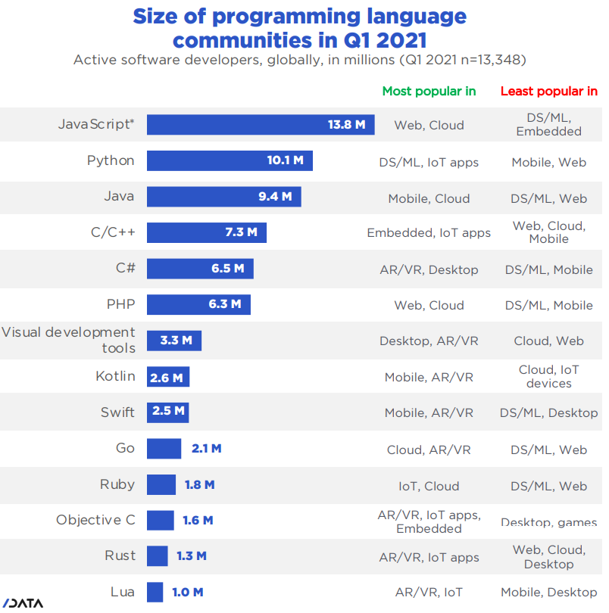
Future of C#

Slide 10
Future of C#

Slide 11
C# Environment Setup
Reference Video : https://www.youtube.com/watch?v=Y7GMBmd1EAk
Step 1 : Download and install visual studio based on the operating system and architecture
https://code.visualstudio.com/download
Step 2 : Download and install .net core 3.1 SDK
https://dotnet.microsoft.com/en-us/download/dotnet/thank-you/sdk-3.1.416-windows-x64-installer
Step 3 : Create project folder and launch visual studio code
Create a folder namely csharptutorial and open it from visual studio code

Slide 12
C# Environment Setup
Step 4 : Install C# extensions
c#
c#snippets
c# Extensions
Step 5: Open New Terminal
Type following commands to get started with hello world program
dotnet new console
dotnet restore
dotnet run

Slide 13
Getting Started-HelloWorld
using System;
namespace HelloWorld
{
class Program
{
static void Main(string[] args)
{
Console.WriteLine("Hello World!");
}
}
}

Slide 14
Getting Started-HelloWorld
Example explained
Line 1: using System means that we can use classes from the System namespace.
Line 2: A blank line. C# ignores white space. However, multiple lines makes the code more readable.
Line 3: namespace is used to organize your code, and it is a container for classes and other namespaces.
Line 4: The curly braces {} marks the beginning and the end of a block of code.
Line 5: class is a container for data and methods, which brings functionality to your program. Every line of code that runs in C# must be inside a class. In our example, we named the class Program.

Slide 15
Getting Started-HelloWorld
Example explained
Line 7: Another thing that always appear in a C# program, is the Main method. Any code inside its curly brackets {} will be executed. You don't have to understand the keywords before and after Main. You will get to know them bit by bit while reading this tutorial.
Line 9: Console is a class of the System namespace, which has a WriteLine() method that is used to output/print text. In our example it will output "Hello World!".

Slide 16
Getting Started-HelloWorld
Example explained
Line 7: Another thing that always appear in a C# program, is the Main method. Any code inside its curly brackets {} will be executed. You don't have to understand the keywords before and after Main. You will get to know them bit by bit while reading this tutorial.
Line 9: Console is a class of the System namespace, which has a WriteLine() method that is used to output/print text. In our example it will output "Hello World!".

Slide 17
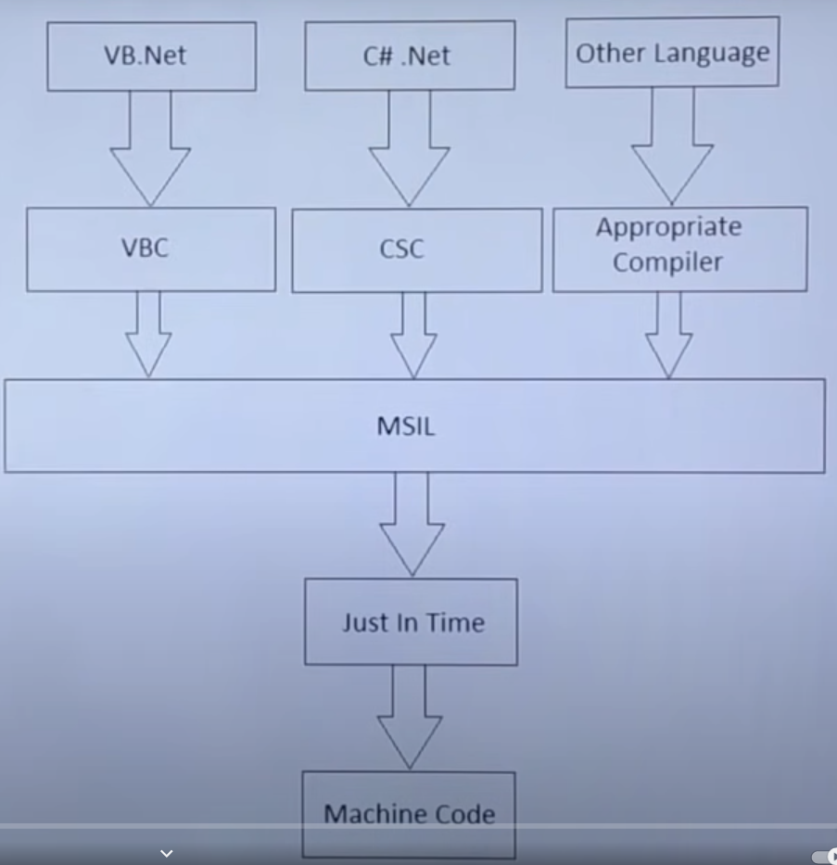
Compilation in .Net

Slide 18
Compilation in .Net
MSIL – Microsoft Intermediate Language
DLL – Dynamic Link Library
EXE – Gets generated with main method
PE – Portable Executable file

Slide 19
Variables
Variables are containers for storing data values.
In C#, there are different types of variables (defined with different keywords), for example:
int - stores integers (whole numbers), without decimals, such as 123 or -123
double - stores floating point numbers, with decimals, such as 19.99 or -19.99
char - stores single characters, such as 'a' or 'B'. Char values are surrounded by single quotes
string - stores text, such as "Hello World". String values are surrounded by double quotes
bool - stores values with two states: true or false

Slide 20
Variables
Declaring (Creating) Variables
To create a variable, you must specify the type and assign it a value:
type variableName = value;
Where type is a C# type (such as int or string), and variableName is the name of the variable (such as x or name). The equal sign is used to assign values to the variable.
Example
string name = "John";
Console.WriteLine(name);

Slide 21
Variables
The general rules for naming variables are:
Names can contain letters, digits and the underscore character (_)
Names must begin with a letter
Names should start with a lowercase letter and it cannot contain whitespace
Names are case sensitive ("myVar" and "myvar" are different variables)
Reserved words (like C# keywords, such as int or double) cannot be used as names

Slide 22
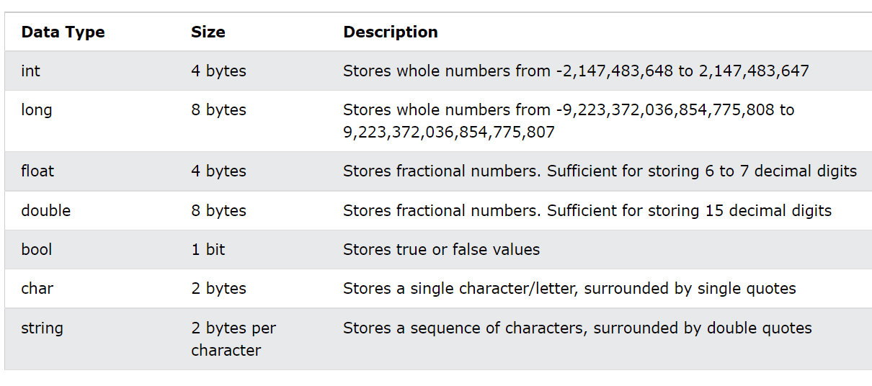
C# Data Types

Slide 23
C# Operators
Arithmetic +,-,*,/,%,++,--
Assignment =,+=,-=,*=,/=
Comparision ==,!=,>,<,>=,<=
Logical Operators &&,||,!

Slide 24
C# Operators
Arithmetic +,-,*,/,%,++,--
Assignment =,+=,-=,*=,/=
Comparision ==,!=,>,<,>=,<=
Logical Operators &&,||,!

Slide 25
C# User Inputs
Get User Input
You have already learned that Console.WriteLine() is used to output (print) values. Now we will use Console.ReadLine() to get user input.
Example
// Type your username and press enter
Console.WriteLine("Enter username:");
// Create a string variable and get user input from the keyboard and store it in the variable
string userName = Console.ReadLine();
// Print the value of the variable (userName), which will display the input value
Console.WriteLine("Username is: " + userName);

Slide 26
C# User Inputs
Get User Input - Integer
Console.WriteLine("Enter your age:");
int age = Convert.ToInt32(Console.ReadLine());
Console.WriteLine("Your age is: " + age);
Type Conversion Methods
It is also possible to convert data types explicitly by using built-in methods, such as Convert.ToBoolean, Convert.ToDouble, Convert.ToString, Convert.ToInt32 (int) and Convert.ToInt64 (long):

Slide 27
C# Conditions and If Statements
C# supports the usual logical conditions from mathematics:
Less than: a < b
Less than or equal to: a <= b
Greater than: a > b
Greater than or equal to: a >= b
Equal to a == b
Not Equal to: a != b
You can use these conditions to perform different actions for different decisions.
C# has the following conditional statements:
Use if to specify a block of code to be executed, if a specified condition is true
Use else to specify a block of code to be executed, if the same condition is false
Use else if to specify a new condition to test, if the first condition is false

Slide 28
While loop
Loops
Loops can execute a block of code as long as a specified condition is reached.
Loops are handy because they save time, reduce errors, and they make code more readable.
C# While Loop
The while loop loops through a block of code as long as a specified condition is True:
Syntax
while (condition)
{
// code block to be executed
}

Slide 29
For loop
When you know exactly how many times you want to loop through a block of code, use the for loop instead of a while loop:
Syntax:
for (statement 1; statement 2; statement 3)
{
// code block to be executed
}
Statement 1 is executed (one time) before the execution of the code block.
Statement 2 defines the condition for executing the code block.
Statement 3 is executed (every time) after the code block has been executed.

Slide 30
Break and Continue
The break statement can also be used to jump out of a loop.
The continue statement breaks one iteration (in the loop), if a specified condition occurs, and continues with the next iteration in the loop.
for (int i = 0; i < 10; i++)
{
if (i == 4)
{
break;
}
Console.WriteLine(i);
}

Slide 31
Arrays
Create an Array
Arrays are used to store multiple values in a single variable, instead of declaring separate variables for each value.
To declare an array, define the variable type with square brackets:
Access the Elements of an Array
string[] cars = {"Volvo", "BMW", "Ford", "Mazda"};
Console.WriteLine(cars[0]);
// Outputs Volvo

Slide 32
Assignment - 1
1. Write a program to find the discount and net amount to be paid based on following advertisements in an ecommerce website. You have to get the user input for the worth of the items purchased
Purchased_amt <= 10000 then discount 5%
Purchased_amt > 10000 and Purchased_amt < =20000 then discount 10%
Purchased_amt > 20000 then discount 15%
Sample Calculation -
Purchase_amt = 15000
Discount = 15000*10/100 = 1500
Net_Amount to pay = Purchase_amt- Discount = 13500

Slide 33
Assignment - 2
2. Write a program to find the electricity bill amount to be paid based on following conditions written on a electricity bill. You have to get the user input for the units consumed
Units_Consumed <= 100 then price/unit is 1 INR
Units_Consumed > 100 and Units_Consumed < =200 then then price/unit is 2 INR
Units_Consumed > 200 then price/unit is 3 INR
Sample Calculation -
Units_Consumed = 50
Bill_Amount = 50*1 = 50
Units_Consumed = 150
Bill_Amount = 100*1+50 * 2 = 200
Please note that bill_amount depends on the rates at a specified slab and its cumulative

Slide 34
Thank You
Raghu Prasad Konandur
9845547471

