Slide 1
Internet Of Things (IoT) Unit 3 – Design and Development
Raghu Prasad
9845547471

Slide 2
Introduction
Raghu Prasad – BE, MS
Total of 29 years of experience
7 years as a lecturer in an Engineering College
22 Years into IT
Worked with companies like CISCO,CSC,ICICI,First Apex – NTT Data
Currently into Corporate training and consultancy
Worked with corporates and public sector
Service Offerings – In person/On-line/Corporate/Academic Institutes
Technologies – Java,Python,Web technologies,Java Script technologies (MEAN stack),IOT,Test Automation,Machine Learning,Artificial Intelligence,ERP,.NET
Customers – Philips,L & T,NextGen,Incarnus,BGS-IT,Sindhi College,Malnad Enginering College,S B College of Management, REVA University

Slide 3
Topics
IoT prototyping environments
Arduino
Raspberry Pi

Slide 4
Microprocessor Vs Microcontroller Vs SoC
Microprocessor is a general purpose processor use for general applications. Microcontroller is a lower performance processor used for embedded systems for specific target applications such as display controller in the mobile phone. SoC is a short for system on chip.
It is a technology where we integrate different architectures/blocks in a silicon die to form a complete system. Example, Apple A4 SoC which has GPU, ARM CPU core, DDR controller
https://appcodelabs.com/microcontroller-microprocessor-socs
https://www.youtube.com/watch?v=sTgYcY6oJWI

Slide 5
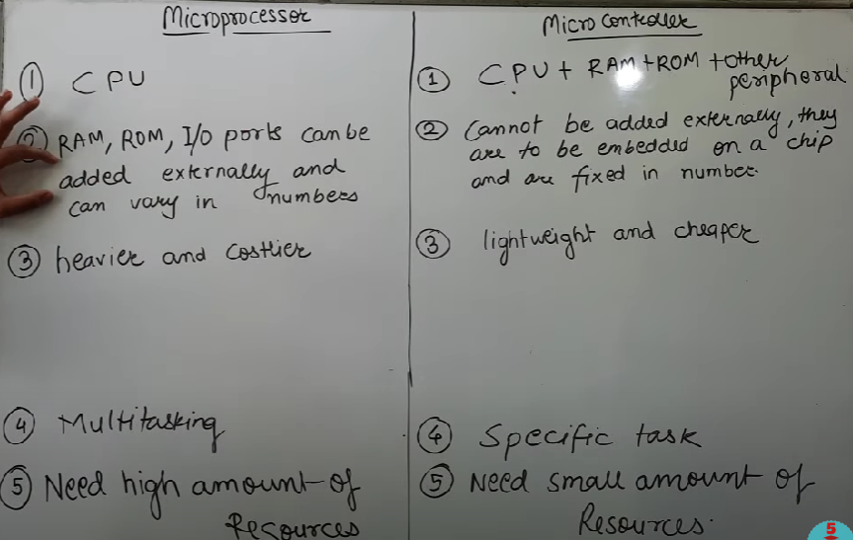
Microprocessor Vs Microcontroller Vs SoC

Slide 6
IoT Prototyping environment
Arduino
Arduino is an open-source platform used for building electronics projects. Arduino consists of both a physical programmable circuit board (often referred to as a microcontroller) and a piece of software, or IDE (Integrated Development Environment) that runs on your computer, used to write and upload computer code to the physical board.
The Arduino platform has become quite popular with people just starting out with electronics, and for good reason. Unlike most previous programmable circuit boards, the Arduino does not need a separate piece of hardware (called a programmer) in order to load new code onto the board – you can simply use a USB cable. Additionally, the Arduino IDE uses a simplified version of C++, making it easier to learn to program. Finally, Arduino provides a standard form factor that breaks out the functions of the micro-controller into a more accessible package.
Arduino board family
Arduino Uno
Arduino Mega
Lily Pad Arduino
https://learn.sparkfun.com/tutorials/what-is-an-arduino

Slide 7
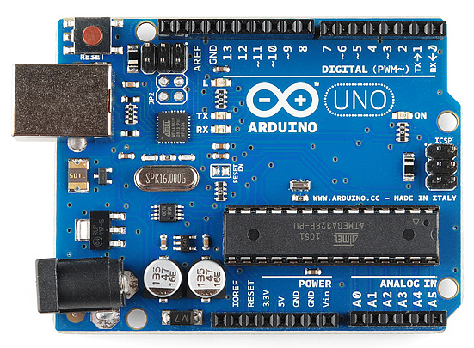
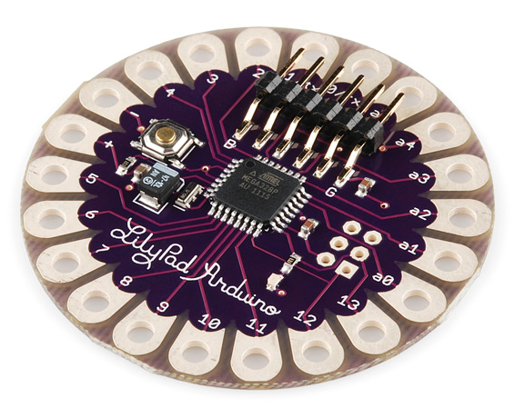
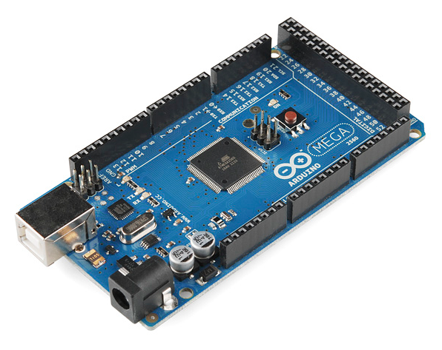
Arduino - flavours

Slide 8
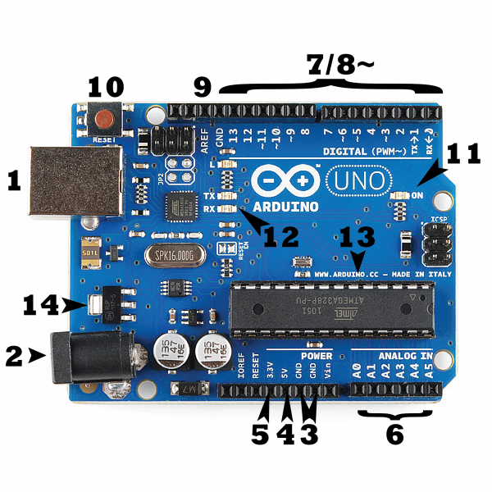
Arduino Uno – Deep drive

Slide 9
Arduino Uno – Deep drive
1 – Power through USB
2 – Power through Barrel Jack (DC – 6 to 12 volts)
PINS
3 – Ground
4 – 5 Volt power
5 – 3.5 Volt power
6 - A0 to A5 Analog pig
7 - Digital pin 0 through 13
8 – Pulse Width Modulation (PWM) - simulate analog output (like fading an LED in and out).
9 – Analog Reference - Most of the time you can leave this pin alone. It is sometimes used to set an external reference voltage (between 0 and 5 Volts) as the upper limit for the analog input pins.
10 – Reset Button
11 – Power Led Indicator
12 – RX/TX indicator LED’s - These LEDs will give us some nice visual indications whenever our Arduino is receiving or transmitting data (like when we’re loading a new program onto the board).
13 – Integrated Chip (IC) – Atmega
14 – Voltage Regulator

Slide 10
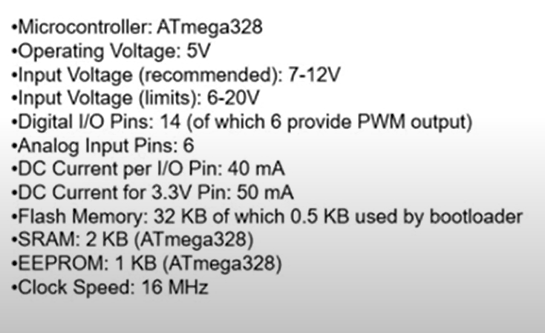
Arduino Uno – Specification

Slide 11
Arduino Uno – Programs
1. Download Arduino Uno software
2. Connect Arduino to Laptop/Desktop using USB port
3. Select board type and port
4. Run Sample programs available in Examples
5. Attach DHT sensor and execute programs
Refer to the programs shared
Parallelly you use https://wokwi.com/ to simulate usage of sensors

Slide 12
Raspberry pi
https://www.raspberrypi.org/
The Raspberry Pi is a series of small single-board computers developed in the United Kingdom by the Raspberry Pi Foundation to promote the teaching of basic computer science in schools and in developing countries.The original model became far more popular than anticipated,selling outside its target market for uses such as robotics. It does not include peripherals (such as keyboards, mice and cases). However, some accessories have been included in several official and unofficial bundles.
It is widely used in many areas, such as for weather monitoring,^{[19]} because of its low cost, modularity, and open design. It is typically used by computer and electronic hobbyists, due to its adoption of the HDMI and USB standards.

Slide 13
Raspberry pi
https://en.wikipedia.org/wiki/Raspberry_Pi
After the release of the second board type, the Raspberry Pi Foundation set up a new entity, named Raspberry Pi Trading, and installed Eben Upton as CEO, with the responsibility of developing technology.^{[20]} The Foundation was rededicated as an educational charity for promoting the teaching of basic computer science in schools and developing countries. Most Pis are made in a Sony factory in Pencoed, Wales,^{[21]} while others are made in China and Japan.^{[22][23]}

Slide 14
Raspberry pi
Series and Generations
There are three series of Raspberry Pi, and several generations of each have been released. Raspberry Pi SBCs feature a Broadcom system on a chip (SoC) with an integrated ARM-compatible central processing unit (CPU) and on-chip graphics processing unit (GPU), while Raspberry Pi Pico has a RP2040 system on chip with an integrated ARM-compatible central processing unit (CPU).
1. Raspberry Pi
Raspberry Pi Model B
Raspberry Pi Model B+
Raspberry Pi 2
Raspberry Pi 3 Model B
Raspberry Pi 3 Model B+
Raspberry Pi 4 Model B
Raspberry Pi 400

Slide 15
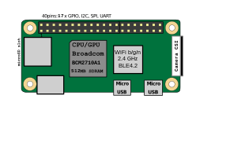
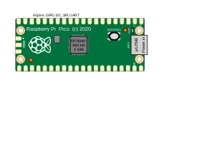
Raspberry pi
Series and Generations
2. Raspberry Pi Zero
3. Raspberry Pi Pico

Slide 16
Raspberry pi
According to the Raspberry Pi Foundation, more than 5 million Raspberry Pis were sold by February 2015, making it the best-selling British computer.^{[369]} By November 2016 they had sold 11 million units,^{[350][370]} and 12.5 million by March 2017, making it the third best-selling "general purpose computer".^{[371]} In July 2017, sales reached nearly 15 million,^{[372]} climbing to 19 million in March 2018.^{[26]} By December 2019, a total of 30 million devices had been sold.^{[373]}

Slide 17
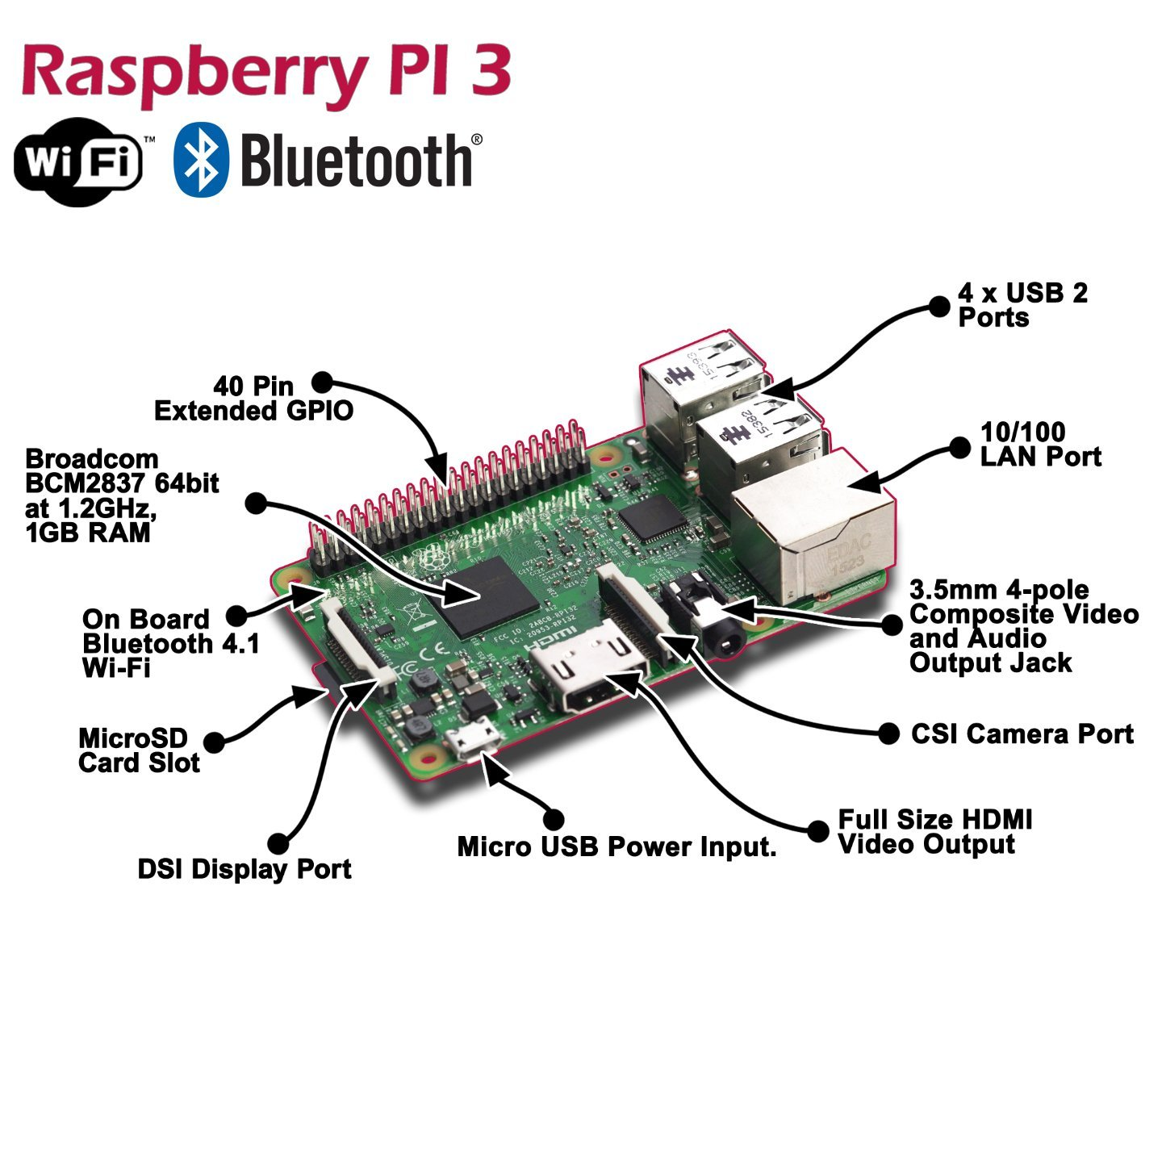
Raspberry pi

Slide 18
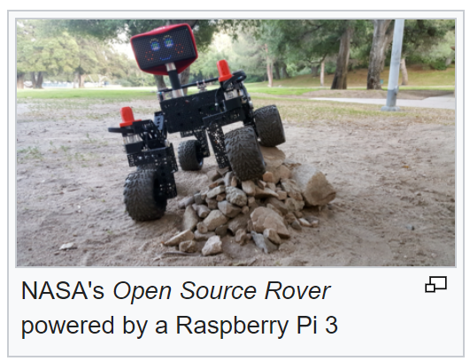
Raspberry pi usages
1. Education
2. Home Automation
3. Industrial Automation
4. Space Research

Slide 19
Raspberry pi – Getting Started
1. Format SD Card
2. Download OS and Copy to SD Card
3. Connect Key Board,Monitor etc.
Reference:
https://www.youtube.com/watch?v=RpseX2ylEuw&list=PLQVvvaa0QuDesV8WWHLLXW_avmTzHmJLv
https://pythonprogramming.net/introduction-raspberry-pi-tutorials/
Simulation
https://wokwi.com/

Slide 20
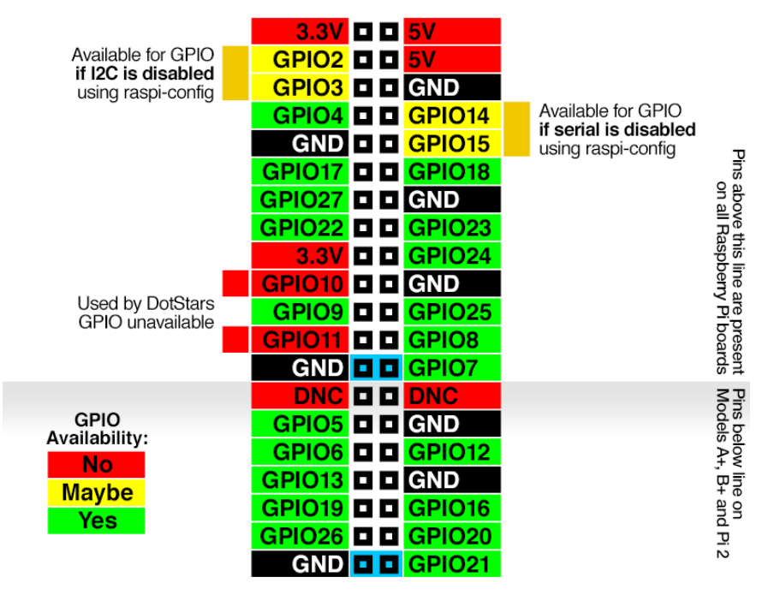
Raspberry pi – GPIO

Slide 21
Programs on Raspberry pi
https://projects.raspberrypi.org/en/projects/physical-computing/0
https://thingsboard.io/docs/samples/raspberry/temperature/

Slide 22
Raspberry pi – LED
import RPi.GPIO as GPIO
import time
GPIO.setmode(GPIO.BCM)
GPIO.setwarnings(False)
GPIO.setup(14,GPIO.OUT)
# While loop
while True:
# set GPIO14 pin to HIGH
GPIO.output(14,GPIO.HIGH)
# show message to Terminal
print "LED is ON"
# pause for one second
time.sleep(1)
# set GPIO14 pin to HIGH
GPIO.output(14,GPIO.LOW)
# show message to Terminal
print "LED is OFF"
# pause for one second
time.sleep(1)

Slide 23
Raspberry pi – DTH
https://www.circuitbasics.com/how-to-set-up-the-dht11-humidity-sensor-on-the-raspberry-pi/
#!/usr/bin/python
import sys
import Adafruit_DHT
while True:
humidity, temperature = Adafruit_DHT.read_retry(11, 4)
print 'Temp: {0:0.1f} C Humidity: {1:0.1f} %'.format(temperature, humidity)

Slide 24
Projects on Raspberry pi
http://www.trustedreviews.com/opinion/best-raspberry-pi-projects-pi-3-pi-zero-2949390
An Amazon Alexa-powered dash cam
An electric skateboard
A disposable GIF camera
An electronic chess board
A Kodi media centre
A DIY NES Classic Mini
A digital DJ system
Automated entrance music
A robot arm
Multiroom audio for under £100
A walkie-talkie
A film-to-digital transfer system
A tiny retro games console
A magic mirror
A mini retro Macintosh Read more at http://www.trustedreviews.com/opinion/best-raspberry-pi-projects-pi-3-pi-zero-2949390#WlFlr3fl5UFfl88j.99

Slide 25
Thank You
Raghu Prasad
9845547471

