Slide 1
Internet Of Things (IoT) Unit 2 –IoT Protocols
Raghu Prasad K S
Professor Of Practice
Kristu Jayanti College
9845547471

Slide 2
Introduction
Raghu Prasad – BE, MS
Total of 29 years of experience
7 years as a lecturer in an Engineering College
22 Years into IT
Worked with companies like CISCO,CSC,ICICI,First Apex – NTT Data
Currently into Corporate training and consultancy
Worked with corporates and public sector
Service Offerings – In person/On-line/Corporate/Academic Institutes
Technologies – Java,Python,Web technologies,Java Script technologies (MEAN stack),IOT,Test Automation,Machine Learning,Artificial Intelligence,ERP,.NET
Customers – Philips,L & T,NextGen,Incarnus,BGS-IT,Sindhi College,Malnad Enginering College,S B College of Management, REVA University

Slide 3
Topics
Introduction to IoT Protocols
Communication Technology
ISM Bands
Zigbee,Z-Wave,Bluetooth,BLE
MQTT
COAP
HTTP - REST

Slide 4
IoT Protocols
What is a protocol ?
Special set of rules that end points in a telecommunication connection use when they communicate. Protocols specify interaction between the communicating entities.
Protocol | Technology | Standard
A network protocol defines rules and conventions for communication between network devices | Activity of designing and constructing and maintaining communication system | A standard is a document that specifies something that has the overwhelming support and agreement of the standards making body
Examples Protocols | Examples of Technology | Examples of standard
IP TCP UDP FTP HTTP MQTT COAP | Wi-Fi Bluetooth ZigBee NFC WiMax GSM CDMA | IEEE 802.11 a/b/g (WiFi,Bluetooth) 802.15 (ZigBee,NFC,GSM) 802.16

Slide 5
IoT Protocols
IoT end node/device requirements
Scalable
Secure
End node addressability
Low power
Limited memory
Low cost
Lightweight connection

Slide 6
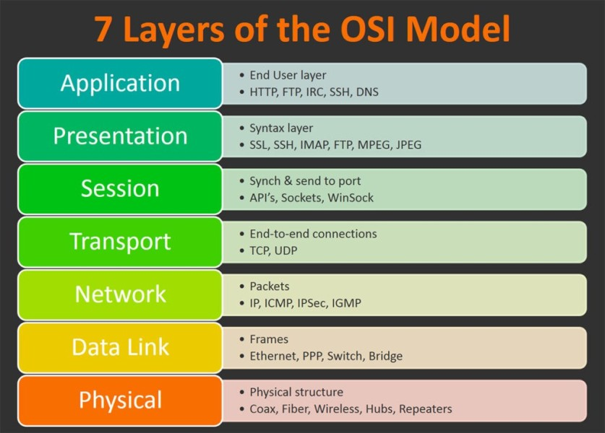
OSI Model(Open System Interconnect)

Slide 7
Communication Technologies
ZigBee
Z-wave
Bluetooth
Bluetooth Low Energy (BLE)
Wi-Fi
Cellular
6LowPAN
LoRaWAN
Sigfox

Slide 8
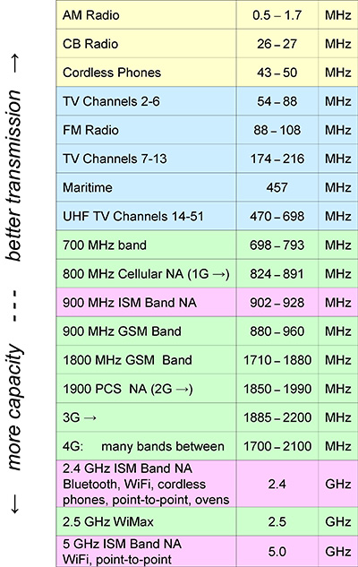
ISM bands

Slide 9
Introduction to Zigbee in IoT
Zigbee is a low-power, low-data-rate wireless communication protocol commonly used in IoT applications. It is designed for efficient, secure communication in devices requiring minimal power consumption and operating over short ranges.

Slide 10
Key Features of Zigbee in IoT
1. Low power consumption for battery-powered devices.
2. Mesh networking extends range and improves reliability.
3. Low data rate (20 kbps to 250 kbps) for small data transmissions.
4. Range of 10-100 meters, extendable through mesh.
5. Built-in 128-bit AES encryption for secure communication.
6. Cost-effective and scalable for large IoT deployments.

Slide 11
Zigbee Architecture in IoT
Zigbee operates on top of the IEEE 802.15.4 standard and consists of:
- Physical Layer: Manages transmission and reception of data.
- MAC Layer: Controls access to the radio channel.
- Network Layer: Handles routing and addressing in the mesh network.
- Application Support Layer: Manages services and communication between devices.
- Application Layer: Defines protocols and profiles for specific applications.

Slide 12
Use Cases of Zigbee in IoT
1. Smart Home: Lights, thermostats, and security systems.
2. Industrial Automation: Reliable communication in harsh environments.
3. Health Monitoring: Remote sensors for patient data.
4. Smart Metering: Real-time monitoring of energy usage.
5. Agriculture: Soil moisture and environmental monitoring.

Slide 13
Comparison with Other IoT Protocols
1. Zigbee: Low power, mesh network, low data rate.
2. Wi-Fi: Higher power consumption, higher data rate.
3. Bluetooth Low Energy (BLE): Similar low power, shorter range.

Slide 14

Zigbee-Summary
ZigBee
Low data rate,Low power consumption,Small pocket devices,Unlicensed bands
Bands (ISM – The industrial, scientific, and medical radio band)
ISM 2.4 GHz Global band at 250 kbps
868 MHz European band at 20 kbps
915 MHz North American band at 40 kbps
Range is very low – 100 to 300 ft
Topologies
Mesh,Star,One to One
Usage
Building automation,Health care,Asset management,Consumer electronics,Lawn and garden irrigation

Slide 15
Zigbee Network Topologies
Overview of different network topologies used in Zigbee

Slide 16
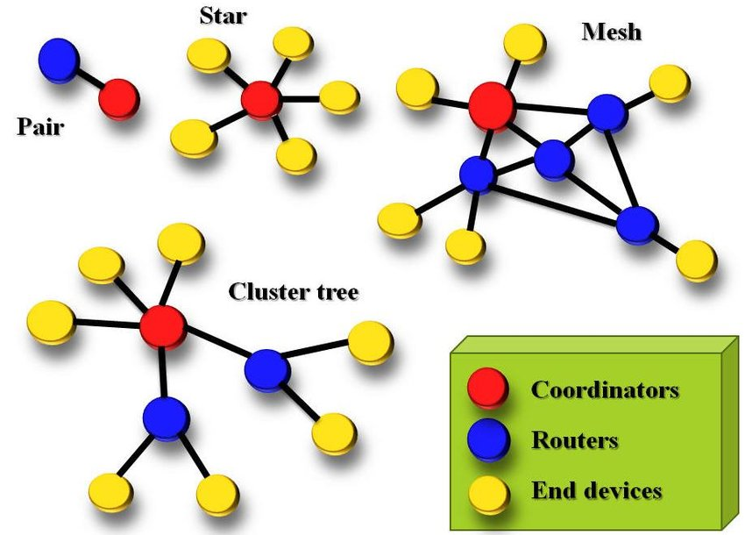
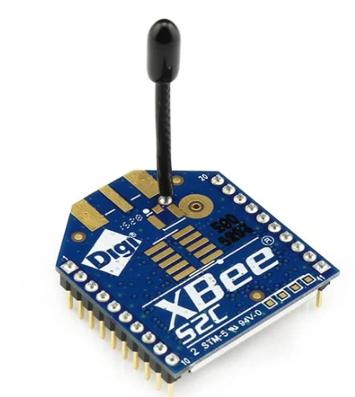
ZigBee

Slide 17
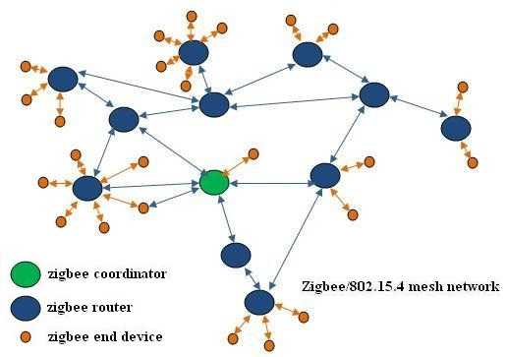
ZigBee – Network topology
Mesh topology in detail

Slide 18
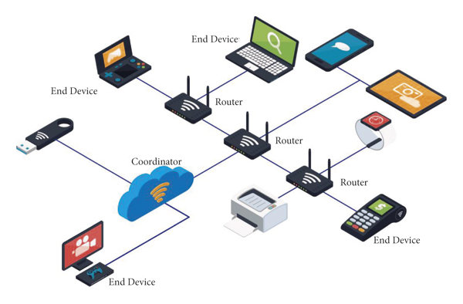
ZigBee – Network

Slide 19
Star Topology
• A central coordinator communicates with all other devices (end devices).
• Simple, but limited range as all devices must be within the coordinator's range.
• If the coordinator fails, the entire network fails.

Slide 20
Tree Topology
• The network is hierarchical, with a coordinator at the root.
• Routers connect to the coordinator or other routers, forming branches.
• Extends range but relies on router communication; failure of routers can disconnect devices.

Slide 21
Mesh Topology
Devices (routers and coordinator) can forward messages to extend the range.
High fault tolerance, messages can reroute if a device fails.
Highly scalable and suitable for large, reliable networks.

Slide 22
Comparison of Topologies
Star: Simple but limited range, central coordinator.
Tree: Hierarchical with routers extending range.
Mesh: Highly scalable, fault-tolerant, and ideal for large networks.

Slide 23
Z-Wave
Z-Wave
Oriented towards residential control and automation market
Bands
Works in sub Giga hertz frequency band – 900 MHz,100 kbps
Can have a maximum of 232 nodes
Topologies
Operates on mesh network architecture with one primary and multiple secondary controllers
USP is interoperability

Slide 24
Introduction to Bluetooth and BLE
Bluetooth and Bluetooth Low Energy (BLE) are wireless communication technologies under the Bluetooth specification. While both are used in IoT, they differ significantly in power consumption, data rate, and use cases, making them suitable for different IoT applications.

Slide 25
Bluetooth
Bluetooth
Open standard for development of Personal Area Network (PAN)
Low cost,low power, short range (with in 10 meters)
Bluetooth enabled device can exchange information (transfer data) with other bluetooth device over a radio
Bluetooth helps in creating small network of devices that are close to one another
Bluetooth Low Energy (BLE)
Integral part of Bluetooth specification from Bluetooth V4.0 onwards
Low power consumption
Wearables, home automation, Health and wellness, Sports and fitness

Slide 26
BLE
Bluetooth Tooth Low Energy
Integral part of Bluetooth core specification from v4.0 onwards
Range : ~150 mtrs open field
Output power: ~10 mW
Max Current: ~15 mA
Topology: Star
Connection : >2 billlon
Modulation : GFSK @2.4 GHz
Security : 128 bit AES CCM

Slide 27
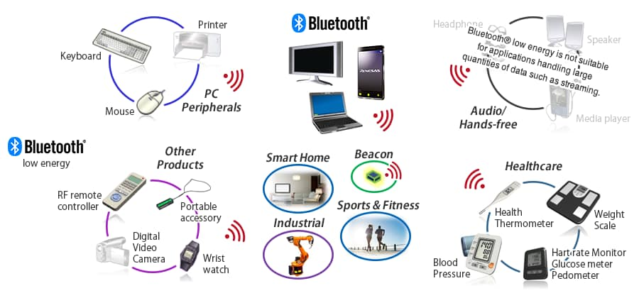
BLE - Applications
BLE and Bluetooth Tooth applications

Slide 28
Key Differences
1. Power Consumption: Bluetooth Classic is high-power, while BLE is designed for low power consumption.
2. Data Rate: Bluetooth Classic offers higher data rates (~2-3 Mbps), while BLE supports lower rates (~125 kbps to 1 Mbps).
3. Battery Life: BLE is optimized for devices with long battery life (months to years), whereas Bluetooth Classic has shorter battery life.
4. Use Cases: Bluetooth Classic is ideal for continuous connections (e.g., audio streaming), while BLE is better for periodic data transfer (e.g., sensors, trackers).

Slide 29
Use Cases for IoT
Bluetooth Classic:
- Audio streaming (wireless speakers, headphones)
- File transfer and hands-free communication
Bluetooth Low Energy (BLE):
- Smartwatches, fitness trackers, medical devices
- IoT sensors, smart home devices, beacons
- Ideal for devices with low power needs and short, infrequent data transfers

Slide 30
Summary of Bluetooth vs BLE for IoT
Bluetooth Classic is best for high-data, continuous applications, such as audio and file sharing, while BLE is optimized for energy-efficient, infrequent data transfers in IoT, such as fitness trackers and smart home sensors. For IoT, BLE is generally preferred due to its low power consumption and long battery life.

Slide 31
Wi-Fi
Wi-Fi
Widely used
Standard – 802.11 n
Frequencies – 2.4 to 5 GHz
Range – 50 m
Data rates – 600 Mbps max. Typically between 150 to 200 Mbps
http://beta.speedtest.net

Slide 32
Cellular
Cellular
IOT application require to operate over longer distance can use GSM/3G/4G
Standard – GSM/GPRS/Edge (2G)/UMTS/HSPA (3G)/LTE (4G)
Frequencies – 900/1800/1900/2100 MHz
Range – 35 kms max for GSM,200 Kms for HSPA
Data rates (typical download)– 35 to 170 kbps (GPRS),120 to 384 kbps (EDGE),384 kbps to 2 Mbps (UMTS),600 kbps to 10 Mbps ( HSPA), 3 to 10 Mbs (LTE)

Slide 33
6LoWPAN
6LoWPAN
IPv6 over low power Wireless Personal Area Network. Works with Mesh architecture
A simple low cost wireless network of devices that have limited power and relaxed throughput requirements
Has the capability to connect to internet
Confirms to 802.15.4-2003
It is an adaption layer for IPv6 over IEEE802.15.4 links

Slide 34
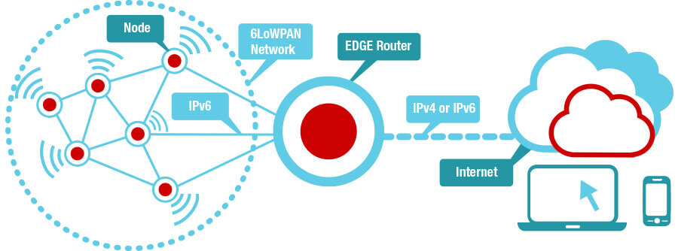
6LoWPAN

Slide 35
6LoWPAN
Nodes
(Self-healing mesh, routers and hosts)
From light bulbs to smoke detectors, each node carries an IPv6 address. Nodes typically require small amounts of memory and processing power, and can be implemented using a wireless microcontroller (MCU).
EDGE router
(Simple IP router, no-application-layer gateway)
The compressed IPv6 header needs an intermediary device to provide a conversion between 6LoWPAN and standard IP header. An EDGE router can be seen as this simplified “gateway”. This can be a standalone or an add-on system.
Internet
Connect to any cloud. TI is partnering with many cloud service providers to provide a simple and direct way to get you to the cloud.

Slide 36
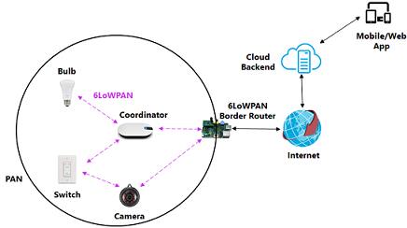
6LoWPAN

Slide 37
Sigfox
Sigfox
Range comes between WiFi and Cellular
Uses ISM bands which is free and no license is required
Ideal for devices having low level of data transfer and communication should be less expensive
Frequency – 900 MHz
Range – 30 to 50 kms Rural, 3 to 10 kms Urban
Data Range – 10 to 1000 bps

Slide 38
LoRaWAN (Long Range Wide Area Network)
LoRaWAN targets wide-area network (WAN) applications and is designed to provide low-power WANs with features specially needed to support low-cost mobile secure bi-directional communication in IOT,M2M and smart city and industrial applications
Optimized for low-power consumption and supporting large networks with millions and millions of devices,data rates rages from 0.3 kbps to 50 kbps.
Standard:LoRaWAN
Frequency :Various
Range: 2-5 km (urban environment), 15 km(suburban environment)
Data Rates:0.-50 kpbs
https://www.techtarget.com/searchnetworking/answer/What-is-the-difference-between-LoRa-and-LoRaWAN

Slide 39
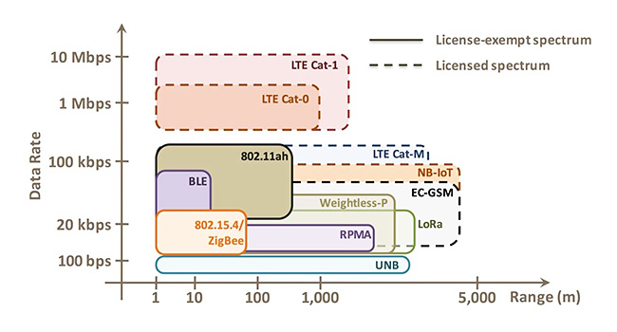
Range vs Data rate

Slide 40
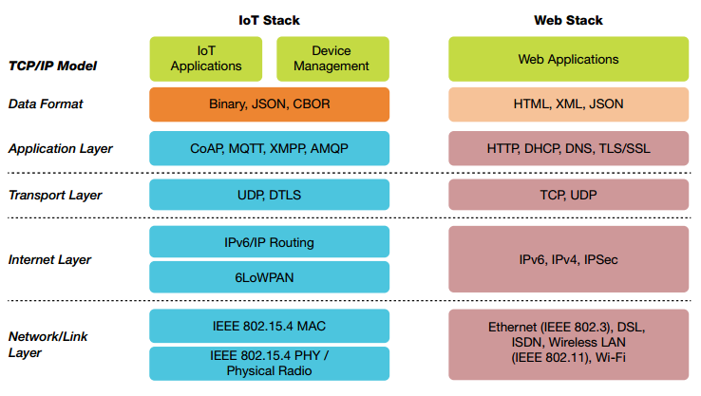
IOT - Protocols

Slide 41
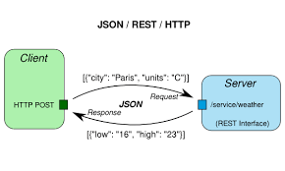
Restful HTTP

Slide 42
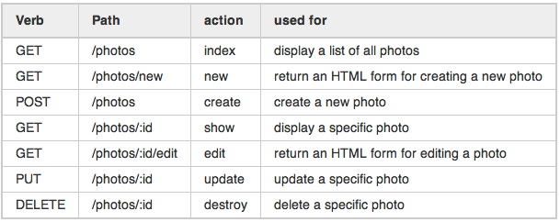
Restful HTTP

Slide 43
Restful HTTP – Hands-on
https://jsonplaceholder.typicode.com/
Get method
https://jsonplaceholder.typicode.com/user
Get method with id
https://jsonplaceholder.typicode.com/user/1
https://openweathermap.org/api
http://api.openweathermap.org/data/2.5/weather?q=London&APPID=384db1ce93218e20fd384d3016372238

Slide 44
MQTT (Message Queue Telemetry Transport)
MQTT stands for MQ Telemetry Transport. It is a publish/subscribe, extremely simple and lightweight messaging protocol, designed for constrained devices and low-bandwidth, high-latency or unreliable networks. The design principles are to minimise network bandwidth and device resource requirements whilst also attempting to ensure reliability and some degree of assurance of delivery. These principles also turn out to make the protocol ideal of the emerging “machine-to-machine” (M2M) or “Internet of Things” world of connected devices, and for mobile applications where bandwidth and battery power are at a premium.
http://mqtt.org/

Slide 45
MQTT (Message Queue Telemetry Transport)
Lightweight message queuing and transport protocol
Low overhead (2 bytes header) for low network bandwidth applications
Publish/Subscribe (Pub Sub0 model
Simple protocol, aimed at low power and low footprint implementation (e,g. WSN-Wireless Sensor Networks)
Runs on connection-oriented transport(TCP)
Sensor and actor nodes communicate with applications through the MQTT message broker

Slide 46
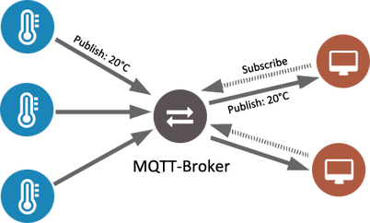
MQTT

Slide 47
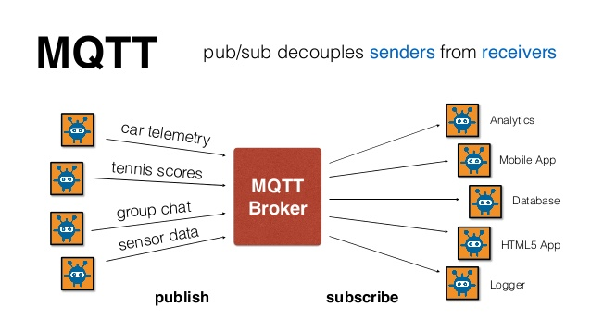
MQTT

Slide 48
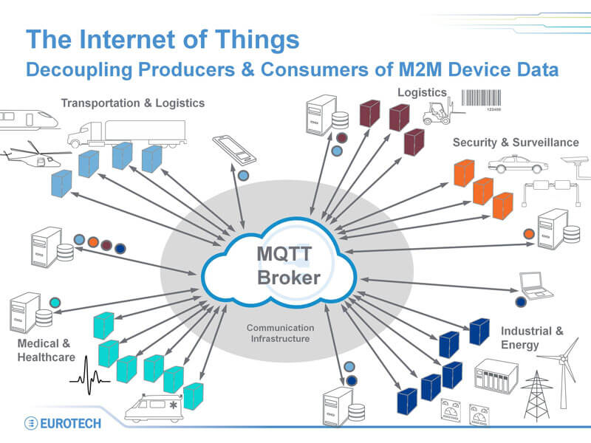
MQTT

Slide 49
MQTT – Quality Of Service
Quality of Service (QoS) in MQTT messaging is an agreement between sender and receiver on the guarantee of delivering a message.
There are three levels of QoS: 0 - at most once. 1 - at least once. 2 - exactly once.
When a client (e.g. a remote IoT device) is publishing to a broker, the client determines the QoS level for that message. When the broker sends the message to a subscribing client, the QoS set by the first client for that message is used again.
So effectively the original publisher of any message determines the QoS of the message all the way to the final recipients.
https://assetwolf.com/learn/mqtt-qos-understanding-quality-of-service

Slide 50
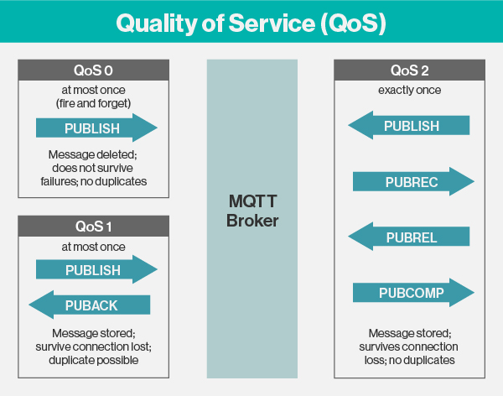
MQTT – Quality Of Service
http://www.steves-internet-guide.com/understanding-mqtt-qos-levels-part-1/

Slide 51
MQTT - Features
Open
Invented by IBM and Eurotech
MQTT client code (C and Java) donated to the Eclipse “Paho” M2M project
Reliable
Three quality of Service
Lean
Minimized on-the-wire format
Smallest possible packet size is 2 bytes
No application message header
Reduced complexity/footprint
Clients:c=30 kb java=100kb
Simple
Simple/minimal pub/sub message semantic s
Asynchronous (“push”) delivery
Simple set of verbs – connect,publish,subscribe and disconnect

Slide 52
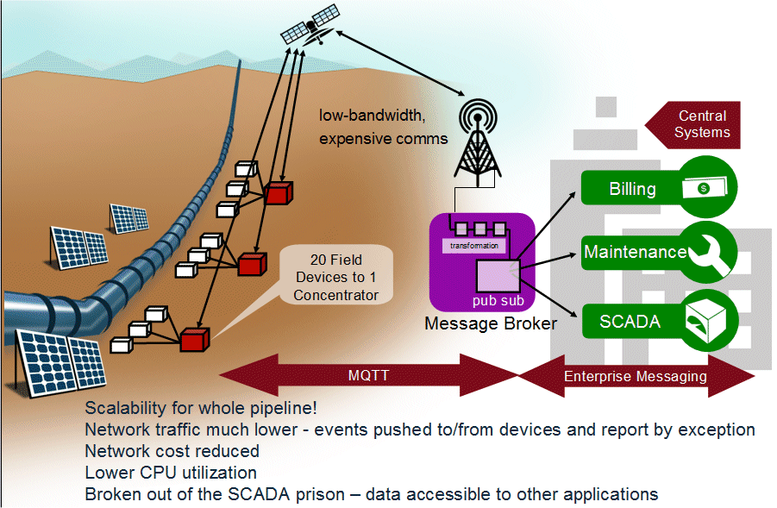
MQTT – Case Study

Slide 53
MQTT Brokers/Servers
Commercial
IBM
Software AG
dcSQuare
Open Source or free download
Mosquitto (https://mosquitto.org/). Client – Chrome add-on – MQTTLens
mosquitto_sub -h test.mosquitto.org -p 1883 -t “test”
mosquitto_pub -h test.mosquitto.org -p 1883 -t “test” –m “this is for testing”
RSMB
ActiveMQ
Apollo
RabbitMQ
Mqtt.js
eMQTT

Slide 54
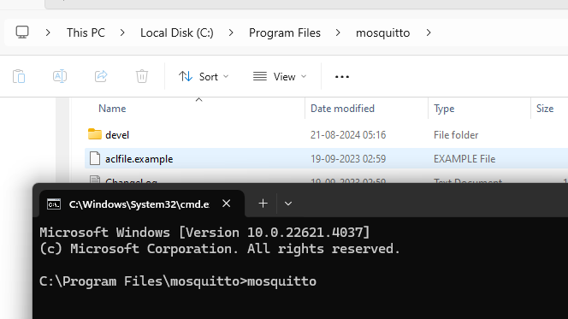
MQTT Hands-on
Download and install mosquitto mqtt broker
https://mosquitto.org/download/
Windows
mosquitto-2.0.18a-install-windows-x64.exe (64-bit build, Windows Vista and up, built with Visual Studio Community 2019
Verify whether mosquitto is running using windows search – services – mosquito
Stop the mosquitto service
Run mosquito from command prompt
Cmd to C:\Program Files\mosquitto
Type mosquito

Slide 55
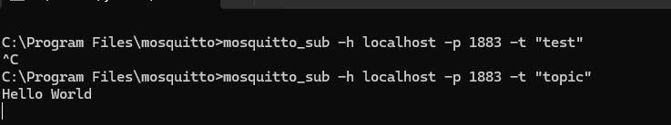
MQTT Hands-on
6. Subscribe to a topic
Open another terminal and cmd to C:\Program Files\mosquito
Type mosquitto_sub -h localhost -p 1883 -t "topic”
7. Publish a topic
Open another terminal and cmd to C:\Program Files\mosquito
Type mosquitto_pub -h localhost -p 1883 -t "topic" -m "Hello World“
8. Check the subscriber whether you have received the message

Slide 56
MQTT Hands-on
Message for home automation
Subscribe
mosquitto_sub -h localhost -p 1883 -t "home/room1/sensor”
3.Publish
mosquitto_pub -h localhost -p 1883 -t "home/room1/sensor" -m "{\"roomtemp\":28.5, \"humidity\":65}“

Slide 57
MQTT Hands-on – Python program
Create mqttdemo folder
cd to mqttdemo folder
Create virtual environment using python –m venv venv
Active virtual environment using .\venv\Scripts\activate
Install paho-mqtt using
pip install paho-mqtt
6. Create mqttdemo_publish.py
7. Create mqttdemo_subscribe.py
8. Ensure that mosquitto broker is running
8. Run both the programs using
python mqttdemo_publish.py
python mqttdemo_subscribe.py

Slide 58
MQTT Hands-on – Python program
mqtt_publish.py
import paho.mqtt.client as mqtt
import time
# Define the callback functions
def on_connect(client, userdata, flags, rc):
if rc == 0:
print("Connected successfully")
#client.subscribe("test/topic")
else:
print(f"Connect failed with result code {rc}")
def on_message(client, userdata, msg):
print(f"Message received: {msg.topic} {msg.payload.decode()}")
# Create an MQTT client instance
client = mqtt.Client()
# Assign the callback functions
client.on_connect = on_connect
client.on_message = on_message
# Connect to the MQTT broker
#client.connect("localhost", 1883, 60)
client.connect("broker.hivemq.com", 1883, 60)

Slide 59
MQTT Hands-on – Python program
#continued from previous slide
# Start the loop to process network traffic and dispatch callbacks
client.loop_start()
# Publish a message to the topic
client.publish("test/topic", "message_payload")
# Add a delay to give the client time to receive the message
time.sleep(2)
# Stop the loop and disconnect
client.loop_stop()
client.disconnect()

Slide 60
MQTT Hands-on – Python program
mqtt_subscribe.py
import paho.mqtt.client as mqtt
# Define the on_message callback
def on_message(client, userdata, message):
print(f"Received message '{message.payload.decode()}' on topic '{message.topic}' with QoS {message.qos}")
# Create an MQTT client instance
client = mqtt.Client()
# Assign the on_message callback
client.on_message = on_message
# Connect to the MQTT broker
client.connect("broker.hivemq.com", 1883, 60)
#client.connect("localhost", 1883, 60)
# Subscribe to a topic
client.subscribe("test/topic")
# Start the loop to process received messages
client.loop_start()
# Keep the script running
import time
while True:
time.sleep(1)

Slide 61
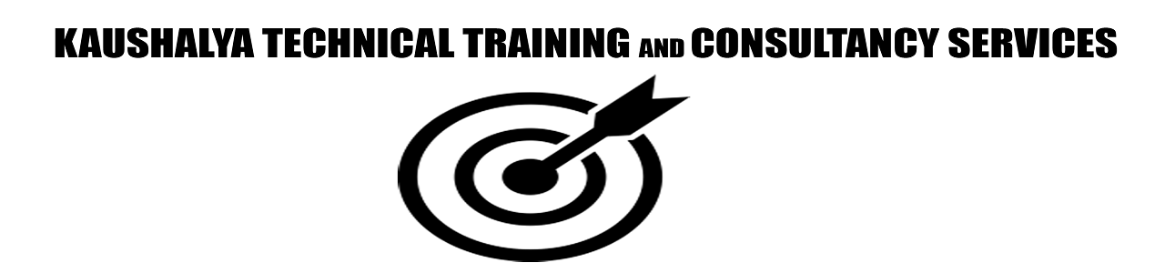
CoAP
Constrained Application Protocol – CoAP is a specialized web transfer protocol
Use with constrained nodes and constrained networks in IOT
The protocol is designed for machine-to-machine (M2M) applications such as
Smart energy
Building automation
And may more

Slide 62
CoAP overview
Inspired by HTTP (GET,POST,PUT, DELETE)
1-to-1 communication protocol
Lightweight and energy-efficient
Additional features on top of HTTP:
Observe
Discovery
QoS
Confirmable messages
Non-confirmable messages (fire and forget)

Slide 63
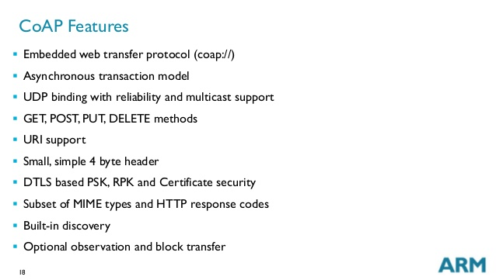
CoAP feature

Slide 64
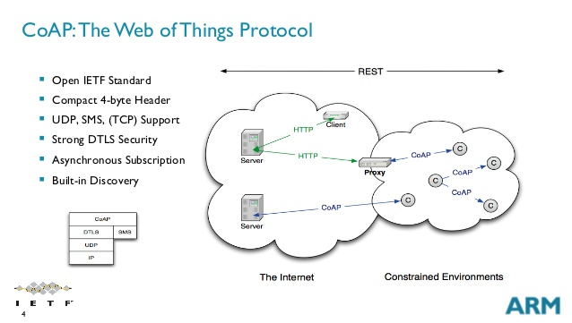
CoAP

Slide 65
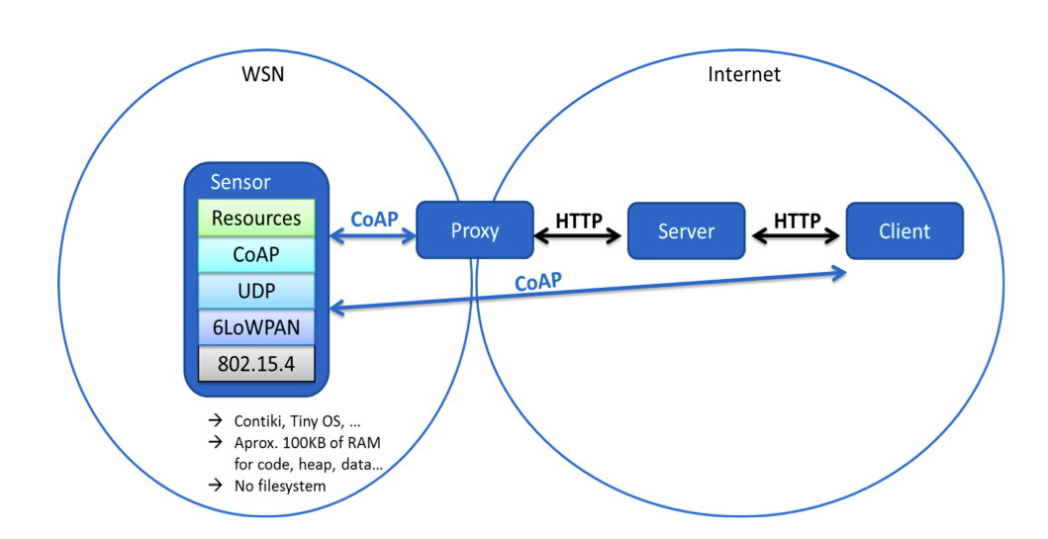
CoAP

Slide 66
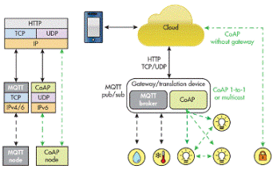
MQTT vs CoAP

Slide 67
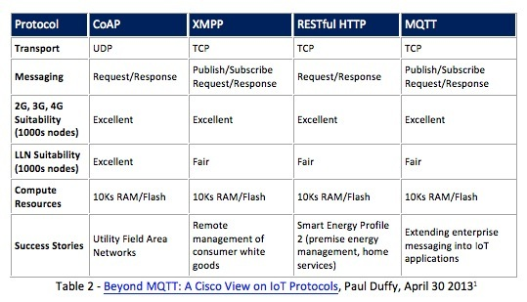
Comparison of IOT protocol

Slide 68
References
Edge Computing - https://www.youtube.com/watch?v=yRBe9YYCGw4
Right Protocol - https://www.youtube.com/watch?v=7eNU4rvdTC0&t=194s
Zigbee - https://www.youtube.com/watch?v=QXV_HgGO--g
NB-IOT - https://www.youtube.com/watch?v=F2YTUwh5-qE
ZigFox - https://www.youtube.com/watch?v=jcYoNvkorOY&t=5s
BLE - https://www.youtube.com/watch?v=NSkIHdV6NoY
OSI - https://www.youtube.com/watch?v=vv4y_uOneC0

Slide 69
References
Zigbee-https://www.youtube.com/watch?v=2KcZcNkRrNU&ab_channel=MAKERDEMY
https://www.youtube.com/watch?v=QXV_HgGO--g&t=14s&ab_channel=MAKERDEMY
SOC -https://www.geeksforgeeks.org/architecture-of-soc/
OSI - https://www.linkedin.com/pulse/osi-model-explained-how-easily-remember-its-7-layers-rahul-jasrotia/

Slide 70
References
Zigbee-
https://www.youtube.com/watch?v=QXV_HgGO--g&t=151s&ab_channel=MAKERDEMY
https://www.youtube.com/watch?v=Jmml-2Ge2WI&ab_channel=talkingStuffNetwork
https://www.youtube.com/watch?v=UmpDXc3cXbU&ab_channel=EverythingSmartHome
https://www.nic.in/blogs/lora-when-iots-talk-with-a-distance/
https://randomnerdtutorials.com/esp32-lora-rfm95-transceiver-arduino-ide/

Slide 71
Thank You
Raghu Prasad K S
9845547471

