Slide 1
BlockSpot & Garbage Dump Detector
Raghu Prasad K S
Gopinath R
Shiva Teja U

Slide 2
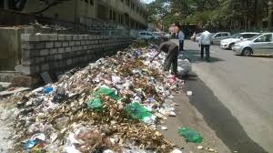
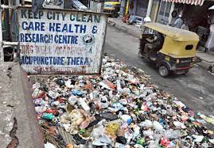
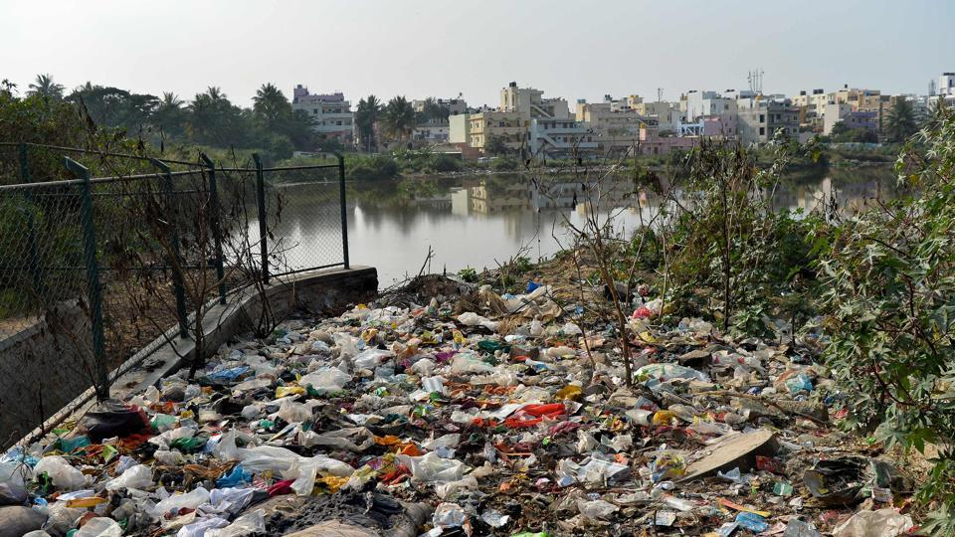
Look around our cities

Slide 3

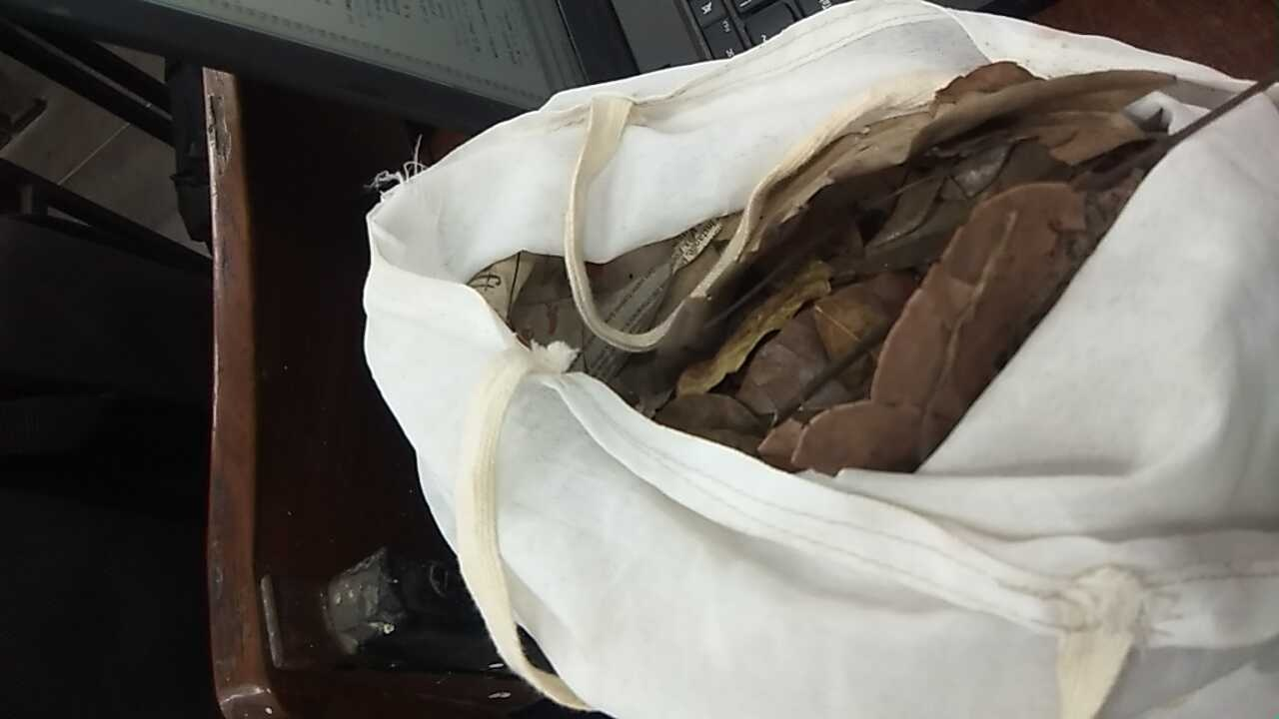
Solution Block Diagram
Cloud
Garbage Detector
Notification
Email –
Long,Lat and Image
Image Classifier
Electric Pole

Slide 4
Components
Detector Box
ESP 8266
Microwave Motion detection Sensor
IP Web Cam
Cloud
Adafruit Cloud
Image Classifier
Python based machine Learning algorithm
Notification
Email with longitude, latitude and image of the garbage
Communication
Wi-Fi

Slide 5
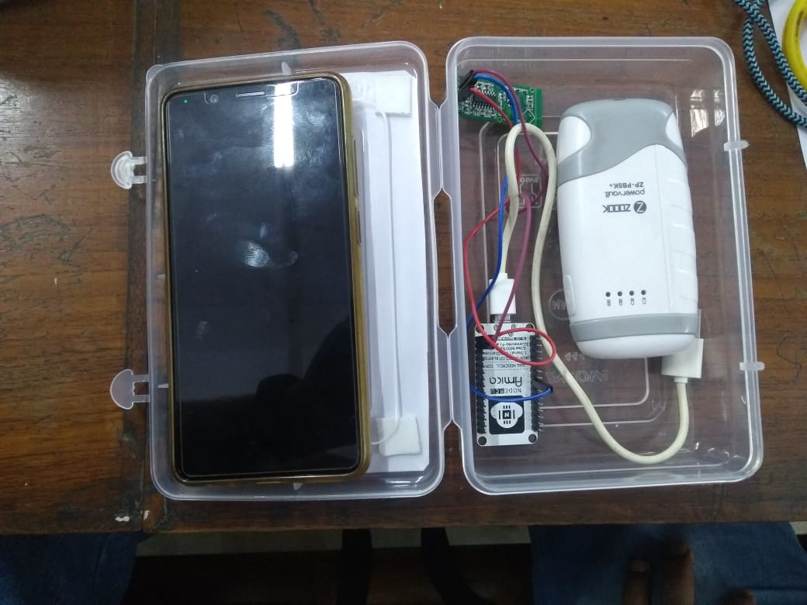
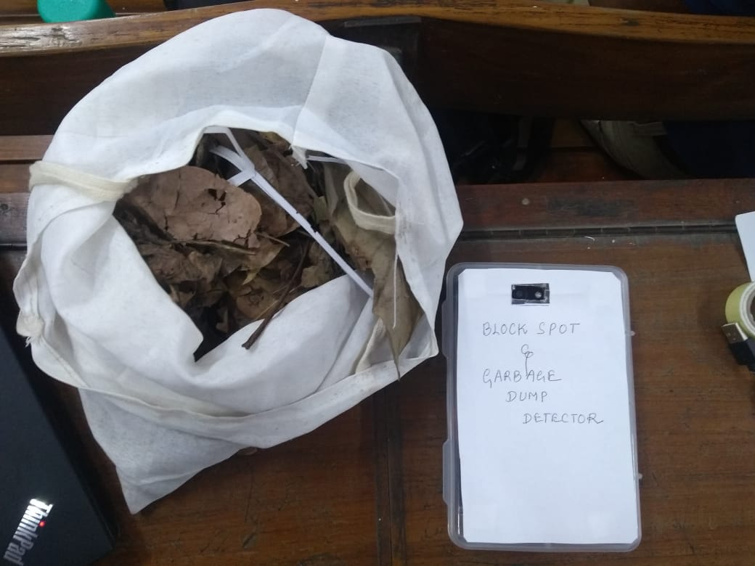
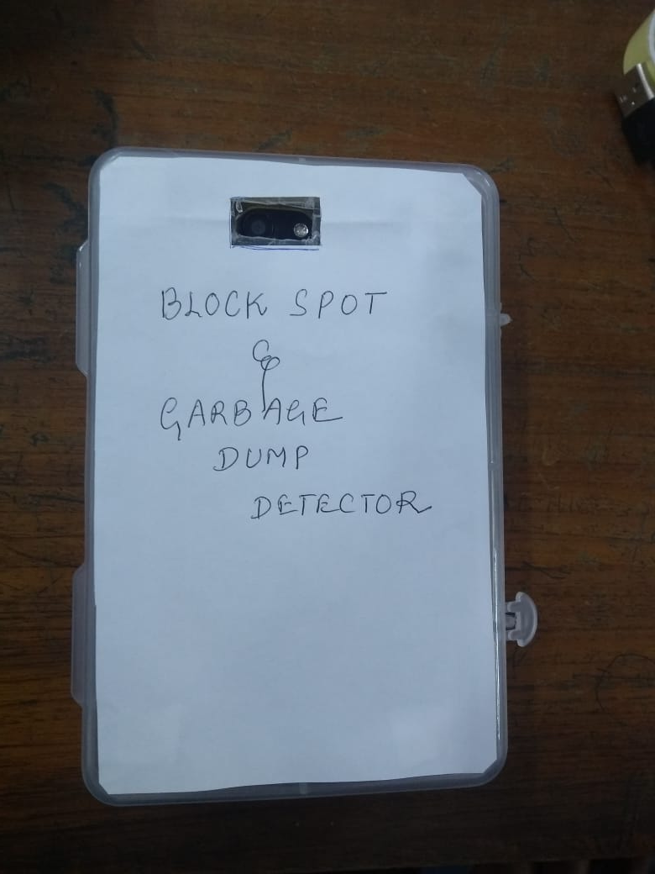
BS&GDD Prototype

Slide 6
Clean cities
Block spot and Garbage dump detector every where..

