Slide 1
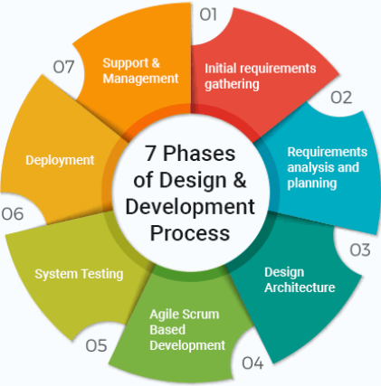
Prototype/Process Design and Development
Raghu Prasad K S
CEO
www.Kaushalya.tech
9845547471

Slide 2
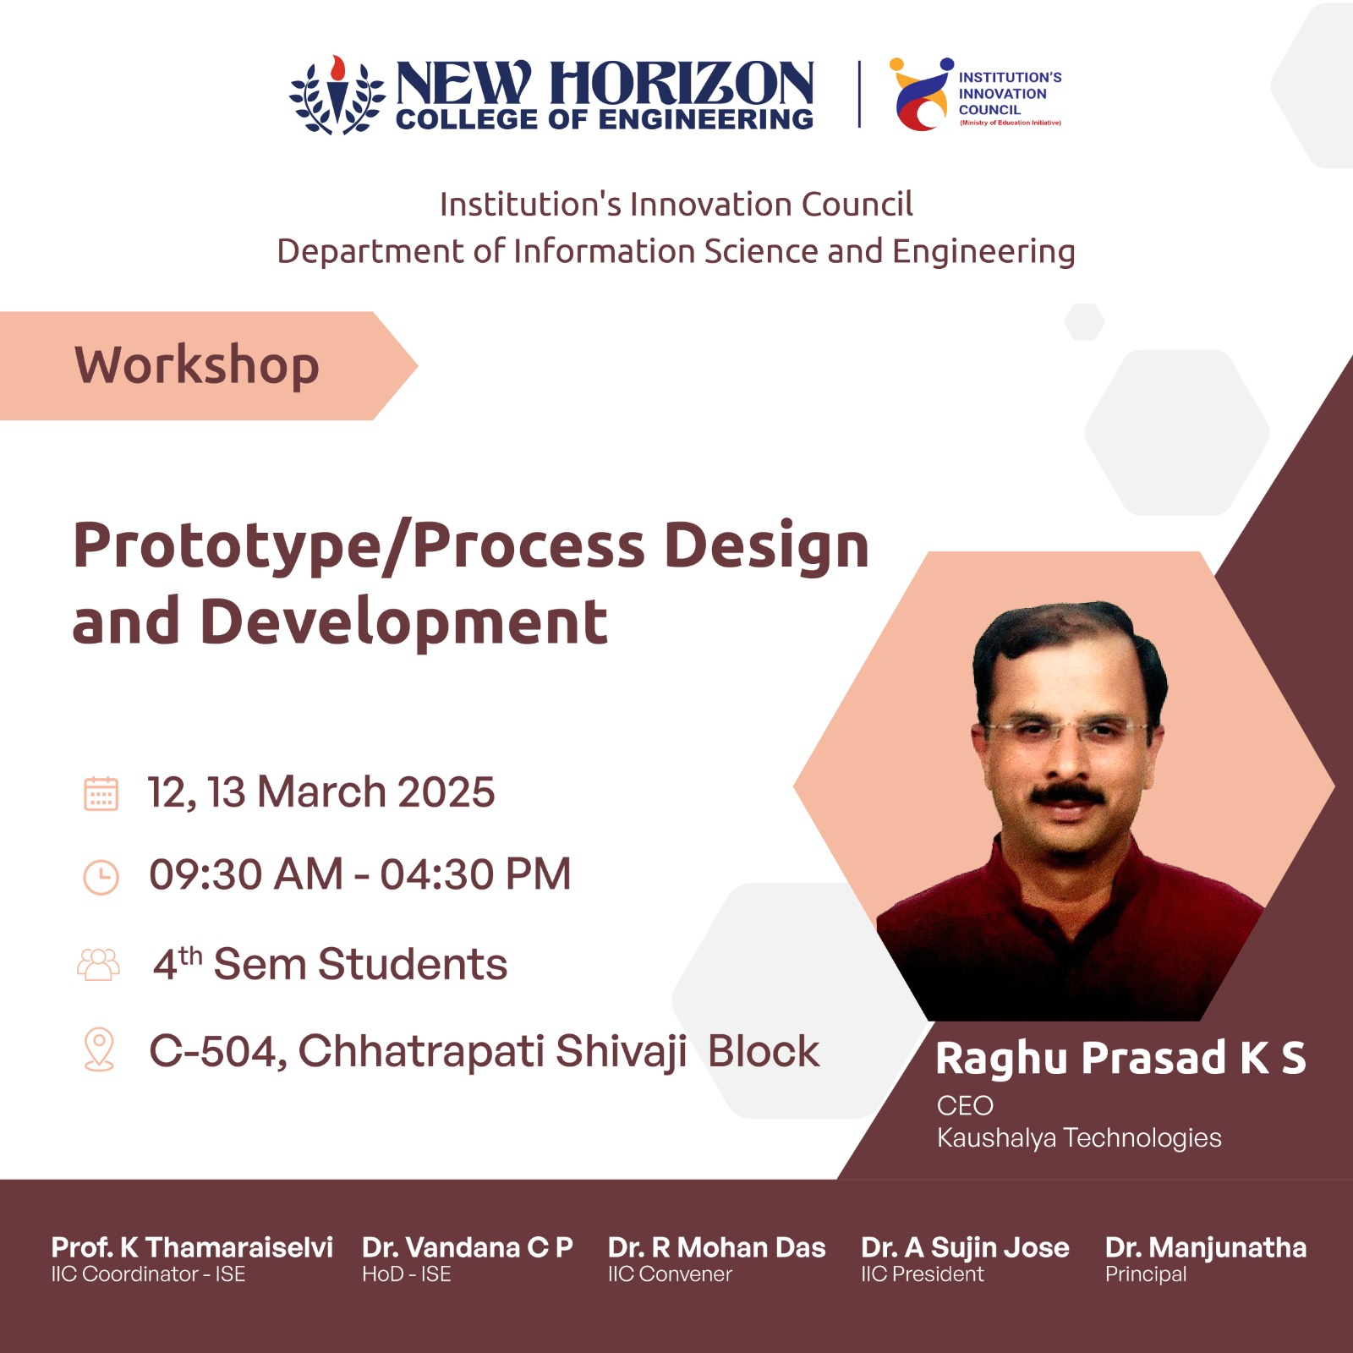

Slide 3
Introduction
Raghu Prasad – BE, MS
Total of 30 years of experience
7 years as a lecturer in an Engineering College
23 Years into IT
Worked with companies like CISCO,CSC,ICICI,First Apex – NTT Data
Currently into Corporate training and consultancy
Worked with corporates and public sector
Service Offerings – In person/On-line/Corporate/Academic Institutes
Consultancy – Consultant to vendor of Atal Tinkering Lab/ECIL-ECIT, Incarnus – Healthcare Service Provider, Automation Spectrum Pty Ltd,Australia,Tech Varaha,Bengaluru
Technologies – Java,Python,Web technologies,Java Script technologies (MEAN/MERN stack),IOT,Test Automation,Machine Learning,Artificial Intelligence and block chain,Tableau,Power BI,Cloud Computing
Corporate Customers – IQVIA,ITC Infotech,Philips,L & T,NextGen,Incarnus,Aspire system,Netwoven,SkillUpRight
Academic Customers – New Horizon College of Engineering,BGS-IT,Sindhi College,Malnad Enginering College,S B College of Management, REVA University,Nagarjuna Engineering College,Dayanand Sagar University,Acharya Institute of Technology,NIE Mysore,NIT-Imphal, AMC College, Kristu Jayanti College,SIT,SVIT etc

Slide 4
Agenda
Introduction to Process Design and Development
Stages of Process Design and Development
Agile Scrum Based Development
Tools for development
Hands-on Session

Slide 5
Process Design and Development
Process design and development refer to the systematic approach of defining, structuring, and optimizing workflows to enhance efficiency, quality, and productivity in various domains, such as manufacturing, software development, business operations, and service delivery.

Slide 6
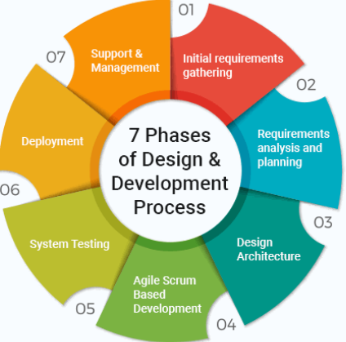
Stages of Process Design and Development

Slide 7
Agile Scrum Based Development
If we define Scrum in simple terms, then Scrum is a way of managing projects, especially in software development. It's like a playbook that teams use to work together more effectively.
Instead of doing everything at once, Scrum breaks work into smaller parts called "sprints." Each sprint focuses on completing a specific piece of the project, allowing teams to adapt and improve as they go. It's all about teamwork, communication, and getting things done step by step.

Slide 8
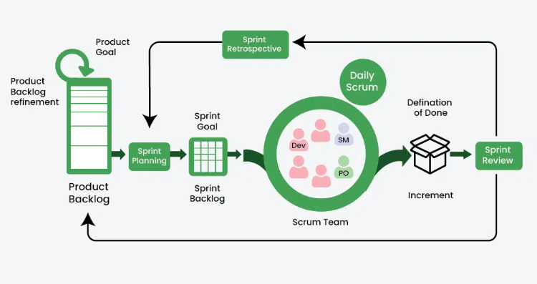
Agile Scrum Based Development

Slide 9
Key tools used for prototyping and development
Prototyping – HTML/CSS/Java Script
Source Code Management System (SCM) – Git and Git Hub
Integrated Development Environment (IDE) – Visual Studio Code
Backend Programming – Python
API Development – Flask
Database – MySQL
Database Client – MySQL Workbench

Slide 10
Hands-on Session
Prototyping -Develop Sample Web Pages
Source Code Management using git/github
Static page deployment using github actions/pages
API Development for CRUD using Python/Flask
Interfacing API With MySQL Database

Slide 11
Conclusion
- Recap:
- Q & A
Thanks
Raghu Prasad Konandur
9845547471
www.Kaushalya.tech
raghuprasadkonandur@kaushalya.tech

