Slide 1
JEE - Servlet and JSP
Raghu Prasad K S
www.kaushalya.tech
9845547471

Slide 2
Introduction
Raghu Prasad – BE, MS
Total of 24 years of experience
7 years as a lecturer in Engineering College
17 Years into IT
Worked with companies like CISCO, CSC, ICICI, First Apex – NTT Data
Currently into Corporate training and consultancy
Worked with corporates and public sector
Technologies – Java, Python, DataSciences, Web-Technologies, Java Script technologies (MEAN stack), IOT, Test Automation – Selenium, JMeter

Slide 3
Course Outlines
Introduction to Java Enterprise Edition (JEE)
JEE Specification
Servlets
SQL
MVC
JSP

Slide 4
Java Enterprise Edition (JEE)
The Java EE stands for Java Enterprise Edition, which was earlier known as J2EE and is currently known as Jakarta EE. It is a set of specifications wrapping around Java SE (Standard Edition). The Java EE provides a platform for developers with enterprise features such as distributed computing and web services. Java EE applications are usually run on reference run times such as microservers or application servers. Examples of some contexts where Java EE is used are e-commerce, accounting, banking information systems.

Slide 5
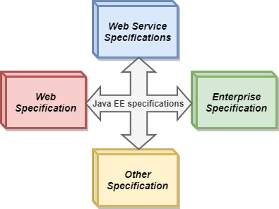
Specifications of Java Enterprise Edition (JEE)
Java EE has several specifications which are useful in making web pages, reading and writing from database in a transactional way, managing distributed queues. The Java EE contains several APIs which have the functionalities of base Java SE APIs such as Enterprise JavaBeans, connectors, Servlets, Java Server Pages and several web service technologies.

Slide 6
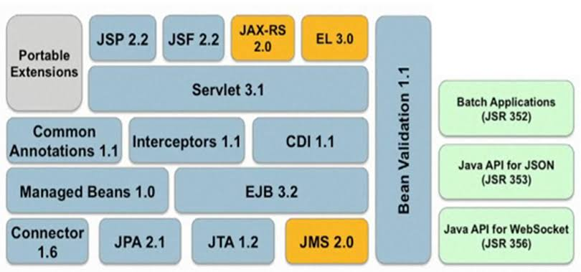
Specifications of Java Enterprise Edition (JEE)

Slide 7
Servlet
Servlet technology is used to create a web application (resides at server side and generates a dynamic web page).
Servlet technology is robust and scalable because of java language. Before Servlet, CGI (Common Gateway Interface) scripting language was common as a server-side programming language. However, there were many disadvantages to this technology. We have discussed these disadvantages below.
There are many interfaces and classes in the Servlet API such as Servlet, GenericServlet, HttpServlet, ServletRequest, ServletResponse, etc.

Slide 8
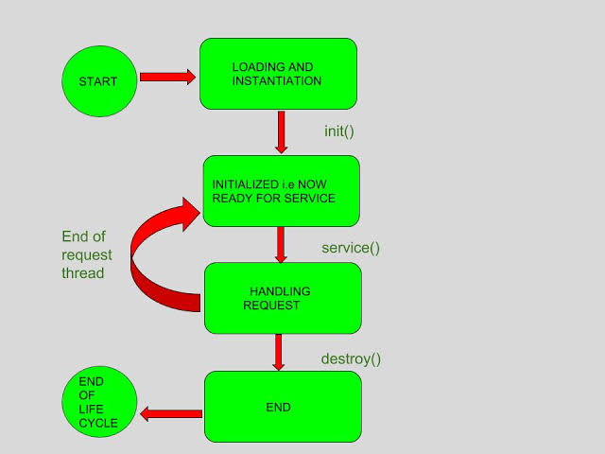
Servlet lifecycle

Slide 9
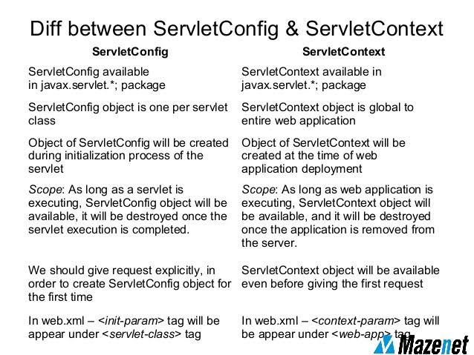
Servlet config and context

Slide 10
RequestDispatcher in Servlet
The RequestDispatcher interface provides the facility of dispatching the request to another resource it may be html, servlet or jsp. This interface can also be used to include the content of another resource also. It is one of the way of servlet collaboration.
There are two methods defined in the RequestDispatcher interface.
public void forward(ServletRequest request,ServletResponse response)throws ServletException,java.io.IOException:Forwards a request from a servlet to another resource (servlet, JSP file, or HTML file) on the server.
public void include(ServletRequest request,ServletResponse response)throws ServletException,java.io.IOException:Includes the content of a resource (servlet, JSP page, or HTML file) in the response.

Slide 11
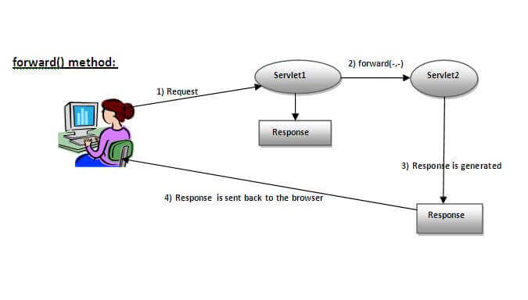
RequestDispatcher in Servlet

Slide 12
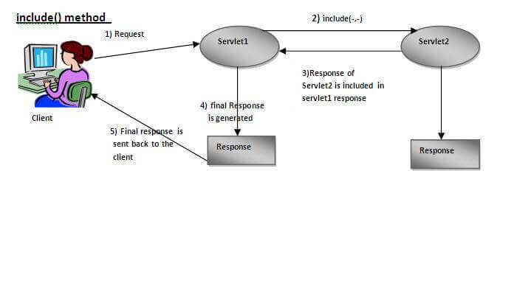
RequestDispatcher in Servlet

Slide 13
Session Tracking
Session simply means a particular interval of time.
Session Tracking is a way to maintain state (data) of an user. It is also known as session management in servlet.
Http protocol is a stateless so we need to maintain state using session tracking techniques. Each time user requests to the server, server treats the request as the new request. So we need to maintain the state of an user to recognize to particular user.

Slide 14
Session Tracking
Session Tracking Techniques
There are four techniques used in Session tracking:
Cookies
Hidden Form Field
URL Rewriting
HttpSession

Slide 15
Session Tracking - Cookies
A cookie is a small piece of information that is persisted between the multiple client requests.
A cookie has a name, a single value, and optional attributes such as a comment, path and domain qualifiers, a maximum age, and a version number.
How Cookie works
By default, each request is considered as a new request. In cookies technique, we add cookie with response from the servlet. So cookie is stored in the cache of the browser. After that if request is sent by the user, cookie is added with request by default. Thus, we recognize the user as the old user.

Slide 16
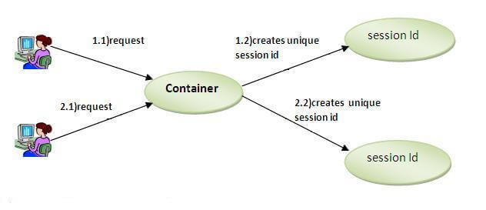
Session Tracking - Cookies

Slide 17
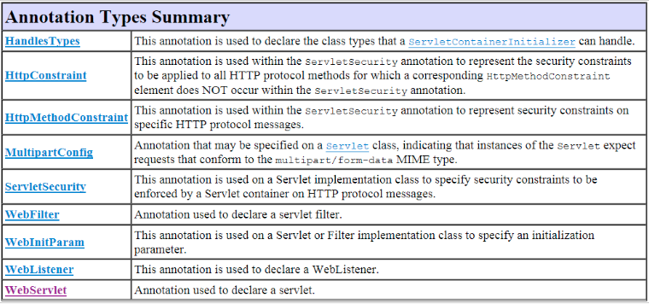
Servlet annotations

Slide 18
JSP
JSP technology is used to create web application just like Servlet technology. It can be thought of as an extension to Servlet because it provides more functionality than servlet such as expression language, JSTL, etc.
A JSP page consists of HTML tags and JSP tags. The JSP pages are easier to maintain than Servlet because we can separate designing and development. It provides some additional features such as Expression Language, Custom Tags, etc.

Slide 19
Advantages of JSP over servlet
1) Extension to Servlet
JSP technology is the extension to Servlet technology. We can use all the features of the Servlet in JSP. In addition to, we can use implicit objects, predefined tags, expression language and Custom tags in JSP, that makes JSP development easy.
2) Easy to maintain
JSP can be easily managed because we can easily separate our business logic with presentation logic. In Servlet technology, we mix our business logic with the presentation logic.
3) Fast Development: No need to recompile and redeploy
If JSP page is modified, we don't need to recompile and redeploy the project. The Servlet code needs to be updated and recompiled if we have to change the look and feel of the application.
4) Less code than Servlet
In JSP, we can use many tags such as action tags, JSTL, custom tags, etc. that reduces the code. Moreover, we can use EL, implicit objects, etc.

Slide 20
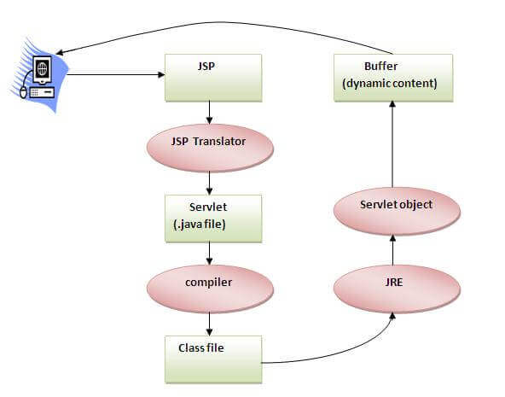
Advantages of JSP over servlet

Slide 21
JSP Scripting elements
The scripting elements provides the ability to insert java code inside the jsp. There are three types of scripting elements:
scriptlet tag
expression tag
declaration tag
JSP scriptlet tag
A scriptlet tag is used to execute java source code in JSP. Syntax is as follows:
<% java source code %>

Slide 22
Example of JSP scriptlet tag
<html>
<body>
<% out.print("welcome to jsp"); %>
</body>
</html>

Slide 23
JSP expression tag
The code placed within JSP expression tag is written to the output stream of the response. So you need not write out.print() to write data. It is mainly used to print the values of variable or method.
Syntax of JSP expression tag
<%= statement %>
Example of JSP expression tag
<html>
<body>
<%= "welcome to jsp" %>
</body>
</html>

Slide 24
JSP Declaration Tag
The JSP declaration tag is used to declare fields and methods.
The code written inside the jsp declaration tag is placed outside the service() method of auto generated servlet.
So it doesn't get memory at each request
Syntax of JSP declaration tag
<%! field or method declaration %>
Example of JSP declaration tag that declares field
<html>
<body>
<%! int data=50; %>
<%= "Value of the variable is:"+data %>
</body>
</html>

Slide 25
JSP Implicit Objects
There are 9 jsp implicit objects. These objects are created by the web container that are available to all the jsp pages.
The available implicit objects are out, request, config, session, application etc.
A list of the 9 implicit objects is given below:

Slide 26
JSP Implicit Objects
Object | Type
out | JspWriter
request | HttpServletRequest
response | HttpServletResponse
config | ServletConfig
application | ServletContext
session | HttpSession
pageContext | PageContext
page | Object
exception | Throwable

Slide 27
JSP Directives
The jsp directives are messages that tells the web container how to translate a JSP page into the corresponding servlet.
There are three types of directives:
page directive
include directive
taglib directive
Syntax of JSP Directive
<%@ directive attribute="value" %>

Slide 28
JSP Page Directive
JSP page directive
The page directive defines attributes that apply to an entire JSP page
Syntax of JSP page directive
<%@ page attribute="value" %>
Example of import attribute
<html>
<body>
<%@ page import="java.util.Date" %>
Today is: <%= new Date() %>
</body>
</html>

Slide 29
Model View Controller (MVC)
MVC Pattern stands for Model-View-Controller Pattern. This pattern is used to separate application's concerns.
Model - Model represents an object or JAVA POJO carrying data. It can also have logic to update controller if its data changes.
View - View represents the visualization of the data that model contains.
Controller - Controller acts on both model and view. It controls the data flow into model object and updates the view whenever data changes. It keeps view and model separate.

Slide 30
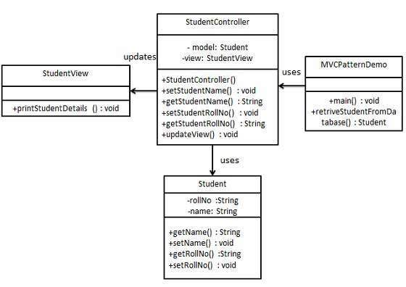
Implementation of MVC using core java

Slide 31
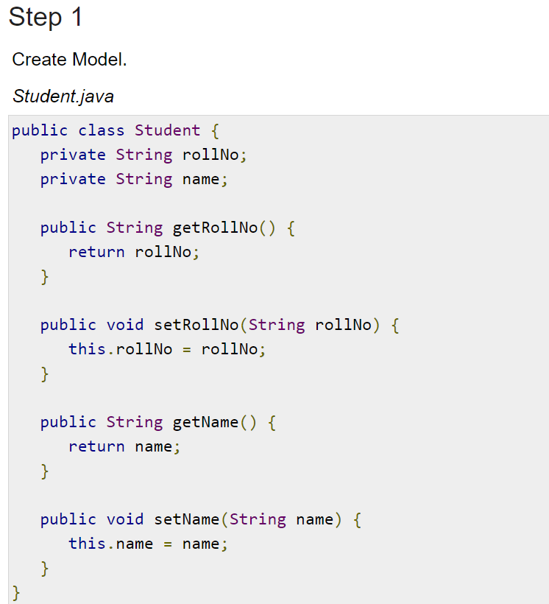
Step 1 – Create Model

Slide 32
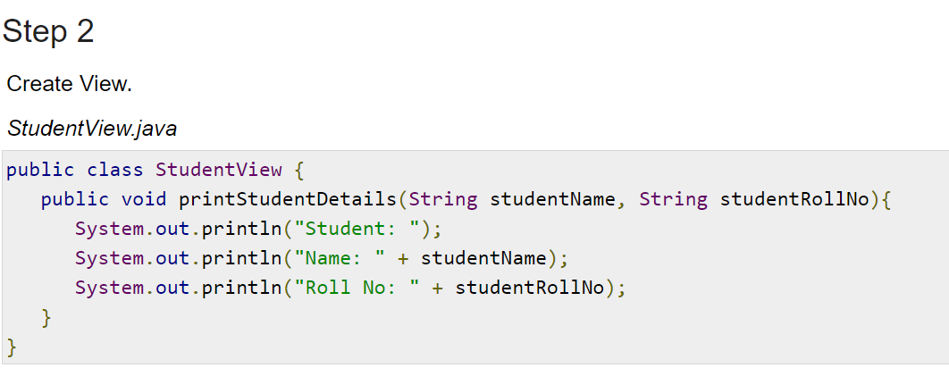
Step 2 – Create View

Slide 33
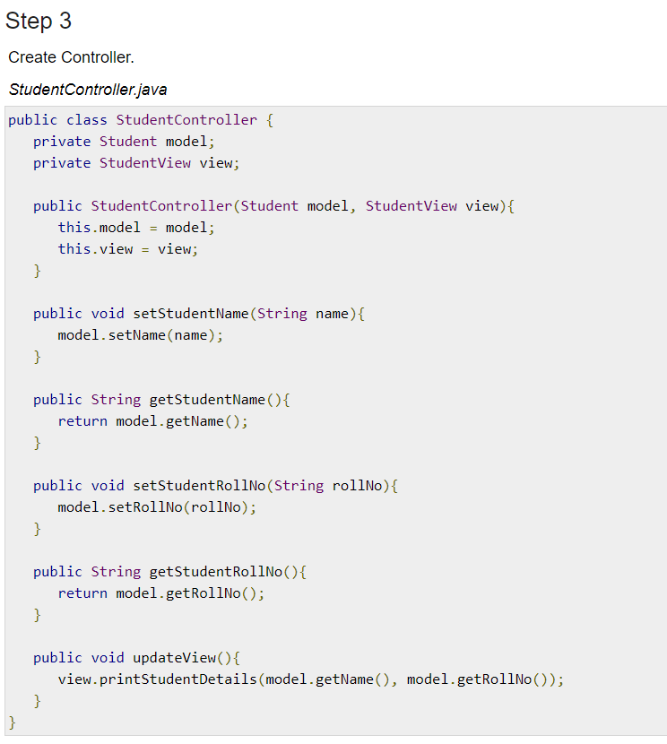
Step 3 – Create a controller

Slide 34
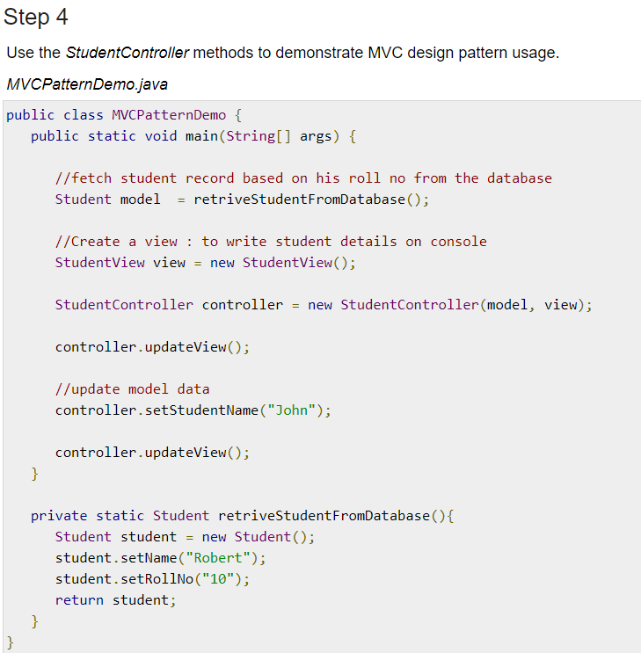
Step 4 - Test

Slide 35
MVC in web application
Before developing the web applications, we need to have idea about design models. There are two types of programming models (design models)
Model 1 Architecture
Model 2 (MVC) Architecture
Servlet and JSP are the main technologies to develop the web applications.
Servlet was considered superior to CGI. Servlet technology doesn't create process, rather it creates thread to handle request. The advantage of creating thread over process is that it doesn't allocate separate memory area. Thus many subsequent requests can be easily handled by servlet.

Slide 36
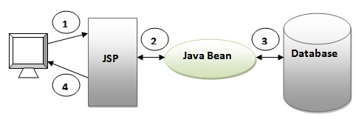
MVC - 1
Problem in Servlet technology Servlet needs to recompile if any designing code is modified. It doesn't provide separation of concern. Presentation and Business logic are mixed up.
JSP overcomes almost all the problems of Servlet. It provides better separation of concern, now presentation and business logic can be easily separated. You don't need to redeploy the application if JSP page is modified. JSP provides support to develop web application using JavaBean, custom tags and JSTL so that we can put the business logic separate from our JSP that will be easier to test and debug.

Slide 37
MVC-1
Browser sends request for the JSP page
JSP accesses Java Bean and invokes business logic
Java Bean connects to the database and get/save data
Response is sent to the browser which is generated by JSP
Advantage of Model 1 Architecture
Easy and Quick to develop web application
Disadvantage of Model 1 Architecture
Navigation control is decentralized since every page contains the logic to determine the next page. If JSP page name is changed that is referred by other pages, we need to change it in all the pages that leads to the maintenance problem.
Time consuming You need to spend more time to develop custom tags in JSP. So that we don't need to use scriptlet tag.
Hard to extend It is better for small applications but not for large applications.

Slide 38
MVC-2
Model 2 is based on the MVC (Model View Controller) design pattern. The MVC design pattern consists of three modules model, view and controller.
Model The model represents the state (data) and business logic of the application.
View The view module is responsible to display data i.e. it represents the presentation.
Controller The controller module acts as an interface between view and model. It intercepts all the requests i.e. receives input and commands to Model / View to change accordingly.

Slide 39
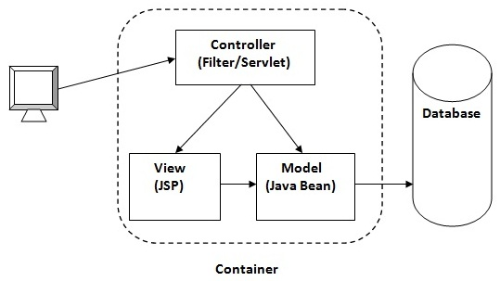
MVC-2

Slide 40
MVC-2
Advantage of Model 2 (MVC) Architecture
Navigation control is centralized Now only controller contains the logic to determine the next page.
Easy to maintain
Easy to extend
Easy to test
Better separation of concerns
Disadvantage of Model 2 (MVC) Architecture
We need to write the controller code self. If we change the controller code, we need to recompile the class and redeploy the application.

Slide 41
Session Management
Cookies
HttpSession

Slide 42
Q&A Session
Thanks
Visit – www.kaushalya.tech
9845547471

