Slide 1

Machine Learning Algorithms K-Means Clustering
Raghu Prasad Konandur
9845547471
www.kaushalya.tech
raghuprasadkonandur@kaushalya.tech

Slide 2
Introduction
Raghu Prasad – BE, MS
Total of 27 years of experience
7 years as a lecturer in an Engineering College
20 Years into IT
Worked with companies like CISCO,CSC,ICICI,First Apex – NTT Data
Currently into Corporate training and consultancy
Worked with corporates and public sector
Service Offerings – In person/On-line/Corporate/Academic Institutes
Consultancy – Consultant to vendor of Atal Tinkering Lab/ECIL-ECIT, Incarnus – Healthcare Service Provider
Technologies – Java,Python,Web technologies,Java Script technologies (MEAN stack),IOT,Test Automation,Machine Learning,Artificial Intelligence,ERP,.NET
Customers – Philips,L & T,NextGen,Incarnus,Aspire system,BGS-IT,Sindhi College,Malnad Enginering College,S B College of Management, REVA University,Nagarjuna Engineering College,Dayanand Sagar University,Acharya Institute of Technology,NIE Mysore,NIT-Imphal,etc

Slide 3
Topics
Un-Supervised machine learning
K-Means Clustering

Slide 4
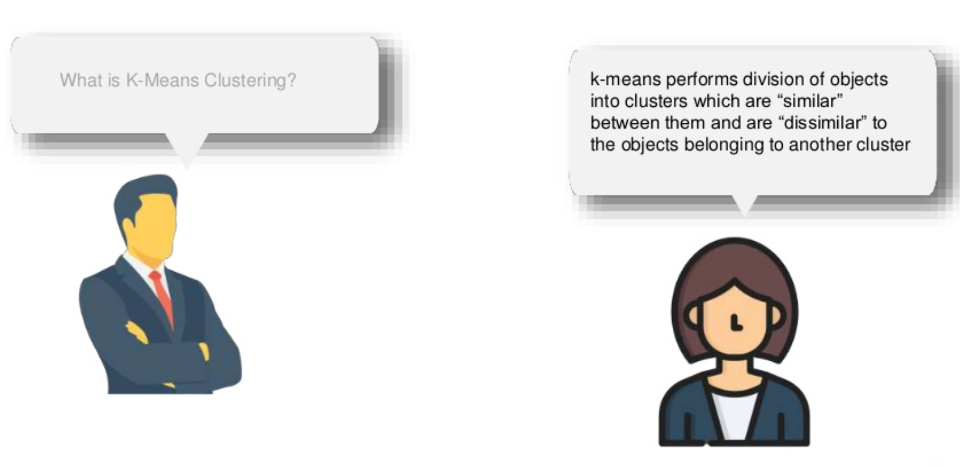
K Means Clustering – Unsupervised learning

Slide 5
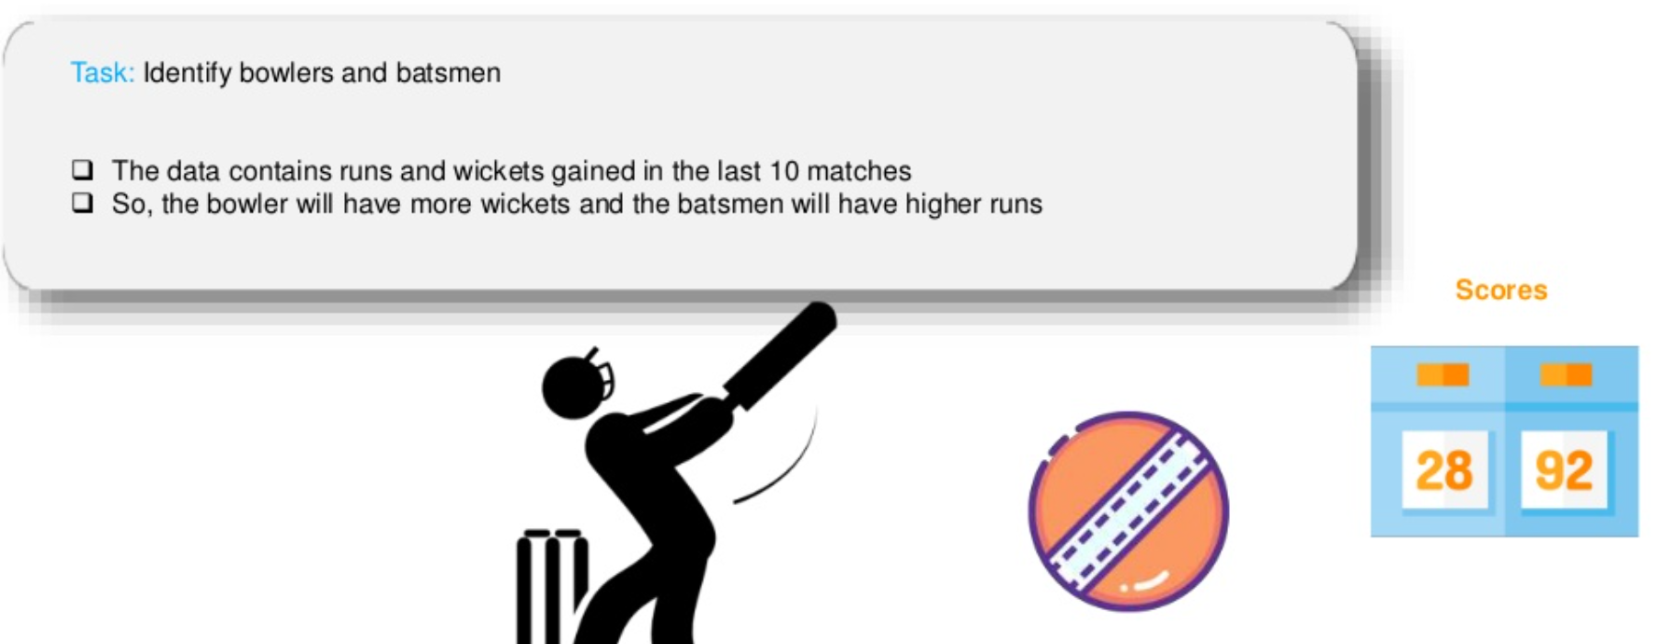
K Means Clustering – Example

Slide 6
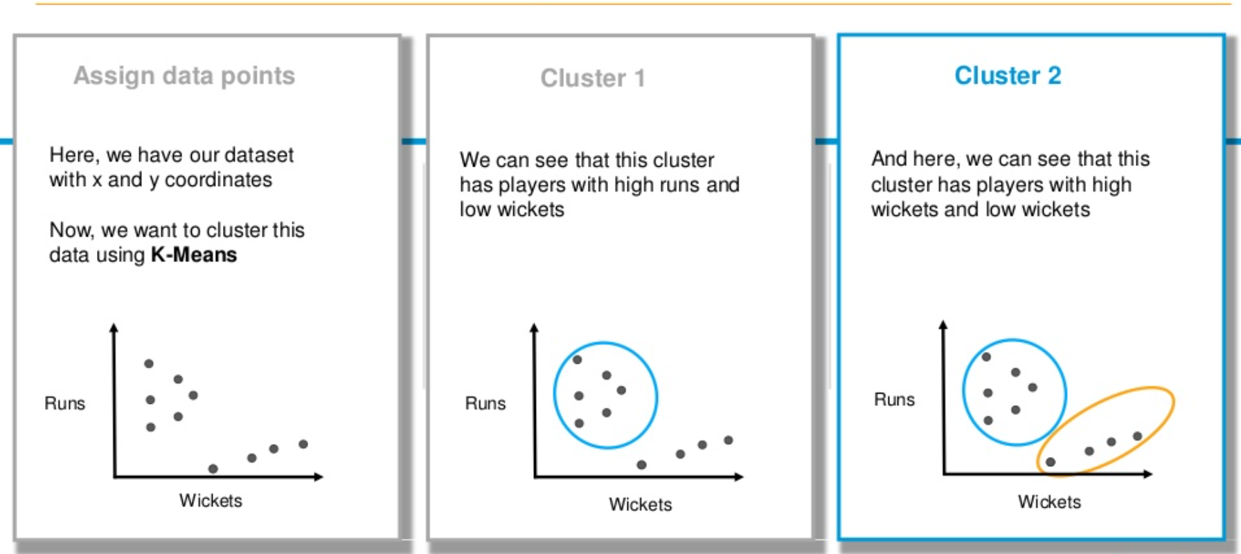
K Means Clustering – Example

Slide 7
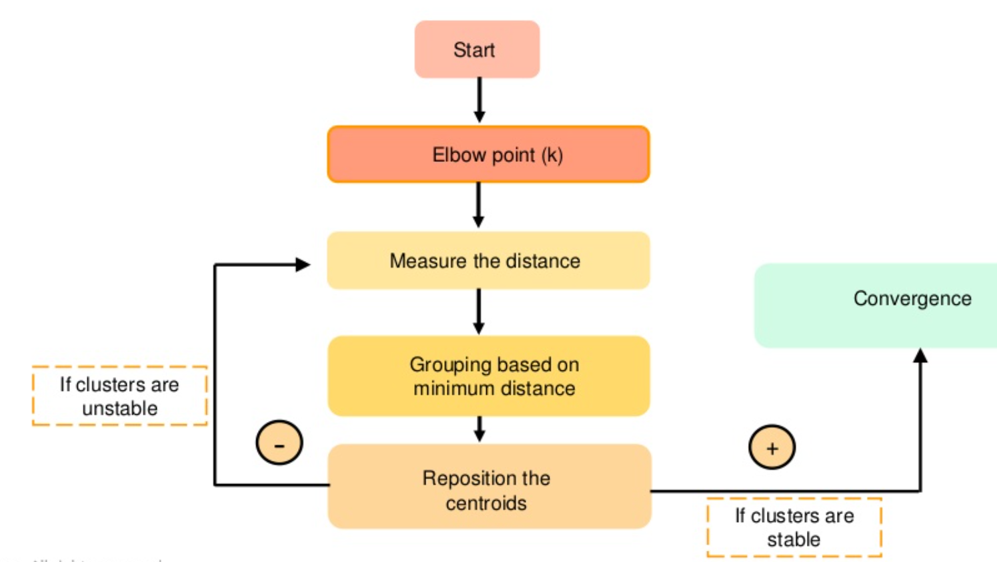
K Means Clustering – Working

Slide 8
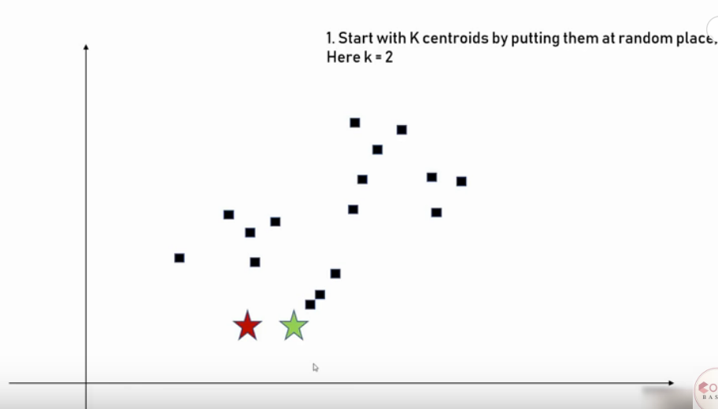
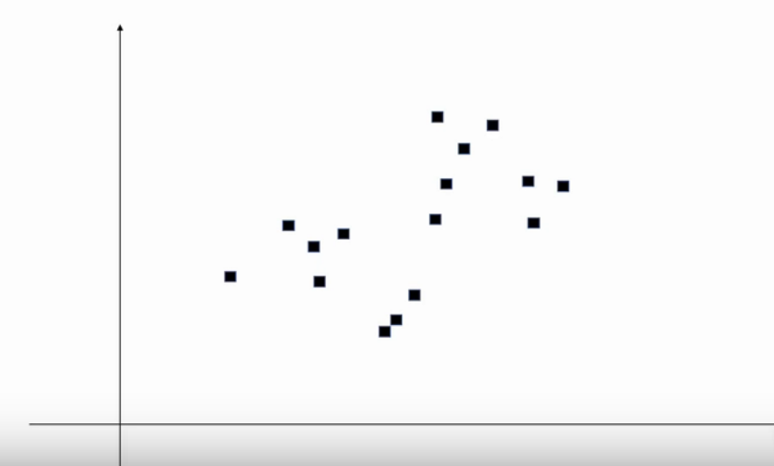
K Means Clustering – Unsupervised learning

Slide 9
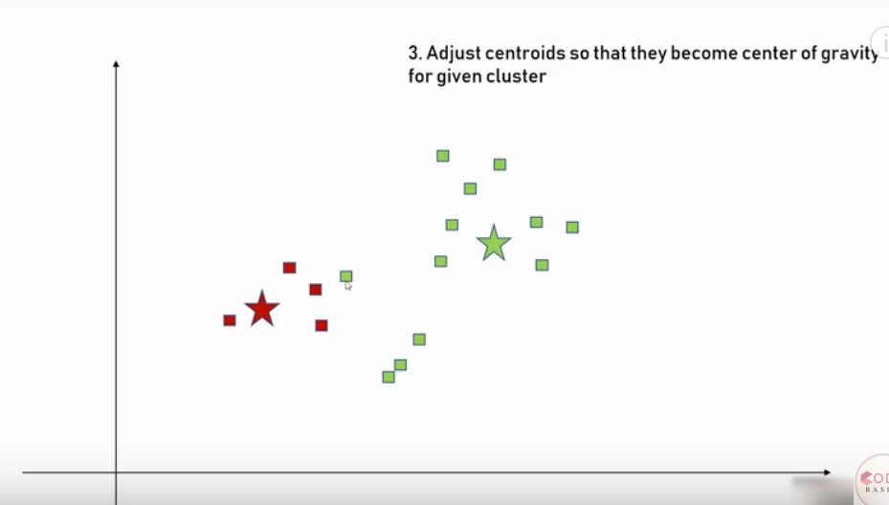
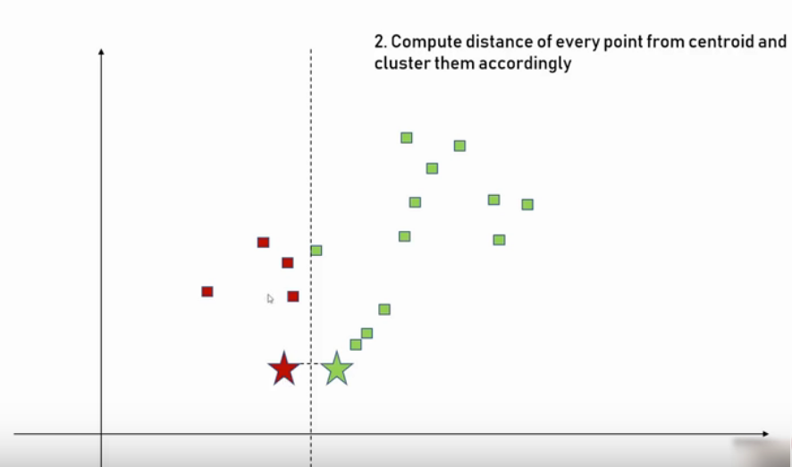
K Mean Clustering – Unsupervised learning

Slide 10
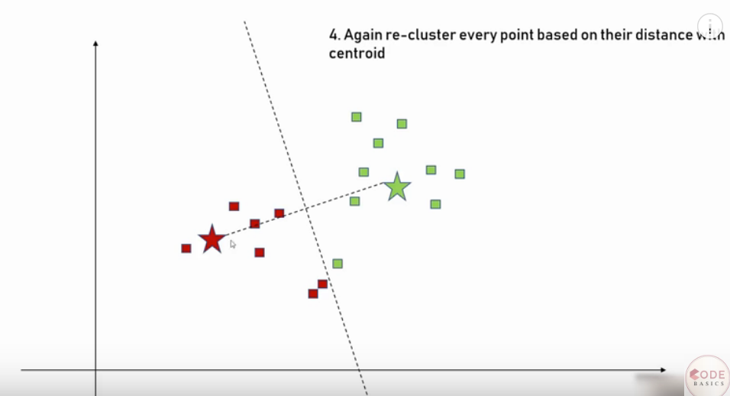
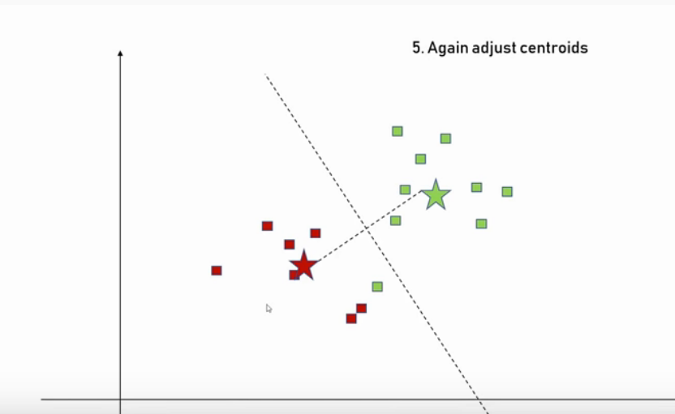
K Mean Clustering – Unsupervised learning

Slide 11
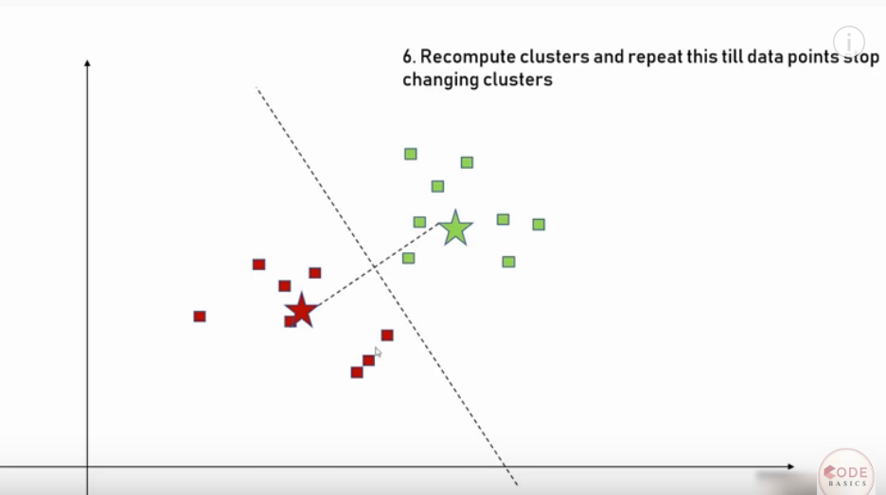
K Mean Clustering – Unsupervised learning

Slide 12
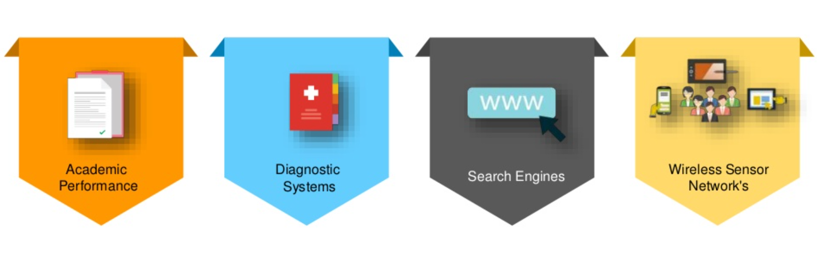
Applications of K-Means Clustering

Slide 13
Hands-on session
K-Means Clustering

Slide 14
References
https://www.skillbasics.com/

Slide 15
Thank You
Raghu Prasad Konandur
9845547471
www.kaushalya.tech
raghuprasadkonandur@kaushalya.tech

