Slide 1
React.js
Raghu Prasad
9845547471

Slide 2
Introduction
Raghu Prasad – BE, MS
Total of 29 years of experience
7 years as a lecturer in an Engineering College
22 Years into IT
Worked with companies like CISCO,CSC,ICICI,First Apex – NTT Data
Currently into Corporate training and consultancy
Worked with corporates and public sector
Service Offerings – In person/On-line/Corporate/Academic Institutes
Technologies – Java,Python,Web technologies,Java Script technologies (MEAN/MERN stack),IOT,Test Automation,Machine Learning,Artificial Intelligence,Account Management,ERP,Digital Marketing
Customers – L & T,NextGen,IQVIA,Philips,Sony,Incarnus,Flatworld,Operative

Slide 3
Topics
Introduction to React – What and Why
Core concept of React
Features
Hands-on

Slide 4
What is React ?
React (also known as React.js or ReactJS) is a free and open-source front-end JavaScript library for building user interfaces based on UI components.
It is maintained by Meta (formerly Facebook) and a community of individual developers and companies.
React can be used as a base in the development of single-page or mobile applications.
React is only concerned with state management and rendering that state to the DOM, so creating React applications usually requires the use of additional libraries for routing, as well as certain client-side functionality.

Slide 5
Why to use React ?
Its Declarative
Component Based
Learn once and write any where
Easy to embed html code in a java script using JSX
Mobile app development using React Native

Slide 6
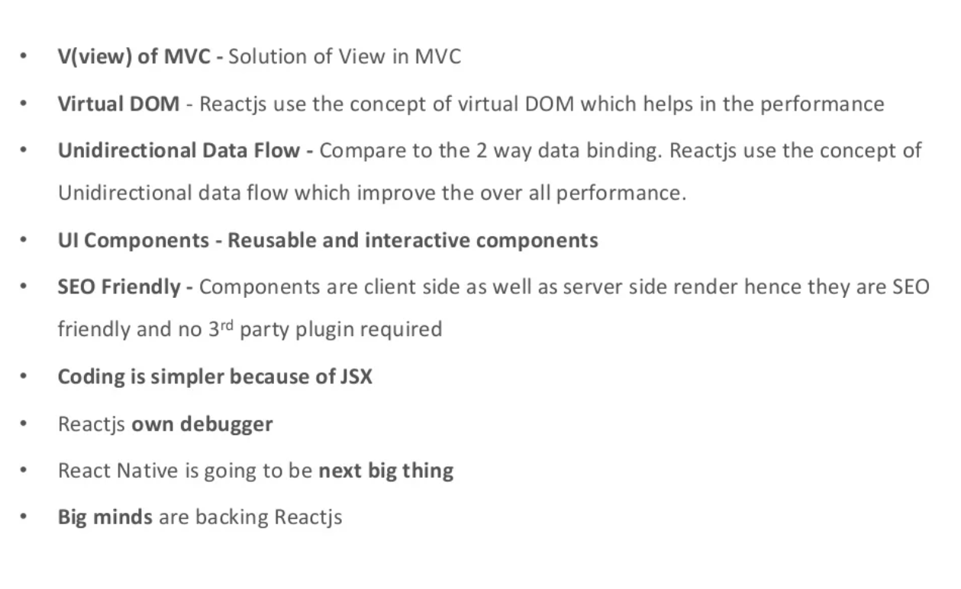
Why to use React ?

Slide 7
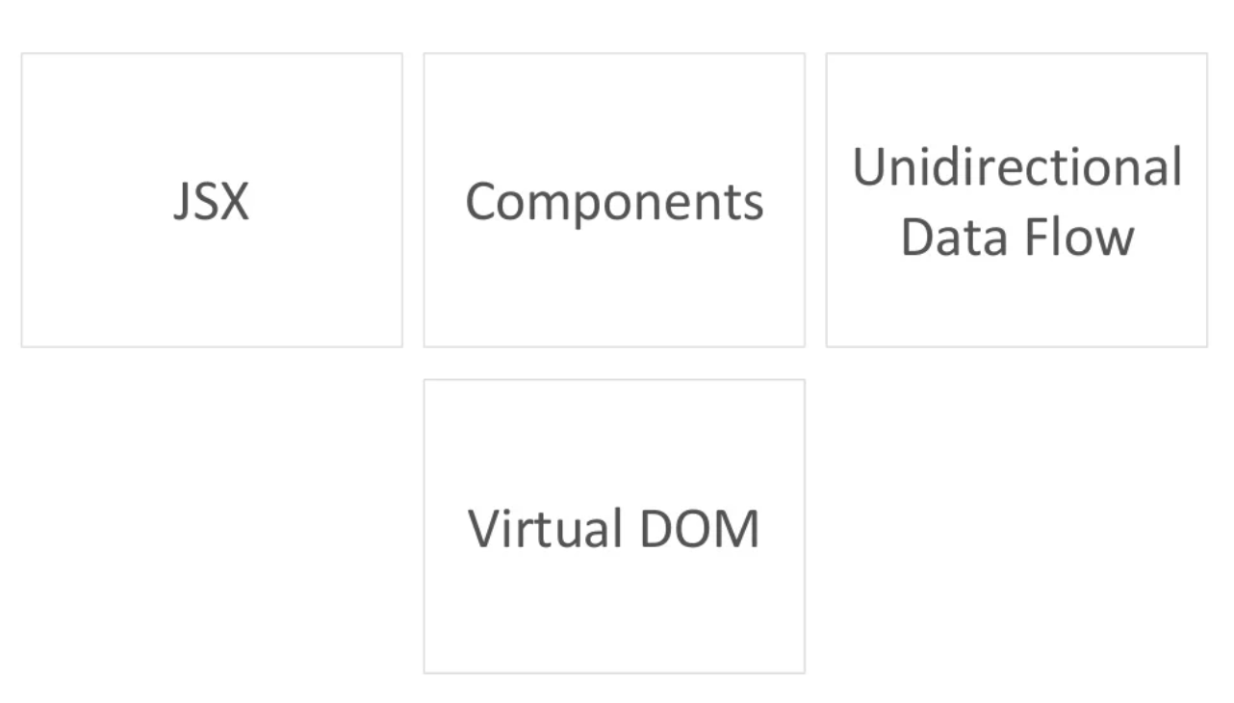
Core concept of React

Slide 8
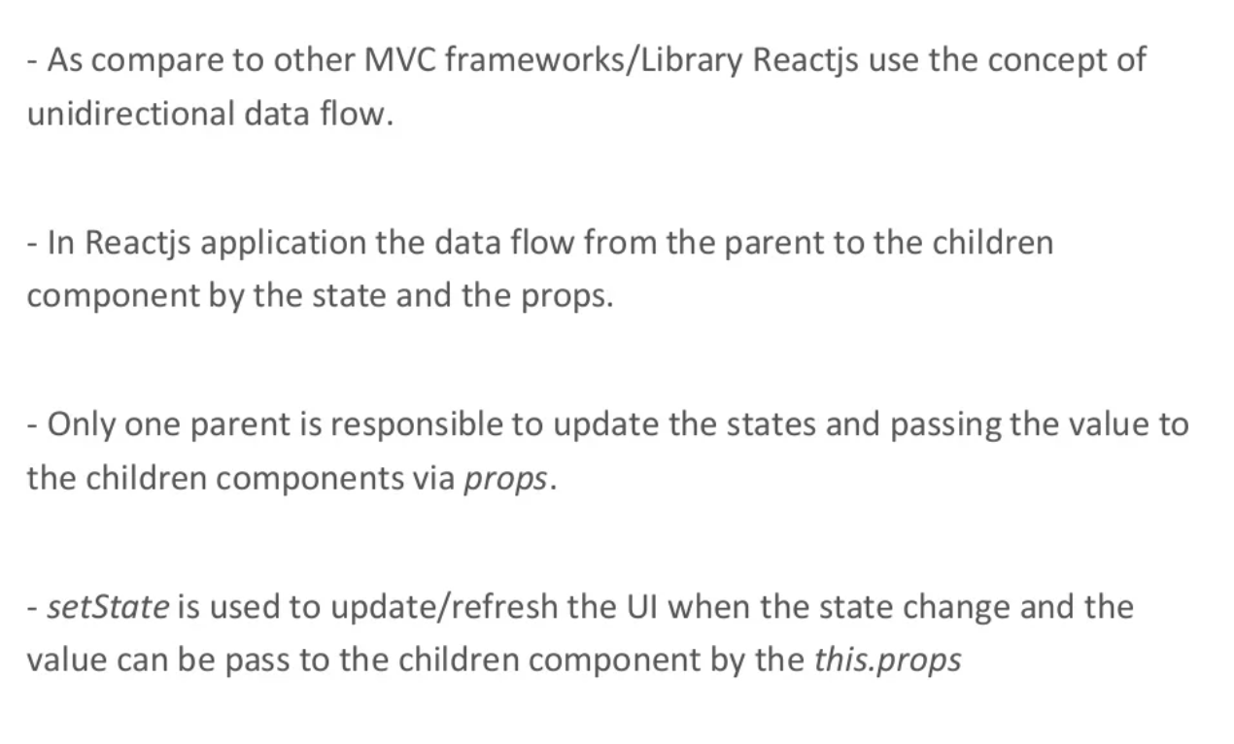
Unidirectional Dataflow

Slide 9
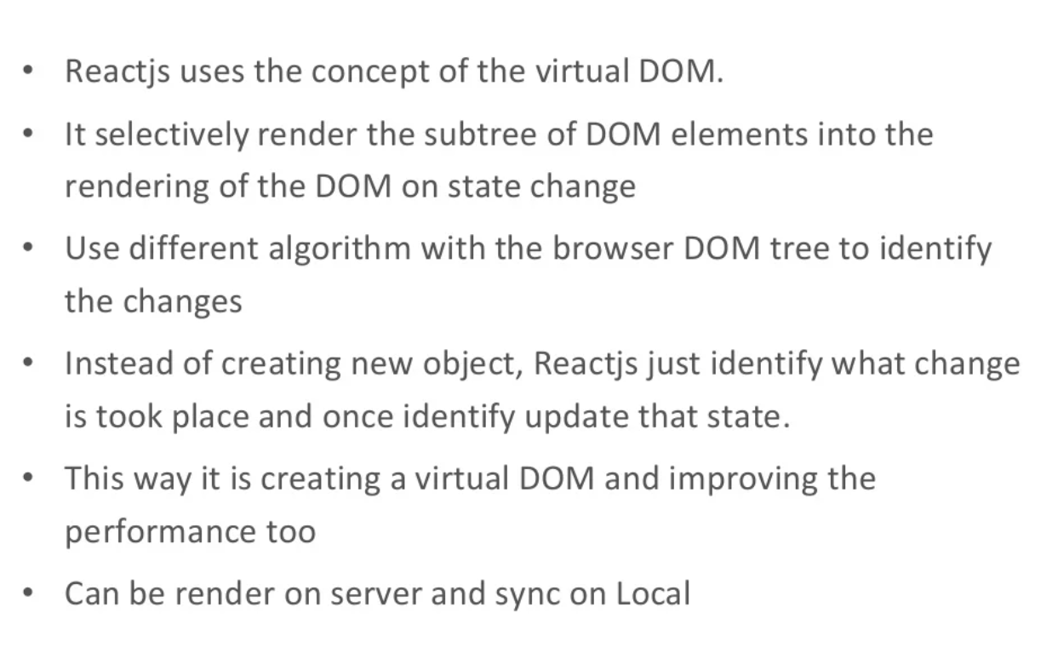
Virtual DOM

Slide 10
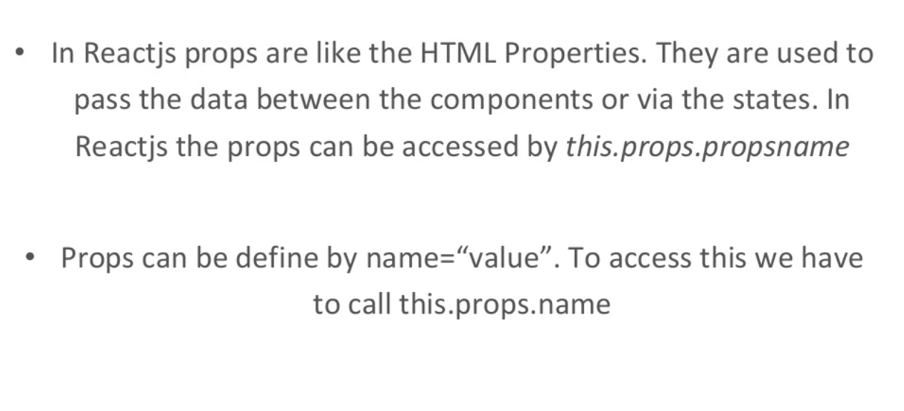
Properties

Slide 11
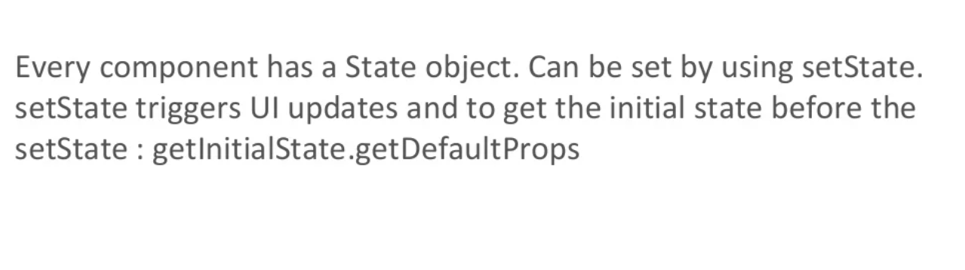
States

Slide 12
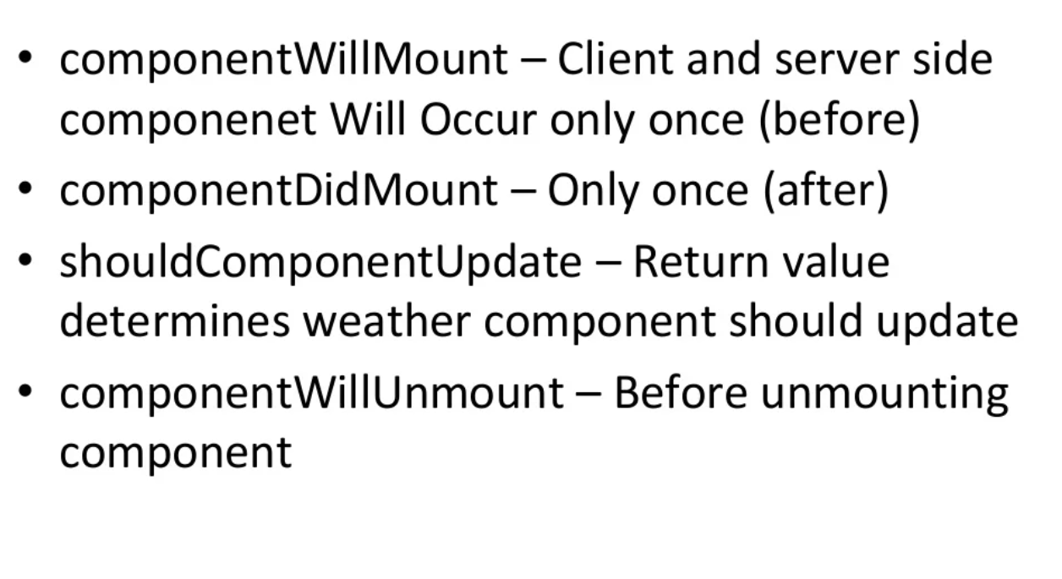
Component Life Cycle

Slide 13
Hands-on
Hands-on session – Creating a react project
1. Download and install node.js
2. npx create-react-app my-app
3. cd to my-app
4. npm start

Slide 14
References
https://react.dev/learn

Slide 15
Thank You
Raghu Prasad K S
9845547471

