Slide 1
Module 3 Ensemble Learning
Raghu Prasad K S
9845547471

Slide 2
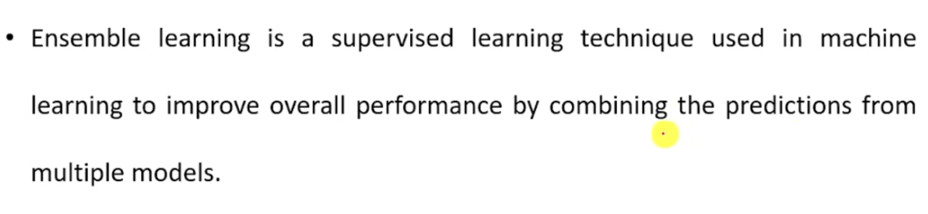
Ensemble Learning

Slide 3
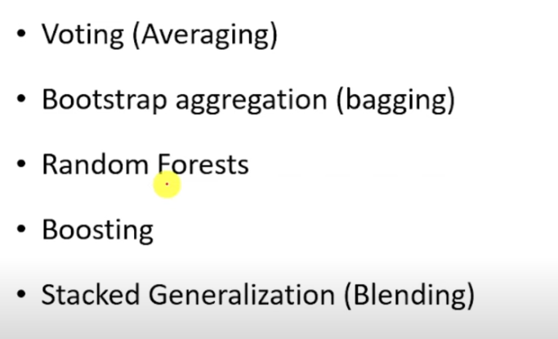
Types of Ensemble Learning

Slide 4
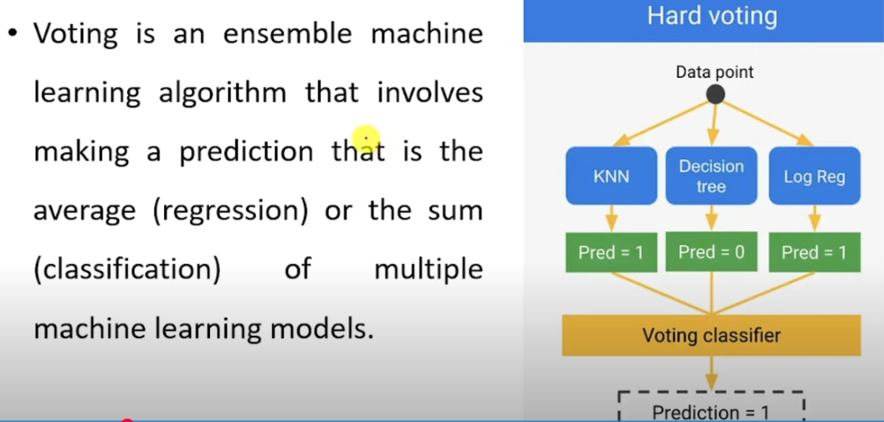
Voting (Averaging)

Slide 5
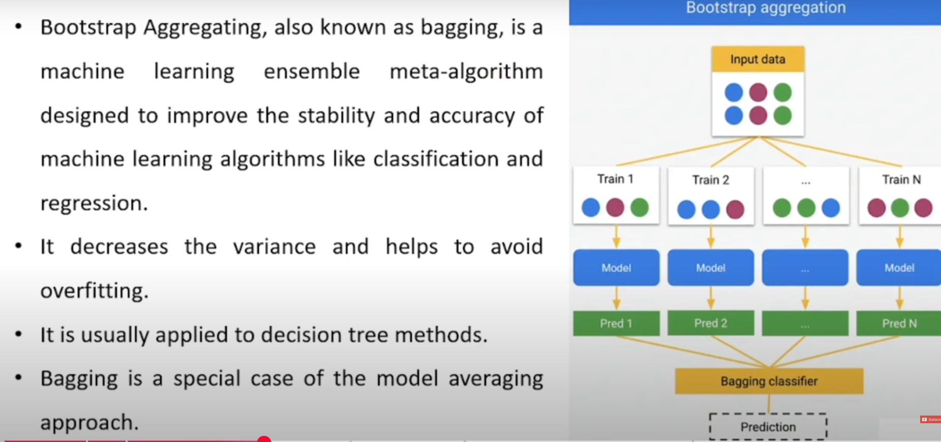
Bootstrap Aggregation (Bagging)

Slide 6
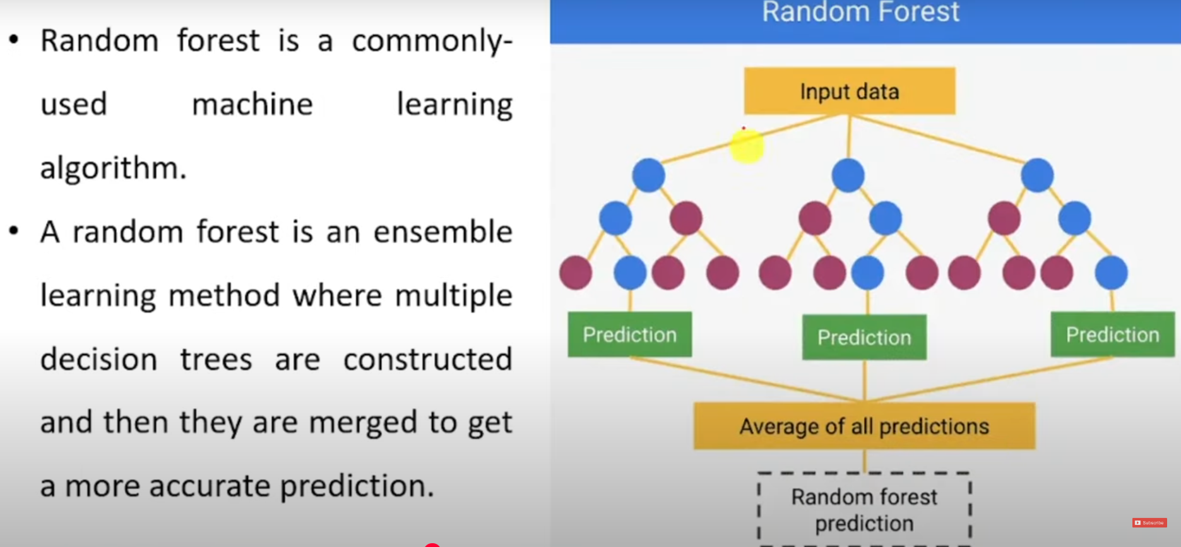
Random Forest

Slide 7
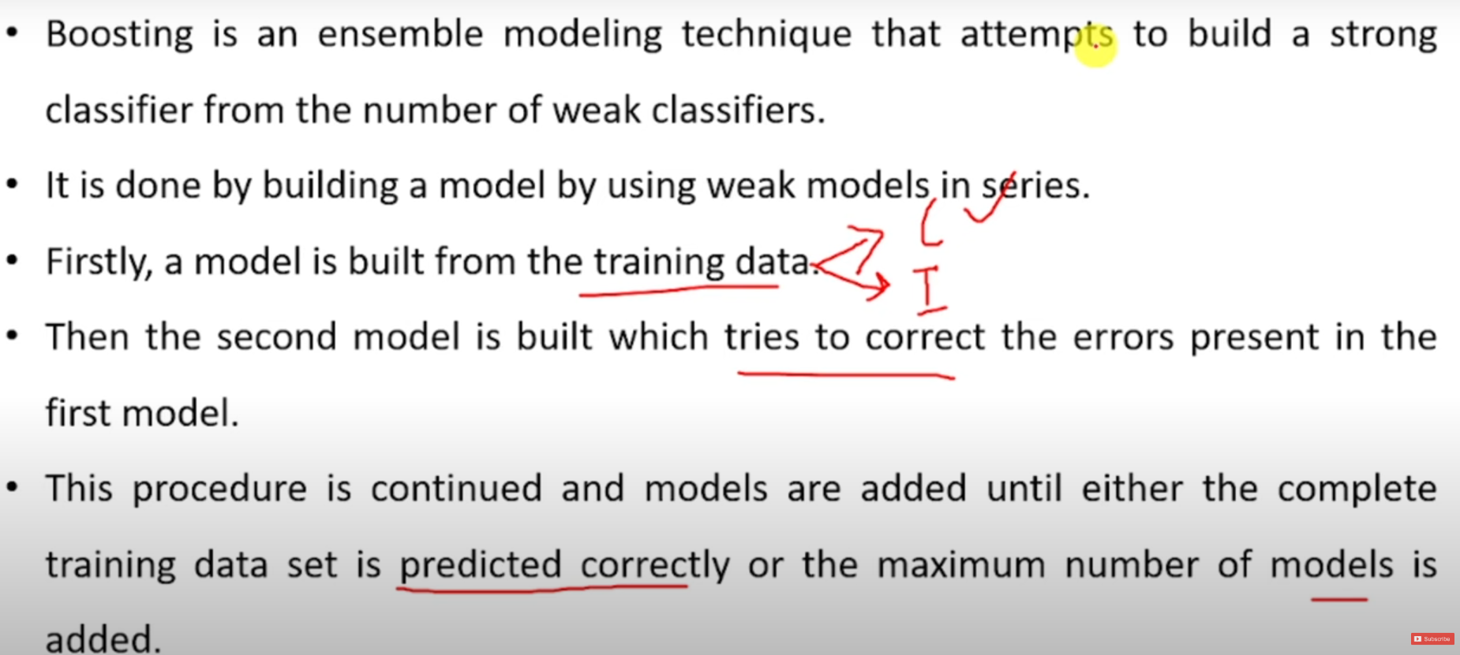
Boosting

Slide 8
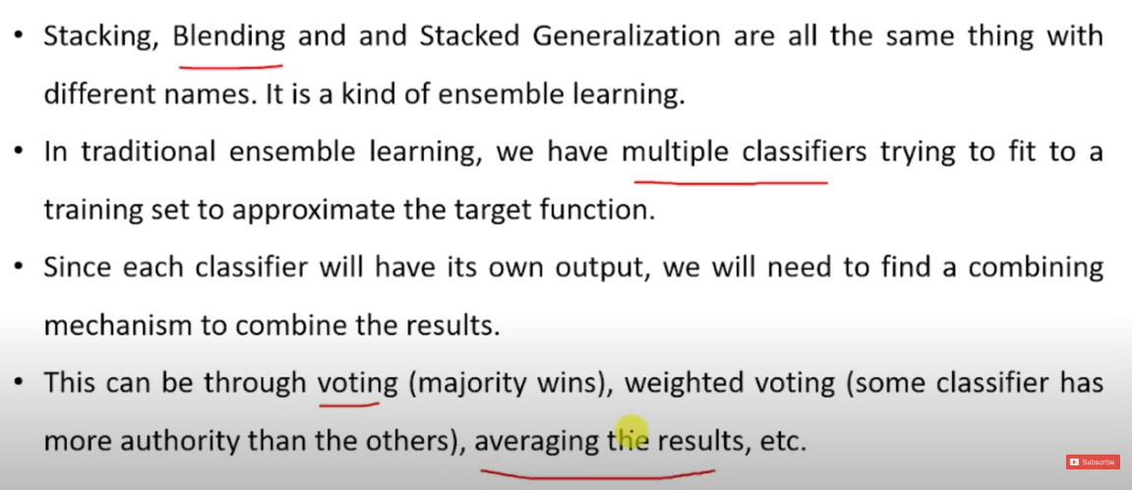
Stacking

Slide 9
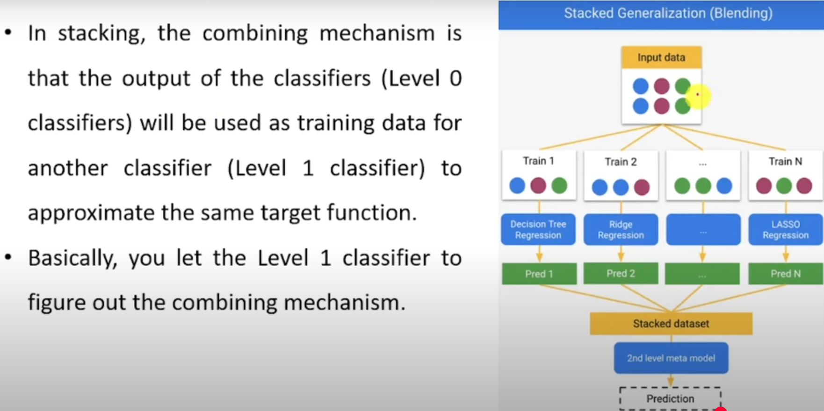
Stacking

Slide 10
Reference
Introduction
https://www.youtube.com/watch?v=eNyUfpGBLts

