Slide 1
ML-Summary
Raghu Prasad K S
9845547471

Slide 2
Machine Learning
Machine learning (ML) is a field of study in artificial intelligence concerned with the development and study of statistical algorithms that can learn from data and generalize to unseen data, and thus perform tasks without explicit instructions. Within a subdiscipline in machine learning, advances in the field of deep learning have allowed neural networks, a class of statistical algorithms, to surpass many previous machine learning approaches in performance.

Slide 3
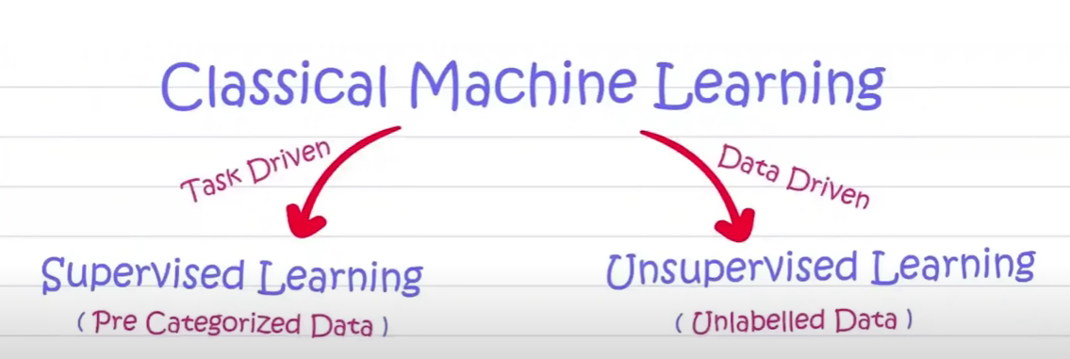
Machine Learning

Slide 4
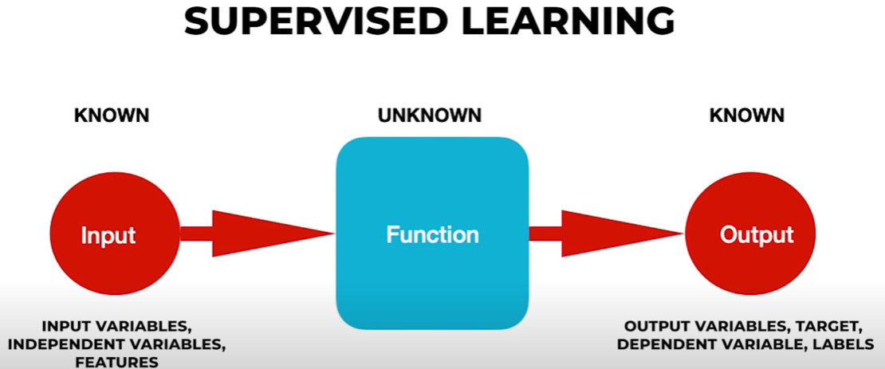
Machine Learning

Slide 5
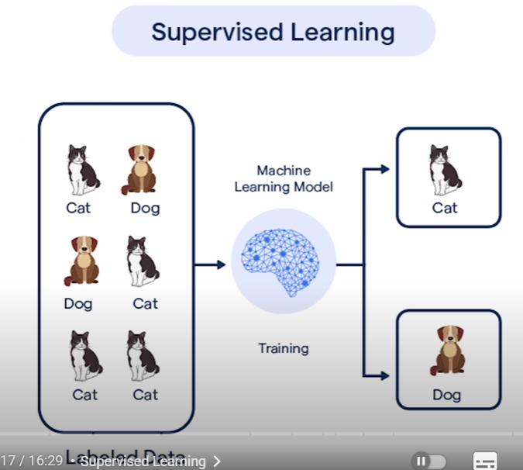
Machine Learning

Slide 6
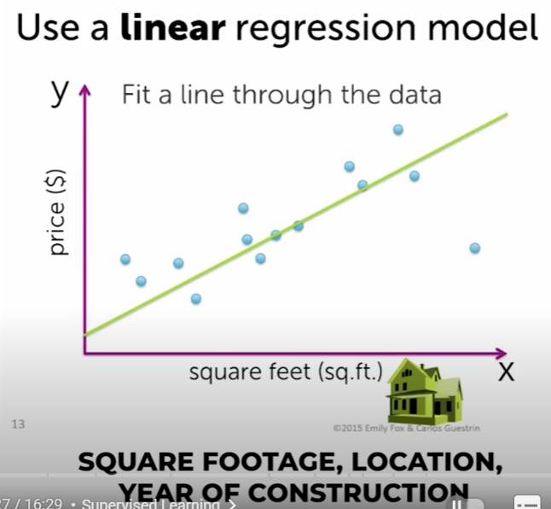
Machine Learning

Slide 7
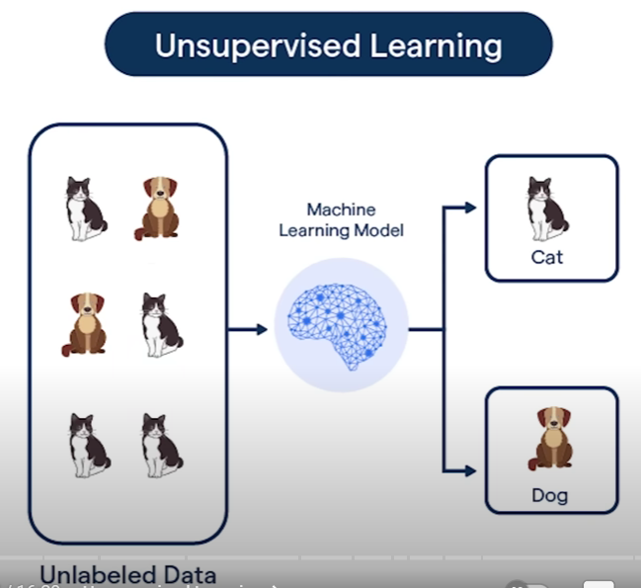
Machine Learning

Slide 8
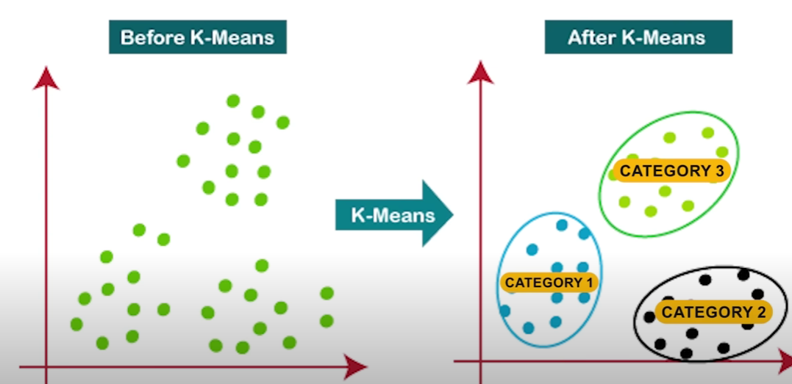
Machine Learning

Slide 9
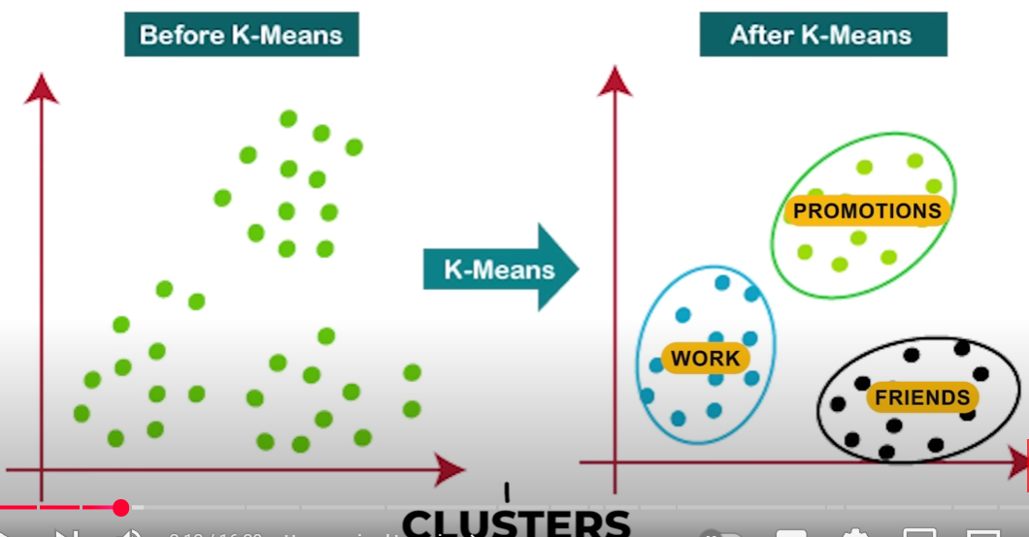
Machine Learning

Slide 10
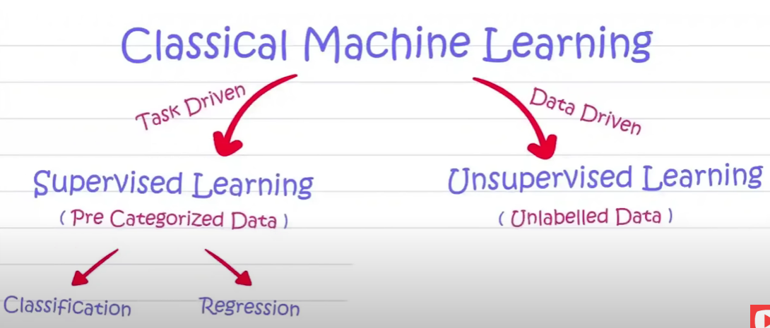
Machine Learning

Slide 11
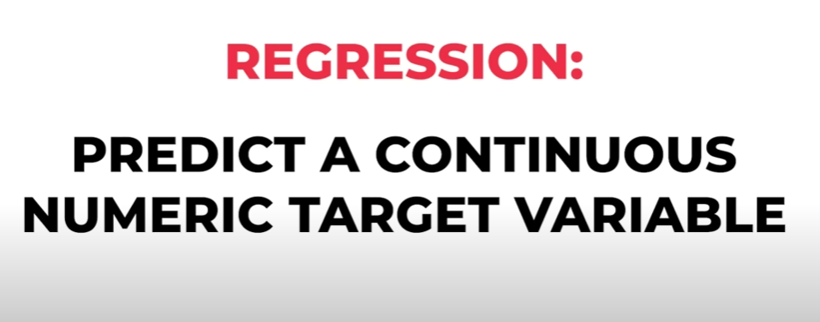
Machine Learning

Slide 12
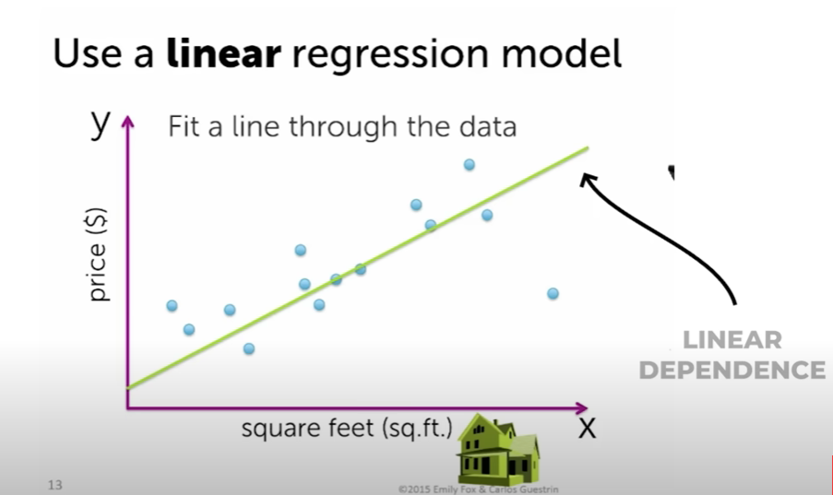
Machine Learning

Slide 13
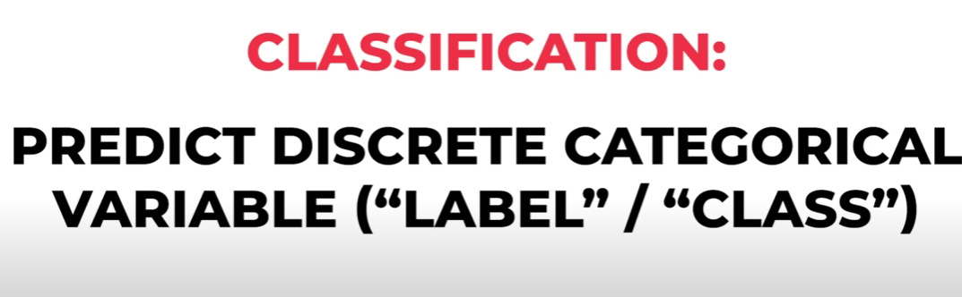
Machine Learning

Slide 14

Machine Learning

Slide 15
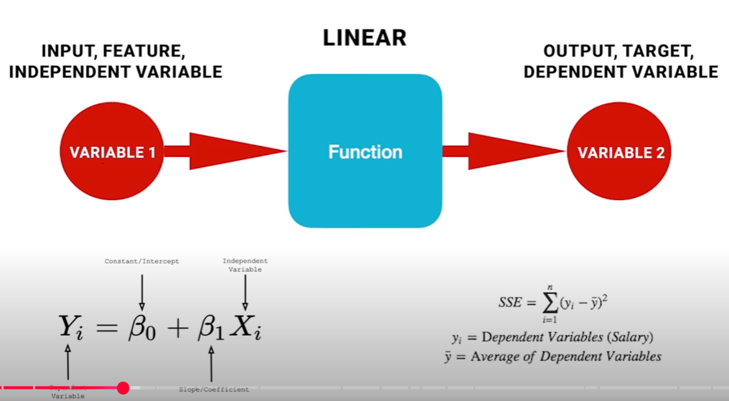
Machine Learning

Slide 16

Machine Learning

Slide 17
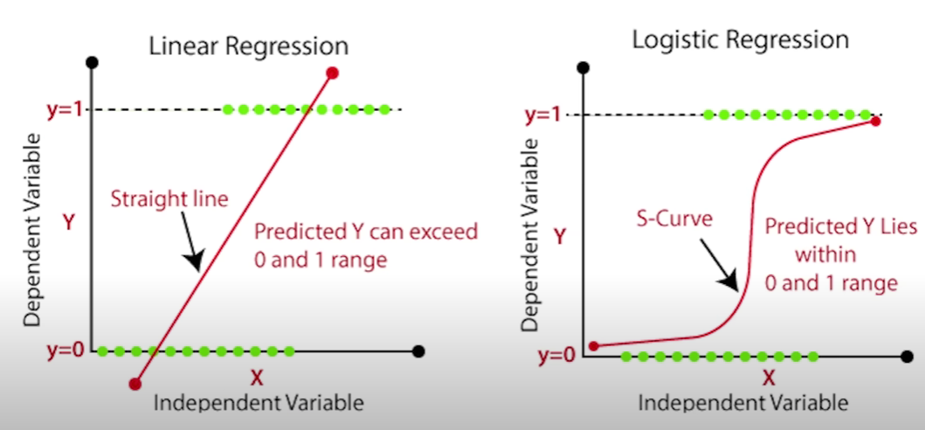
Machine Learning

Slide 18
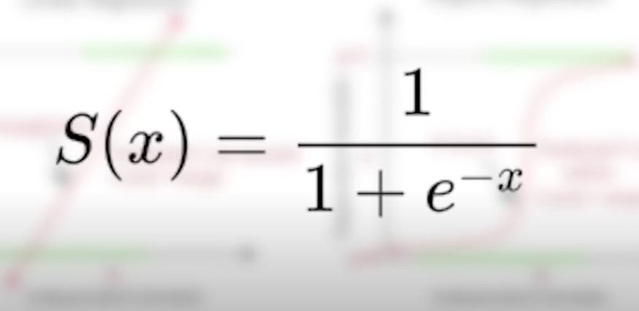
Machine Learning

Slide 19

Machine Learning

Slide 20
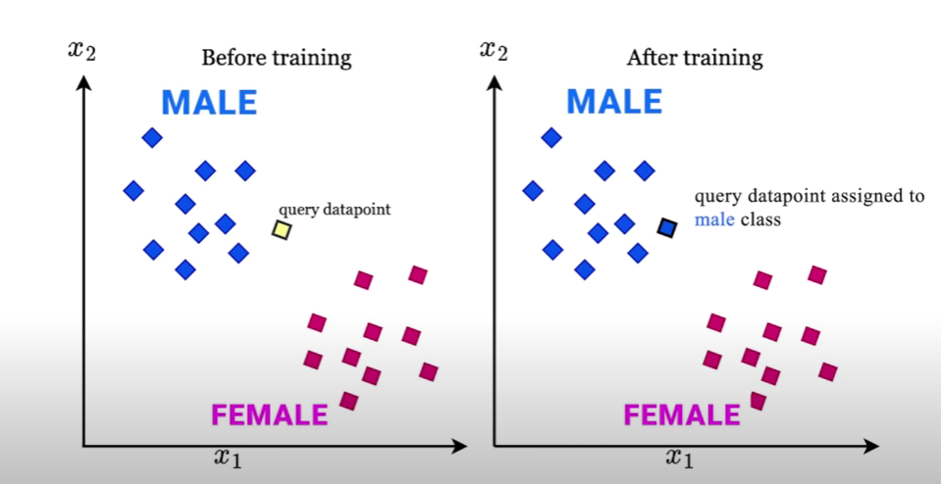
Machine Learning

Slide 21
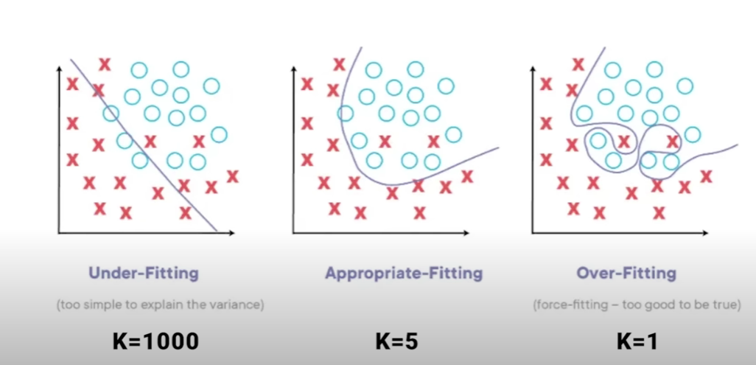
Machine Learning

Slide 22
Sample Code
From code basics
https://github.com/codebasics/py

