Slide 1
Module 1 Find - S
Raghu Prasad K S
9845547471

Slide 2
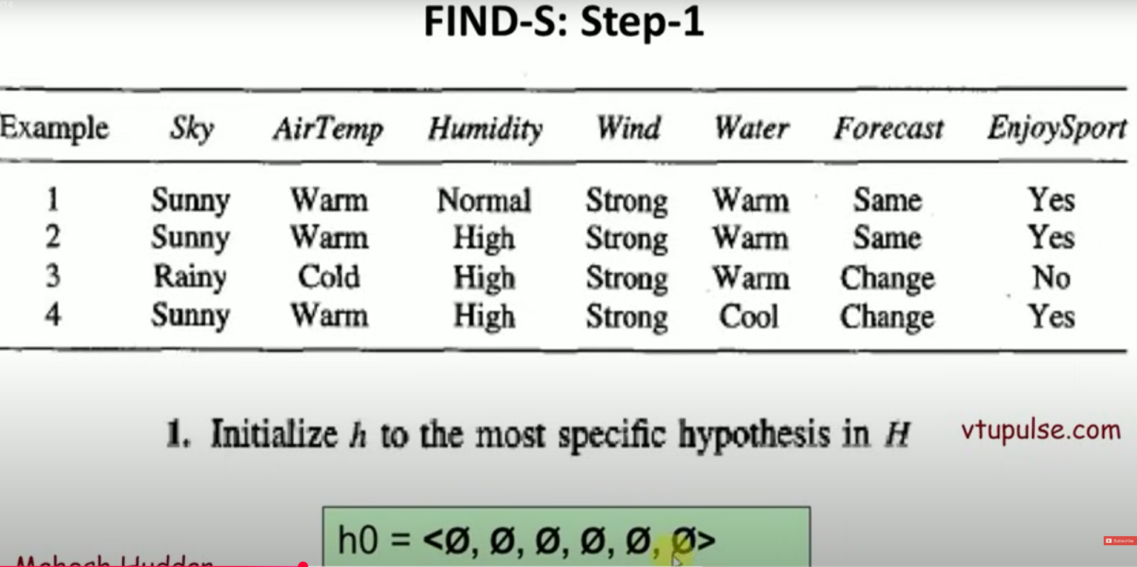
Find - s
Finding a maximally specific hypothesis – problem 1

Slide 3
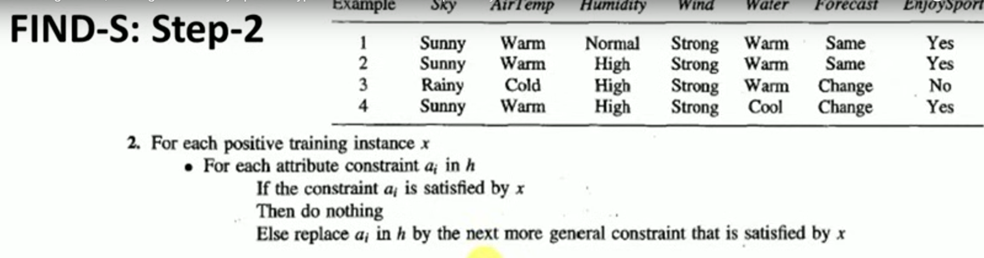
Find - s

Slide 4
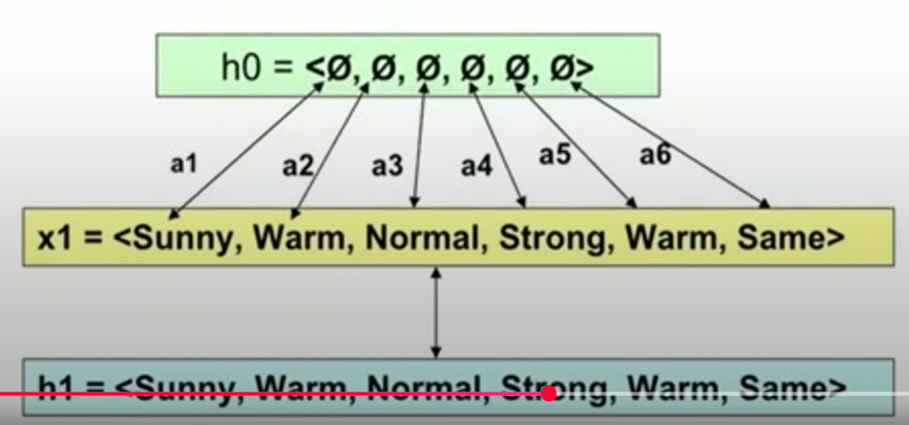
Find – s – Iteration 1

Slide 5
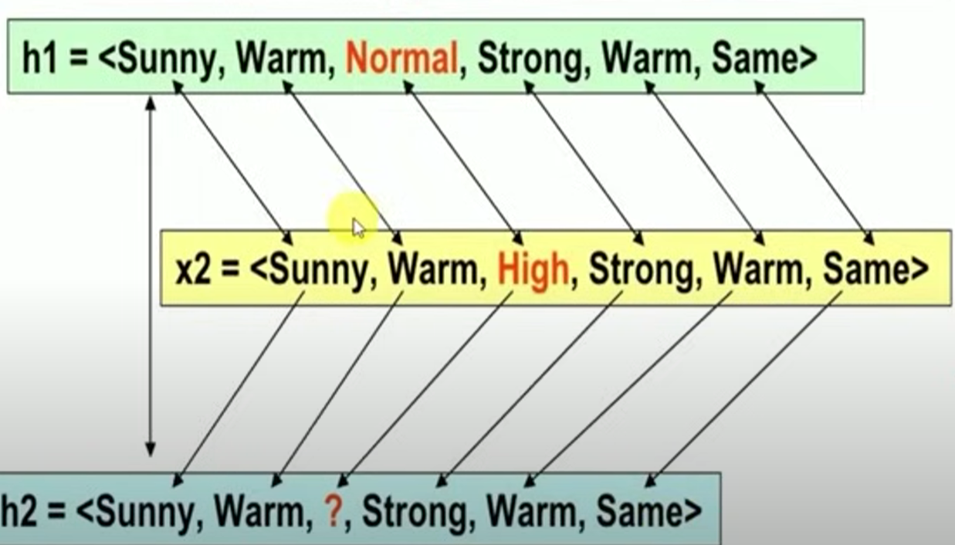
Find – s – Iteration 2

Slide 6
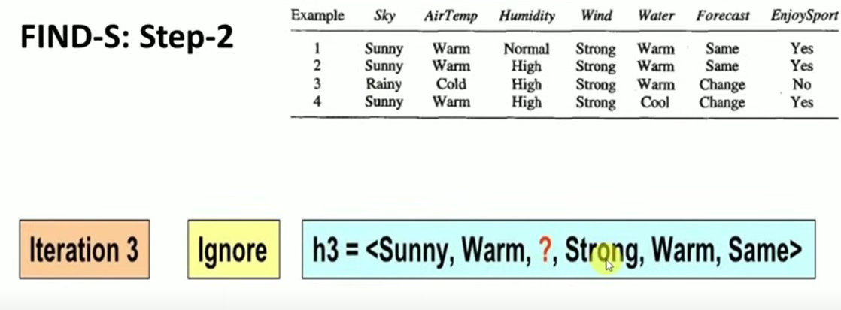
Find – s – Iteration 3

Slide 7
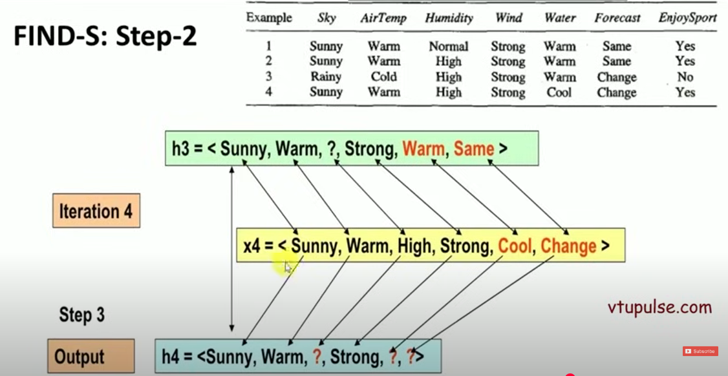
Find – s – Iteration 4

Slide 8
Reference
Introduction
https://www.youtube.com/watch?v=O6vwN74aSGY&list=PL4gu8xQu0_5L4Pl0Kd3om41FwG86usrQH&index=2

