Slide 1
Module 1 Candidate Elimination Algorithm
Raghu Prasad K S
9845547471

Slide 2
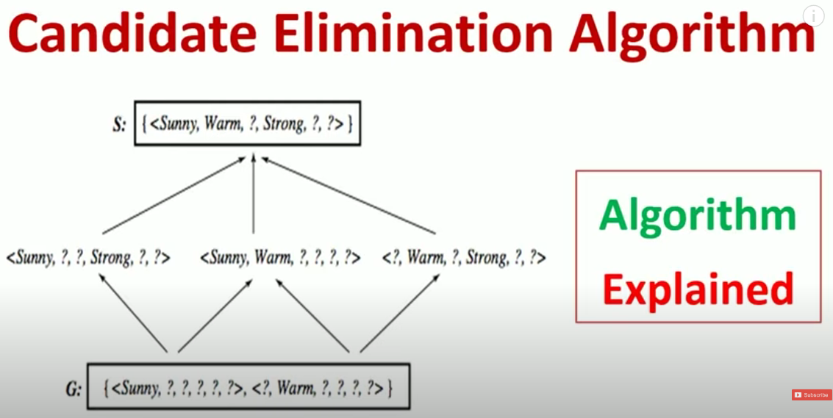
Candidate Elimination

Slide 3
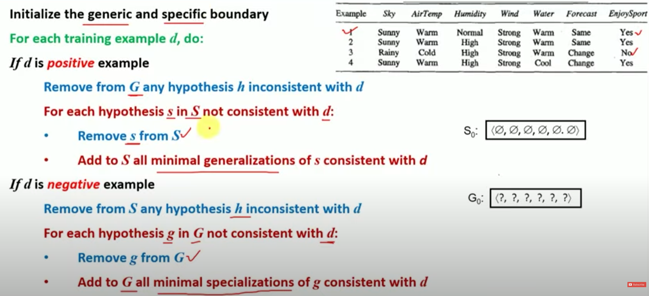
Candidate Elimination

Slide 4
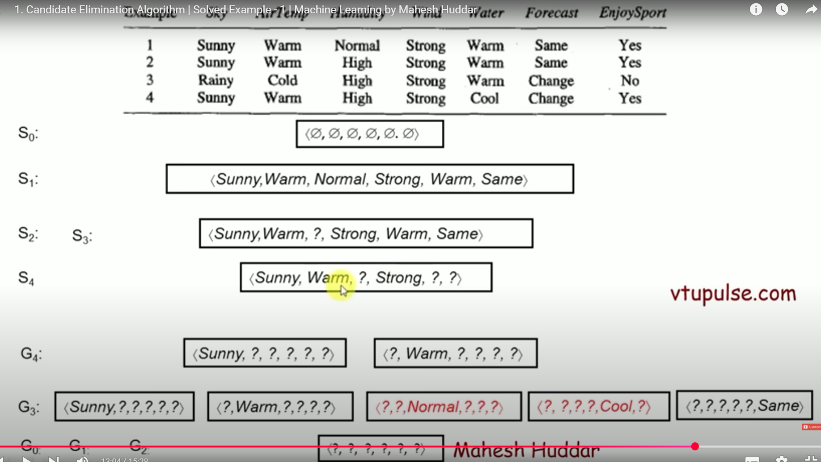
Candidate Elimination

Slide 5
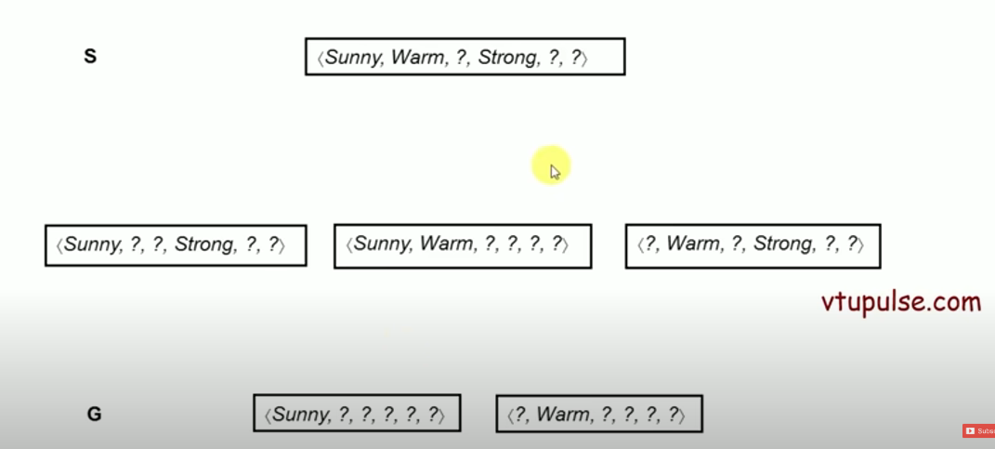
Candidate Elimination

Slide 6
Reference
Introduction
https://www.youtube.com/watch?v=l-Uk3jDFrWI&list=PL4gu8xQu0_5L4Pl0Kd3om41FwG86usrQH&index=7
https://www.youtube.com/watch?v=O2wYwFOMQ24&list=PL4gu8xQu0_5L4Pl0Kd3om41FwG86usrQH&index=8
https://vtupulse.com/machine-learning/candidate-elimination-algorithm-solved-example-1/#google_vignette

