Slide 1
Module 3 Ensemble Learning Kmeans Clustering- Unsupervised Machine Learning
Raghu Prasad K S
9845547471

Slide 2
Unsupervised Machine Learning
Unsupervised Machine Learning is a type of machine learning where algorithms are trained on unlabeled data — meaning the dataset does not contain predefined outputs or categories. Instead of learning from examples with correct answers, the system tries to discover hidden patterns, structures, or groupings in the data by itself.
Key Characteristics
No labels: Only input features are provided, no target/output values.
Goal: To find structure, relationships, or representation of the data.
Exploratory: Often used to understand data before applying other methods.

Slide 3
Unsupervised Machine Learning
Common Techniques
1. Clustering
Grouping similar data points together.
Examples:
K-Means Clustering
Hierarchical Clustering
DBSCAN
2. Dimensionality Reduction
Reducing the number of features while preserving important information.
Examples:
Principal Component Analysis (PCA)
t-SNE
Autoencoders

Slide 4
Unsupervised Machine Learning
3. Association Rule Learning
Finding relationships between variables in large datasets.
Example:
Market Basket Analysis (e.g., “Customers who buy bread also buy butter”).
4. Anomaly Detection
Identifying unusual data points that don’t fit the general pattern.
Useful in fraud detection, network intrusion, etc.

Slide 5
Unsupervised Machine Learning
Real-World Applications
Customer segmentation in marketing
Fraud detection in banking
Recommendation systems (e.g., Netflix, Amazon)
Reducing noise in images (using autoencoders)
Medical data analysis (grouping patients based on symptoms)

Slide 6
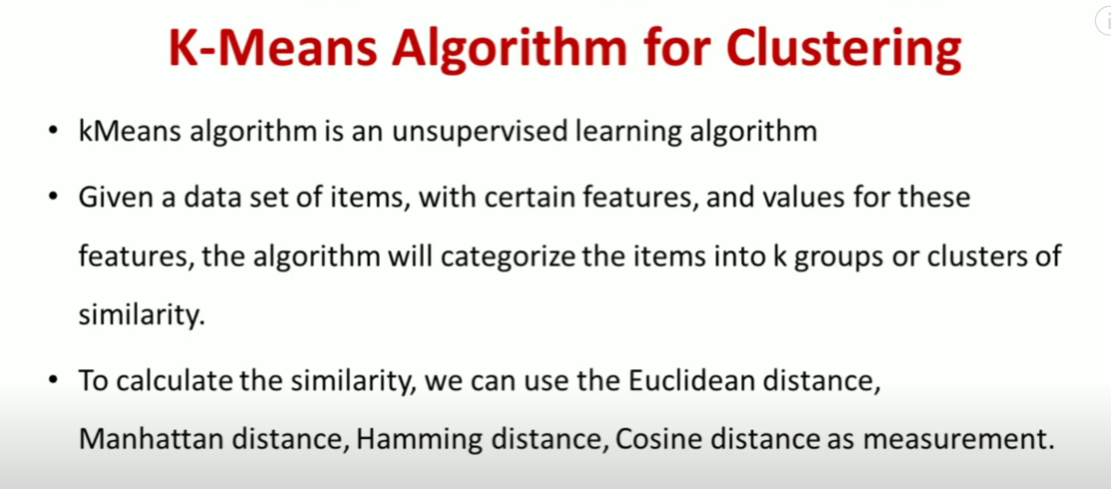
K-Means Clustering

Slide 7
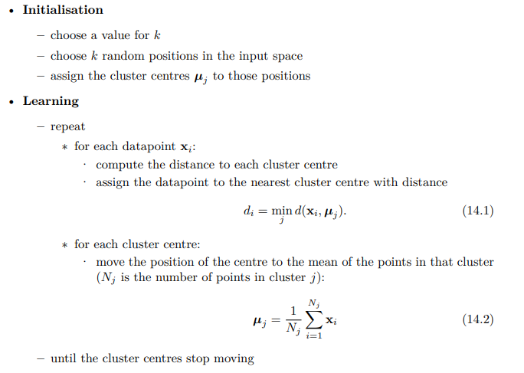
K-Means Clustering - Algorithm
•

Slide 8
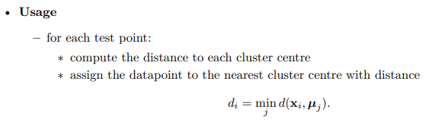
K-Means Clustering - Algorithm
•

Slide 9
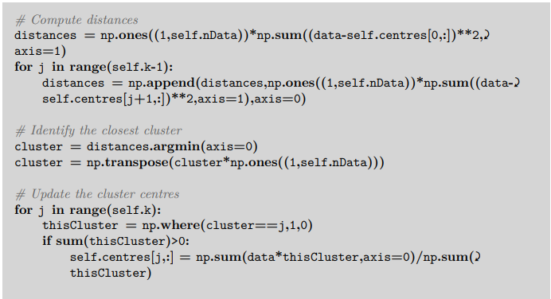
K-Means Clustering – Implementation in python numpy
•

Slide 10
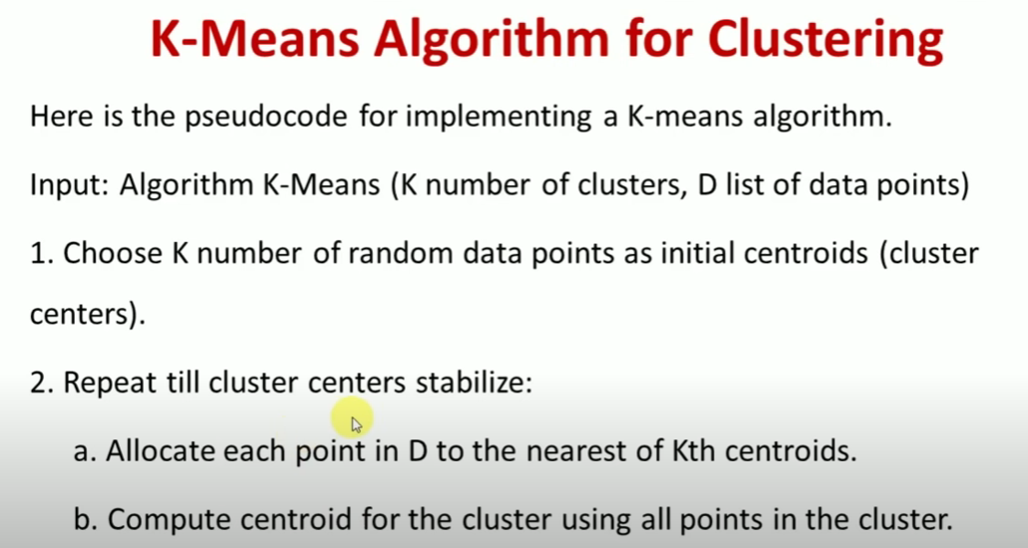
K-Means Clustering

Slide 11
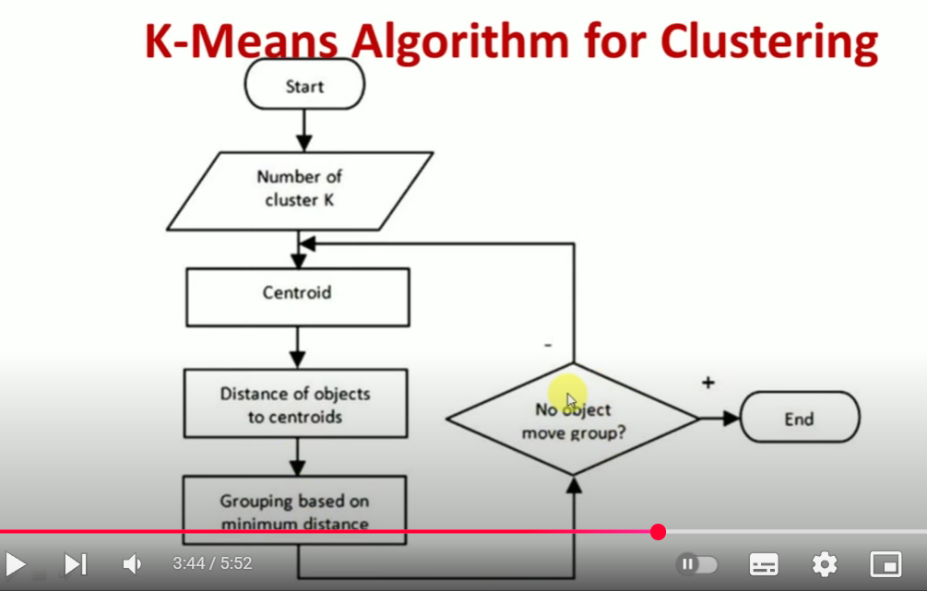
K-Means Clustering

Slide 12
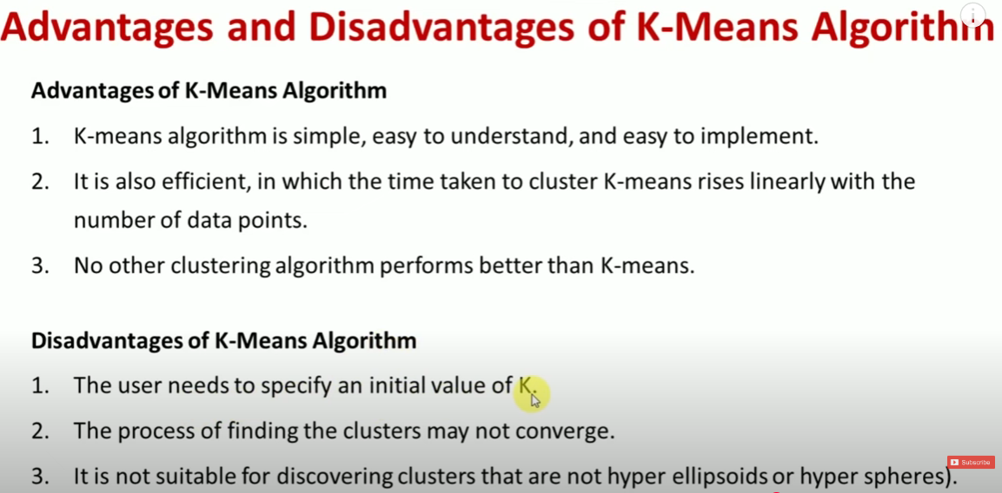
K-Means Clustering

Slide 13
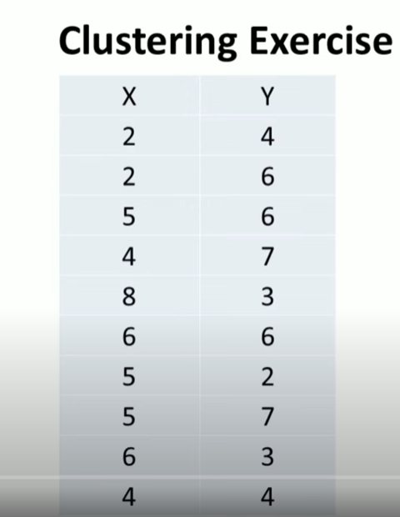
K-Means Clustering-Solved Problems

Slide 14
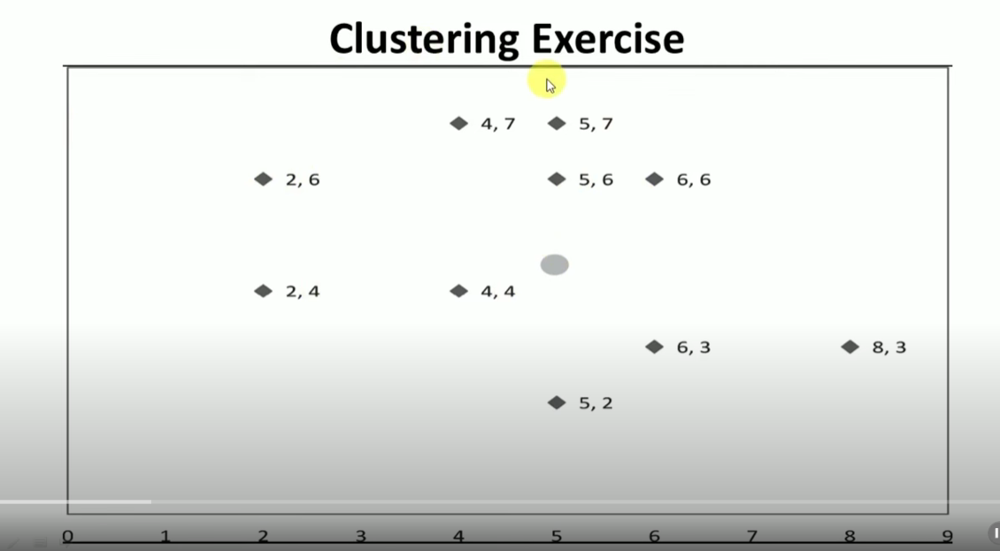
K-Means Clustering-Solved Problems

Slide 15
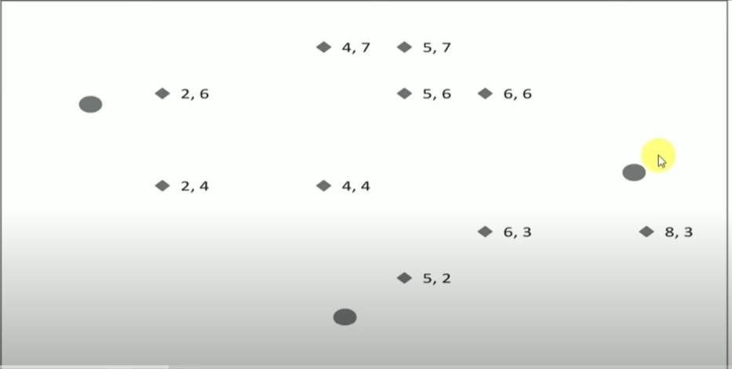
K-Means Clustering-Solved Problems

Slide 16
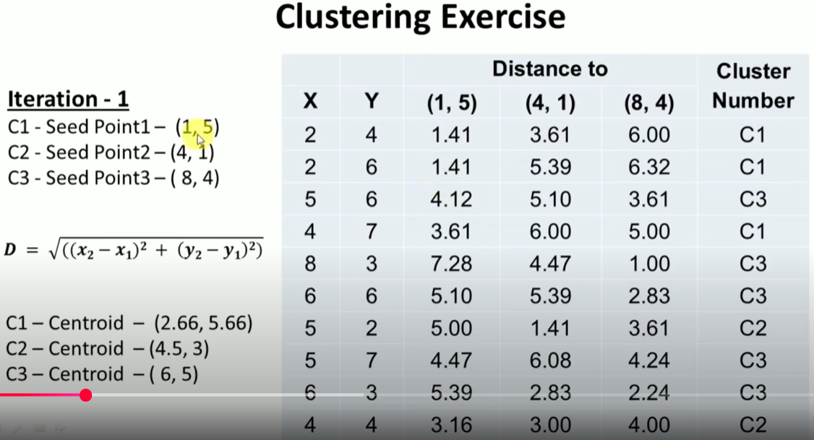
K-Means Clustering-Solved Problems

Slide 17
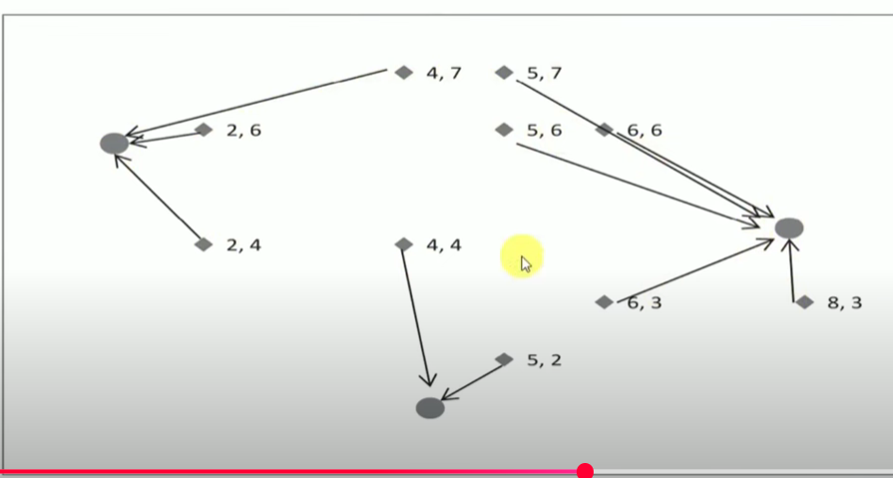
K-Means Clustering-Solved Problems

Slide 18
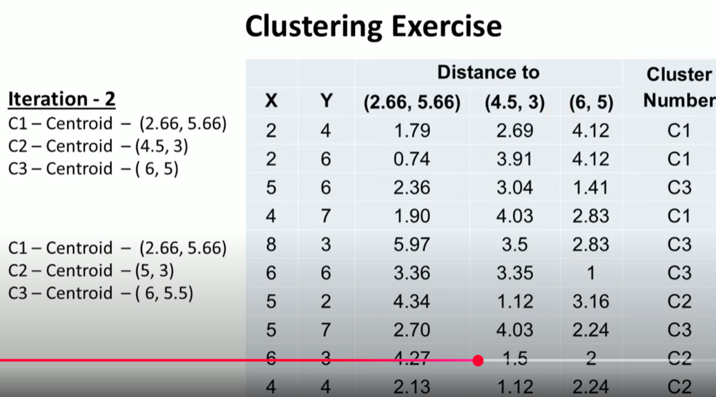
K-Means Clustering-Solved Problems

Slide 19
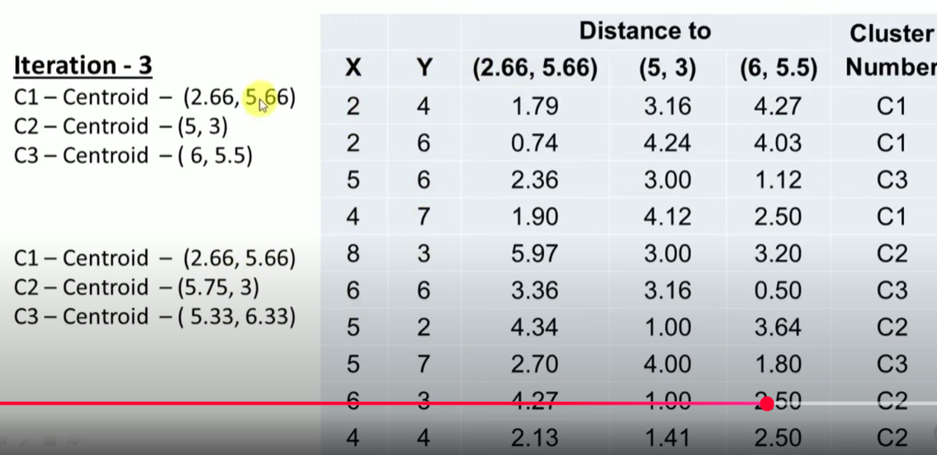
K-Means Clustering-Solved Problems

Slide 20
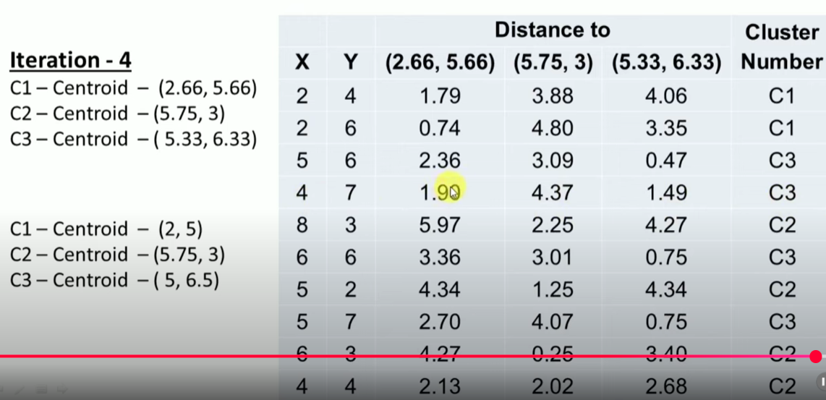
K-Means Clustering-Solved Problems

Slide 21
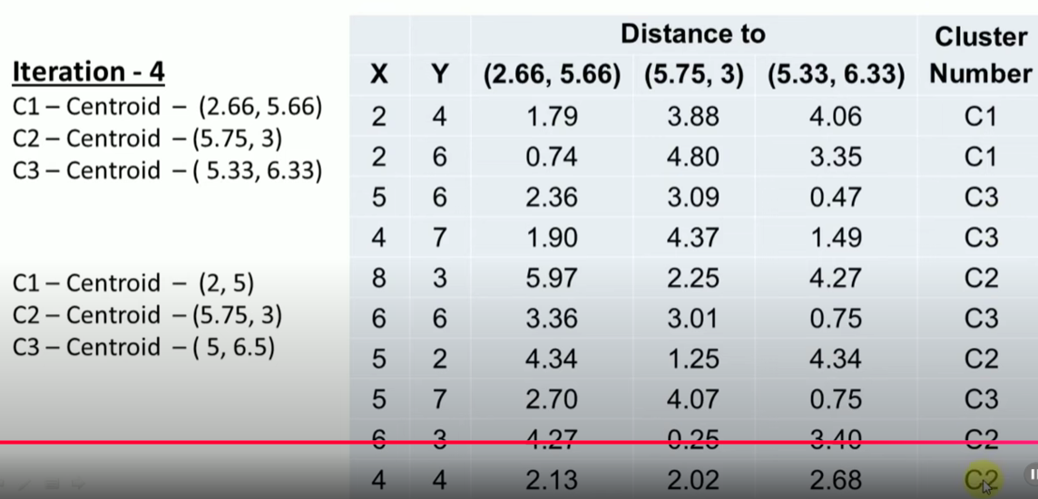
K-Means Clustering-Solved Problems

Slide 22
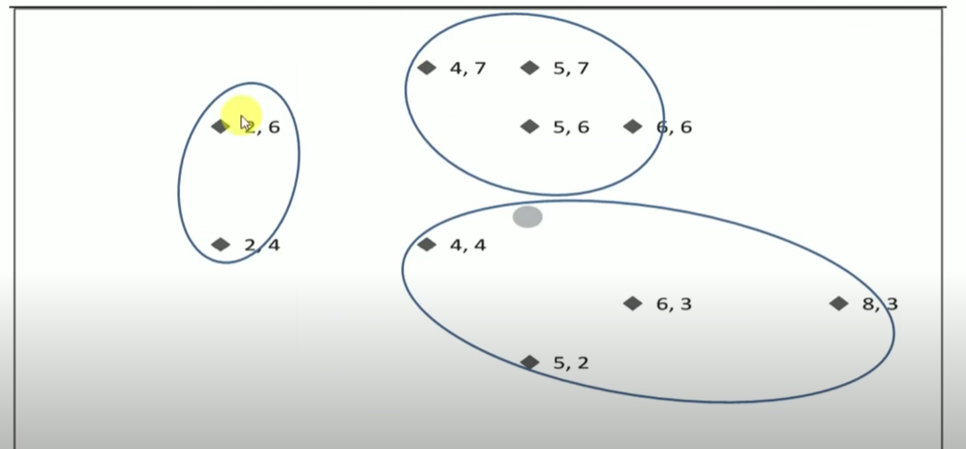
K-Means Clustering-Solved Problems

Slide 23
Dealing with noise
There are lots of reasons for performing clustering, but one of the more common ones is to deal with noisy data readings. These might be slightly corrupted, or occasionally just plain wrong. If we can choose the clusters correctly, then we have effectively removed the noise, because we replace each noisy datapoint by the cluster centre (we will use this way of representing datapoints for other purposes in Section 14.2). Unfortunately, the mean average, which is central to the k-means algorithm, is very susceptible to outliers, i.e., very noisy measurements. One way to avoid the problem is to replace the mean average with the median, which is what is known as a robust statistic, meaning that it is not affected by outliers (the mean of (1, 2, 1, 2, 100) is 21.2, while the median is 2). The only change that is needed to the algorithm is to replace the computation of the mean with the computation of the median. This is computationally more expensive, as we’ve discussed previously, but it does remove noise effectively.

Slide 24
Dealing with noise
There are lots of reasons for performing clustering, but one of the more common ones is to deal with noisy data readings. These might be slightly corrupted, or occasionally just plain wrong. If we can choose the clusters correctly, then we have effectively removed the noise, because we replace each noisy datapoint by the cluster centre (we will use this way of representing datapoints for other purposes in Section 14.2). Unfortunately, the mean average, which is central to the k-means algorithm, is very susceptible to outliers, i.e., very noisy measurements. One way to avoid the problem is to replace the mean average with the median, which is what is known as a robust statistic, meaning that it is not affected by outliers (the mean of (1, 2, 1, 2, 100) is 21.2, while the median is 2). The only change that is needed to the algorithm is to replace the computation of the mean with the computation of the median. This is computationally more expensive, as we’ve discussed previously, but it does remove noise effectively.

Slide 25
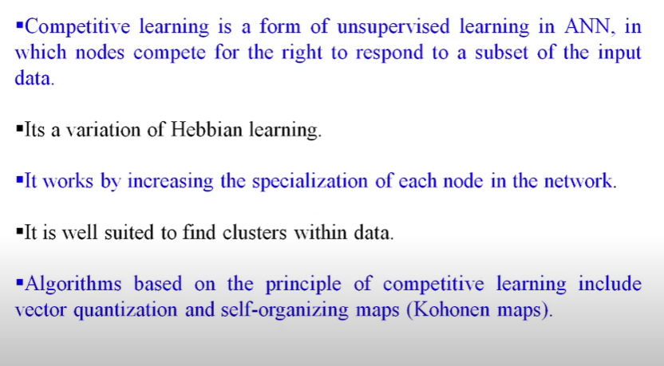
Competative Learning

Slide 26
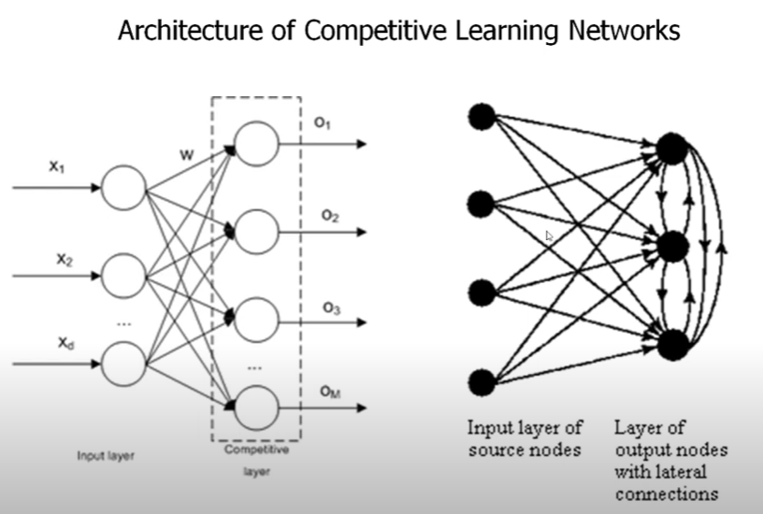
Competative Learning

Slide 27
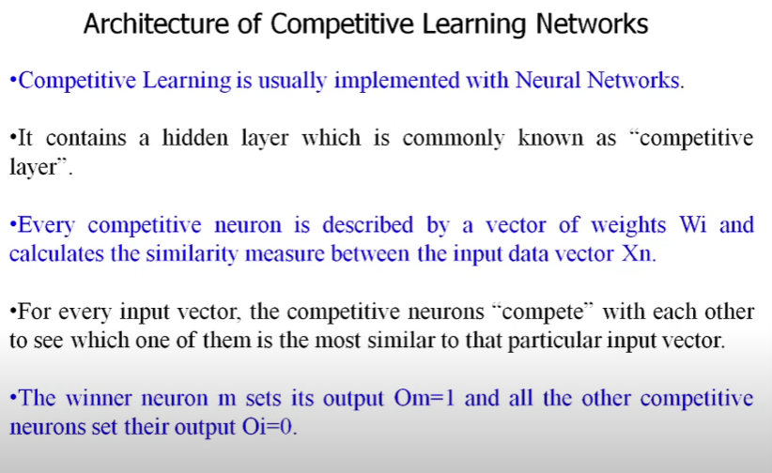
Competative Learning

Slide 28
Reference
Introduction
https://www.youtube.com/watch?v=3tLdD-4-wnI
Solved Problem
https://www.youtube.com/watch?v=FllcPjvztTI
Programs
https://www.geeksforgeeks.org/machine-learning/k-means-clustering-introduction/

